Slide 1
Remembering Professor AW Skempton
4th June 1914 - 9th August 2001
2nd ISSMGE President, from 1957
March 2022
Richard Jardine & John Burland

Slide 2
Recognising Skempton’s contributions
Skem’s career summarised in:
https://en.wikipedia.org/wiki/Alec_Skempton
We offer here for ISSMGE more personal and technical volumes and events published and held over thirty years from 1984 to 2104 that commemorated his contributions and celebrated his life
We also signpost video material of him delivering a lecture to the UK Institution of Civil Engineers in 1994

Slide 3
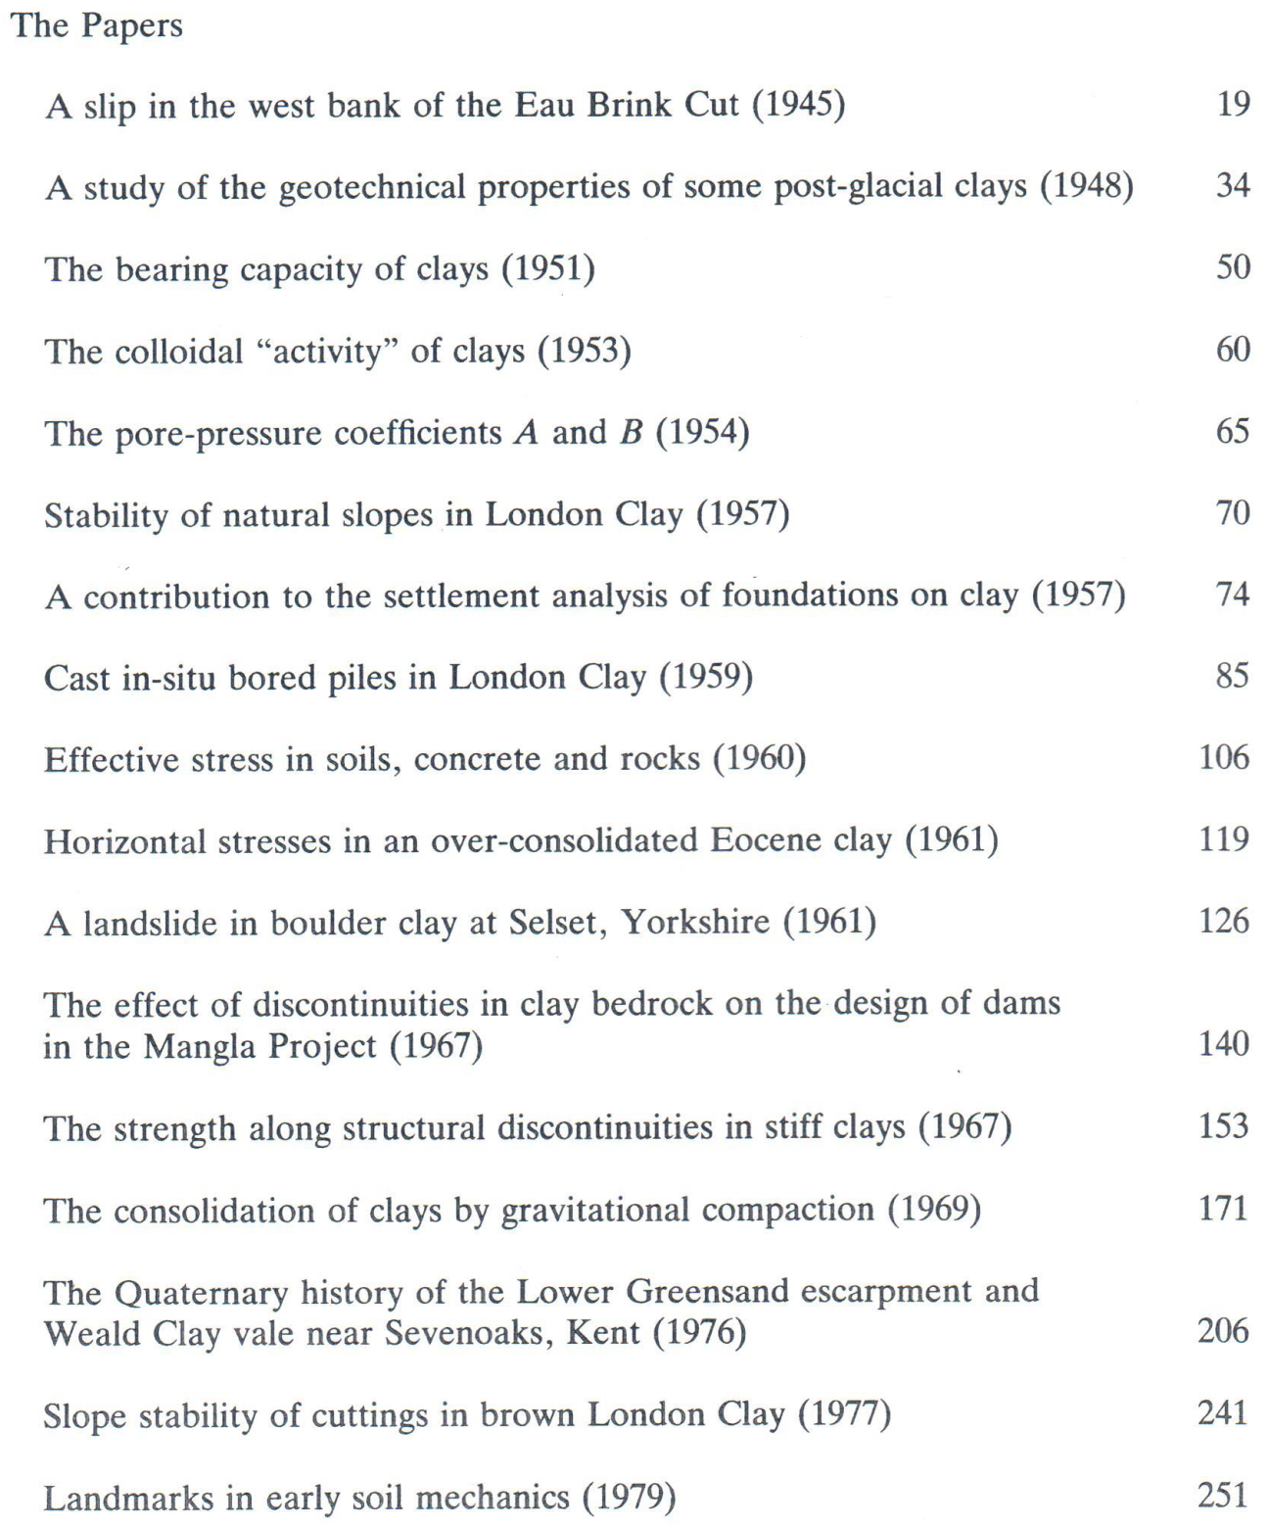
1984 volume of re-printed papers

Slide 4
See article from collected papers volume by Professor R E Gibson “Working with Skempton”
https://www.icevirtuallibrary.com/doi/abs/10.1680/sposm.02050.0004to pdf

Slide 5
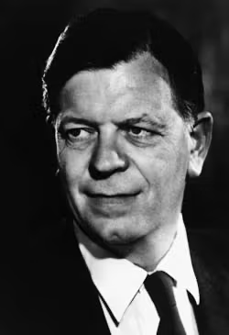
Skempton’s last major technical lecture, 1994
Held with British Geotechnical Association (BGA) at 1994 at Institution of Civil Engineers, London
In parallel with publication of Skempton, A. W. & Chrimes, M. M. (1994). “Thames Tunnel : geology, site investigation and geotechnical problems”. Geotechnique 44, No. 2, 191-216.
Video recorded and published by BGA
Click the image to play video

Slide 6
Skempton memorial Conference, June 2004
Over 350 delegates at Royal Geographical Society, near Imperial College, London
Keynotes and state of the art papers by internationally leading academics
Personal reflections by several leading geotechnical engineers on ‘working with Skem’
Creation at Imperial College of Skempton and Bishop’ Archive at Imperial College:
http://www.cv.ic.ac.uk/SkemArchive/index.htm
Publication of Biography by Skem’s daughter Judith Niechciel
https://www.amazon.co.uk/Particle-Clay-Biography-Skempton-Engineer/dp/1870325842
2004 3 Vol. Memorial Conference Proceedings
https://www.icevirtuallibrary.com/doi/book/10.1680/aigev1.32644

Slide 7
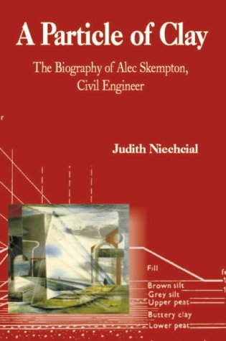
2004 Publication of Biography by Skem’s daughter Judith Niechciel
https://www.amazon.co.uk/Particle-Clay-Biography-Skempton-Engineer/dp/1870325842

Slide 8
100th Anniversary of Skempton’s birth
British Geotechnical Association Celebration 12th June 2014
Included talk on Skempton and an update on the behaviour of stiff clays

Slide 9
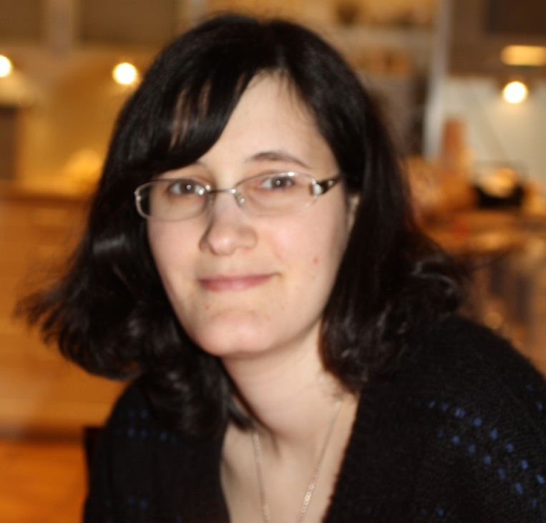
Hollow Cylinder Apparatus & Triaxial experiments
London clay: Heathrow-T5 study with Matthew Coop & David Hight
Three PhDs 2005-7: Liana Gasparre, Satoshi Nishimura & Nguyen Anh-Minh, Géotechnique papers 2007
Then Gault, Oxford and Kimmeridge clays: two 2012 PhDs, Géotechnique papers 2014-18
R Jardine: “On stiff clay research at Imperial College 2004-2014”
Amandine Brosse Ramtin Hosseini Kamal

Slide 10
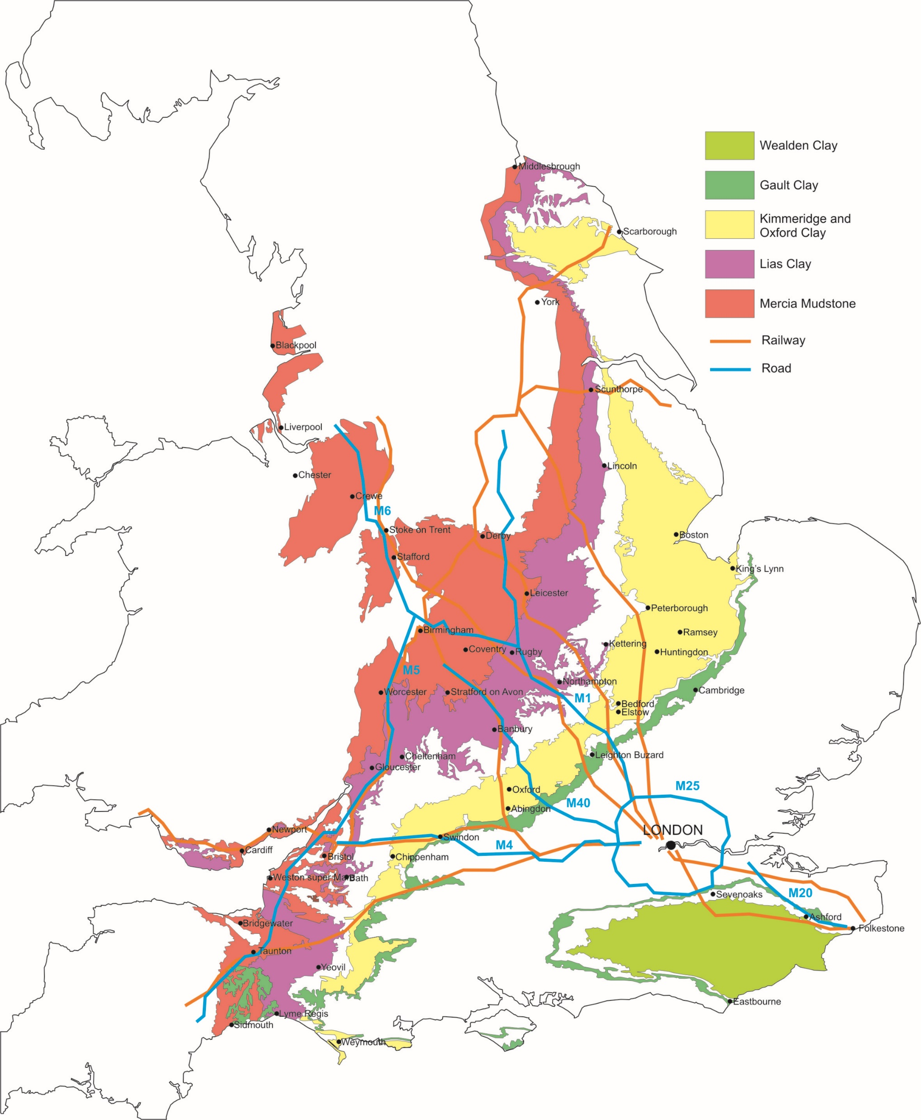
Engagement and motivation
Effects of age and structure on shear strength and non-linear stiffness?
Main routes to North and West and key cities
Multiple projects in London: Heathrow T5, Crossrail etc:
Projects on Gault in Kent, M20; M25; HS1 etc
Coastal instability along Jurassic Coast, also Hinkley Point etc
Page 10
© Imperial College London
Notes:
10

Slide 11
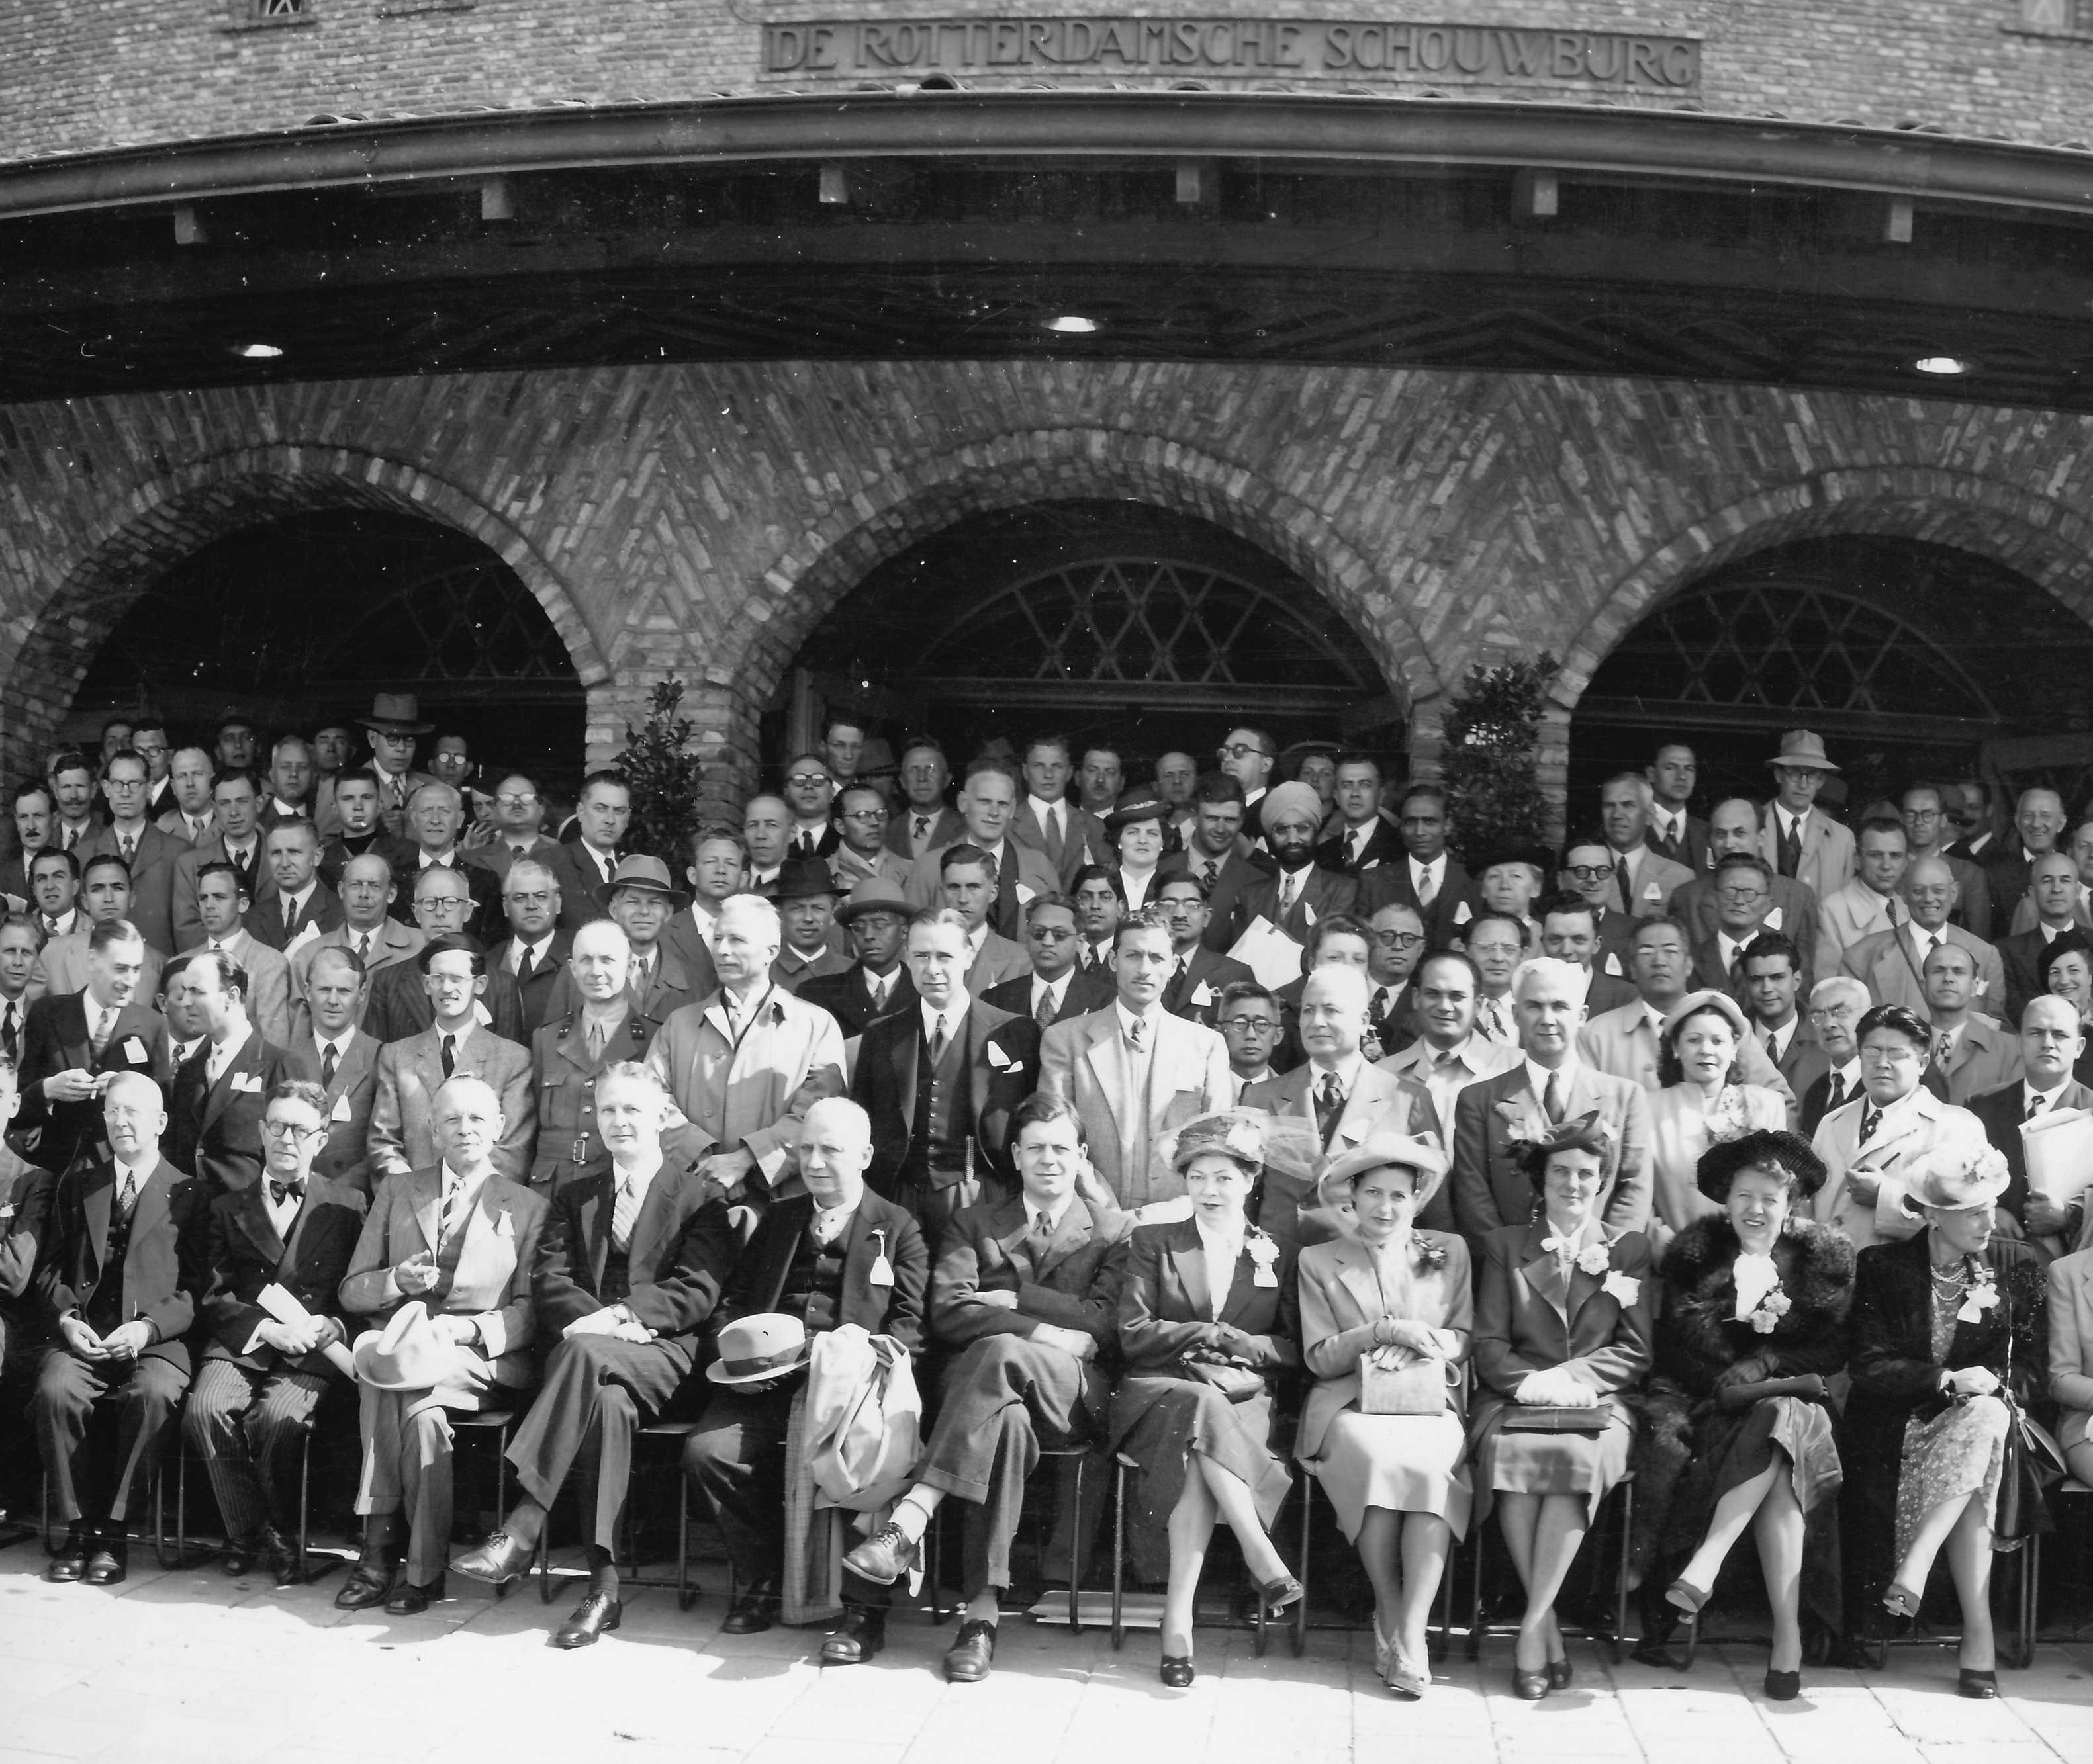
He’d be interested…
What would Skem have thought?
He’d make interesting observations…
Be encouraging and kind…
Notice any weak points
Remind us who had tried this before and
Urge us towards practical application
Rotterdam ICSMGE 1948

