Slide 1
Time Capsule
Discoverers’ review
Monica Löfman
22.4.2022

Slide 2



Discoverer
Monica Löfman
Finnish Geotechnical Society (SGY)
University Teacher at Aalto University & Specialist at Ramboll Finland Oy
YMPG Liaison
Main interests: soft soils, geotechnical reliability, machine learning

Slide 3
Case 1 – Member Society’s TC

Slide 4
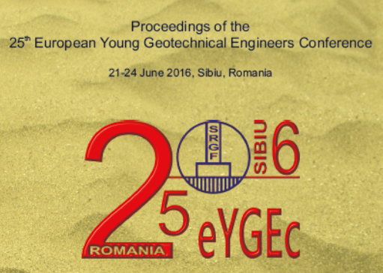
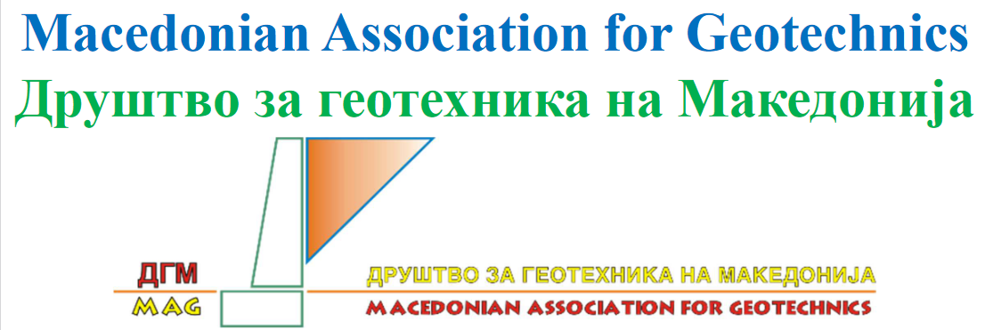
Member Society’s TC
I chose the TC of the Macedonian Association for Geotechnics
Why? Back in 2016 I attended the 25th European Young Geotechnical Engineers Conference in Sibiu, Romania, and I heard many good things about North Macedonia. I was planning to pay a visit during my travels across the Balkan area, but could not make it. This is my chance to get to know North Macedonia better!

Slide 5
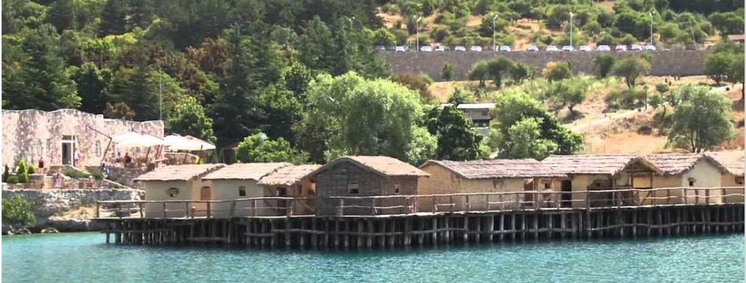
North Macedonian geotechnics
Deep historical roots extending to as far as 1200 BC (Prehistoric settlement in the Bay of Bones near Gradishte on Ohrid Lake, see figure below)
Up to 6000 wooden piles found from the bottom of the lake!

Slide 6
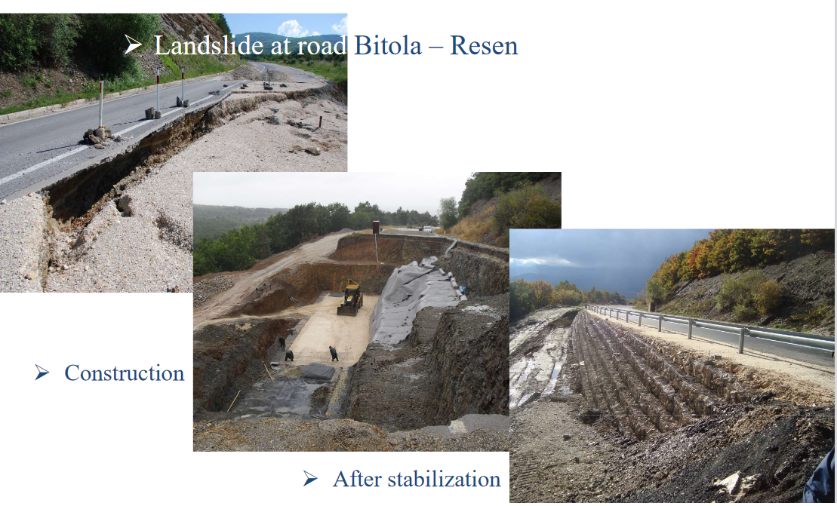
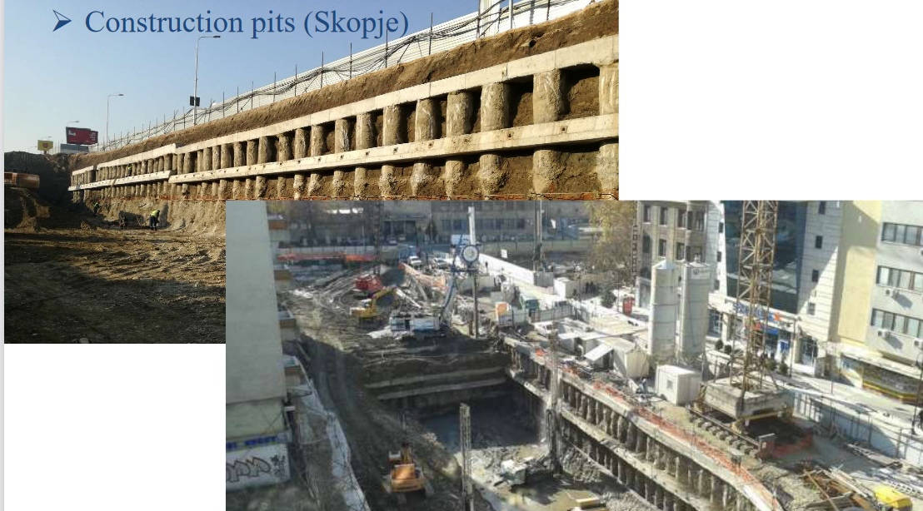
Geotechnical applications
For a geotechnical engineer, is there anything more satisfying than to see the progress from failure (e.g. landslide) to a finished, safe structure?
…But what method is usually used to stabilize landslides in North Macedonia?
Interesting! In Finland we use sheet pile walls for these kind of construction pits (good for clay subsoil)

Slide 7
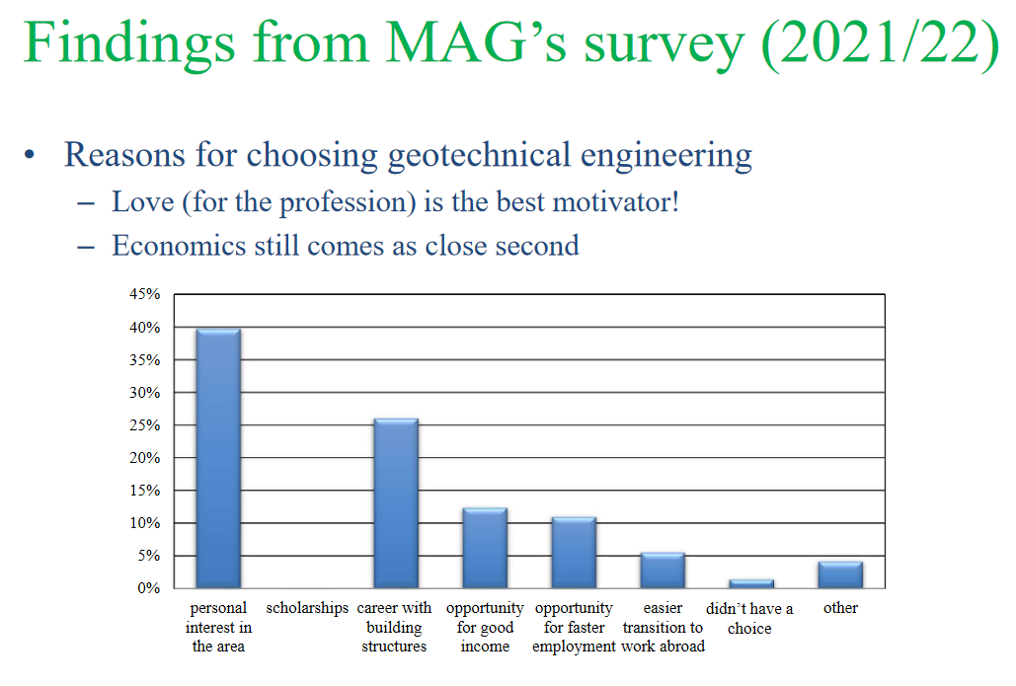
Love for the profession
As in North Macedonia, also in Finland the main reason for choosing geotechnical engineering as a profession seems to be the personal interest → Good income and fast employment are other motivators but not the most important ones
Love for the profession probably grows during studies, not beforehand → At least for me, I knew nothing about geotechnics when I entered university. I changed my major later, as the interest started to grow

Slide 8
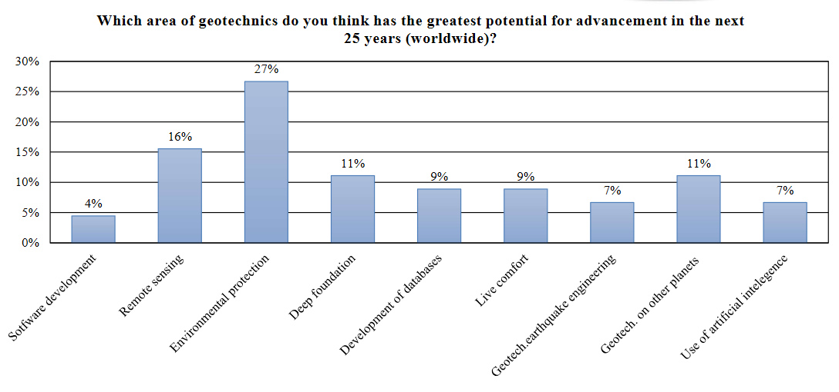

Geotechnics for sustainability
North Macedonians believe that the greatest potential for advancements in the field of geotechnics in the next 25 years is environmental protection
I agree 100 %, there is a lot of untapped potential in the field to reduce emissions and to support environmental protection and sustainability → geotechnical engineers are no longer just one of the emitters, we can be the environmental protectors!

Slide 9
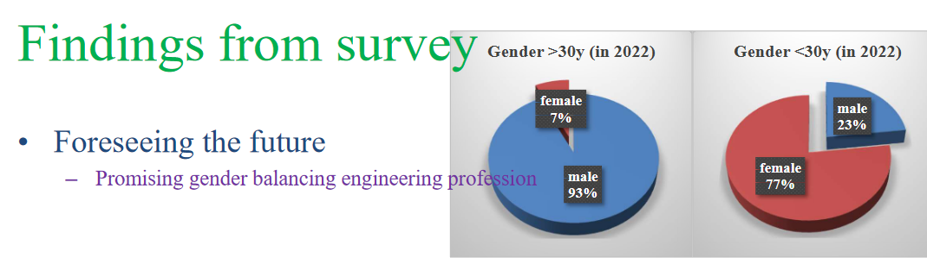
Geotechnics for all genders
The younger generation of North Macedonian women is discovering the field of geotechnics and entering the profession, wonderful news!
(In Finland, the proportion of female students seems to be growing every year, but there is still work to be done in terms of gender equality and diversity & inclusion in the field)
More versatile workplaces will bring the field further

Slide 10

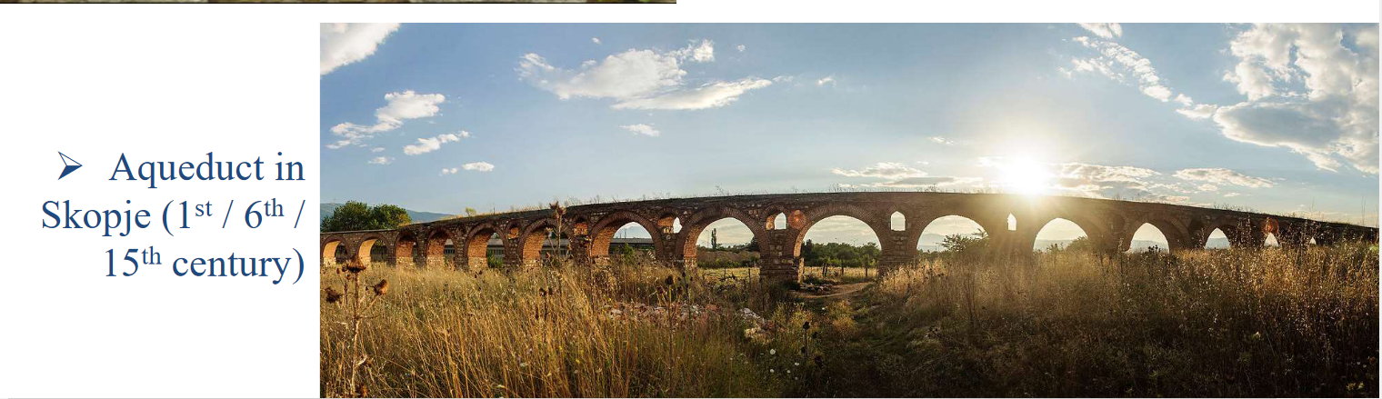
Summary
Long and rich history of civil engineering in the area
Geology has a significant role in the North Macedonian field of geotechnics
Currently focus on standardization and application of the Eurocodes
North Macedonian geotechnical engineers are passionate and satisfied with their profession
North Macedonian women are entering the profession, amazing!
Environmental protection is considered as an important part of the geotechnics
Very impressive time capsule, it was a pleasure to review it!

Slide 11
Case 2 – Technical committee’s TC

Slide 12
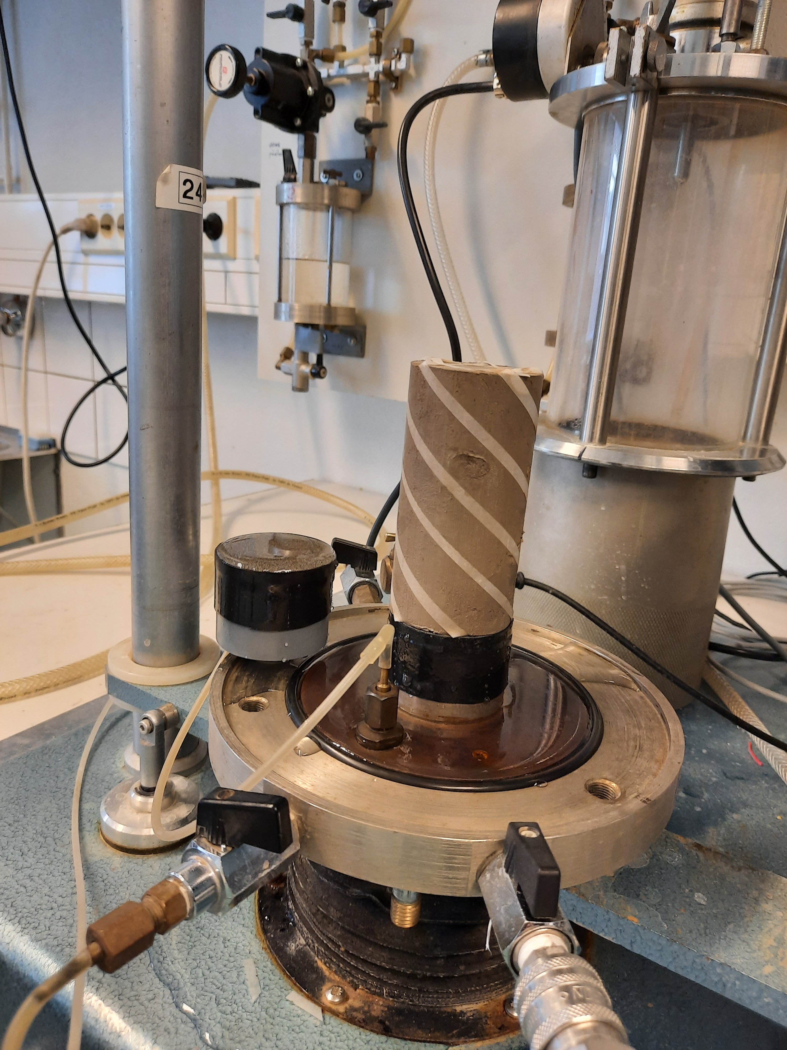
TC101 Laboratory Testing
TC101 Laboratory Testing was the technical committee whose TC I chose to review
Why? Laboratory testing of soils has always interested me. In fact, my path towards the profession started when I spend one summer at Aalto’s soil laboratory back in 2014. Handling soft clay specimens was so intriguing and fun that I realized that geotechnical engineering could become my future career.
Later my focus shifted from experimental research into more theoretical one, but I still work with laboratory testing and field testing in my job at both Aalto and Ramboll
I look forward to learn more about the past, nowadays and future of laboratory testing of soils!
Photo: Monica Löfman 2021, Aalto University’s soil laboratory

Slide 13
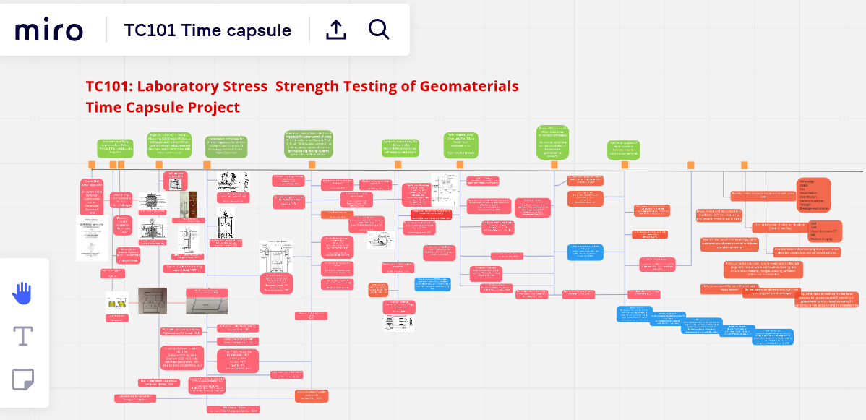
Exploring the Miro board
TC101 has prepared their time capsule as a Miro board
Exploring its contents was fun! Although I hope there were more figures :D

Slide 14
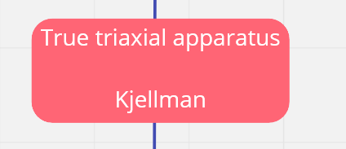
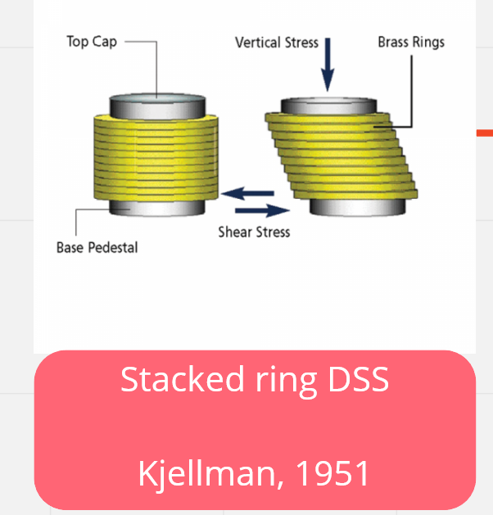
Kjellman and DSS
Dr. Walter Kjellman from Sweden has one of the pioneers in the laboratory testing of soils
Kjellman’s work has been appreciated in Finland as well – the Swedish geotechnical practice has been widely adopted in Finland too (e.g. Swedish weight sounding test, fall cone test,..). After all, Finnish and Swedish clays and other soils share very similar geological history
Direct shear test, DSS, is widely used all over the world.. But for some reason, not in Finland!
  In Finland, we usually define the undrained shear strength simply with field vane test or fall cone test (and correct the result with reduction factor/correction factor)

Slide 15
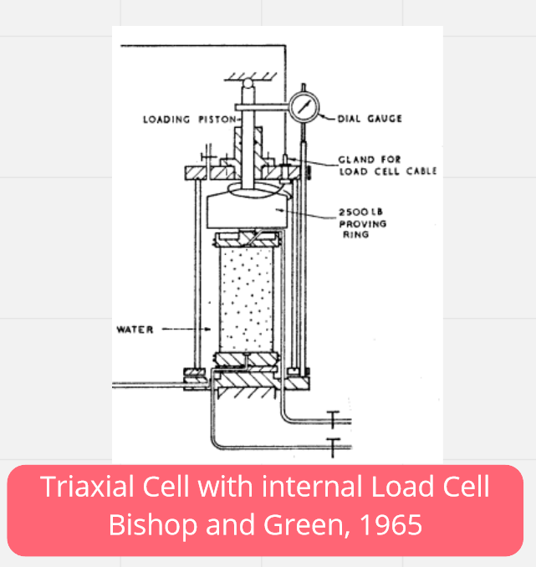
Triaxial test and internal load cell
I was very surprised to learn that the internal load cell was introduced as early as in 1965
Internal load cell has one major advantage: because the load applied to the specimen is measured inside the triaxial cell, the friction between the piston rod and the cell does not affect the measured load
When measuring small loads (e.g. soft clays and with low cell pressure), the accuracy with external load cell may pose challenges

Slide 16
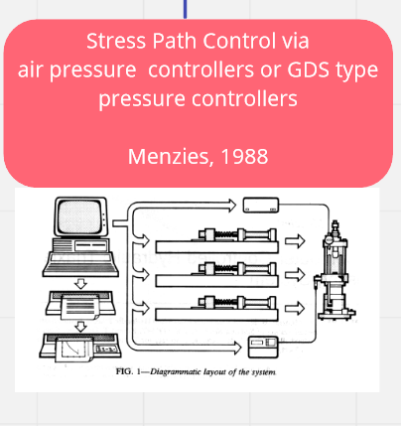
Automatization
Automatization of laboratory tests got its first advancements in 1988 as the stress path control in triaxial test was introduced
Since then, automatization has taken huge leaps
  Test equipment allows stress control and defining the test stages in advance
  Loops can be created (e.g. failed B-check → another saturation step)
  Remote control allows to monitor and control the test from anywhere with a mobile device
  Parameter interpretation is quicker and more flexible

Slide 17
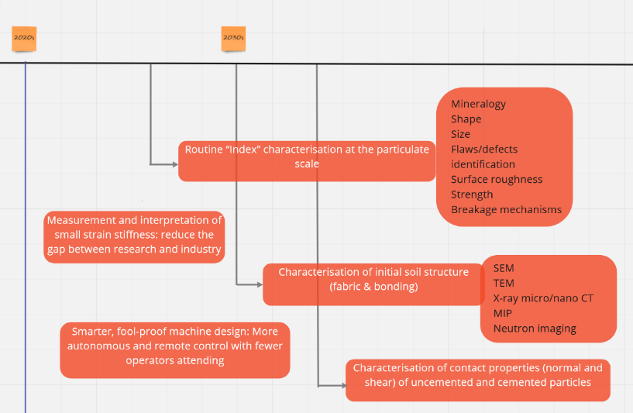
Future of laboratory testing
Laboratory testing is moving towards smaller scale: small strain stiffness, imaging and of soil structure (fabric and bonding)…
Laboratory testing to support the research on the interfaces between soil properties and chemistry, temperature and time effects
Even better automatization and remote control

Slide 18
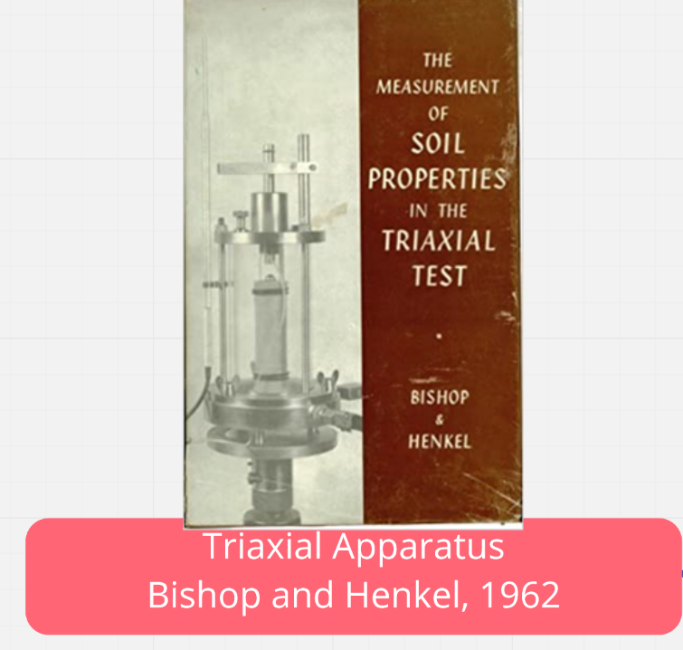
Summary
Classic!
Thorough look into the most important innovations and research during the history of laboratory testing of soils
Good use of alternative medium (the Miro board)
Interesting look into the future of laboratory testing → I have seen the similar topics to emerge in my own research group too (bender elements, dynamic/cyclic testing, imaging techniques, chemistry)
Challenges in the filed in my opinion: How to ensure good quality of soil specimens? Sampling techniques are developing, but maybe slower than laboratory testing?

Slide 19
Thank you!

