Slide 4
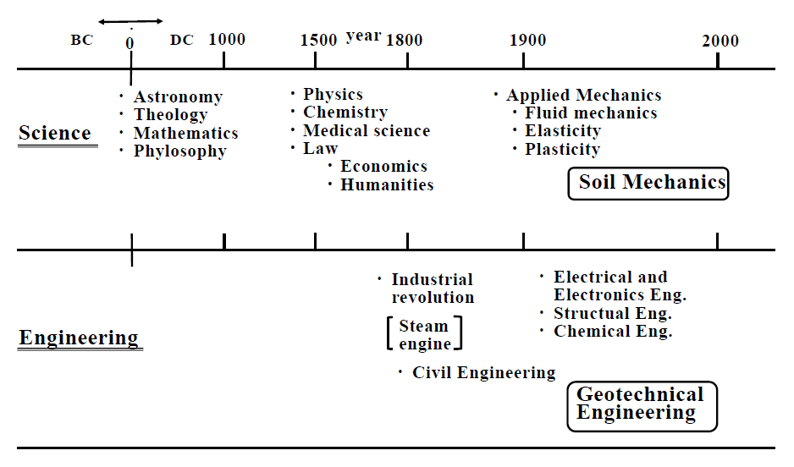

Slide 5
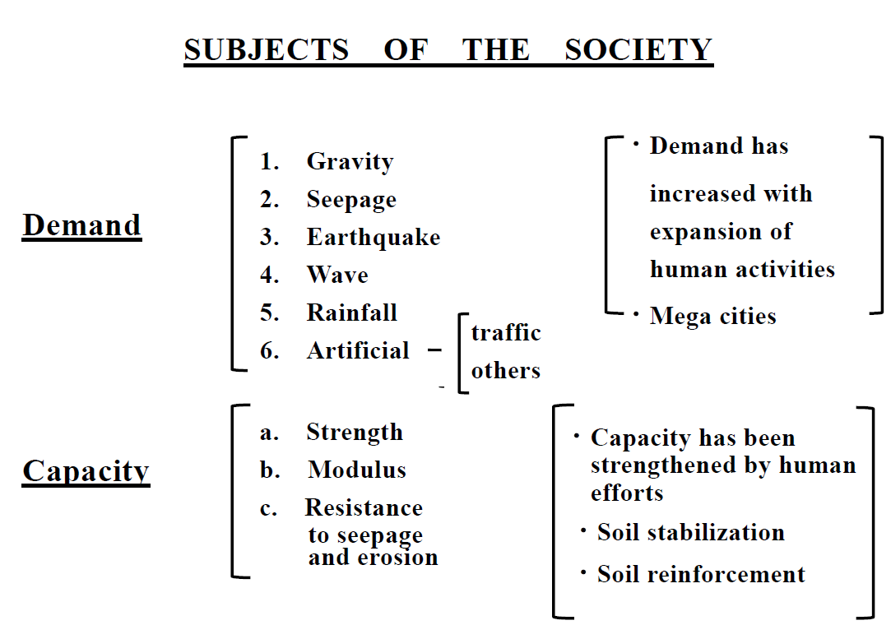

Slide 6
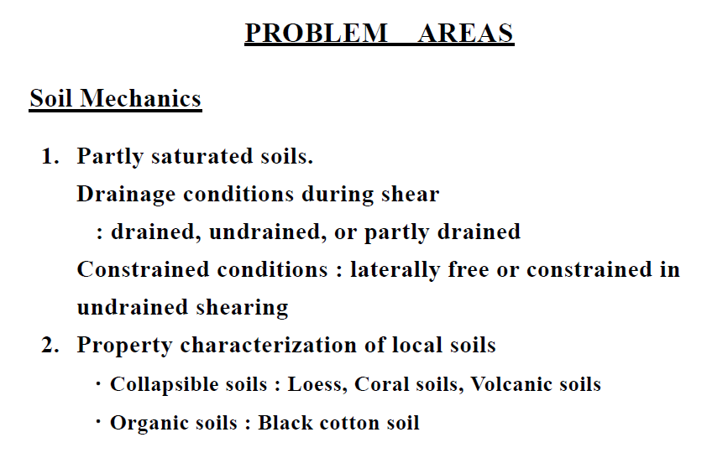

Slide 7
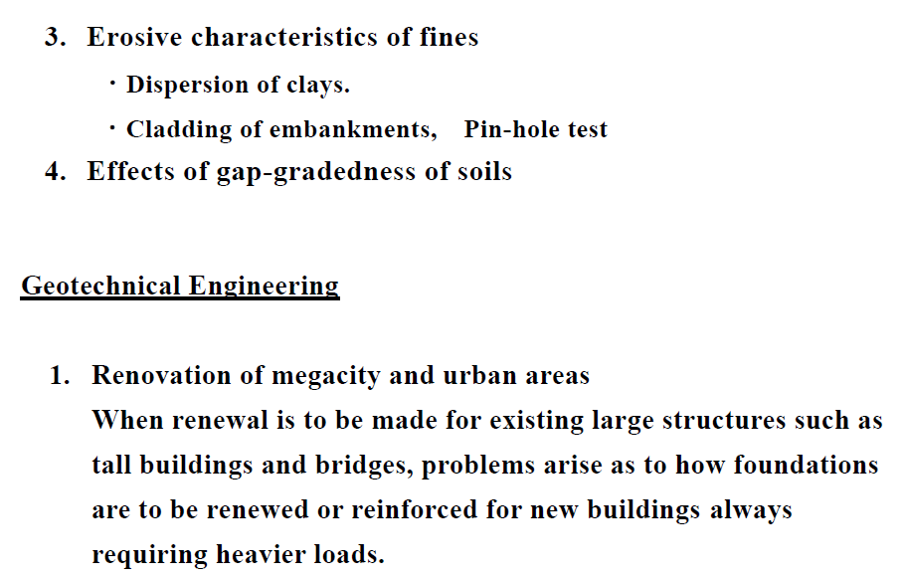

Slide 8
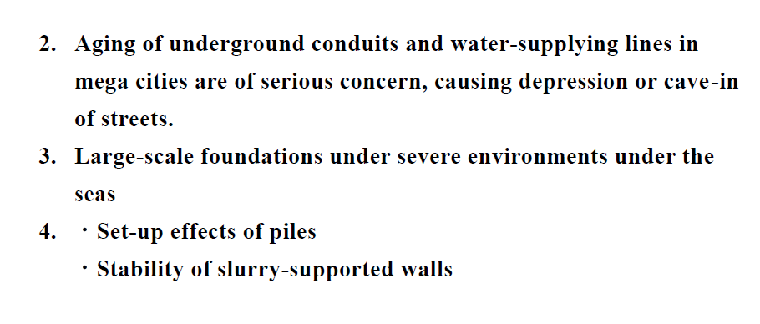

Slide 10
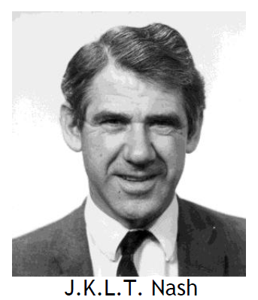
Appreciation to Secretary Generals
J.K.T.J.Nash (1965-1981)
・He established the framework of ISSMEG:
Constitution and bye-law.
・ISSMEG will exist forever as long as human
being exists on the globe.

Slide 11
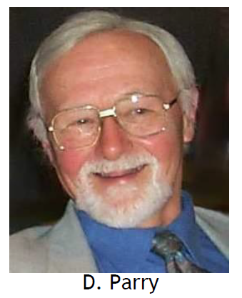
R.H.G.Parry (1981-1999)
・His stewardship and steady efforts should
be remembered in the era when several new
deciplines came into existence in ISSMEG.

Slide 12
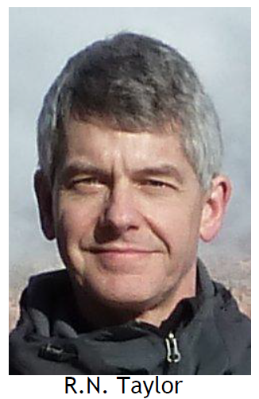
R.N.Taylor (1999 - present)
・He is serving for ISSMEG with the mind of complete fairness and justices.

Slide 13
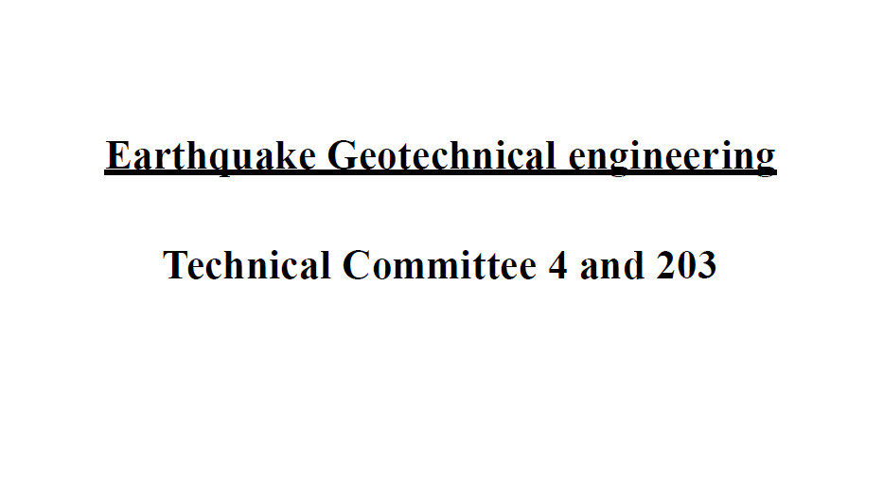

Slide 14
International Conference on Earthquake Geotechnical Engineering
1985 – today, every four years
International Conference on Performance – based Design in Earthquake Geotechnical Engineering
2009 – today, every four years

Slide 15
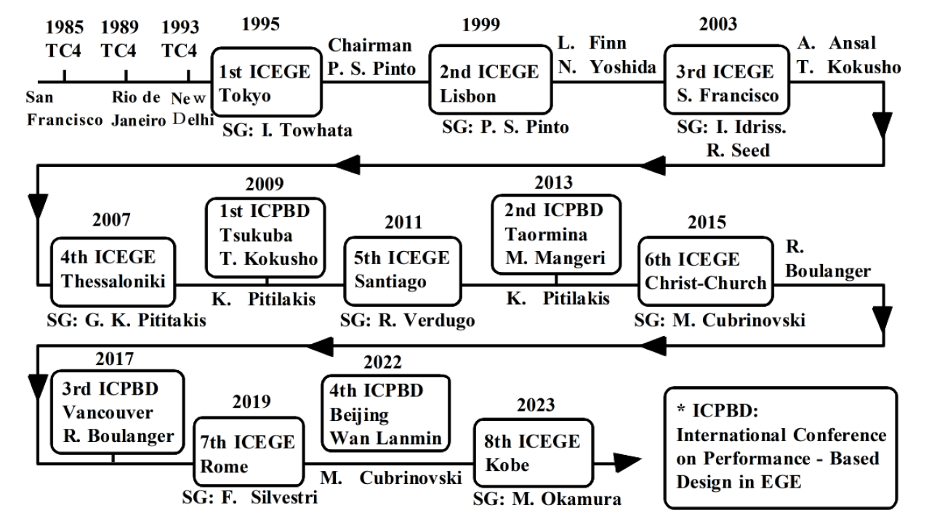
2004
2012
M. Maugeri
Christchurch
Osaka
Kazama,
Koseki

Slide 16
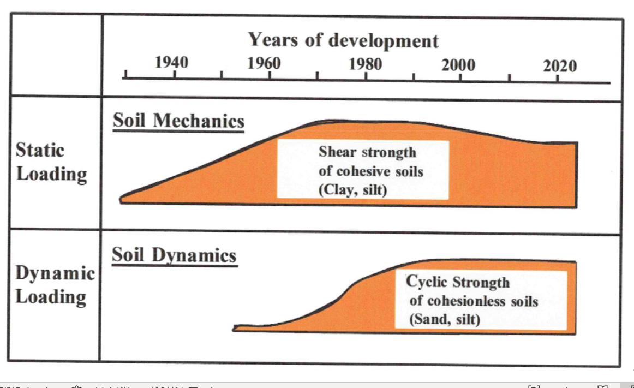

Slide 17
Soil Dynamics
Loading is cyclic and short time
Two problems exist
1) During the loading … Cyclic strength
2) Aftereffects of loading … Residual strength, Lateral displacement,
flow

Slide 18
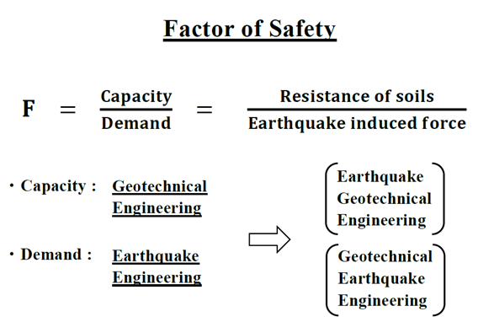

Slide 19
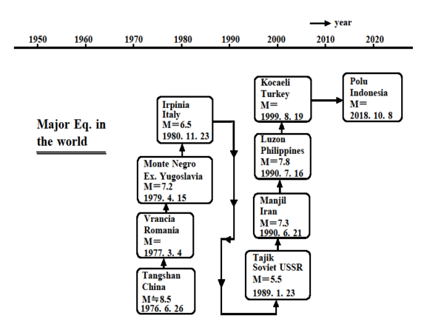

Slide 20
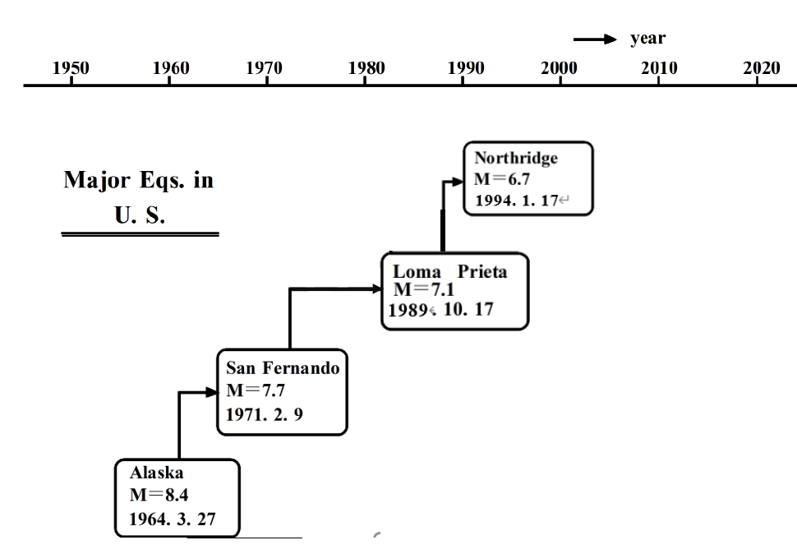

Slide 21
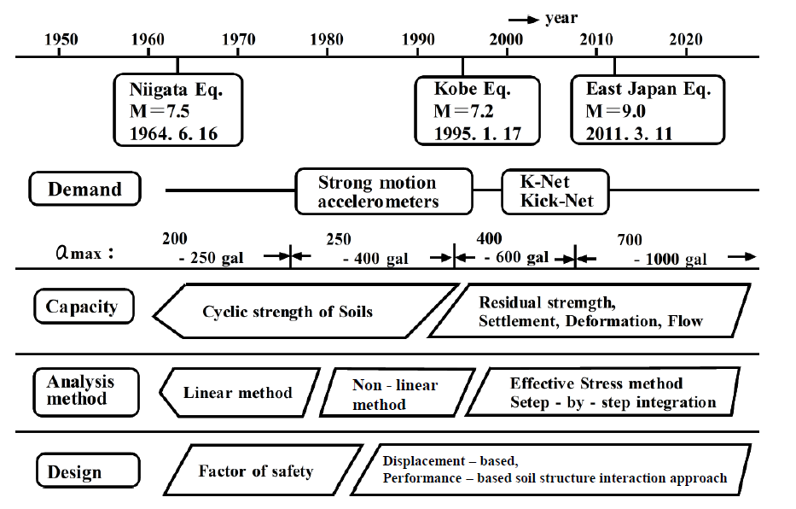
Residual strength,
Settlement, Deformation, Flow

Slide 22
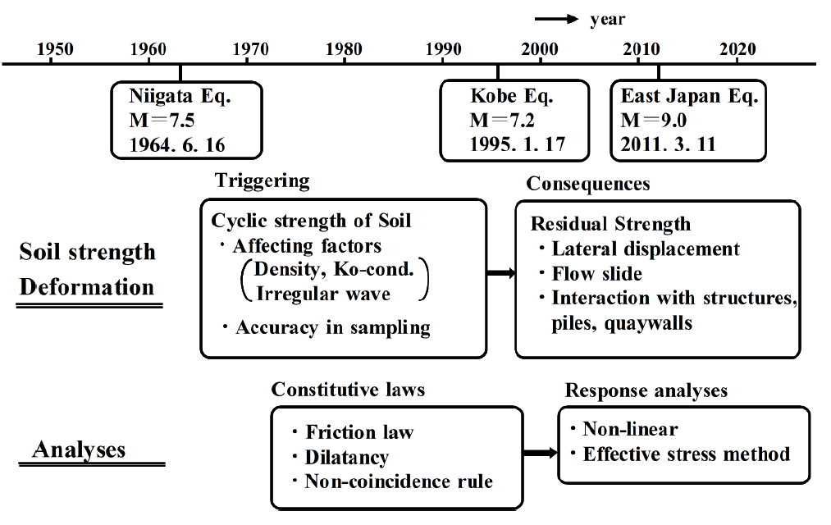

Slide 23
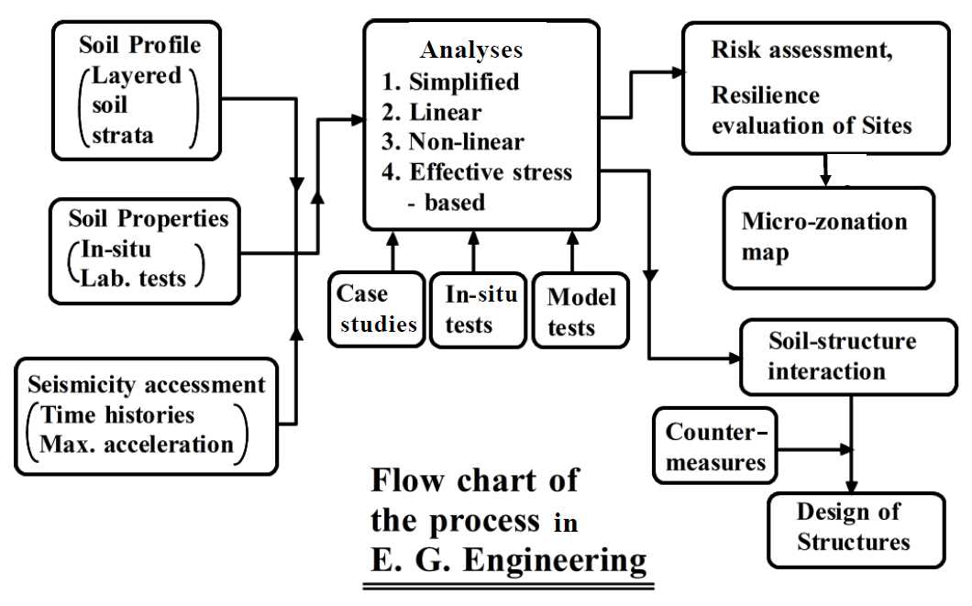

Slide 24
Basic laws of deformation for granular soils
Friction Law
Dilatancy Law
Modified law for non-coincidence of axes
of principal stresses and plastic strains.
Hardening rule

Slide 25
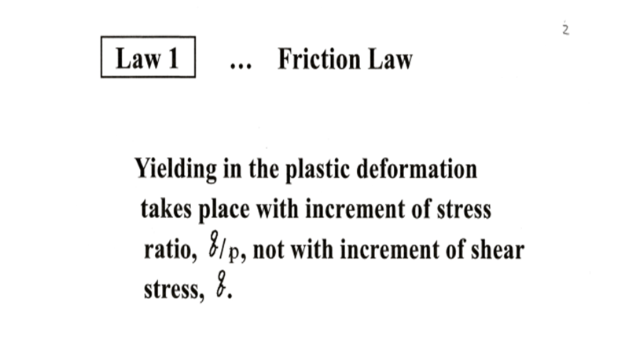

Slide 26
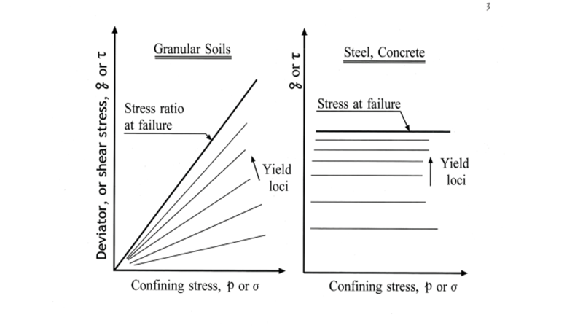

Slide 27
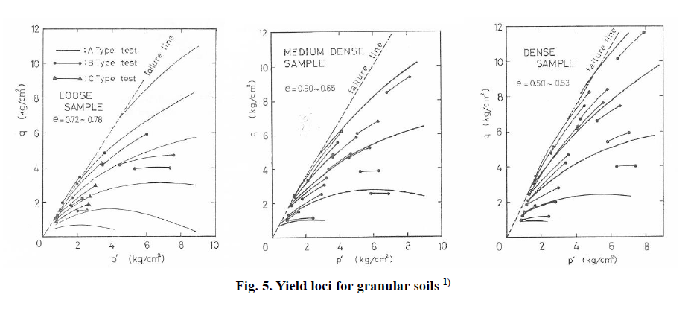

Slide 28
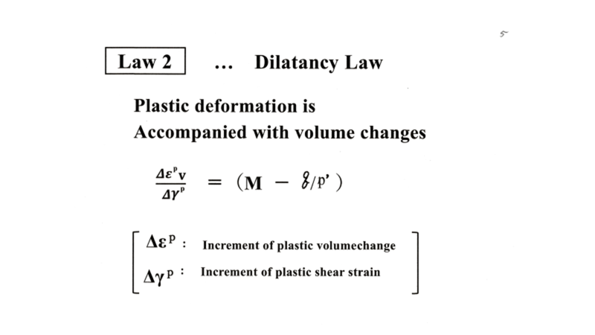
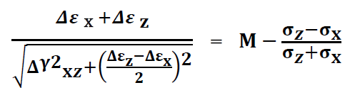
Plastic deformation is accompanied by volume change

Slide 29
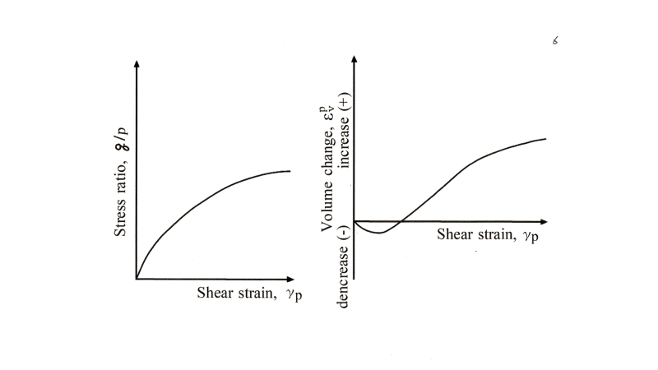

Slide 30
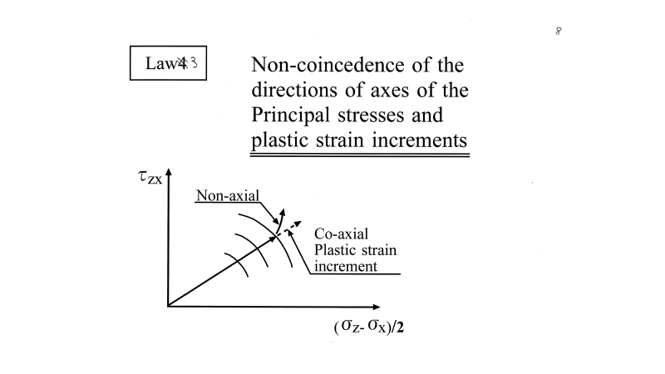
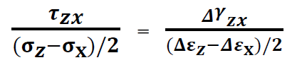
Non-coincidence of axes of principal stresses and plastic strain increments
Law 3
…
Coincidence of the principal stresses and plastic strain increments is valid for the metal plasticity and conventionally called “flow rule”. However, this rule is
not applicable in the
granular soil mechanics.
≠

Slide 32
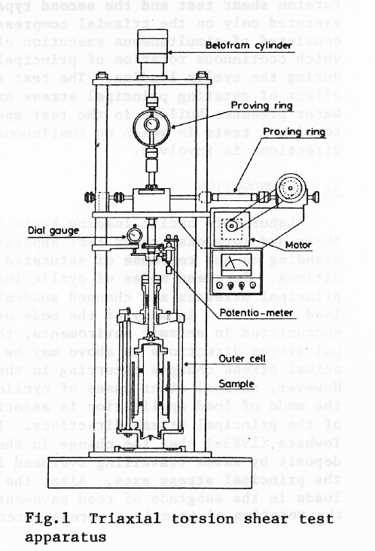

Slide 33
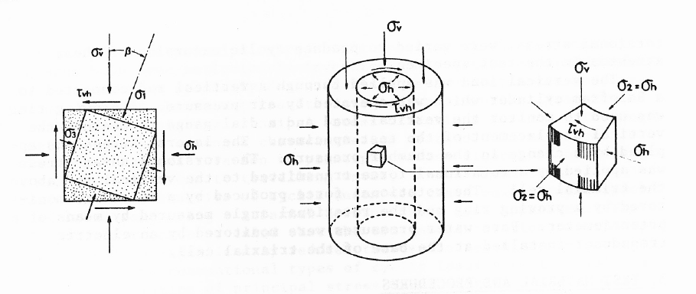

Slide 34
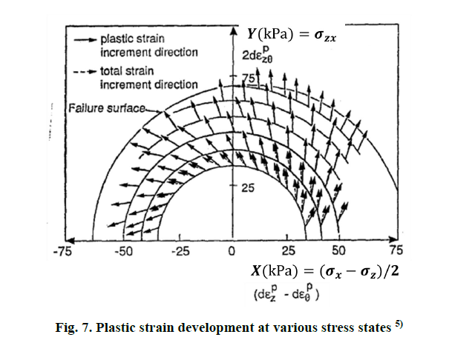

Slide 35
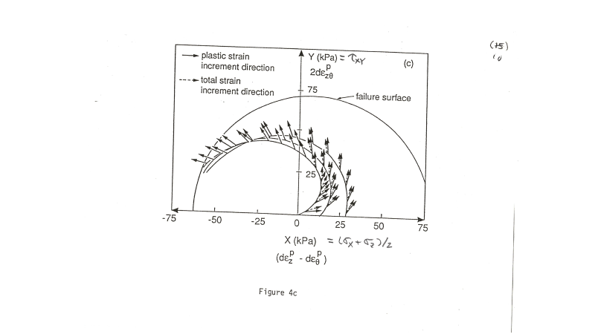

Slide 36
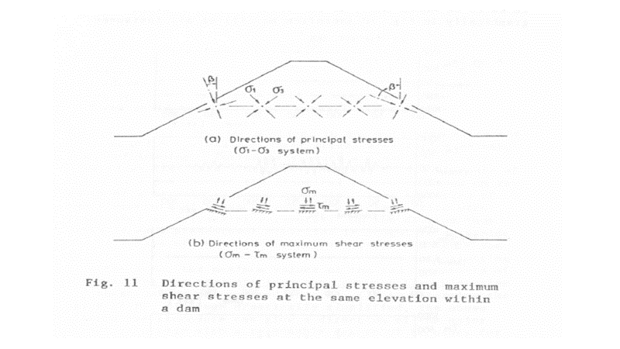

Slide 37
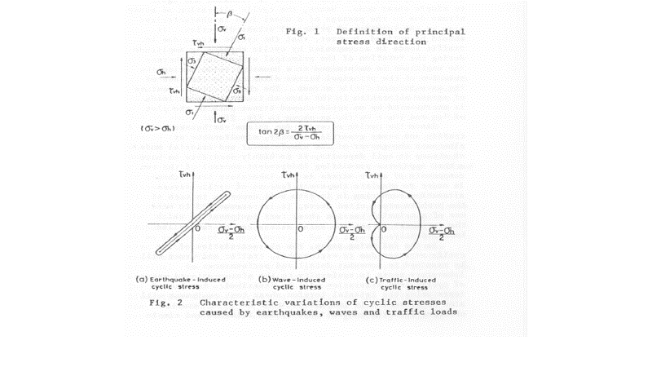

Slide 38
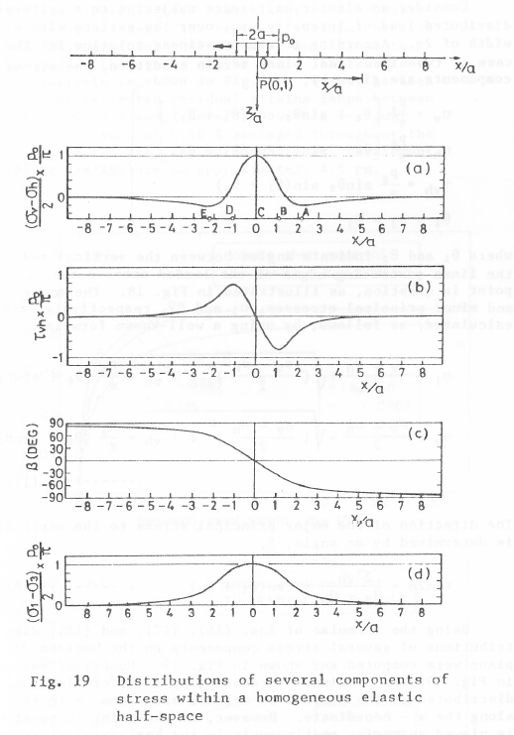

Slide 39
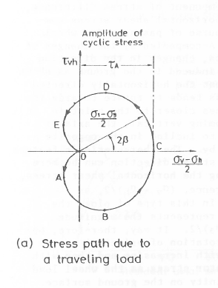

Slide 40
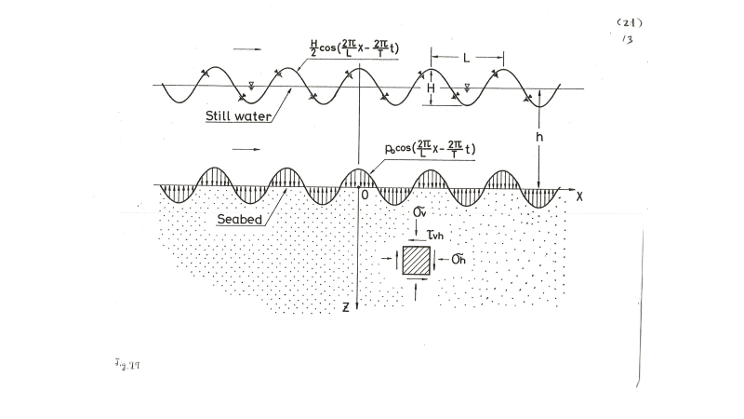

Slide 42
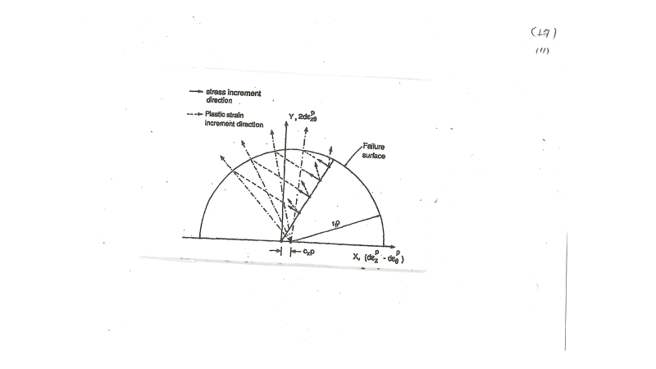

Slide 43

Stress ratio-strain relations
Law 4
…
Hyperbolic relation
$$τ=\frac{G_{0}}{1+γ/γ_{r}}γ$$

Slide 44
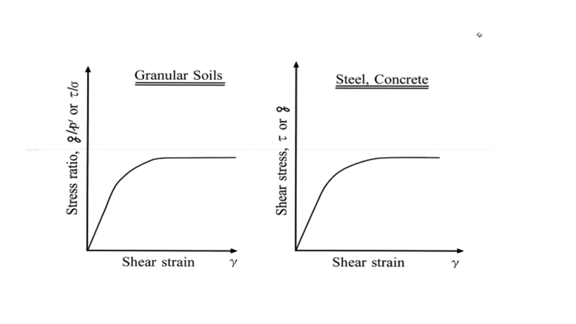
Hardering function

Slide 45
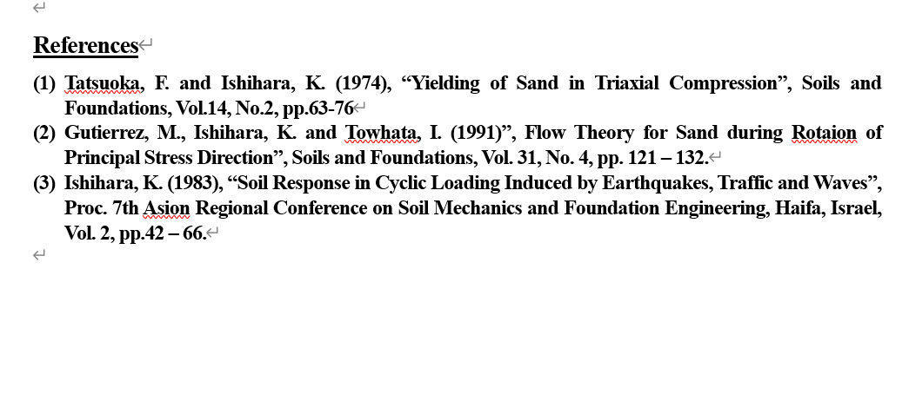

Slide 46
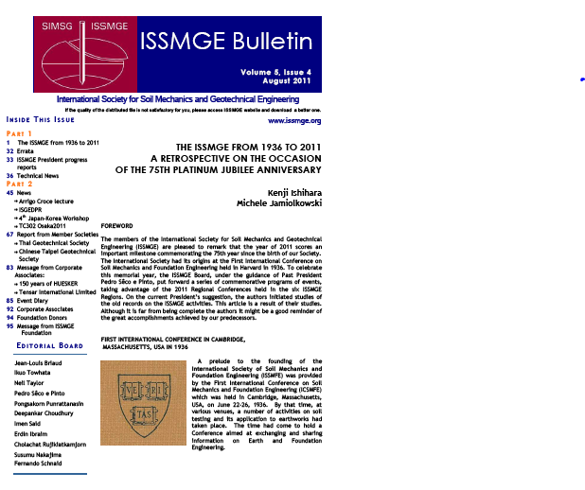

Slide 47
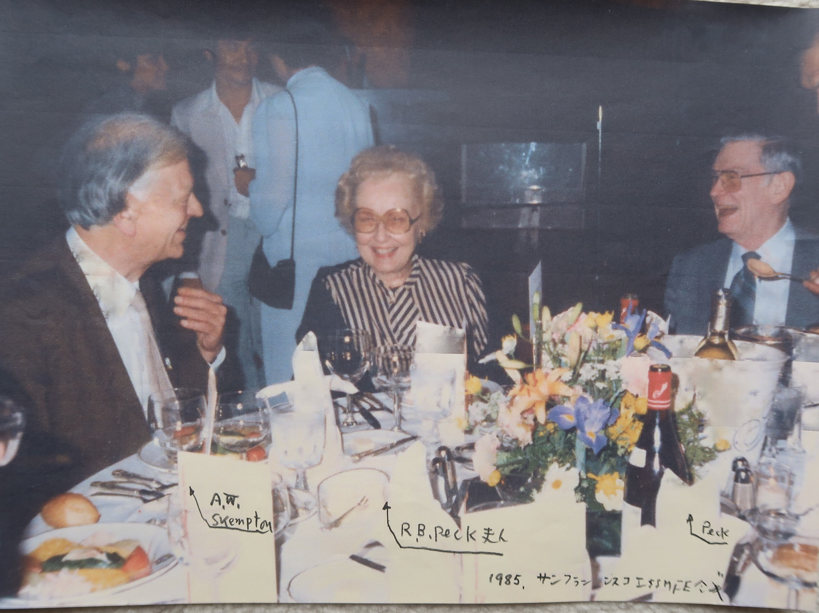

Slide 48
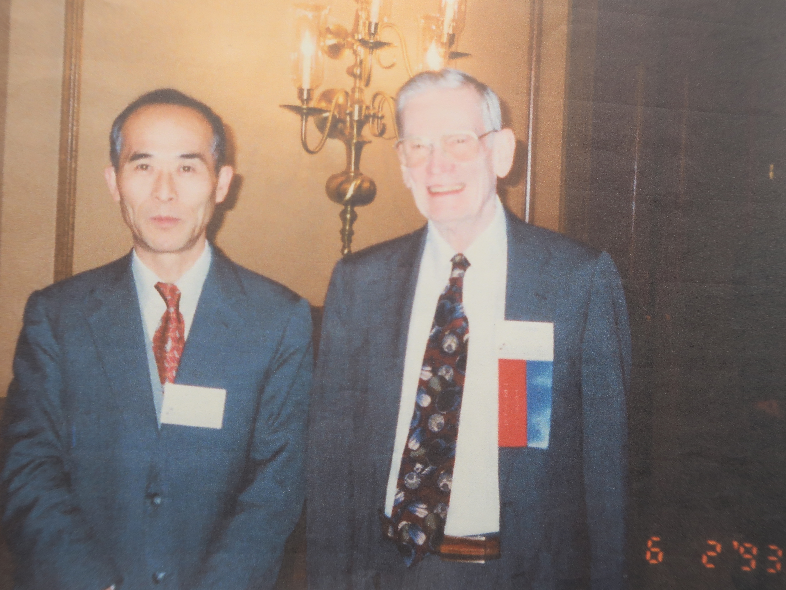

Slide 49
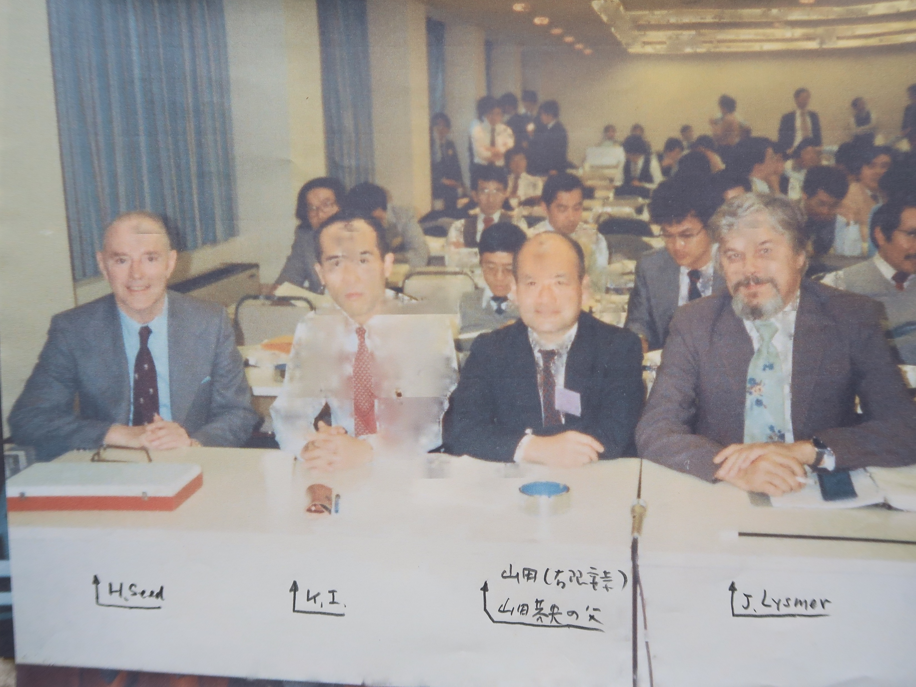

Slide 50
