Slide 1
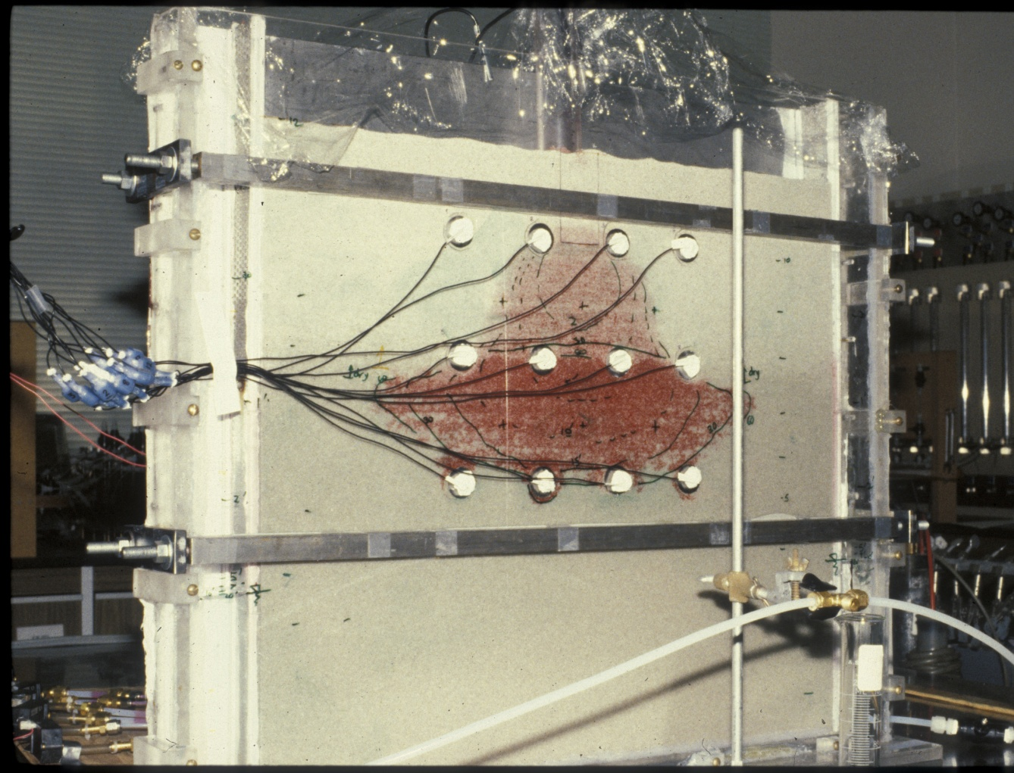
Kerosene * (LNAPL) in coarse-grained sand
faint red: residual degree of saturation S_{o} = 5-10%
Bright red, NAPL lens: possibility of pumping - further movement, S_{o} = 30-50%
water table
* dyed red

