Slide 1
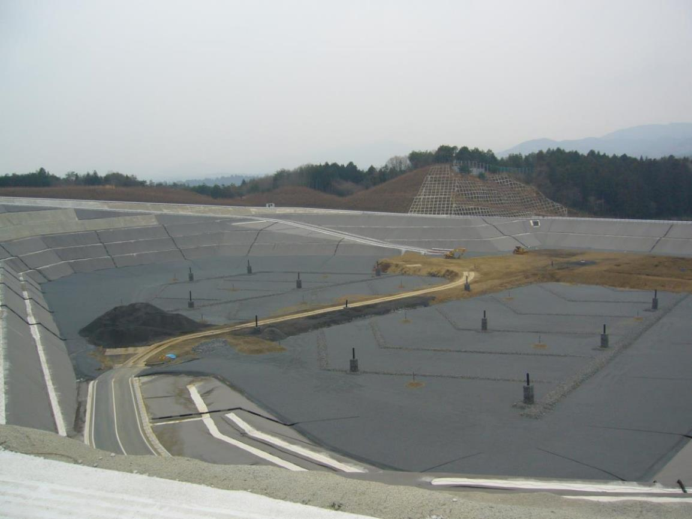
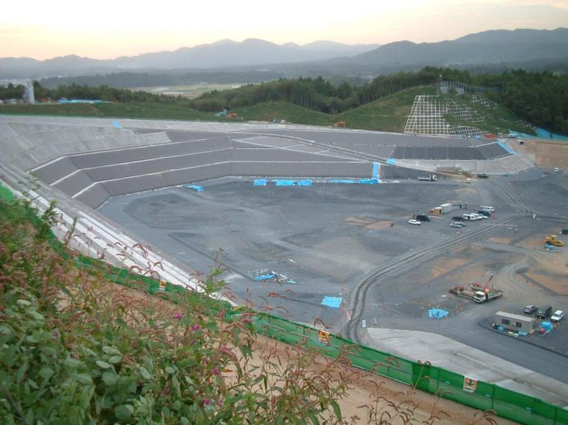
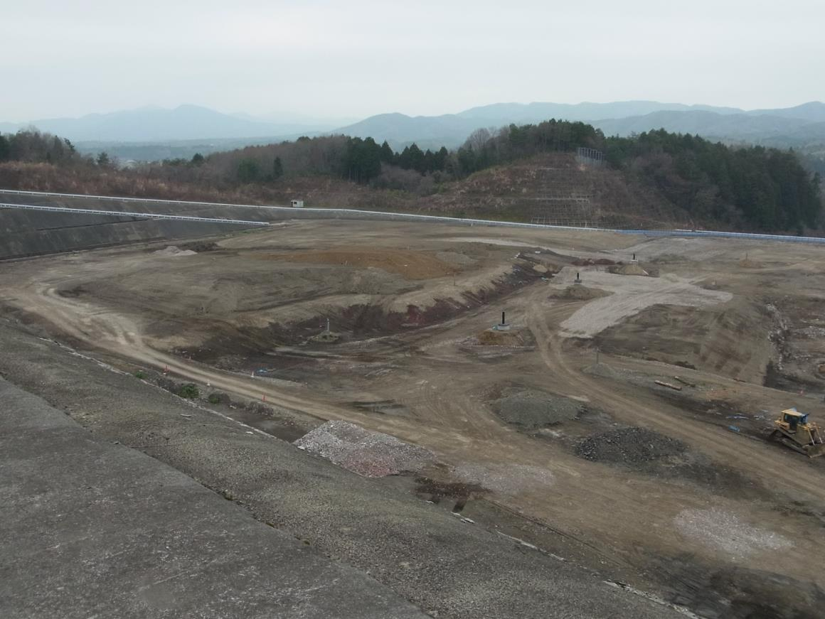
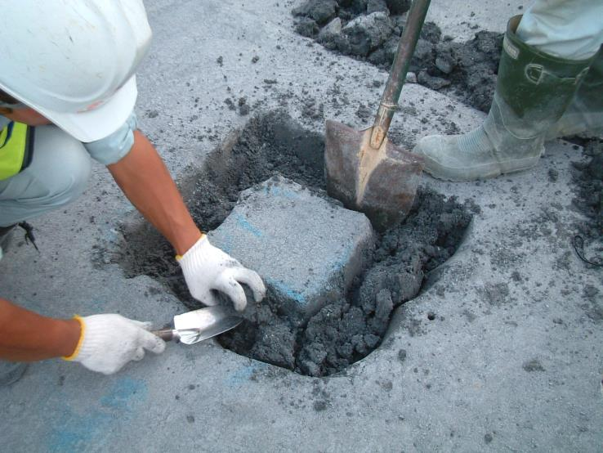
Waste disposal facility in Japan Soon after start of disposal
Disposal facility under construction
After 7 years
Half of the landfill volume has been filled
Slag waste that can be used as protective sand
Pipes for waste-derived gas release
Hideo Komine, Waseda University
Waste is being landfilled
Sampling and quality testing of bentonite based clay-liner

