Slide 1
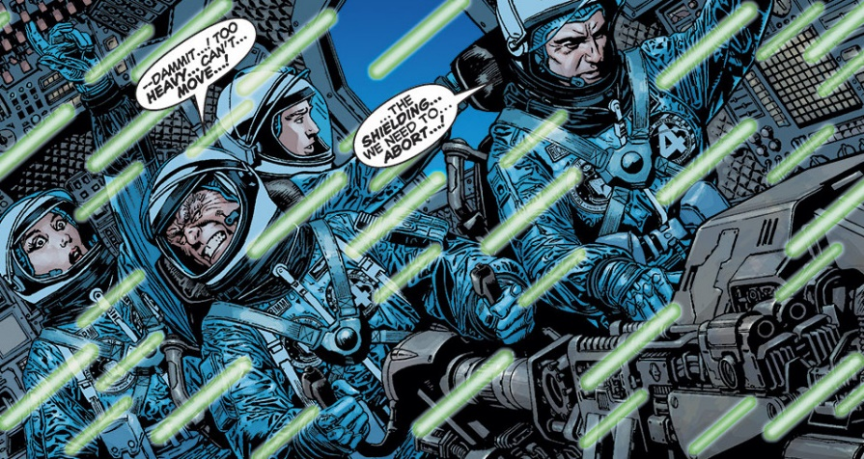

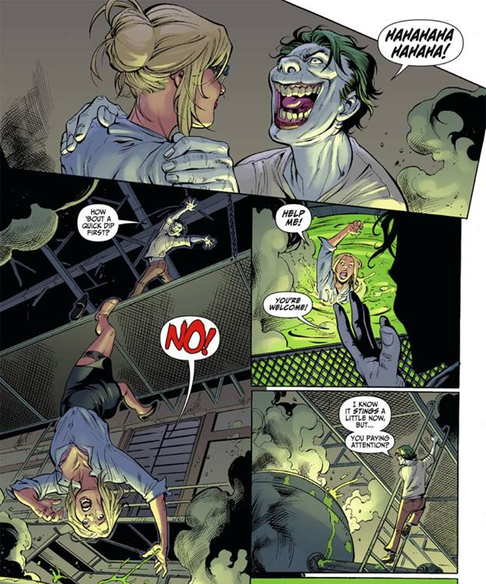


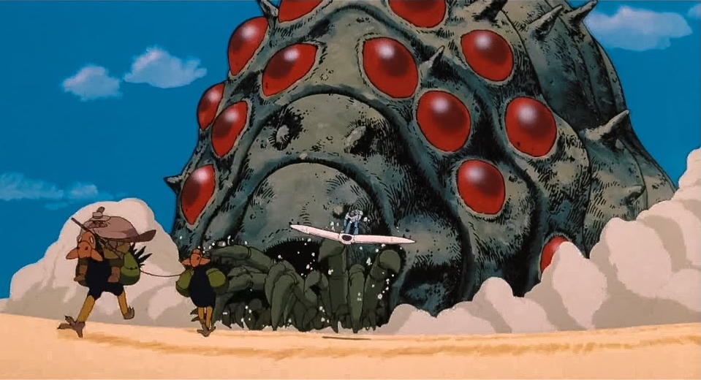

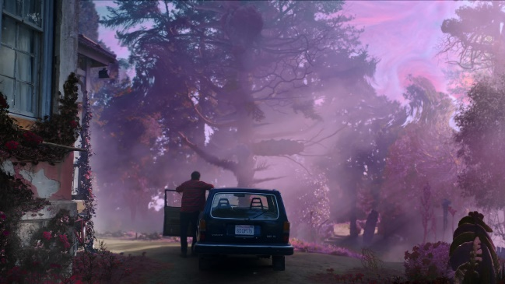

Contamination Exposure in Pop Culture
Notes:
Left column: Fantastic 4, Resident Evil (Biohazard), Fallout
Mid column: Godzilla, Hulk, Annihilation
Right column: Joker, Nausicaä of the Valley of the Wind, Color Out of Space

