Slide 1
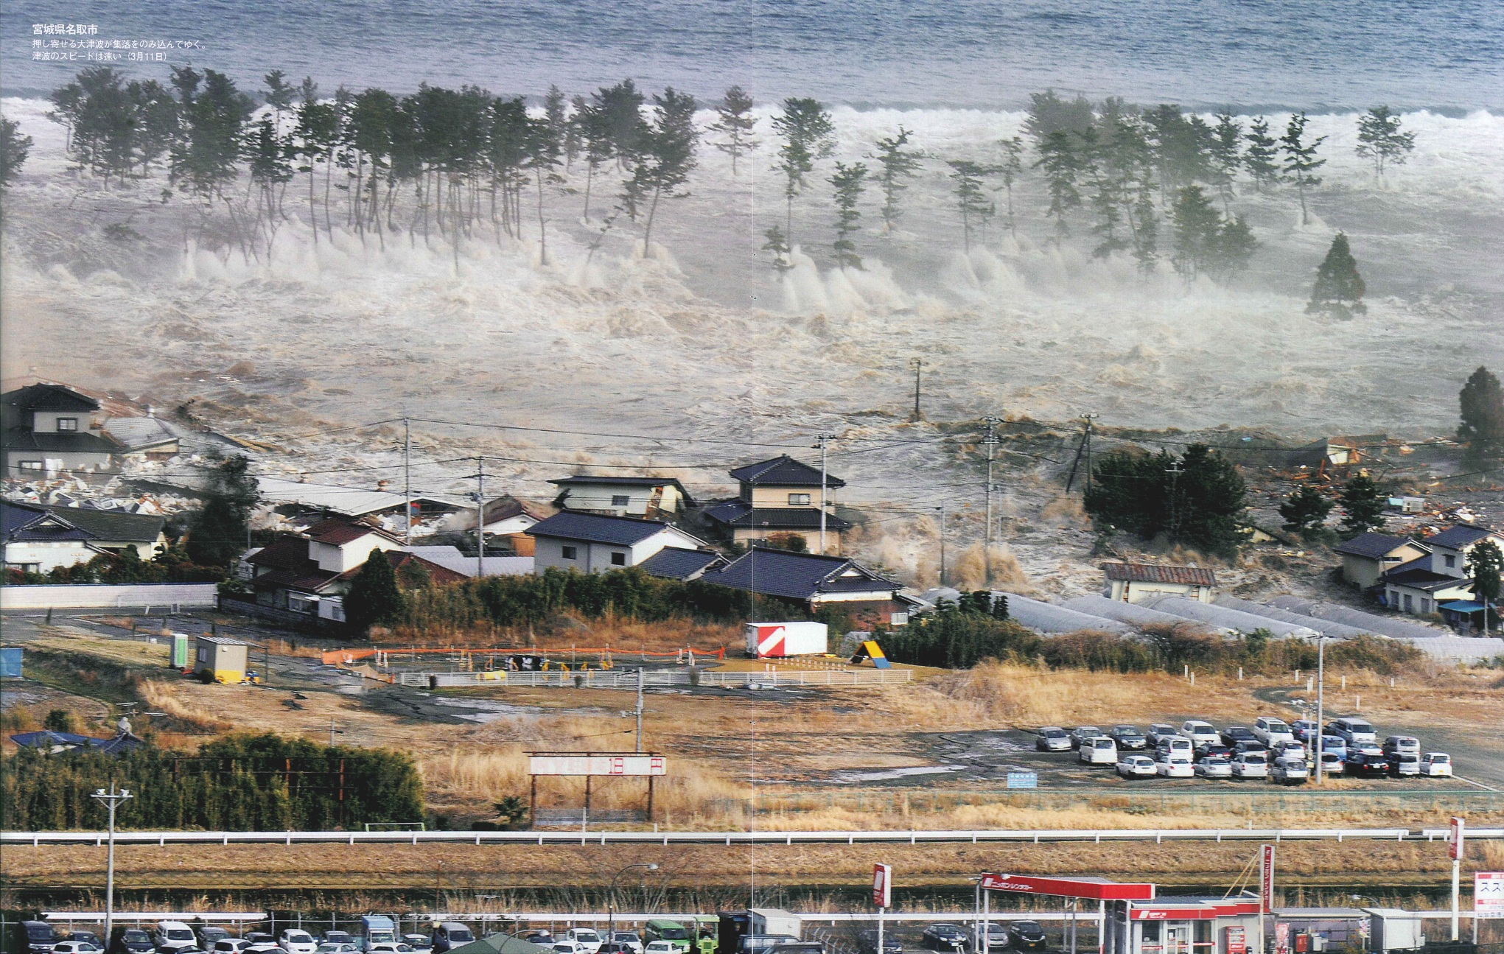
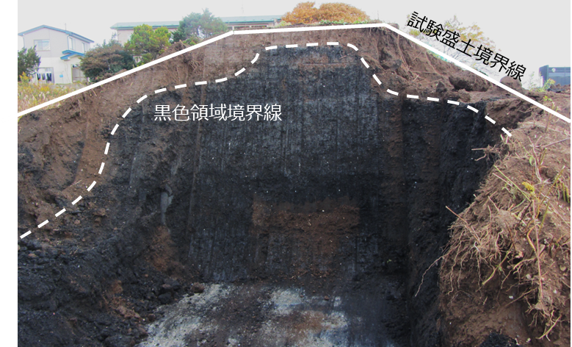
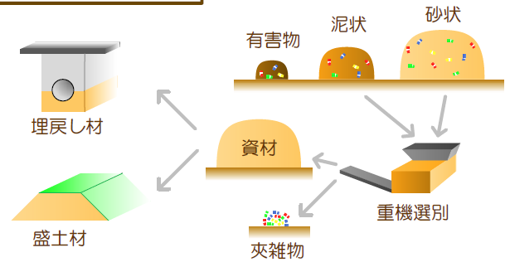
Recovered soils from disaster debris
~30,000,000 tons of disaster wastes with large fraction of the soils were generated at 2011 East Japan disaster.
Recovered soils were utilized, but research was necessary to determine efficient treatment capable of achieving better soil recovery & better soil quality.
Tsunami at 2011 East Japan earthquake (Photograph by K. Tezuka 写真：毎日新聞社 手塚耕一郎氏）
Waste-soil mixtures
Use in embankment
Recovered Soils
Excavated cross section of test embankment of recovered soils – Black color portion of anaerobic condition possibly due to the waste wood fraction remained in the recovered soil (courtesy of Dr. K. Endo)
Crushing & Separation using equipments
Waste fraction
Notes:
In this slide, let me introduce the Japanese local case. I think this was the local challenge, but it can be an universal topic to be implemented in other places in the world which are prone to the severe natural disasters. Also applicable to the remediation of illegal dumpings.

