Slide 1
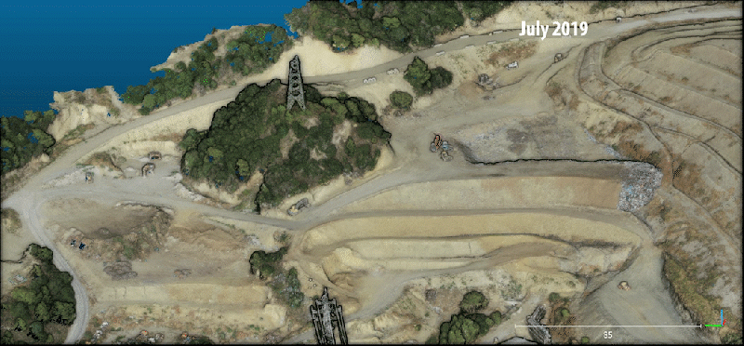
3D models of a landfill based on optical data collected by Unmanned Aerial Vehicles
Data collected in collaboration with John Manousakis, ARGO-E Group, Athens and Prof. George Athanasopoulos, University of Patras
Notes:
Note the scale (85 m) at lower right corner of the slide.

Slide 2
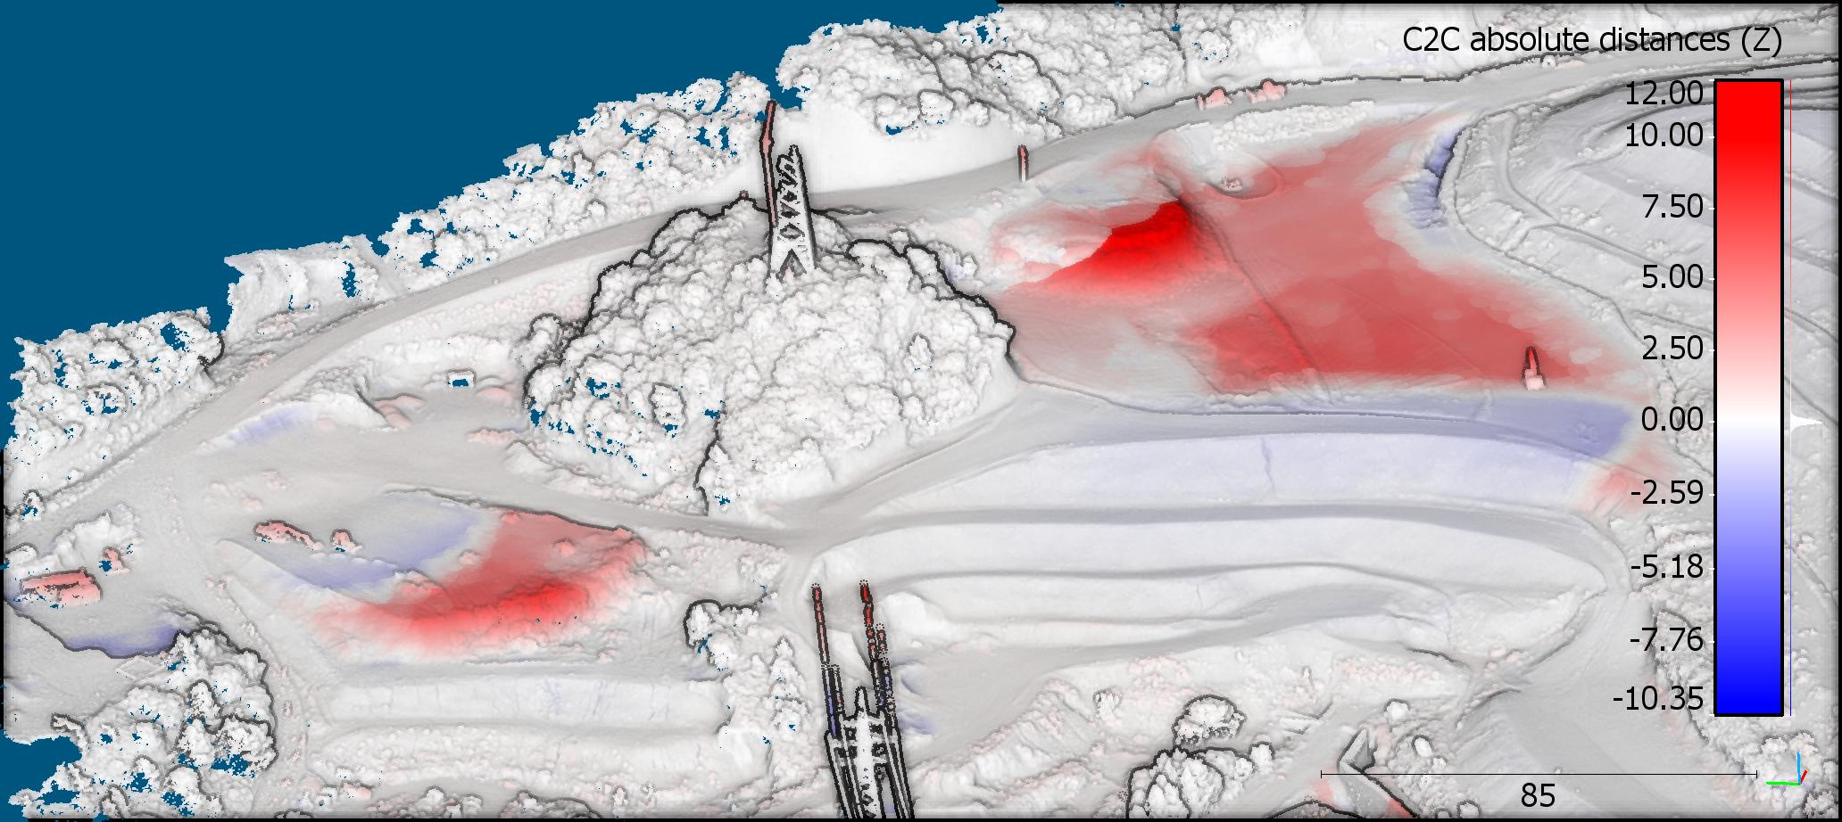
3D models of a landfill based on optical data collected by Unmanned Aerial Vehicles showing also elevation change between deployment dates
Volume of material placed between July 30 and December 18 2019: 53,200 m³
Volume of material excavated between July 30 and December 18 2019 : 8,500 m³
Notes:
Note the scale (85 m) at lower right corner of the slide.

