Slide 1
Second River Niger Bridge in Onitsha, Nigeria – Use of geosynthetic encased granular columns for soil improvement
Dr.- Ing. Oliver Detert
HUESKER Synthetic GmbH

Slide 2
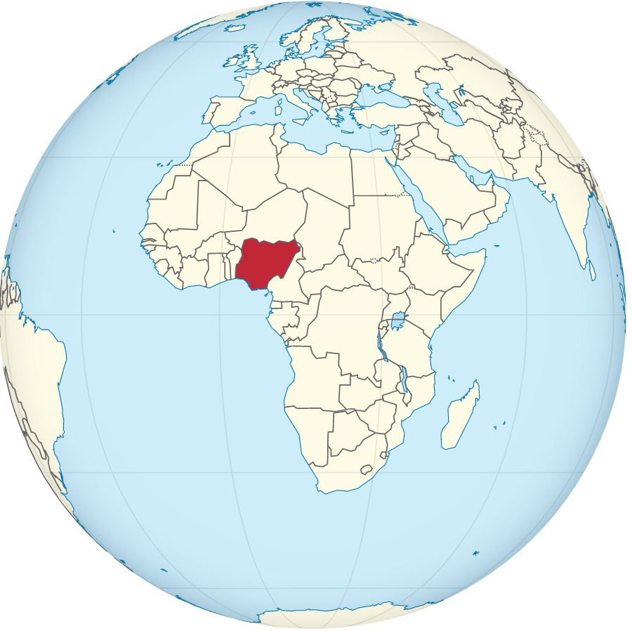
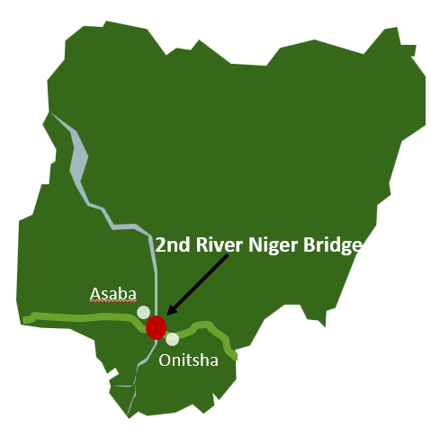

Second River Niger Bridge in Onitsha, Nigeria
Introduction
Nigeria
210 Mio. inhabitants
Most populated country in Africa
Focus on infrastructure modernisation and development for sustainable economic growth
Niger river
Natural barrier (flow rate 4500 m³/s)
4184 km, third-longest river Africa’s
Limited crossings
Construction of a second bridge with four lanes and road embankments on very soft soils between Asaba and Onitsha

Slide 3
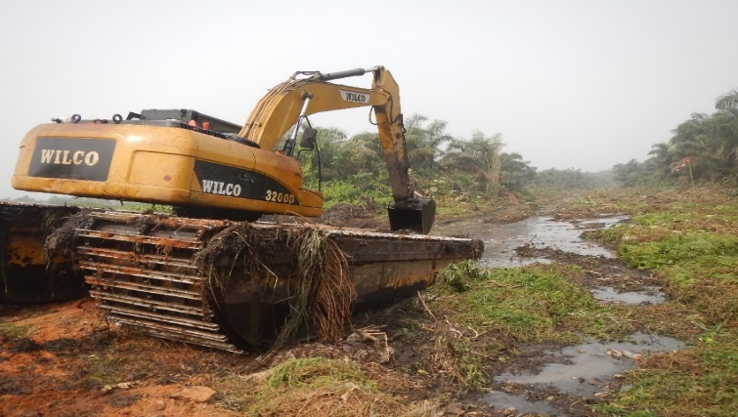
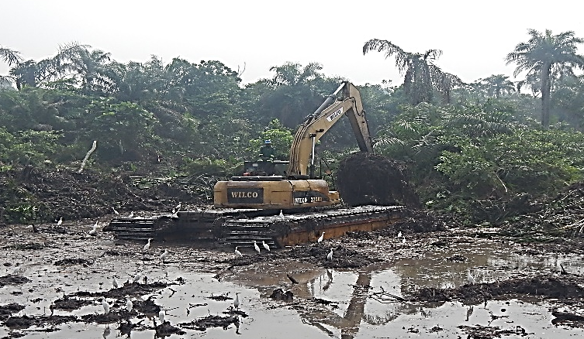
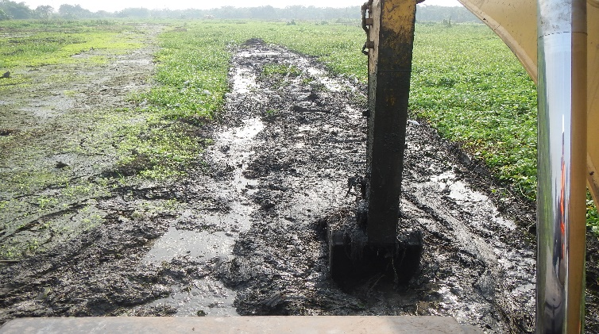
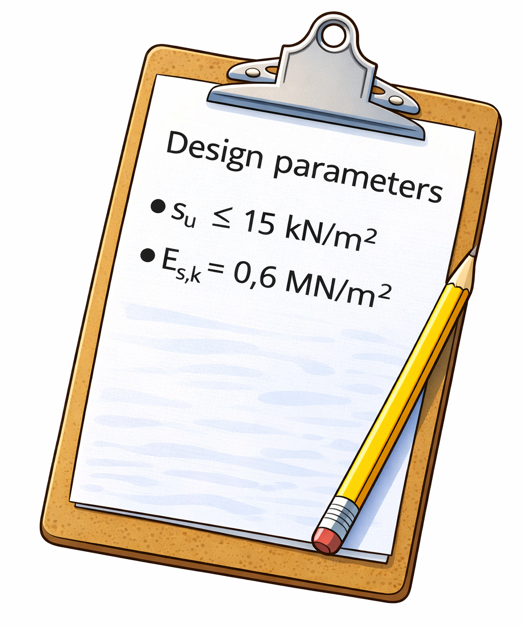
Second River Niger Bridge in Onitsha, Nigeria
Challenging site conditoin
Site located in the Niger Delta
200 km wide, 75.000 km²
Sedimentation region and swamp area for thousands of years
Very soft soils, partly flooded
Site access with floating swamp buggies

Slide 4
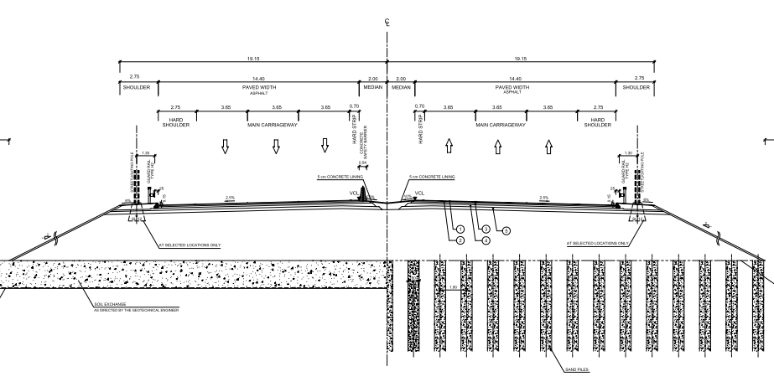
Second River Niger Bridge in Onitsha, Nigeria
Final Design – two Options
PVD‘s in shallow and/or less loaded areas
GEC‘s in deeper and/or higher loaded areas
Prefabricated Vertical Drain
(PVD)
Geotextile Encased Colums
(PVD)

Slide 5
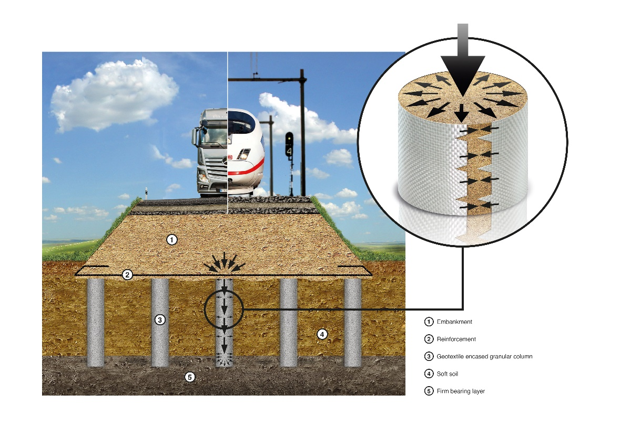
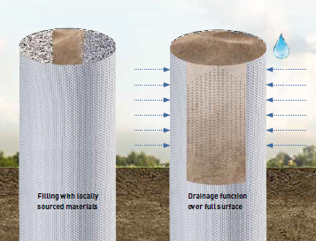
Second River Niger Bridge in Onitsha, Nigeria
Geotextile encased columns

Slide 6
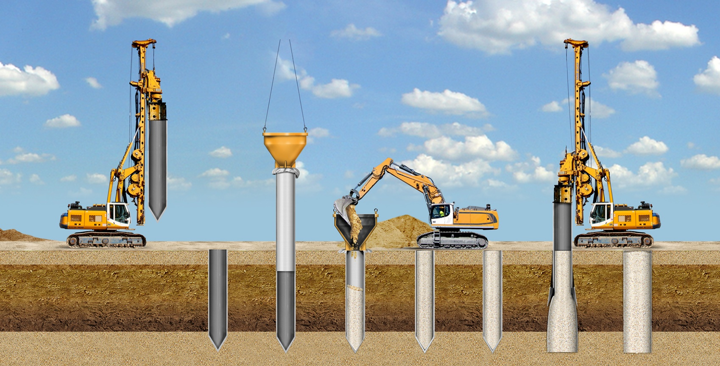
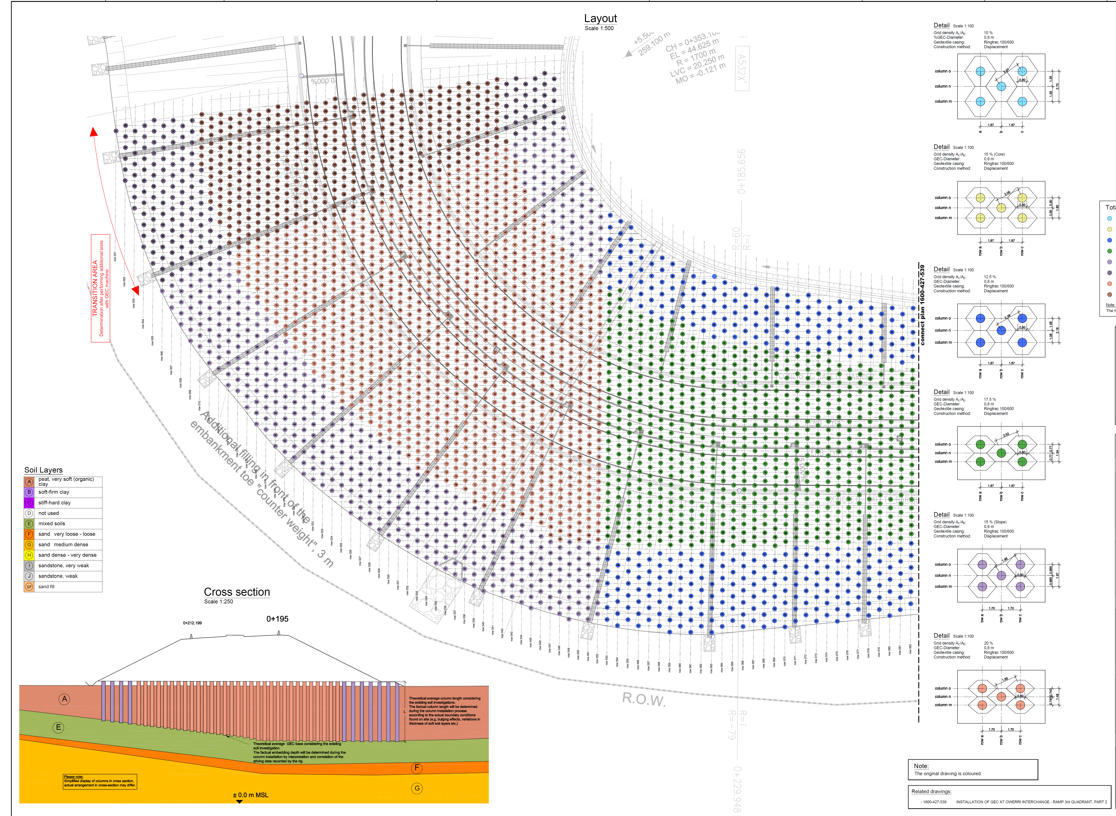
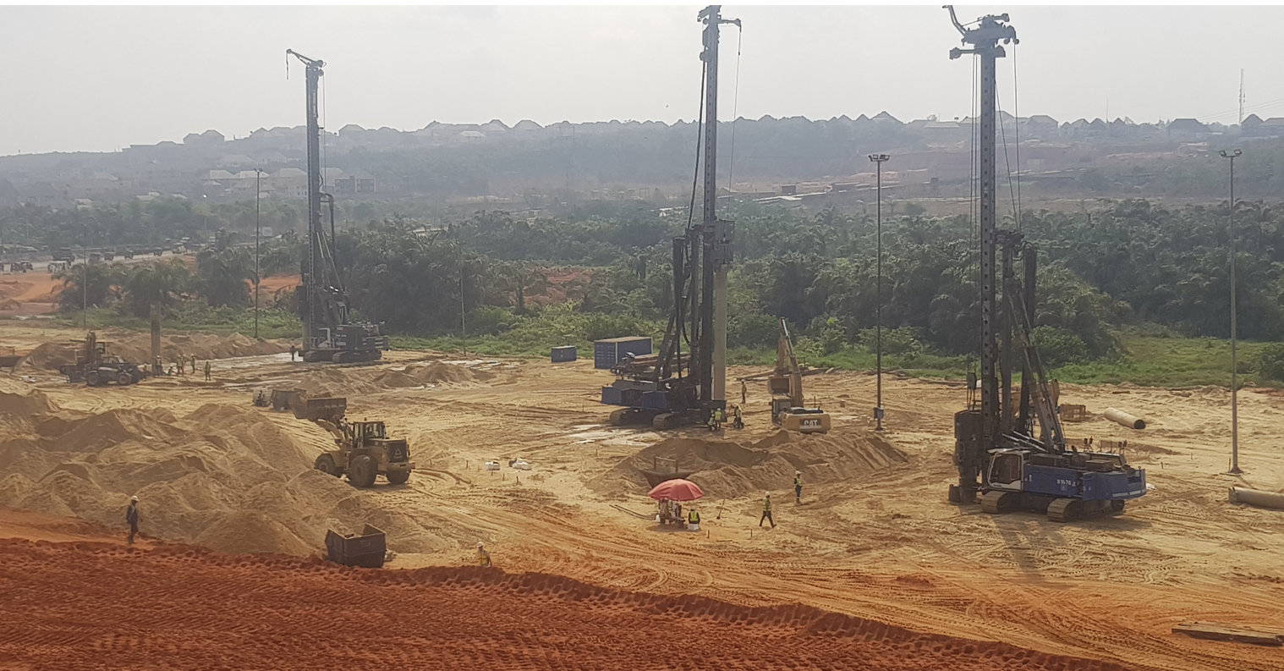
Second River Niger Bridge in Onitsha, Nigeria
Construction phase - GEC
about 17.000 geotextile encased columns
about 200.000 running meter columns
area ratio in between 10% to 20%

Slide 7
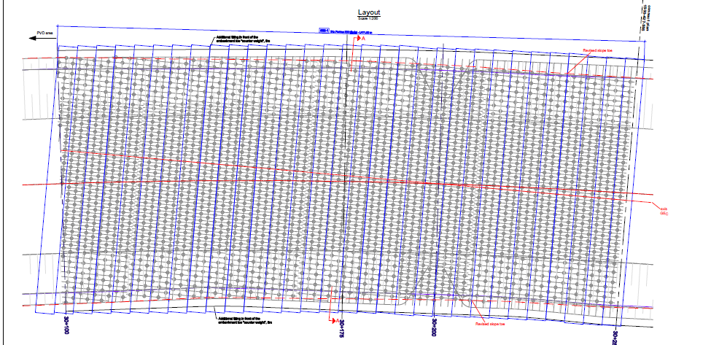
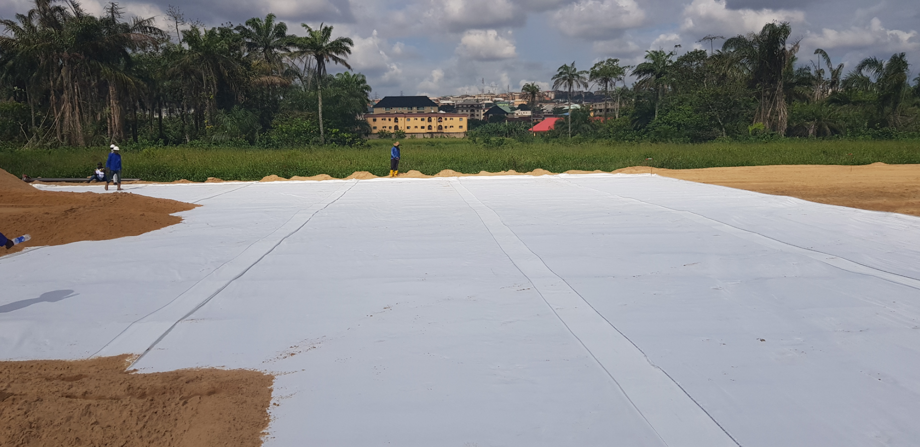
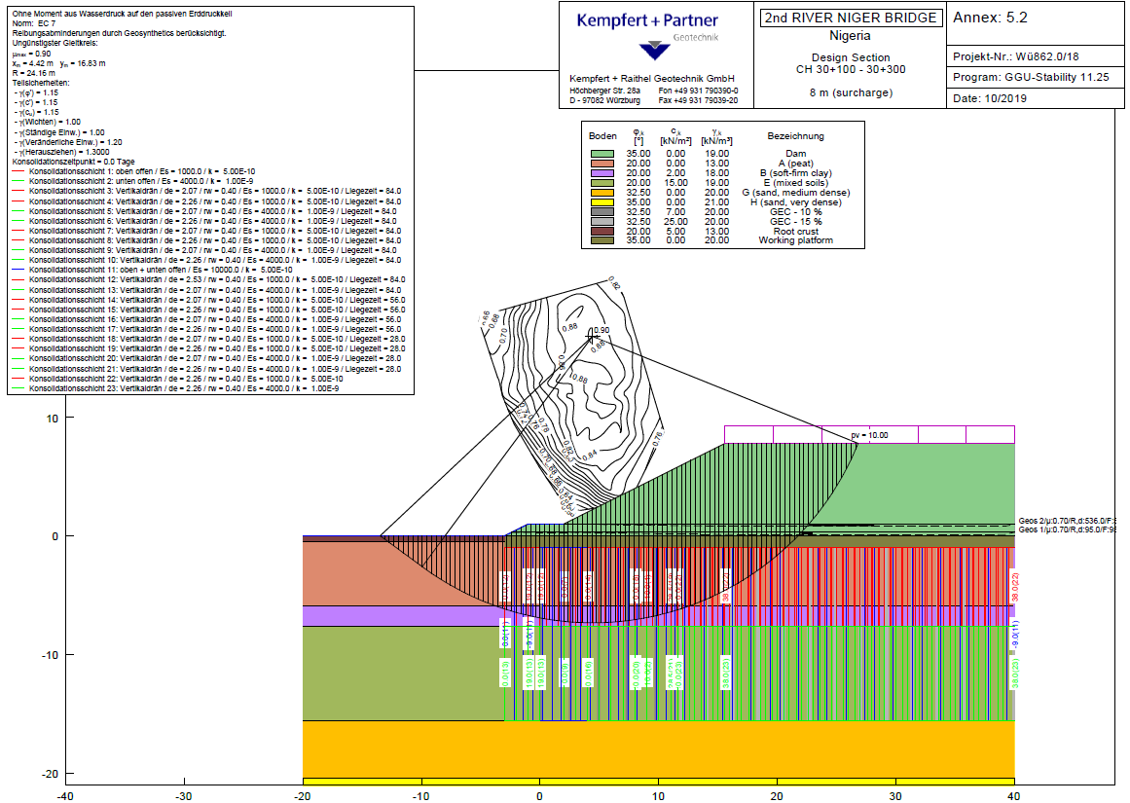
Second River Niger Bridge in Onitsha, Nigeria
Construction phase – basal reinforcement
Horizontal basal reinforcement (woven)
850.000 m² with short term strength from 300 to 2.500 kN/m

Slide 8
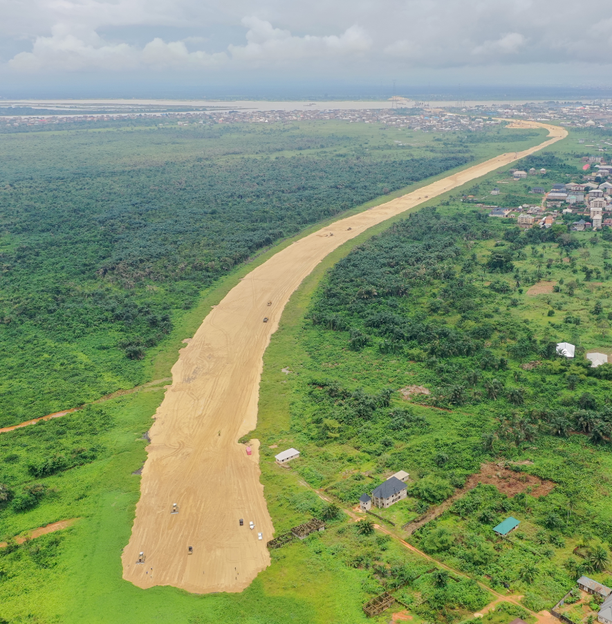
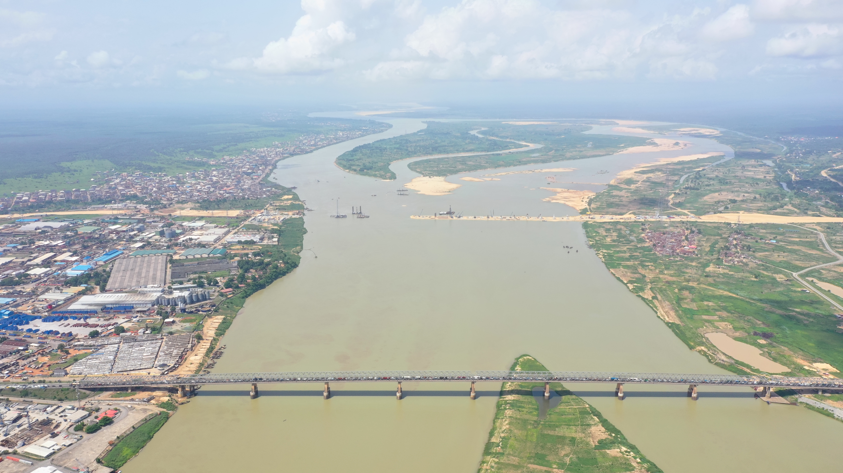
Second River Niger Bridge in Onitsha, Nigeria
Many thanks for your attention!

