Slide 1

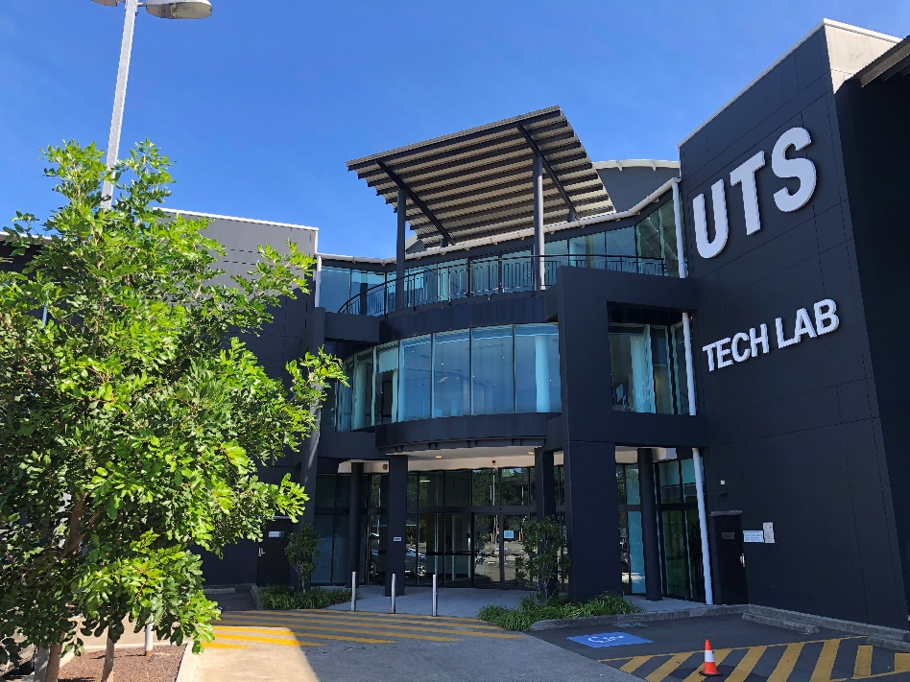
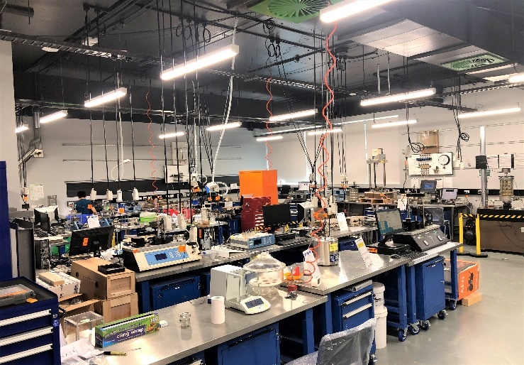
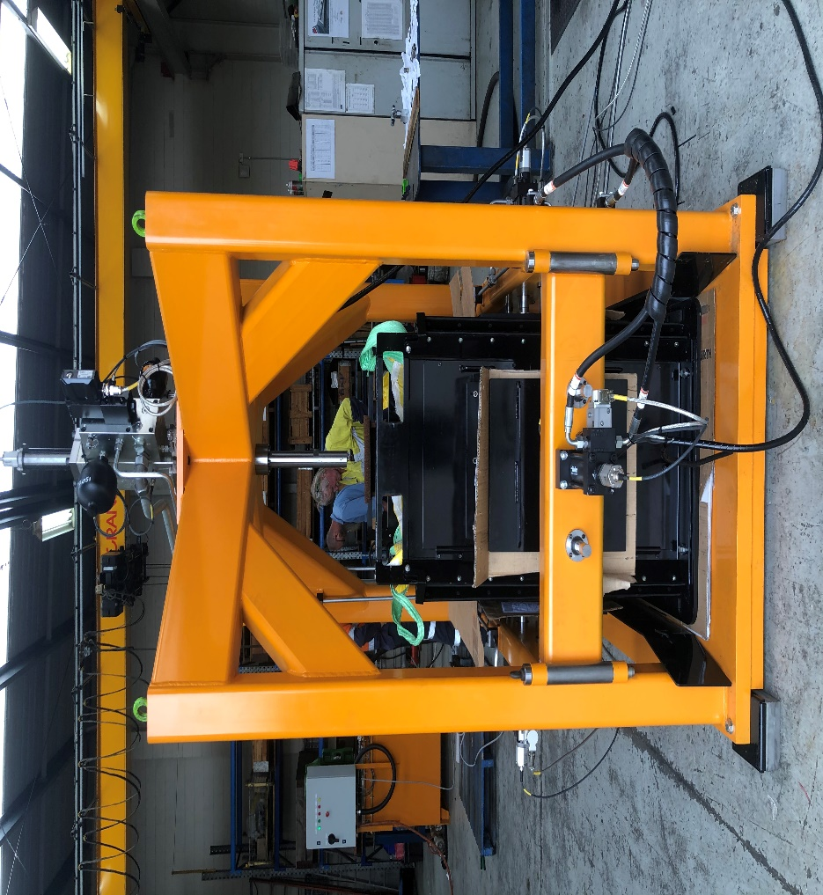
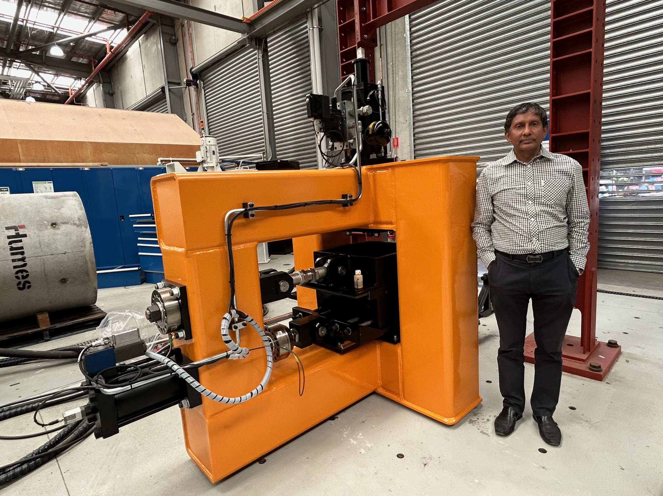
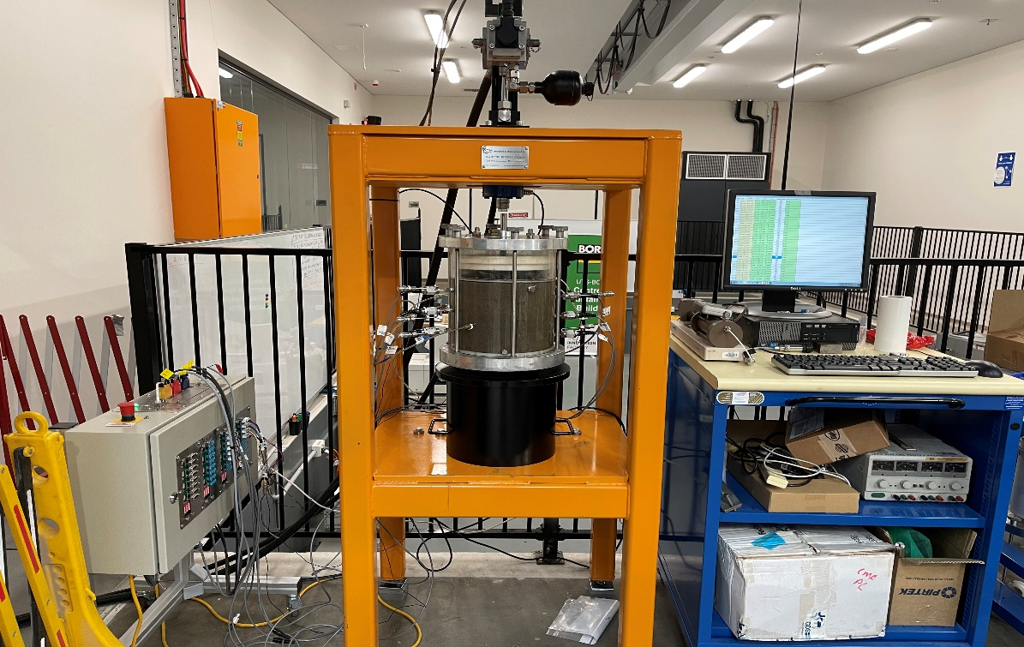
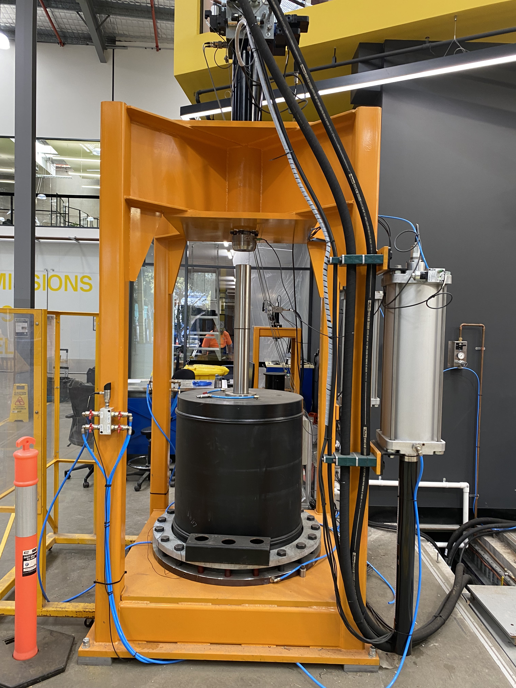
TRANSPORT
Research Centre
Recycled-Rubber Energy Absorbing Layer (2REAL) for Heavy Haul Railways
Patent No. AU2018214448
Distinguished Professor Buddhima Indraratna, AM
PhD, FTSE, FRSN. FIEAust, FASCE, FAusIMM, FGS, FIESL, CEng, CPEng, DIC.
Member of the Order of Australia
Director, UTS Transport Research Centre (UTS-TRC),
Faculty of Engineering and Information Technology,
University of Technology Sydney (UTS), Australia
Industry Partners: Ecoflex Australia, Sydney Trains (Transport for NSW)

Slide 2
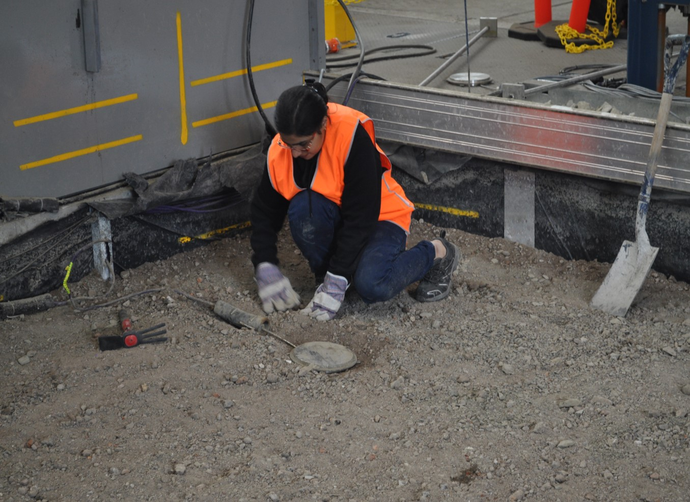
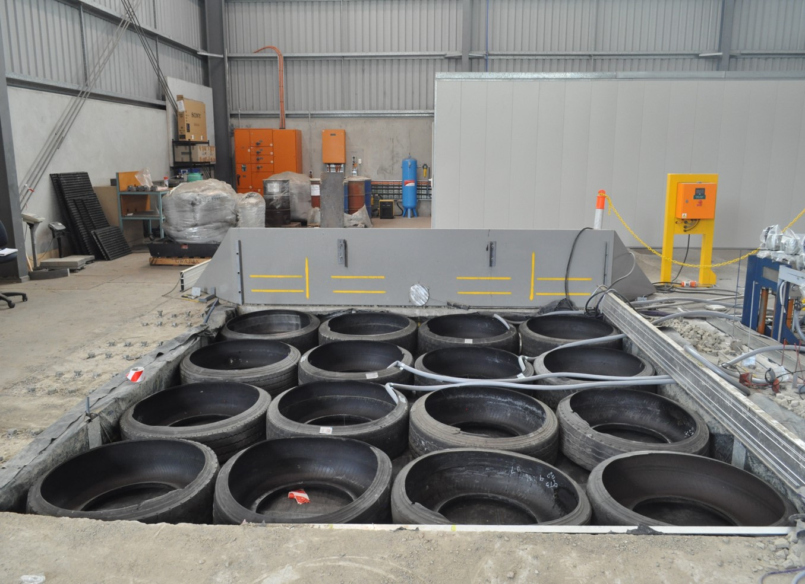
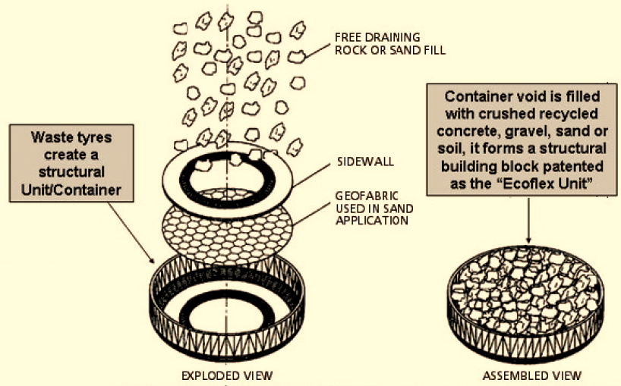
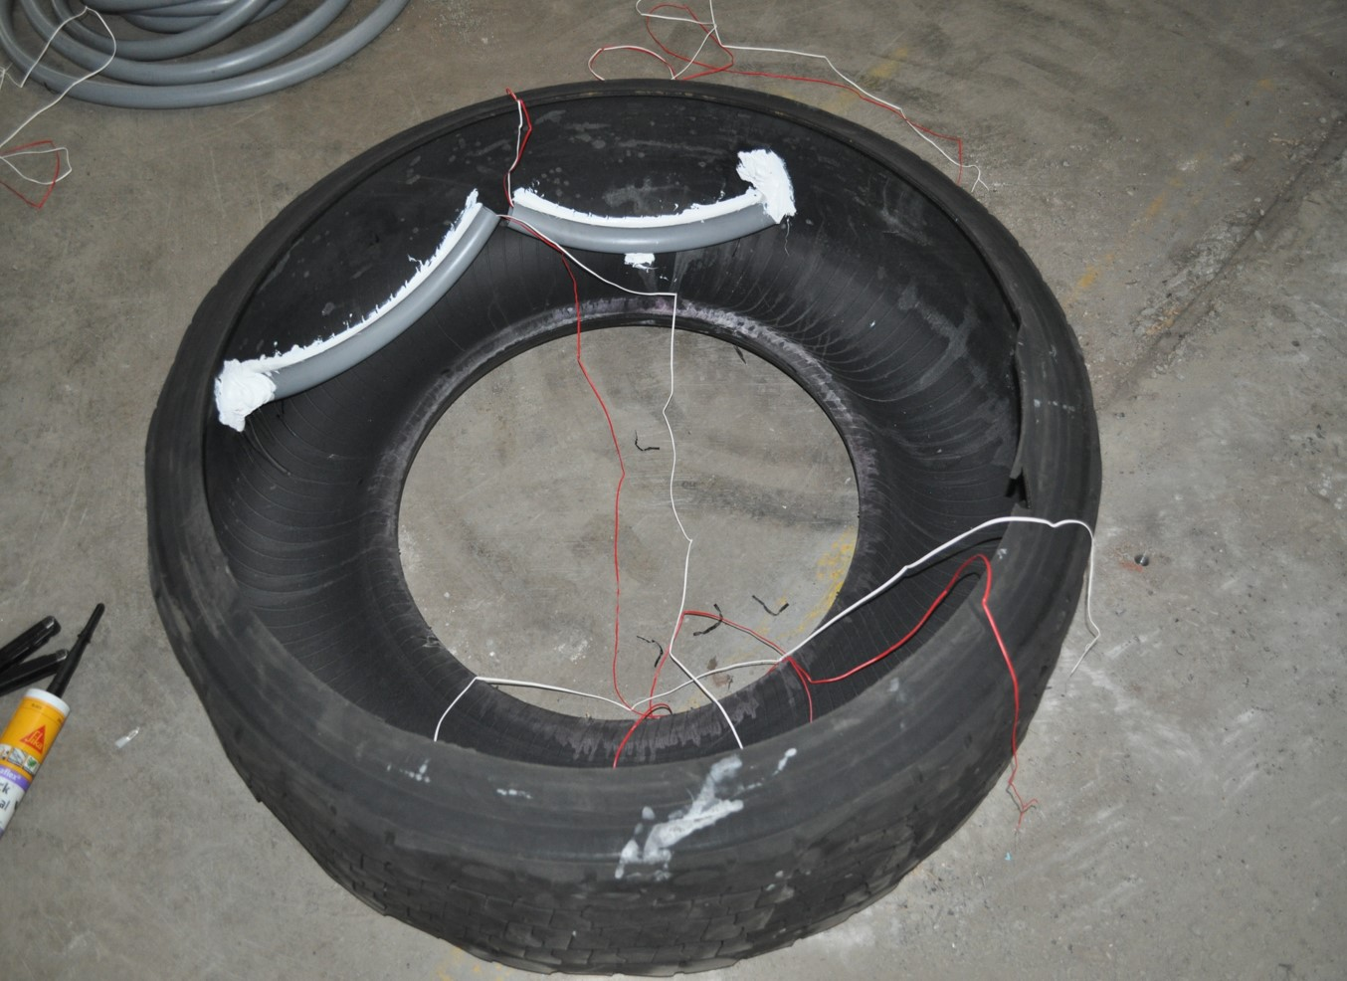
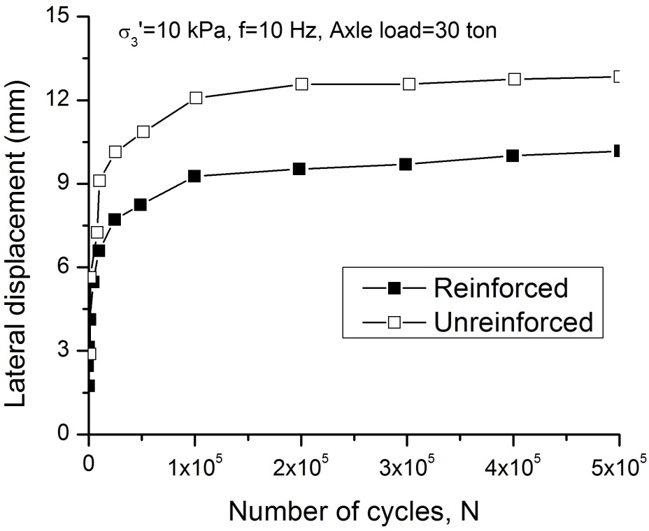
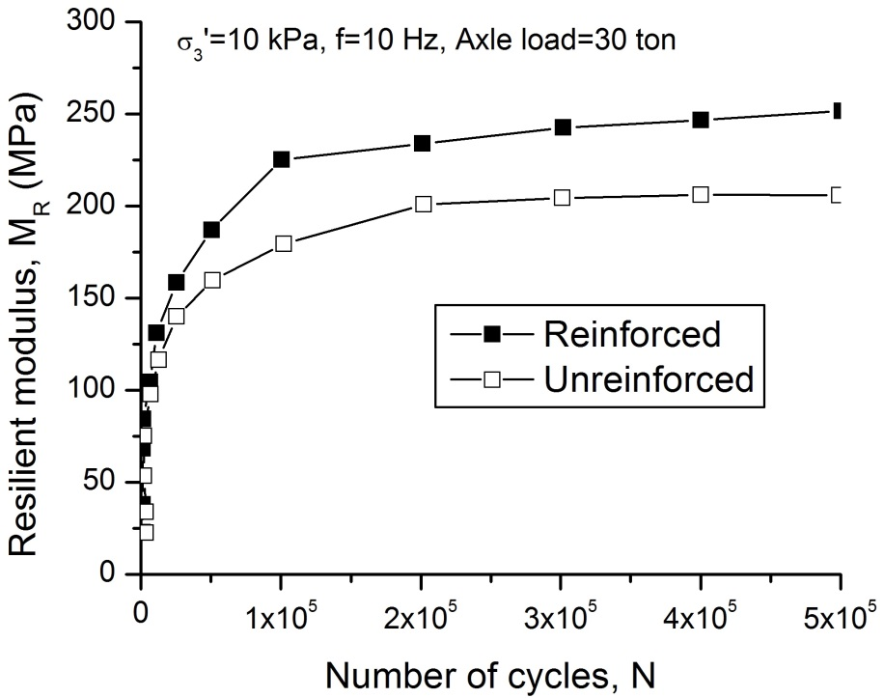
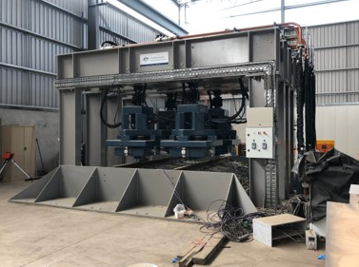
Beta-testing through 1:1 scale physical modelling at National Facility for Dynamic High-speed Rail Testing
Strain gauges bonded in a Tyre
Instrumentation in Sub-ballast
Installation of Tyre Assembly
Concept of Infilled Rubber Tyre Assembly
Dynamic Load Actuators
Dynamic Loading of Tyre-Track
2

Slide 3
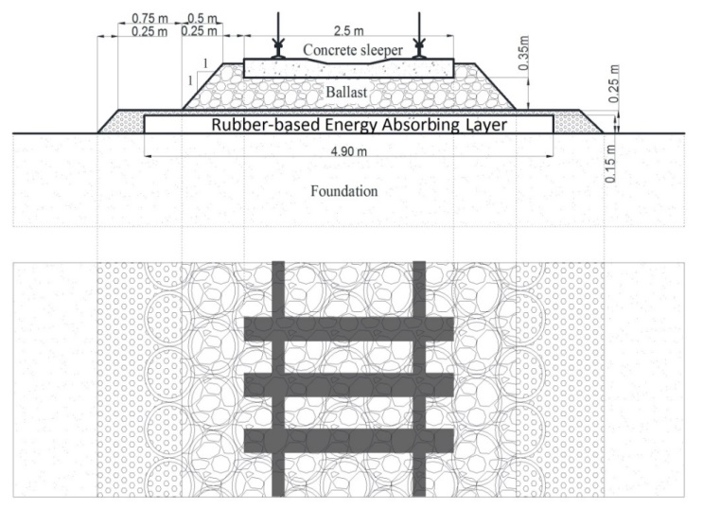
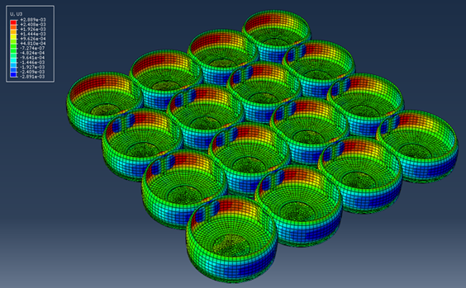
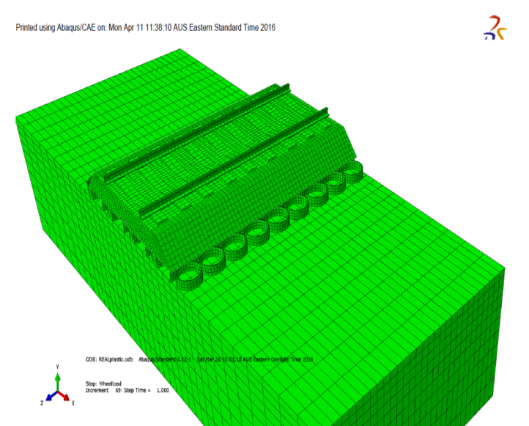
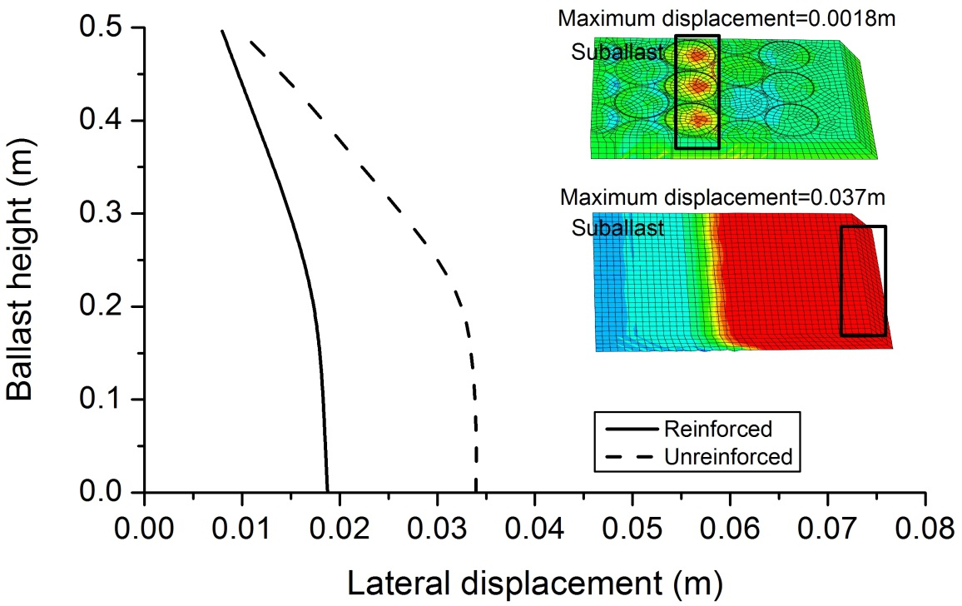
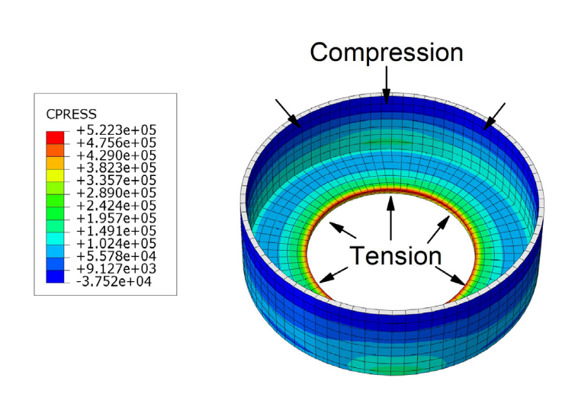
Finite Element Modelling of Recycled Tyre-reinforced Tracks
Plan view of a typical track with waste tyres
Almost 50% reduction in lateral displacement of ballast due to additional confinement from rubber tyre assembly
Indraratna, Sun & Grant (2017)
Transportation Geotechnics, Vol. 12, 26-36.
3

Slide 4
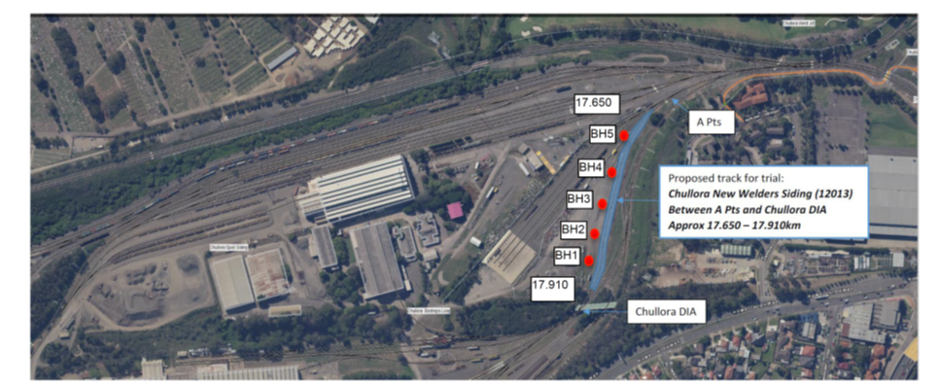
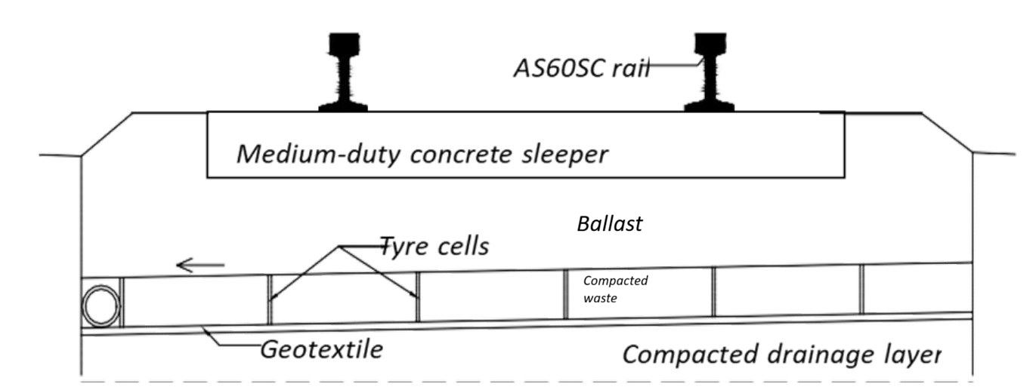
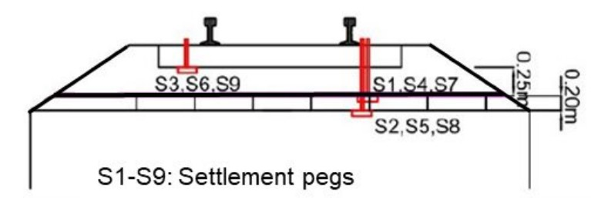
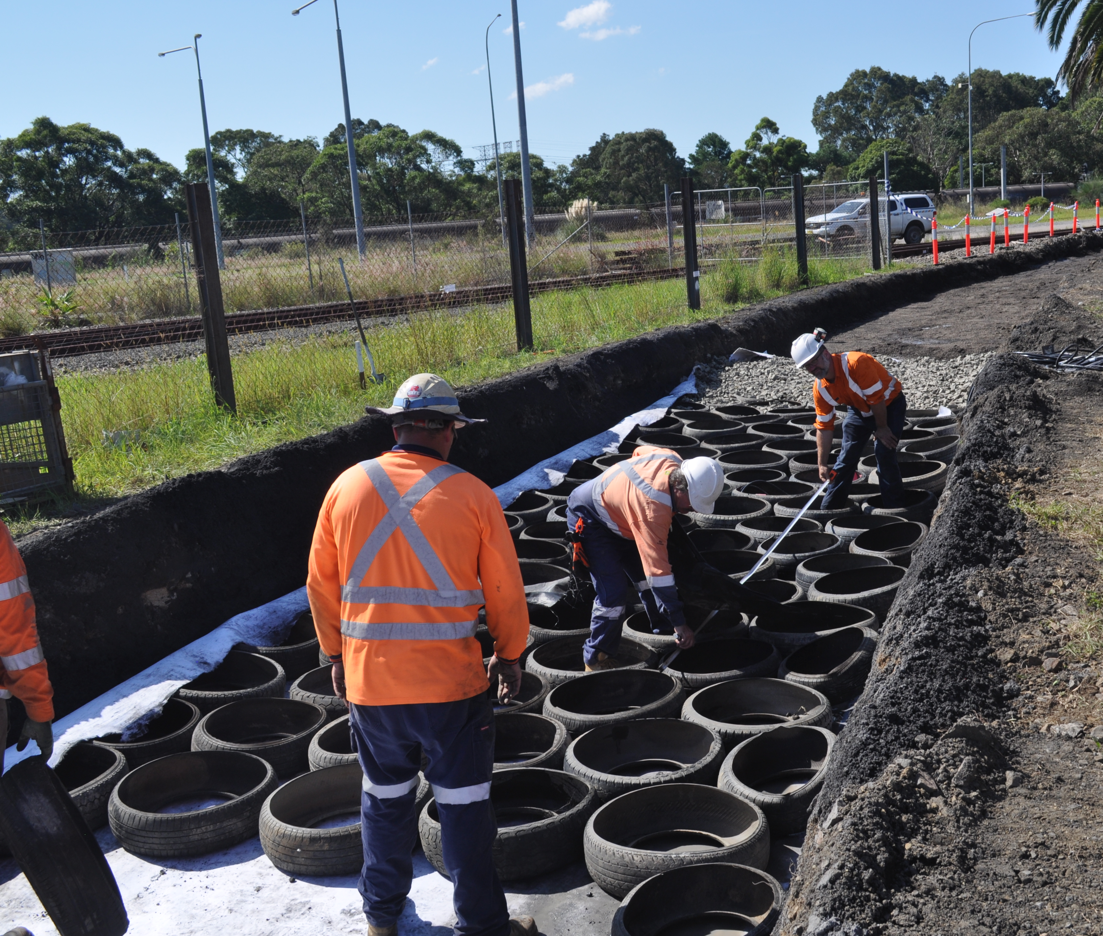
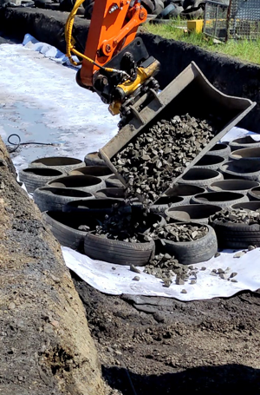
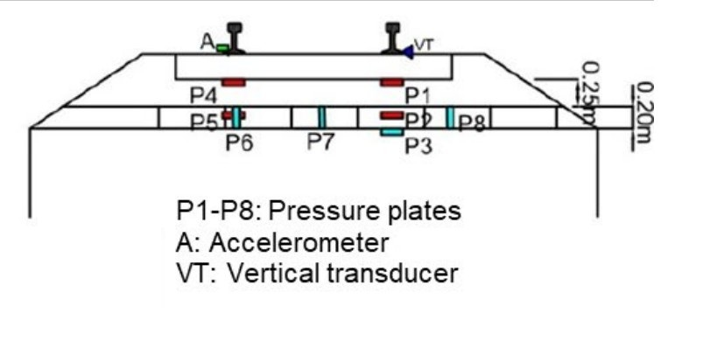
Field Implementation of 2-REAL in Western Sydney
Track design with 2REAL
Instrumentation
Placement of tyre cells
Filling tyre cells with waste materials before compaction

Slide 5
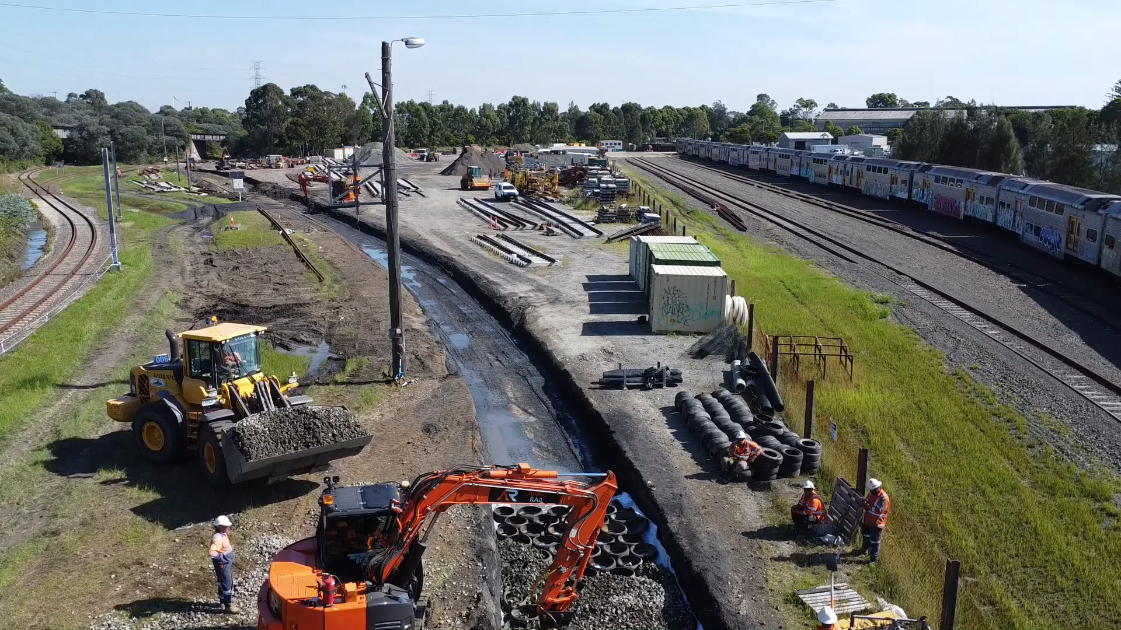
Recycled-Rubber Energy Absorbing Layer (2REAL) as Track Foundation
(Indraratna et al., 2022)
Tyres can be infilled with waste materials (e.g., discarded stones and gravel, crushed glass, concrete aggregates from demolition yards)
Drone video of Rubber Tyre Track Construction
5

