Slide 1





Instrumented Bi-Directional Static Load Testing (BDSLT) on Large Diameter Hand-dug Caisson via Distributed Fiber Optic Sensor (DFOS)
Mr. Ang Koh An
Founder of GDS Instruments Sdn Bhd
https://smartsensing.com.my

Slide 2
Abstract
The utilization of Bi-Directional Static Load Testing (BDSLT) in conjunction with fiber optic technology has emerged.
Caisson piles are frequently used in structures necessitating substantial foundation support and in project locations inaccessible to heavy machinery.
This study presents case studies conducted in Pahang, Malaysia, where caisson 4000mm in size were constructed.
Instrumented BDSLT tests were conducted on these piles with test loads reaching up to 238,000 kN.

Slide 3
Introduction
This paper describes the successful application of the DFOS systems to measure the strain within hand-dug caissons during the BDSLT and its corresponding interpretation of the continuous strain profile.

Slide 4
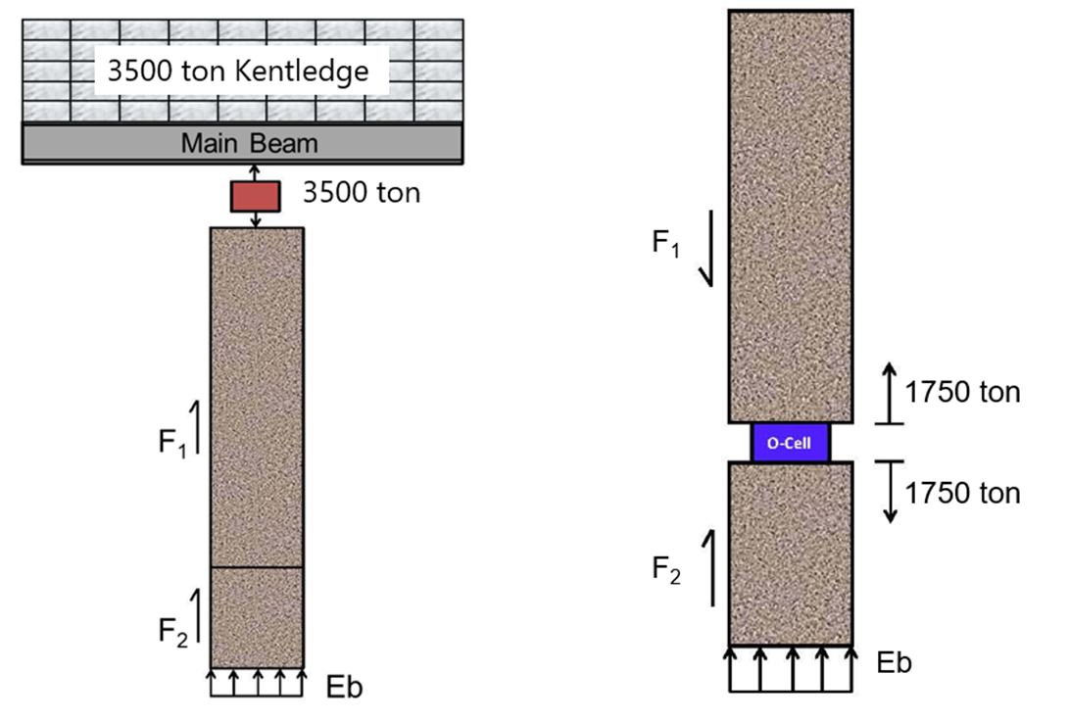
General Principle
Bi-Directional Static Load Test (BDSLT)
Jack Top
Hydraulic Jack
Jack Bottom
Kentledge Method
BDSLT

Slide 5
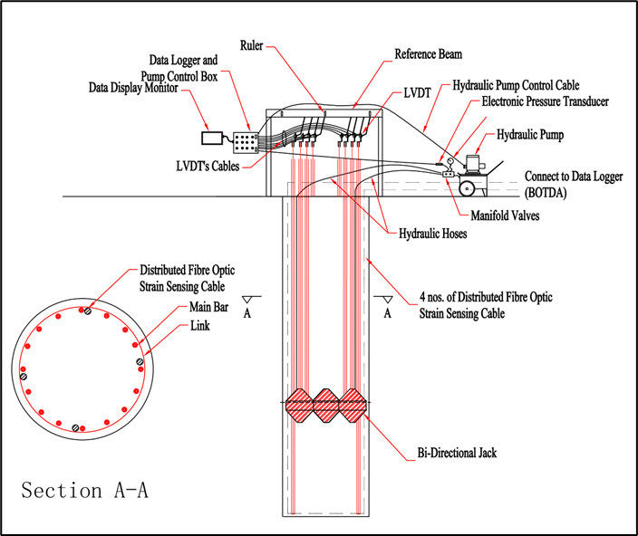
General Principle
Bi-Directional Static Load Test (BDSLT)
Typical Schematic Diagram of Bi-Directional Static Load Test

Slide 6
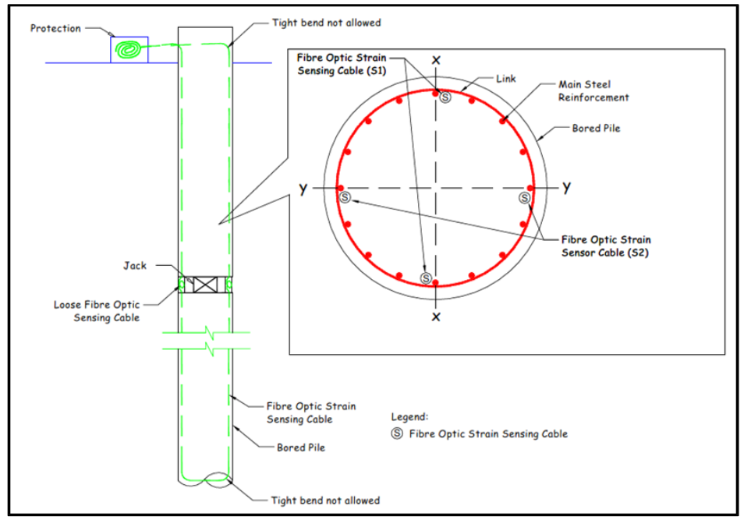
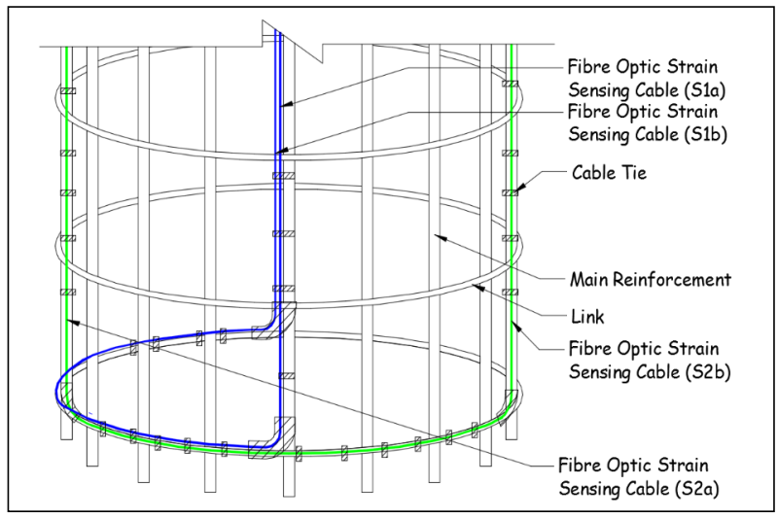
General Principle
Distributed Fiber Optics Sensors (DFOS)
DFOS is used to measure deformation, which is then used to calculate through analysis the friction of the pile shaft and pile end bearing.
Configuration of Fibre Optic Sensing Cable in Caisson Pile
Detail at the bottom cage

Slide 7
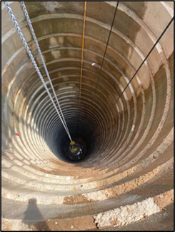
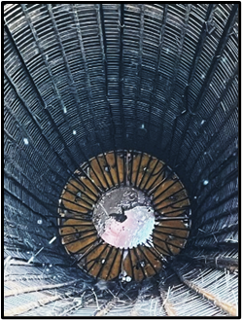
General Principle
Hand-dug Caisson Pile
The heavy machinery is impractical due to access restrictions or the need to minimize vibrations that could affect nearby structures.
Caisson pile’s concrete lining
Bi-Directional Jack in Caisson Pile

Slide 8
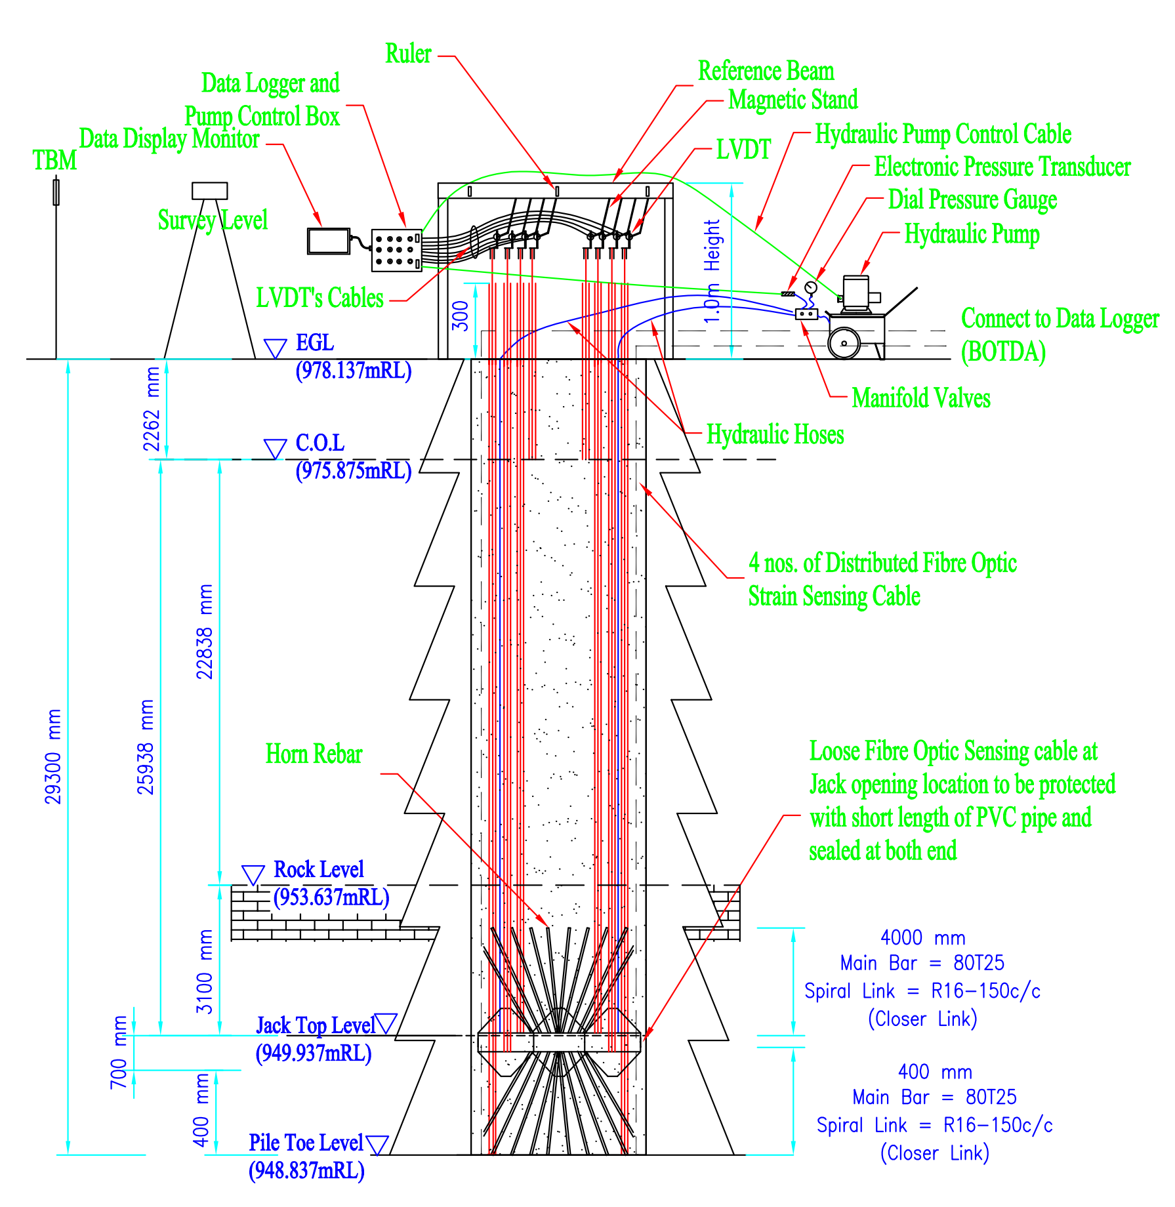
Methodology
Instrumented BDSLT on Hand-dug Caisson Pile with Rock Socket

Slide 9
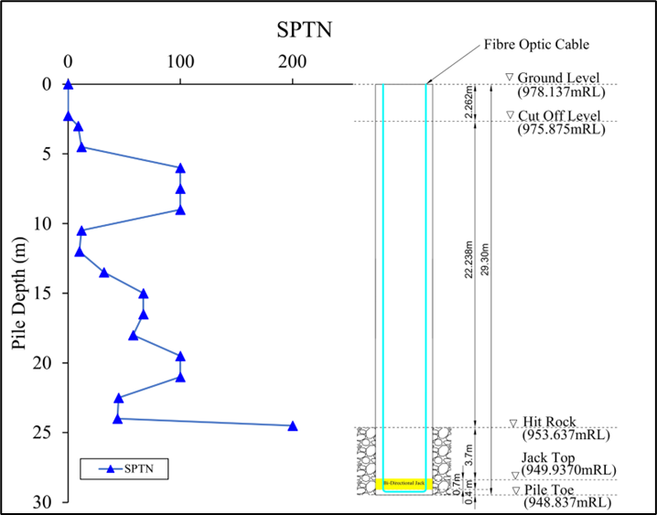
Methodology
Geological Information
Depth(m) | SPT N Value
0.00-2.26 | Empty Bore
2.26-24.00 | < 100
24.00-24.50 | > 200
24.90-29.30 | RQD > 57%
Geological Information of Pile Location

Slide 10
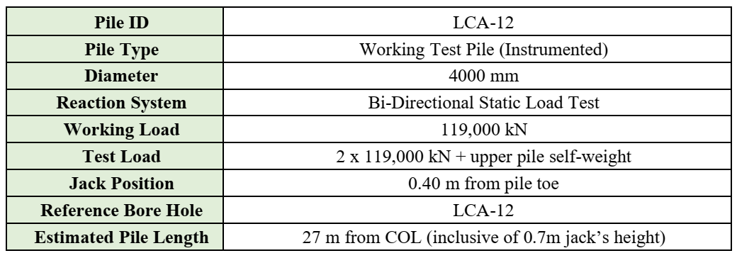
Methodology
Test Pile Information

Slide 11
Methodology
Testing Procedures and Criteria
ASTM D8691/D8691M-18 (Standard Test Methods for Deep Foundations Under Bi-Directional Static Axial Compressive Load).
Designed to a factor safety of 2.
The pile settlement is not more than 0.0625mm per 15 minutes, or 0.25mm per hour.

Slide 12
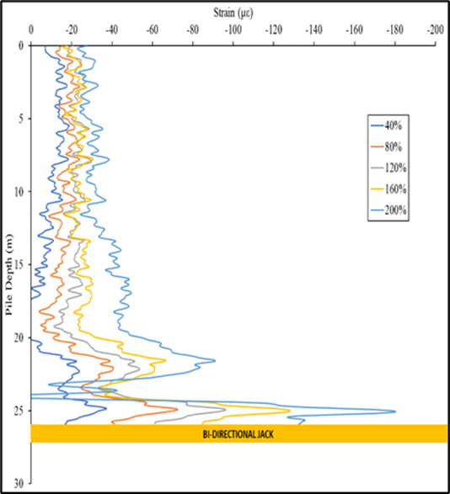
Data Analysis
Strain profile, load transfer curve, mobilized shaft friction and mobilized end bearing
Localized lower strain detected in between 22m to 24m depth.
Change in strain during BDSLT

Slide 13
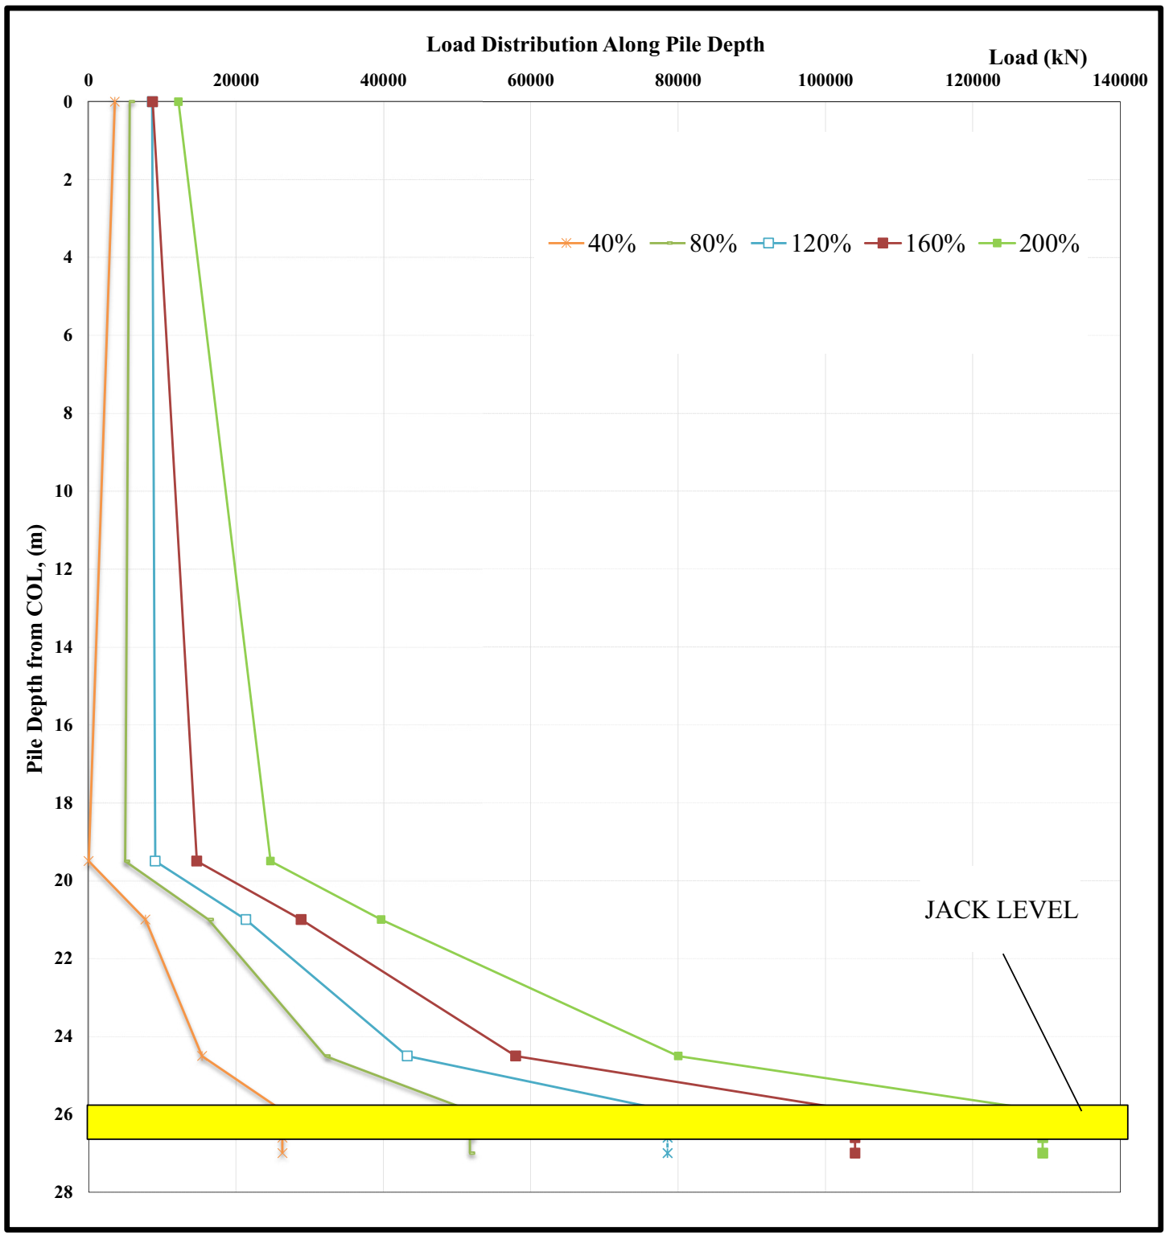
Data Analysis
Strain profile, load transfer curve, mobilized shaft friction and mobilized end bearing
The strain value below the jack were ignored since the stress were not distributed uniformly.
This method is supported by Hayes et al. [4].
Load distribution along test pile

Slide 14
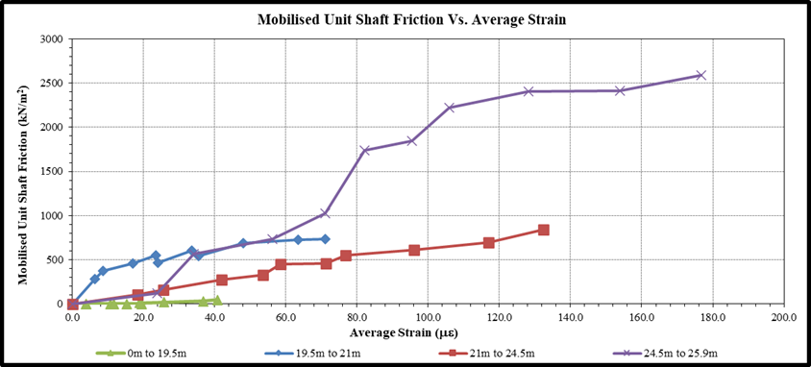
Data Analysis
Strain profile, load transfer curve, mobilized shaft friction and mobilized end bearing
The maximum shaft friction recorded was 2586 kN/m².
In the hard layer (19.5 to 21.0 m), the shaft friction was 733.8 kN/m².
In the rock layer (21.0 to 24.5 m), the shaft friction was 842.2 kN/m² .
Mobilized Unit Shaft Friction (Upper Pile Section) against Average Strain

Slide 15
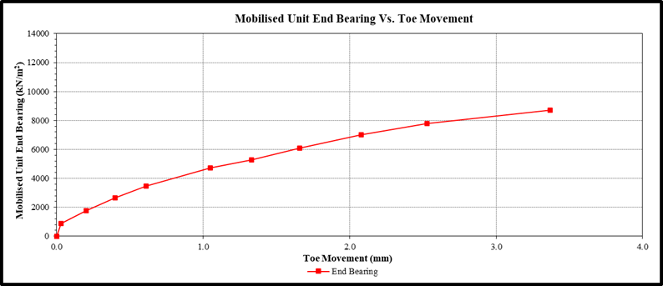
Data Analysis
Strain profile, load transfer curve, mobilized shaft friction and mobilized end bearing
The mobilized end bearing was 8712.6 kN/m² up to maximum test load.
Mobilized Unit End Baring against Toe Movement

Slide 16
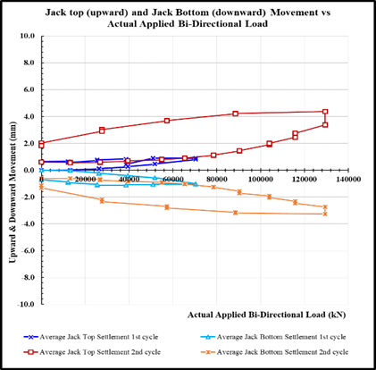
Data Analysis
Pile movement
At 200% working load, the upper pile exhibited a movement of 4.38 mm.
While the lower pile section was 3.26 mm.
Upward and Downward movement

Slide 17
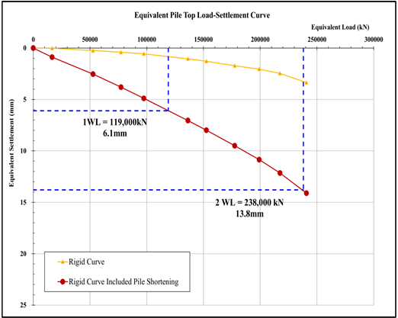
Data Analysis
Pile movement
The maximum equivalent pile top settlement at 200% working load (238,000 kN) is 13.8mm.
Equivalent Top Settlement Curve

Slide 18
Conclusion
This test has yielded significant insights into the pile behavior under load conditions, particularly in challenging granite formations characteristic of hilly areas.
The test results for the hand-dug caisson with a rock socket (RQD>50%) achieved mobilized shaft friction of approximately 2586.0 kN/m².
The adoption of Distributed Fiber Optics Strain Sensing (DFOS) in instrumented load testing offering several distinct advantages over conventional strain sensing methods.

Slide 19
References
[1] Soga, K; Kwan, V; Pelecanos, L; Rui1, Y; Schwamb, T; Seo, H and Wilcock, M. (2015) "The Role of Distributed Sensing in Understanding the Engineering Performance of Geotechnical Structures". Proceedings of the XVI ECSMGE Geotechnical Engineering for Infrastructure and Development, Keynote Paper, pp13-48.
[2] Federation of Piling Specialists (FPS). (2006) "Handbook on Pile Load Testing".
[3] Annamdas, V.G.M. (2011) "Review on Developments in Fiber Optical Sensors and Applications". International Journal of Materials Engineering, vol.1(1), pp1-16.
[4] Hayes, J., & Simmonds, T. (2002). “Interpreting Strain Measurements From Load Tests In Bored Piles”.
[5] Loadtest (2001). “Construction Of The Equivalent Top-Loaded Load-Settlement Curve From The Results Of An O-Cell Test”.

Slide 20
THANK YOU

