Slide 1
Sustainable Solutions backed by industry leading R & D
Jacek Kawalec

Slide 2
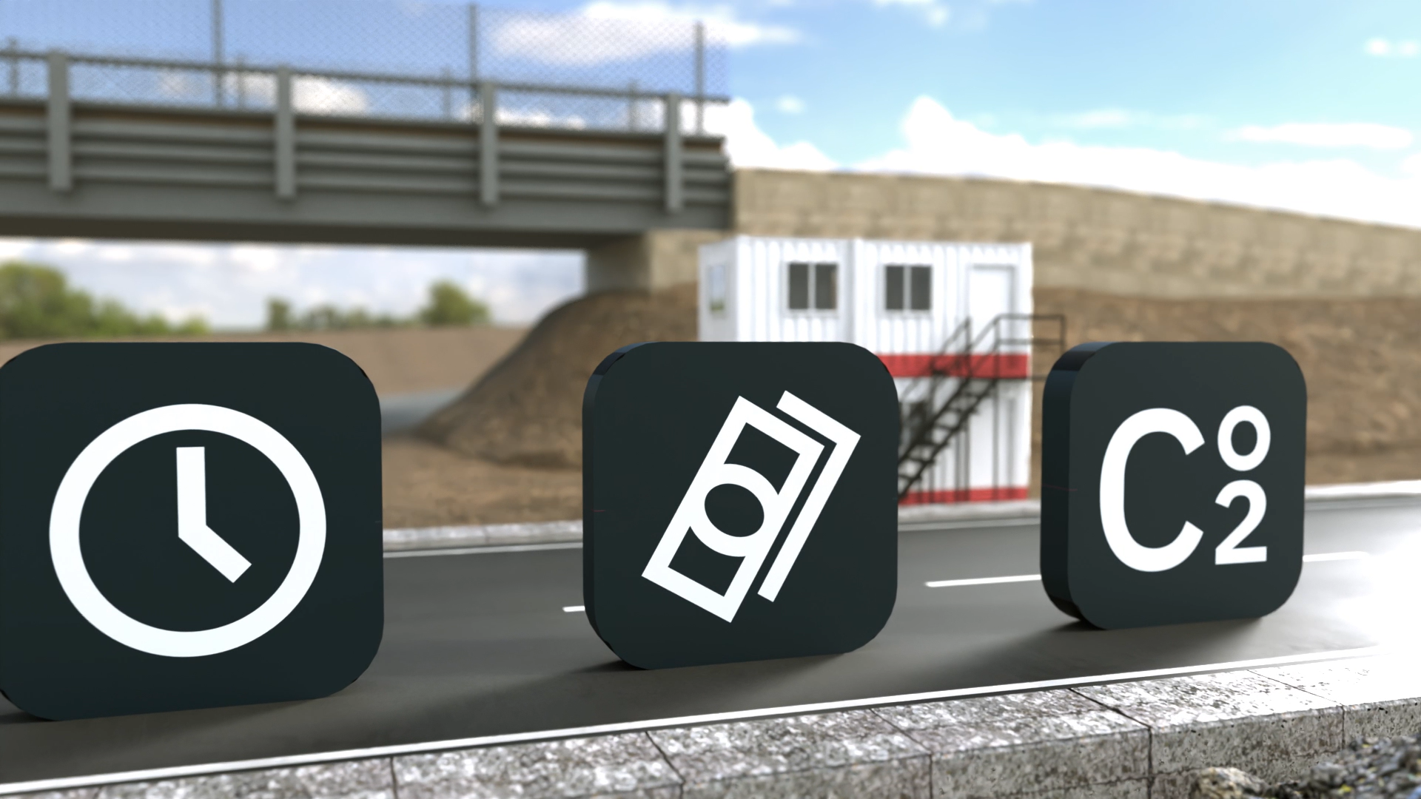

Slide 3
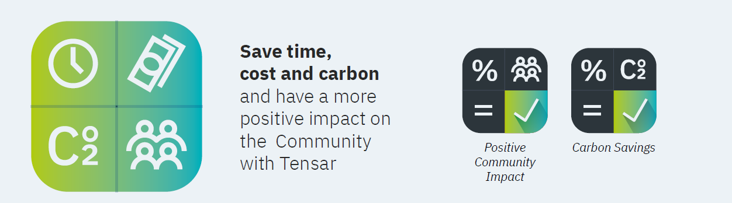
Sustainability delivered
Manufactured using 100% renewable energy
Temp works? Why not recycle!
Reduced time, reduced aggregate = Reduced CO2!

Slide 4
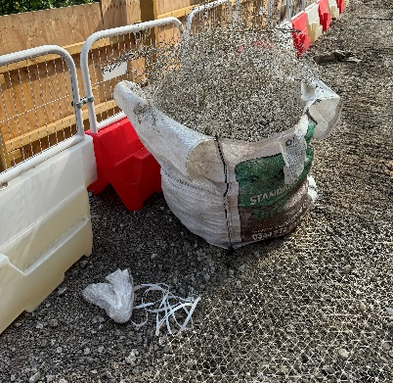
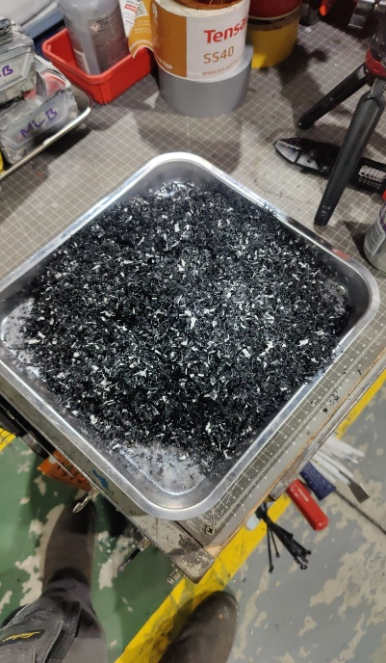
Tensar geogrids can be removed and recycled!!!
All of Tensar’s geogrids and geocomposites can be removed and recycled. This reflects our dedication as market leaders to meet customer needs and support environmentally responsible practices.
Exhumed InterAx NX850
Recycled granulated InterAx NX850
Notes:
How to remove and recycle a Tensar geogrid
1. Remove Excess Aggregate: Remove as much aggregate as possible from above the geogrid, leaving no more than 50mm of aggregate on the grid. Contact your aggregate supplier to explore recycling options or repurpose the material for another project.
2. Remove the Geogrid: Use a digger/excavator bucket to hook underneath the nearest section of the geogrid by inserting the teeth through as many apertures as possible to extract carefully. Alternatively use a grapple type attachment to grab the geogrid and/or geocomposite; Pull upwards while shaking the grid to dislodge any aggregate that remains interlocked with the grid. Repeat this process until the entire geogrid has been removed.
3. Transport to Recycling Centres: Place the removed geogrid into an open-top skip/dumpster. Compact the removed grid to optimise shipping and minimise transport trips, reducing CO₂ emissions. Compaction can be done using bundling equipment or by placing heavy equipment (e.g., an industrial weight or digger bucket) on the grid while in the skip/dumpster.
4. Additional Tips for Efficient Transport:
An open-top skip is recommended, during excavation and storage on site as exposure to rain can help wash off residual dirt/ aggregates.
Ensure the skip is covered during extended periods of storage to prevent the grid from being blown away.
5. Recycle the Geogrid: Send the compacted geogrid to the nearest industrial polypropylene recycling facility. Some facilities may offer monetary compensation for the material.
Once transported, the geogrid is typically cleaned and processed into granules (see figure 2 as an example), to be made ready for reuse in new products.
Recycling and end-of-life options
Polypropylene and high-density polyethylene, the primary materials in Tensar geogrids, are widely recyclable and versatile. They can be repurposed into numerous everyday products, such as garden furniture, bottle caps, and automotive components. Tensar is considering various options for improving the circularity of its products, including moving towards a cradle-to-cradle approach.
Tensar geogrid and geotextile products are recyclable and can be repurposed into other non-Tensar items. However, current UKCA and CE marking regulations prevent the recycling of post-consumer geosynthetics into new geosynthetics with the same functional properties.
If you are interested in discussing recycling options for geogrids, please contact tensarsustainability-uk@cmc.com.
For Recycling
The products must be processed into sizes compatible with the selected recycling plant and be reasonably free from contaminants such as vegetation, soil, cement, or bitumen-bound materials. Depending on the region, some recycling facilities may offer to collect post-consumer geogrids directly from the site for recycling.
Leaving In Place
If removal of the geogrid is not necessary, Tensar advises leaving it in place. This approach retains the stabilisation benefits over the long-term and is often the most environmentally friendly option. Leaving the geogrid in place avoids the potentially significant carbon footprint associated with exhuming, transporting and processing of the geogrid.
Incineration
Incineration with energy recovery is a viable solution for materials unsuitable for recycling. Total combustion of polypropylene produces only water vapor and carbon dioxide. If incineration is not fully optimized, by-products such as soot, carbon monoxide, and small quantities of hydrocarbons may form. The product can be incinerated in standard waste disposal plants without requiring special flue gas controls. With a high heat content of approximately 44.0 MJ/kg (comparable to light fuel oil at 42.5 MJ/kg), polypropylene can serve as an efficient fuel substitute in solid fuel furnaces through co-combustion methods.
Landfill
Tensar products are non-hazardous and can be disposed of in landfills following local regulations. They do not produce leachate or cause environmental harm when landfilled.
End of Life Tensar geogrids are inert and environmentally safe. Tensar encourages recycling its products and associated waste wherever regional facilities allow. However, in cases where recycling isn’t feasible, the geogrids’ inert nature ensures minimal environmental impact.

Slide 5

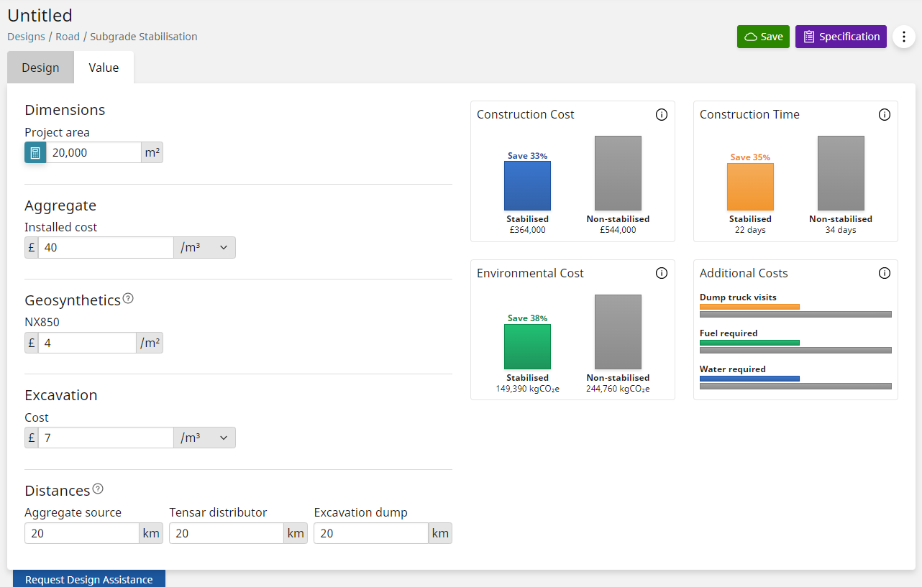
Tensar+ Value – Environmental Cost
Notes:
Reducing the thickness of construction with an MSL reduces the amount of construction materials which are often “carbon rich”. The calculations take into account the sources, delivery and installation operations for the component parts and again offer a comparison between the MSL and the non-stabilised thickness shown.

Slide 6
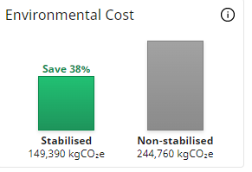
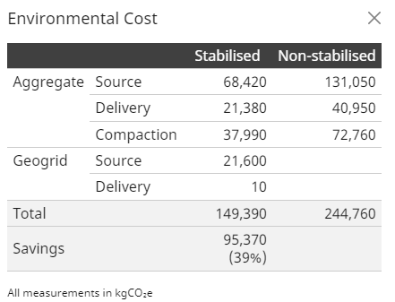
Tensar+ Value – Environmental Cost
Notes:
Environmental costs use universal references – Univ of Bath Inventory of carbon for example for the aggregate, delivery and compaction values. EPD values for the TX geogrid component and the recently awarded EPD’s for NX will be included soon. Geogrid delivery doesn’t include transport from Blackburn into Europe or across the world at the moment but it will soon.
The component breakdown behind the “i” button show in most cases how small a component the geogrid actually represents and how important reducing aggregate thickness can be.

Slide 7
Case Studies

Slide 8
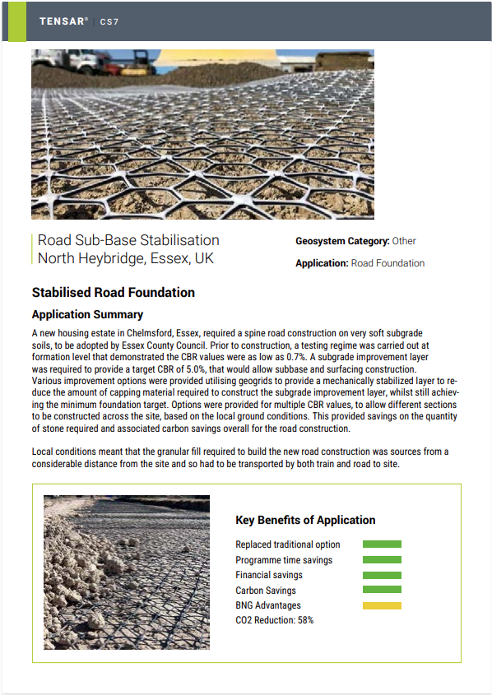
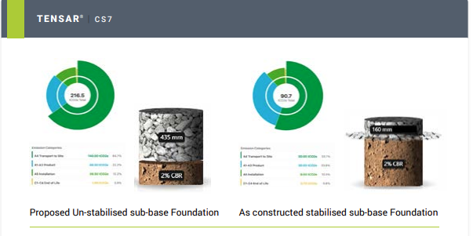

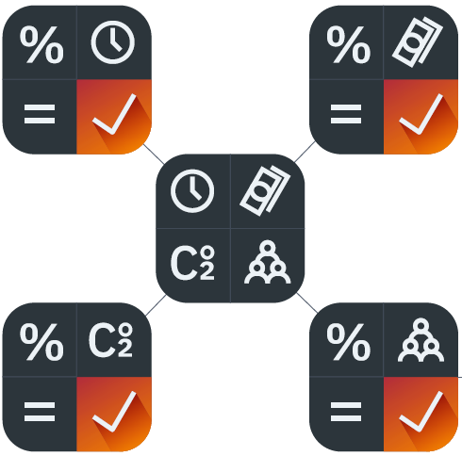
Road Foundation
58% CO2 Reduction

Slide 9
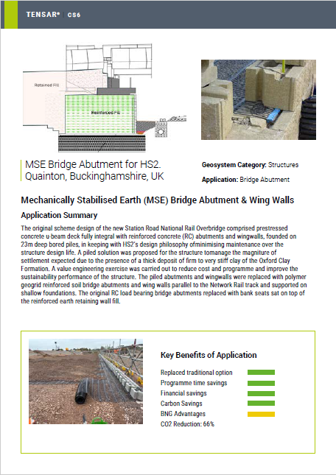
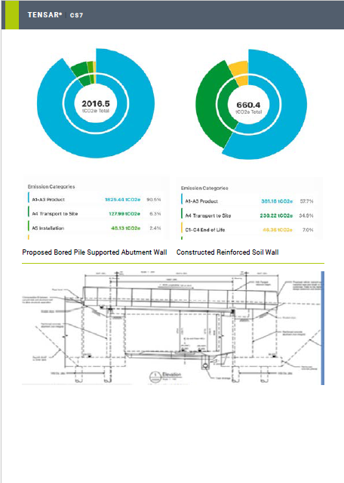
Bridge Abutment
66% CO2 Reduction

Slide 10


Access the Presentations
and inquire more

