Slide 1



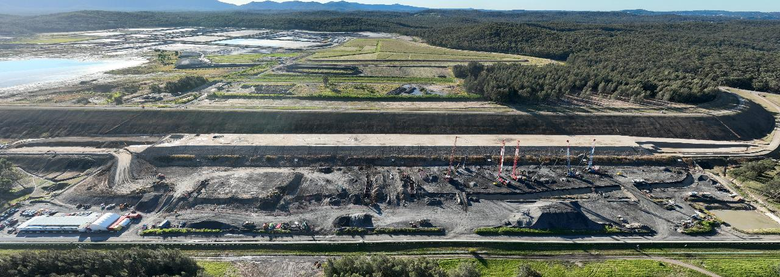
TAILING STORAGE FACILITIES (TSFs) GROUND STABILISATION

Slide 2
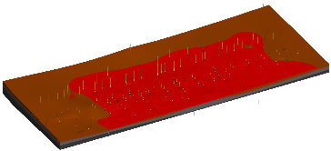
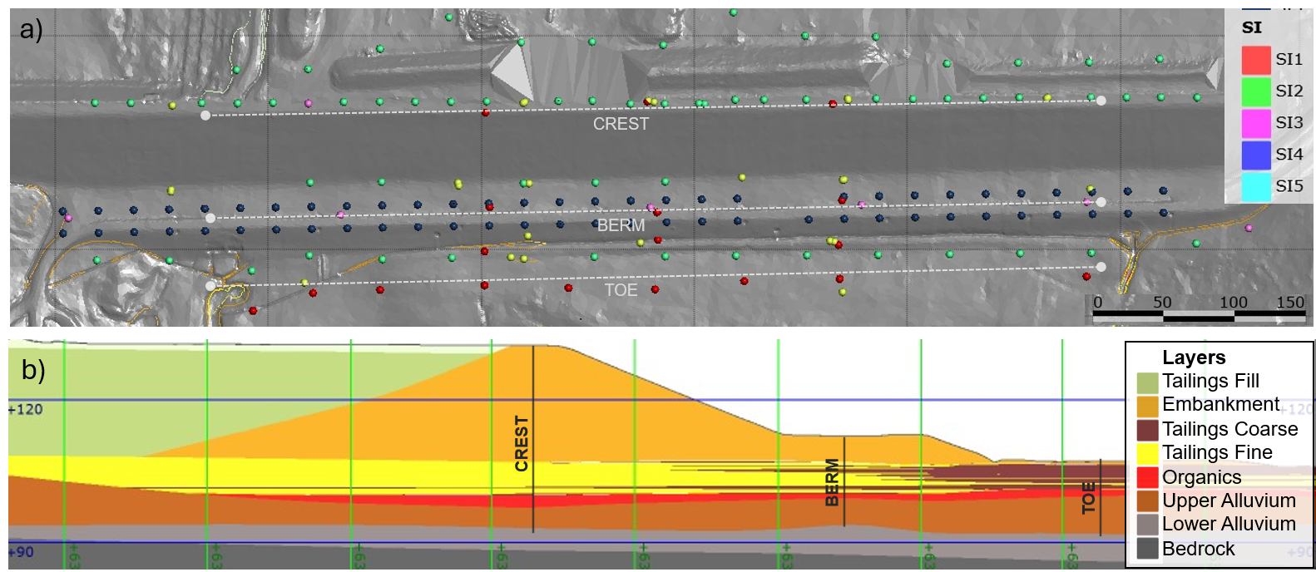
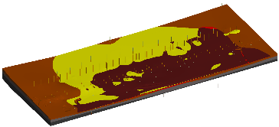
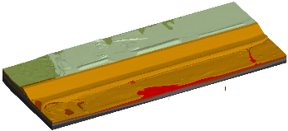
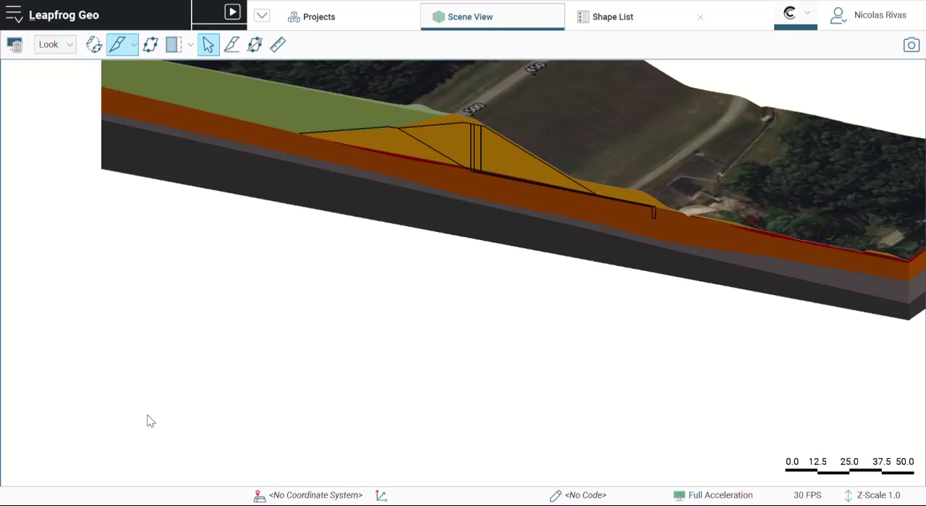

Organics
Fine and coarse Tailings
Key Numbers
SI
  206 CPTs, 37 BHs, 35 TPs
  + additional VST, BPT

Slide 3
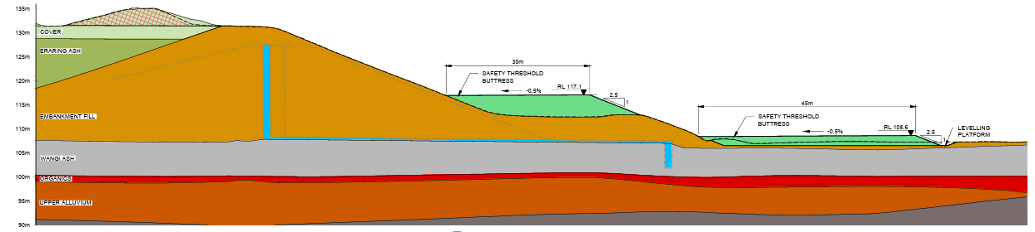
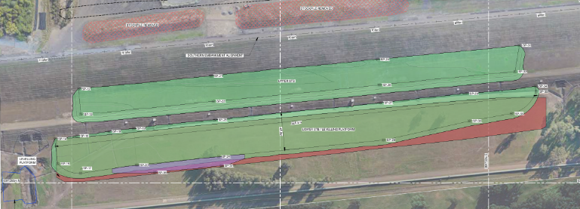
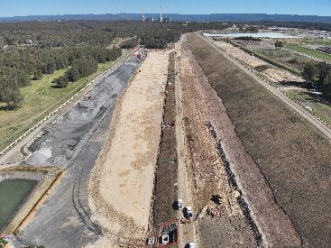


Early Works: Safety Threshold Buttress
Tailings
Tailings

Slide 4
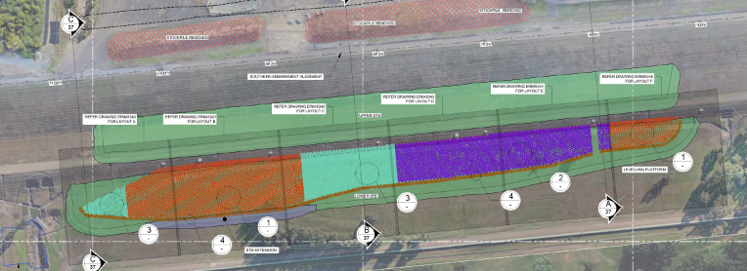
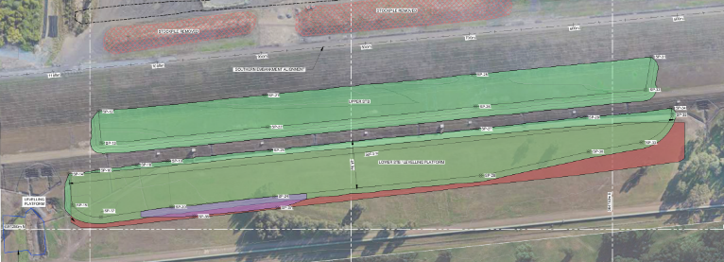
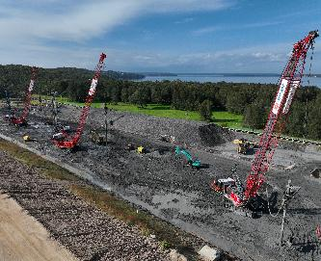

Stone columns
Key Numbers
6454 Total Stone Columns
97km of Stone columns
131,000T
Tailings
Tailings

Slide 5
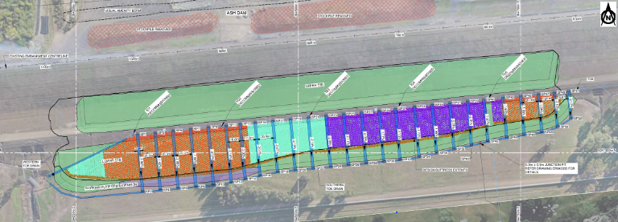
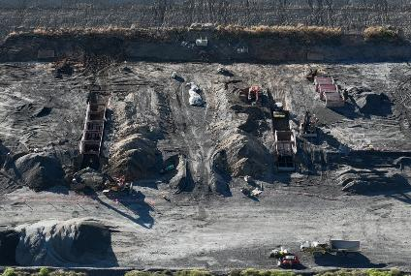
Drainage
Key Numbers
26 Finger Drains connected to existing Drainage Blanket
New Toe Drains Installed
2.2km of Drainage works
Tailings
Tailings

Slide 6
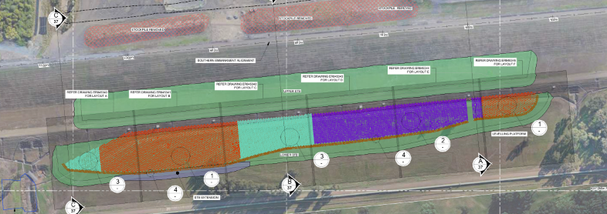

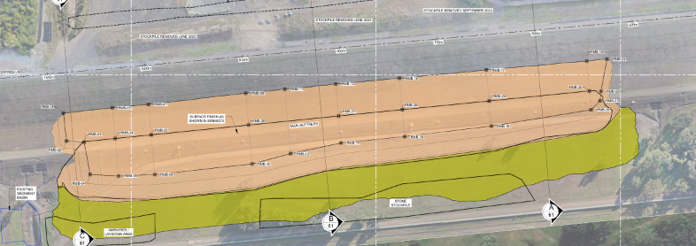
Main Buttress Works – Earthworks
Key Numbers
220,000m³ of Conglomerate to be placed and compacted.
Estimated 24,000 40T moxy movements
Tailings
Tailings

