Slide 1

Young Members Presidential Group
(YMPG)
Progress Report
Period: March 2014 – September 2014
ISSMGE Board Meeting
12 September 2014
Goiania, Brazil
Notes:
1

Slide 2
YMPG Membership
Notes:
2

Slide 3
Membership
Membership was finalized in December 2013 [Confirmed]
  3 members from each region, nominated by the regional VP, and 1 Chair, appointed by the Board (19 members total)
  Restricted to ISSMGE members younger than 35 years of age at the time of appointment
  2-year terms, but can be renewed
YMPG Executive Leadership Team finalized in February 2014 [Confirmed]
  Elections were held for the Vice-Chair and Secretary positions, to help assist the Chair

Slide 4
Membership
Chair:
Jennifer Nicks
Vice-Chair:
Aleksandra Chepurnova
Secretary:
Juan Ayala
Board Liaisons:
Roger Frank
Paul Mayne
Fatma Baligh
Region | Name | Country
Africa | Sherif Adel Yahia Akl | Egypt
 | Mohamed Elbyhagi Elfadil | Sudan
 | Abdou Xaadir Gaye | Senegal
Asia | Ilhan Chang | Korea
 | Janaka J. Kumara | Japan
 | Lucy Wu | Hong Kong
Australasia | Martin Barrientos | New Zealand
 | Ross Kristinof | Australia
 | Darshan Leckraz | Australia
Europe | Aleksandra Chepurnova | Russia
 | Sabatino Cuomo | Italy
 | Felix Jacobs | Germany
North America | Julian McGreevy | Canada
 | Mehdi Omidvar | USA
 | Cassandra Rutherford | USA
South America | Juan Ayala | Chile
 | Marcelo Heidemann | Brazil
 | Marcos Montoro | Argentina
Notes:
Statistics:
- 80% Male; 20% Female
- 50% Academic; 50% Practitioner

Slide 5
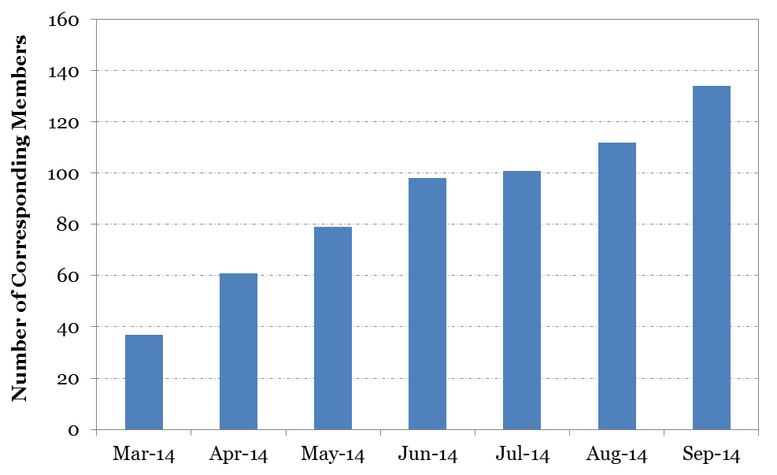
Corresponding Members (CM)
Unlimited; open to anyone
Currently at 134 people [~250% increase from March]

Slide 6
Completed Activities
Notes:
6

Slide 7
Completed Activities
Refined our name [YMPG] and mission statement
Developed a work plan and established task forces to accomplish the objectives
Task Force | Chair | Objective(s)
Communications & Marketing | Marcos Montoro | To communicate and promote S/YM and YMPG activities and events of interest
Membership | Julian McGreevy | T0 increase the number of CMs within the YMPG and promote networking amongst YMs
Motivation Mechanisms | Mehdi Omidvar | To develop motivation mechanisms to encourage more S/YM involvement within the ISSMGE
Website | Lucy Wu | To update and maintain the web-presence of the YMPG

Slide 8
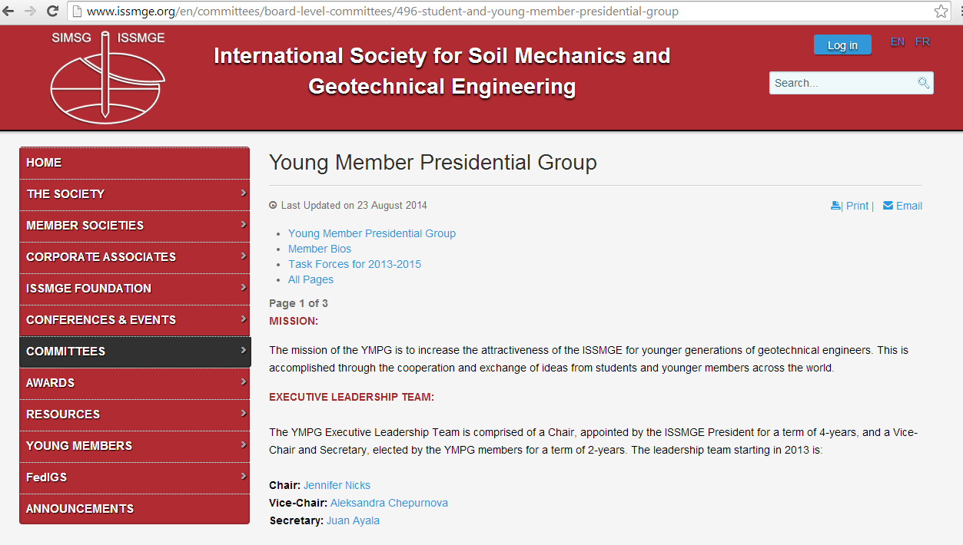
Completed Activities
Updated the ISSMGE YMPG website with our membership and terms of reference

Slide 9
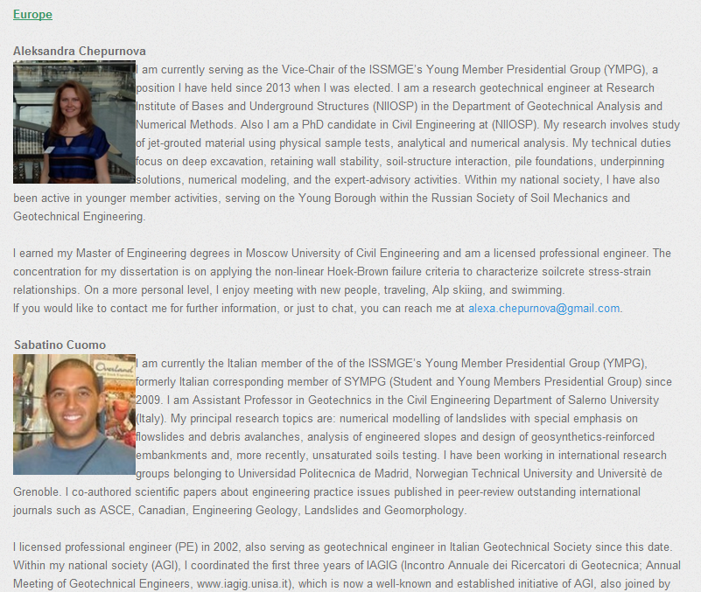
Completed Activities
Added YMPG member bios to the ISSMGE website to communicate our background and technical interests and open the door for outreach by YMs

Slide 10
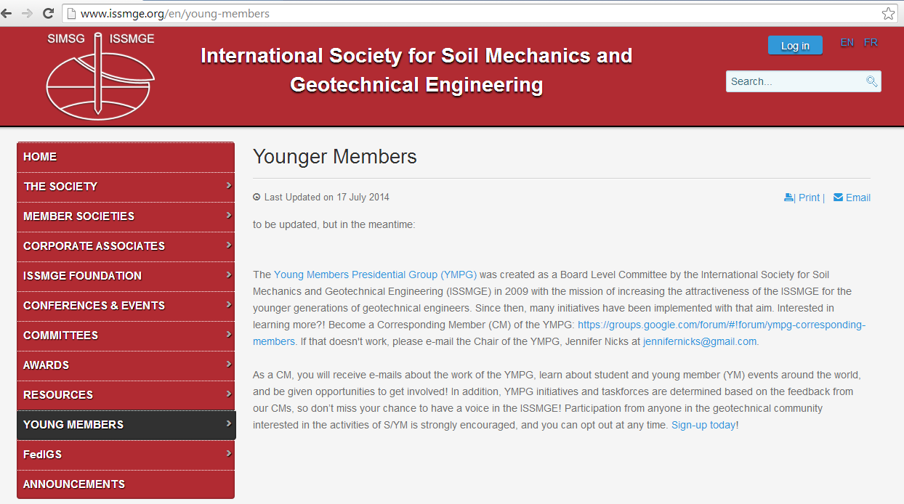
Completed Activities
Developed a CM listserv
  https://groups.google.com/forum/#!forum/ympg-corresponding-members
Included information on how to become a CM on the ISSMGE website

Slide 11
Completed Activities
Established Board Level Committee Liaisons
Initiated communication with the Young Members Committee of the International Geosynthetics Society
  YMC to share CM link to their members
  YMC to contribute articles to the Bulletin’s YM Arena
BLC | YMPG Liaison
AWAC | Cassie Rutherford
CAPG | Julian McGreevy
IDC | Lucy Wu
PIC | Janaka Kumara
TOC | Jennifer Nicks

Slide 12
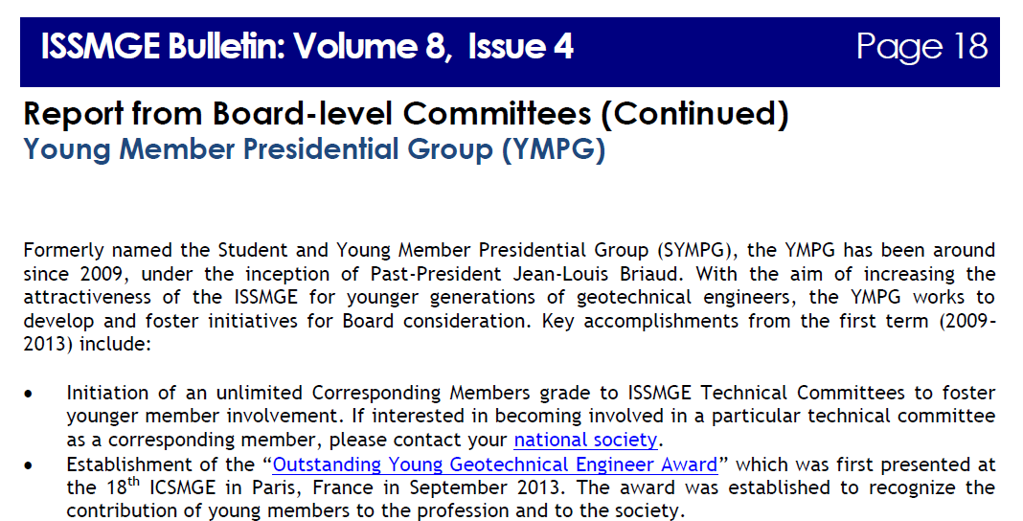
Completed Activities
Published a YMPG article in the August 2014 issue of the ISSMGE Bulletin

Slide 13
Ongoing and Planned
YMPG Task Force Activities
Notes:
13

Slide 14
Communications & Marketing Task Force:
YM Publications
Purpose
  Develop guidance for publishing articles related to research, case histories, technical notes, etc.
Progress
  Finalizing guidelines for submissions to the ISSMGE Bulletin Young Members’ Arena
  Plan to communicate the need for submissions by soliciting select individuals (e.g. the previous YM award winners, iYGEC outstanding presentation winners, etc.), issuing a broad call to CMs, and posting on the ISSMGE website
  First submission to the YM Arena is planned for the October issue

Slide 15
Communications & Marketing Task Force:
YM Webinars
Purpose
  Organize webinars for the YM audience to communicate technical achievements and provide opportunities for presentation
Progress
  Developing a list of YM webinar topic ideas
  Brainstorming ideas for coordinating presentations with Young Members’ Arena articles

Slide 16
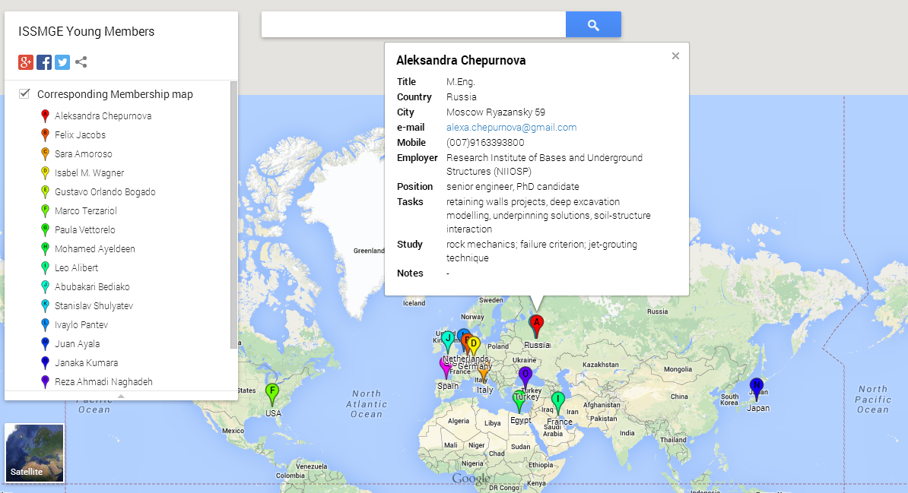
Membership Task Force:
Membership Map
Purpose
  An interactive geographical and technical map of YMPG and CMs to highlight potential links and collaborations between academics, students, practitioners, and researchers, etc.
Progress
  Continuing to solicit and add content
  Will add layers for filtering specific details
  Upload to the website

Slide 17
Membership Task Force:
Geotechnical Topics List and Mentorship
Purpose
  Provide students and younger members with opportunities to connect with mentors and with a reason to stay connected with the ISSMGE
Progress
  Topics list has been prepared and will be uploaded to the YMPG section of the ISSMGE website in the near future.
  Task force is currently exploring options for running a pilot mentoring program.

Slide 18
Membership Task Force:
Student Fee Reduction or Elimination
Purpose
  Investigate methods to promote the reduction or elimination of ISSMGE membership fees for students to increase involvement in the ISSMGE.
Progress
  Collecting data on current student fee practices of member national societies.
  There has been some difficulty finding information for some national societies.
  The task force plans to contact the regional VPs of the ISSMGE to receive assistance finding information on the national societies for which information has been hard to come by for the YMPG; expect an e-mail shortly.

Slide 19
Motivation Mechanisms Task Force:
Awards
Purpose
  To better differentiate the current YM awards and identify additional mechanisms for recognizing YMs
Progress
  Proposal and draft nomination form sent to AWAC on new YM award structure
    Consolidate the current two quadrennial YM awards into a single annual cash award, with all formally recognized at the ICSMGE
    The award would recognize contributions to any or all of the following: (a) geotechnical project development and construction, (b) research contributions in the geotechnical community, (c) involvement in national and international geotechnical societies, and (d) publications and education in the geotechnical discipline

Slide 20
Motivation Mechanisms Task Force:
Other Activities
Working with the organizing committee of the 19ICSMGE to establish YM activities during the conference
Developing a template for the ISSMGE Bulletin’s Young Members’ Arena articles to make it easier for YMs to contribute
Plan to expand the Young Members’ Arena concept to the ISSMGE website as an additional resource for YMs to publish information
  Oversight by the YMPG
  Top articles will be forwarded to the ISSMGE Bulletin

Slide 21
Website Task Force
Purpose
  To update and maintain content for three websites with S/YM content: (1) ISSMGE Younger Members webpage, (2) YMPG Board Level Committee webpage, and (3) the YMPG page on Geo-World
Progress
  Established a test website to create content before transfer to the official websites
  Collaborating with other task forces to upload content to the websites as it’s completed
  Will work with IDC to explore features and capabilities that would be useful to the YMPG and also attract the YM audience

Slide 22
Board Considerations
Notes:
22

Slide 23
Discussion
Proposal to AWAC on new YM award structure [Move forward or in a different direction?]
YM Webinars [Possibility and frequency?]
Website content [What else would you like to see on the YM sites?]
Mentorship [Thoughts? Would Board members be willing to serve in a pilot program if we decide to move forward?]
Interaction with IGS and other Fed-IGS societies [Continue informally? any other suggestions?]

Slide 24
Thank you
Any additional questions, comments, or suggestions?
Want to be a CM or know someone who does?
  https://groups.google.com/forum/#!forum/sympg-corresponding-members

