Slide 1

Young Members Presidential Group
(YMPG)
Progress Report
Period: September 2014 – February 2015
ISSMGE Board Meeting
23-24 February 2015
Wellington, New Zealand
Notes:
1

Slide 2
Membership
Chair:
Jennifer Nicks
Vice-Chair:
Aleksandra Chepurnova
Secretary:
Juan Ayala
Board Liaisons:
Roger Frank
Paul Mayne
Fatma Baligh
Vlasta Szavits-Nossan [new]
Region | Name | Country
Africa | Sherif Adel Yahia Akl | Egypt
 | Mohamed Elbyhagi Elfadil | Sudan
 | Abdou Xaadir Gaye | Senegal
Asia | Ilhan Chang | Korea
 | Janaka J. Kumara | Japan
 | Lucy Wu | Hong Kong
Australasia | Martin Barrientos | New Zealand
 | Ross Kristinof | Australia
 | Darshan Leckraz | Australia
Europe | Aleksandra Chepurnova | Russia
 | Sabatino Cuomo | Italy
 | Felix Jacobs | Germany
North America | Julian McGreevy | Canada
 | Mehdi Omidvar | USA
 | Cassandra Rutherford | USA
South America | Juan Ayala | Chile
 | Marcelo Heidemann | Brazil
 | Marcos Montoro | Argentina
Notes:
Statistics:
- 80% Male; 20% Female
- 50% Academic; 50% Practitioner

Slide 3
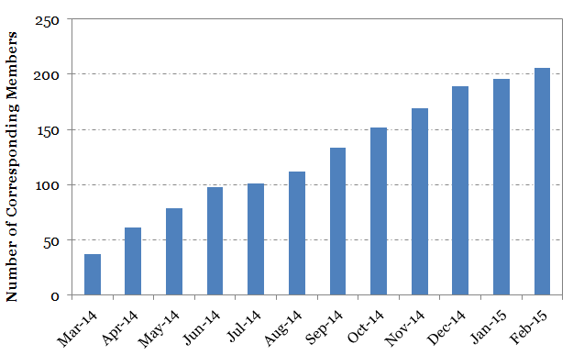
Corresponding Members (CM)
Unlimited; open to anyone
https://groups.google.com/forum/#!forum/ympg-corresponding-members
Currently at 224 people [67% increase from last meeting]

Slide 4
Completed Activities
Notes:
4

Slide 5
Review of Previously Completed Activities
Refined our name [YMPG] and mission statement
Developed a work plan and established task forces
Developed a CM listserv
Updated the ISSMGE YMPG website
  Membership bios and terms of reference [YMPG]
  How to become a CM on the ISSMGE website [Young Members]
Established Board Level Committee Liaisons
Initiated communication with the Young Members Committee of the International Geosynthetics Society (IGS)
Submitted a YMPG article in the ISSMGE Bulletin
Developed Outstanding Young Member Award Criteria

Slide 6
Completed Activities in this Period
Corresponding Membership Map
  Google Maps platform
  https://www.google.com/maps/d/edit?mid=zXC81j5J49pI.kxKnuWOdxER0
  Voluntary [48 out of 224 CMs signed up]
    6% Africa
    27% Asia
    2% Australasia
    40% Europe
    10% North America
    15% South America
  https://docs.google.com/spreadsheets/d/1_HbaCAkTwWVgUmj6OkA8QUpJ2xIacBqixe5YH6Bh610/edit?pli=1#gid=0
  Updated monthly
  YM Technical Contacts included as a layer [YMPG Members]

Slide 7
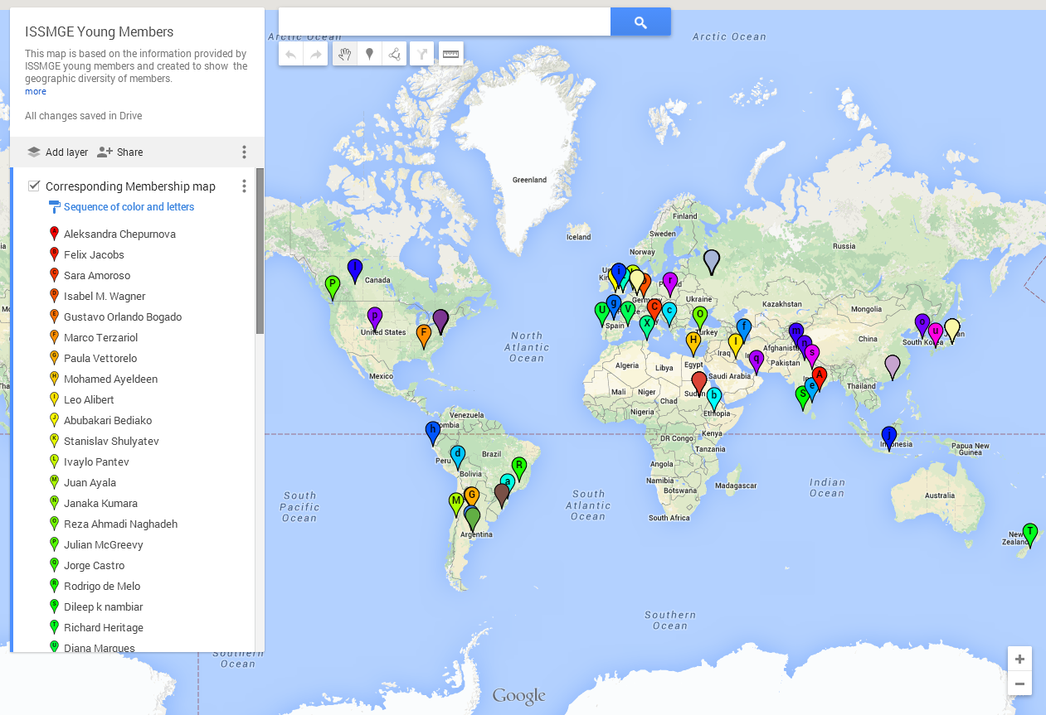
Corresponding Membership Map

Slide 8
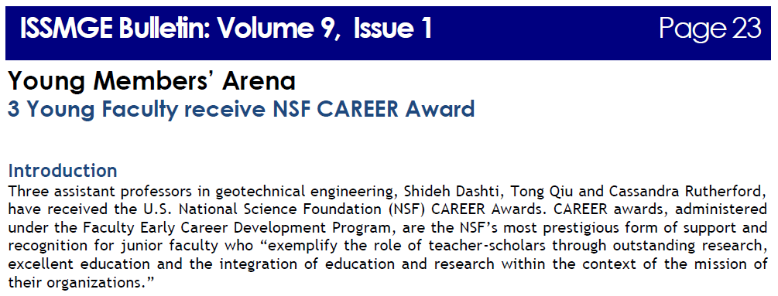
Young Members’ Arena Articles
ISSMGE Bulletin and February 2015 Issues
  “Geothermal Energy for Heating and Cooling: Full-Scale Testing and Numerical Modelling”
    YM: Guillermo A Narsilio, recipient of the ISSMGE Outstanding Young Member Award, Sept. 2009
  “3 Young Faculty receive NSF CAREER Award”
    YMs: (1) Shideh Dashti, (2) Tong Qiu, and (3) Cassandra Rutherford, YMPG member

Slide 9
Young Members’ Arena
YMPG expanding YM Arena beyond ISSMGE Bulletin
Working with GeoWorld on method to upload approved content to that site
Template and call for contributions developed and sent out to CMs, USUCGER list-serv, and IGS Young Members Committee [submitted with this presentation]
Article submittals via e-mail: issmge.ymarena@gmail.com
Must be a CM to submit an article
YMPG Members to serve as reviewers (2 minimum)
“Best papers” to be formally submitted to the ISSMGE Bulletin

Slide 10
Introductory “What is …?” Video Series
Developed a proposal for PIC and Board consideration [submitted with this presentation]
  Complement the “What is Geotechnical Engineering?” video previously developed
  Expand to broad topics based on those featured in www.whatisgeotech.org
    For example, “What is Transportation Geotechnics?”, “What are deep foundations?”, etc.
  More involvement from technical committees
  Benefits students, young members, teachers, public

Slide 11
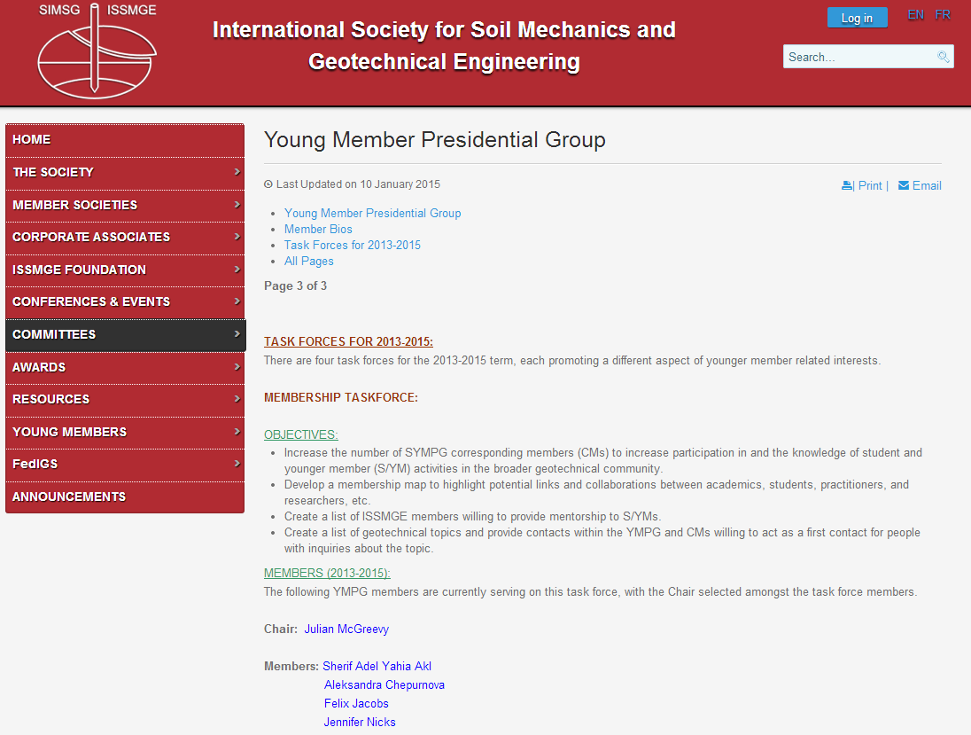
YMPG Webpage Updates
Task Force Information

Slide 12
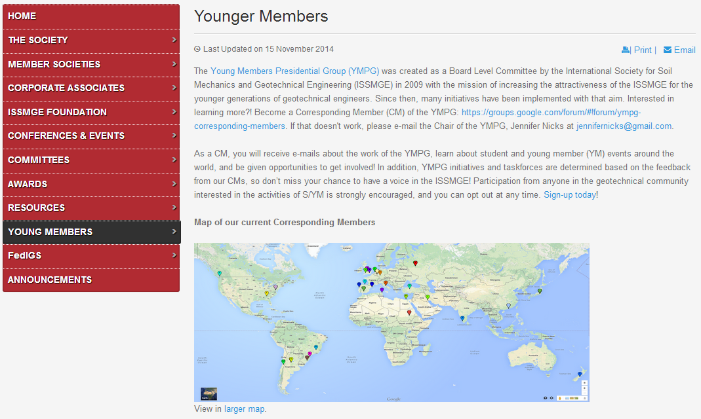
Young Members Webpage Updates
Corresponding Membership Map

Slide 13
Ongoing and Planned
YMPG Task Force Activities
Notes:
13

Slide 14
Young Members’ Arena
Ongoing activity for life of YMPG
Continue to solicit, review, and post articles on GeoWorld
Continue to provide submissions to the ISSMGE Bulletin

Slide 15
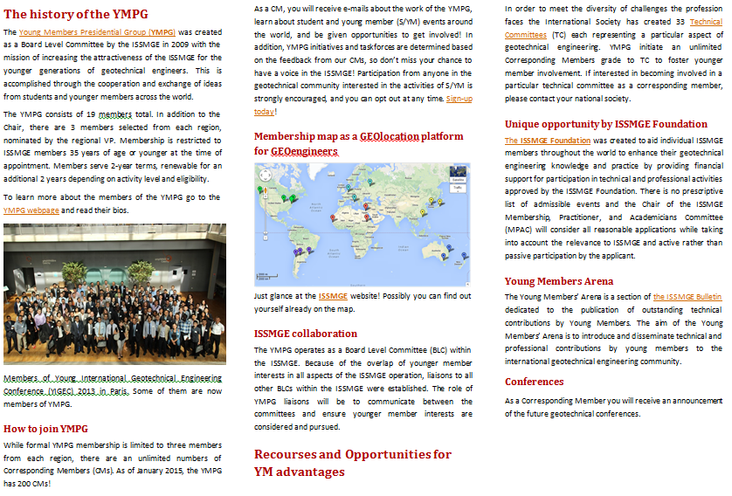
Young Members Flyer
Purpose
  To provide information on young member participation opportunities within the ISSMGE
Progress
  Draft tri-fold flyer has been developed
  Completion expected in coming months
  Plan to send to member societies for distribution

Slide 16
Geotechnical Mentorship Guidelines
Purpose
  Provide professionals with guidance on how to a mentorship program in their organizations
Progress
  Draft guidance is developed based on a member’s company mentorship program
  Review needed to make it generic
  Plan to upload it on Young Members page

Slide 17
Student Fee Reduction or Elimination
Purpose
  Investigate methods to promote the reduction or elimination of ISSMGE membership fees for students to increase involvement in the ISSMGE
Progress
  Collected data on current student fee practices of member national societies from readily available information
  The Membership Task Force plans to contact the regional VPs of the ISSMGE to receive assistance finding information; expect an e-mail shortly

Slide 18
Other Activities
Working with the organizing committee of the 19ICSMGE to establish YM activities during the conference
Increase YM participation in technical committees
Develop a document/list of successful student activities at conferences, workshops, events, etc.

Slide 19
Webpage Updates
YMPG page
  None planned
Young Members page
  Include YM Arena information
  Include information on how to be a corresponding member of technical committees
  Include links to contact information in member societies to join the ISSMGE
  Post flyer once finished
GeoWorld
  Establish a database of YM Arena articles

Slide 20
Board Considerations
Notes:
20

Slide 21
Discussion Items
Video Series Proposal [PIC interest? Move forward or in a different direction? Budget?]
YM Arena [Guidelines for technical quality?]
Website content [What else would you like to see on the YM sites?]
Other items?

Slide 22
Thank you
Any additional questions, comments, or suggestions?
Want to be a CM or know someone who does?
  https://groups.google.com/forum/#!forum/sympg-corresponding-members

