Slide 1

Students and Younger Members
Presidential Group
(SYMPG)
Progress Report
Period: Sept. 2013 – March 2014
Jennifer Nicks, PhD, PE
Chair, SYMPG
ISSMGE Board Meeting
18 March 2014
London, UK
Notes:
1

Slide 2
Background
Timeline:
  Sept. 2009: SYMPG created by now Past-President Briaud
  Sept. 2013: SYMPG-1 ended their term
  Oct. 2013: Board approval for SYMPG-2
  Dec. 2013: SYMPG-2 membership selected
  Jan. 2014: SYMPG-2 Kick-Off Meeting
  Feb. 2014: SYMPG-2 Leadership Team Elections
  Mar. 2014: Board Update

Slide 3
Background
Membership:
  3 members from each region, nominated by the regional VP, and 1 Chair, appointed by the Board (19 members total)
  Restricted to ISSMGE members younger than 35 years of age at the time of appointment
  2-year terms, but can be renewed

Slide 4
Membership
Chair:
Jennifer Nicks
Vice-Chair:
Aleksandra Chepurnova
Secretary:
Juan Ayala
Board Liaisons:
Roger Frank
Paul Mayne
Nicoleta Radulescu
Region | Name | Country
Africa | Sherif Adel Yahia Akl | Egypt
 | Mohamed Elbyhagi Elfadil | Sudan
 | Abdou Xaadir Gaye | Senegal
Asia | Ilhan Chang | Korea
 | Janaka J. Kumara | Japan
 | Lucy Wu | Hong Kong
Australasia | Martin Barrientos | New Zealand
 | Ross Kristinof | Australia
 | Darshan Leckraz | Australia
Europe | Aleksandra Chepurnova | Russia
 | Sabatino Cuomo | Italy
 | Felix Jacobs | Germany
North America | Julian McGreevy | Canada
 | Mehdi Omidvar | USA
 | Cassandra Rutherford | USA
South America | Juan Ayala | Chile
 | Marcelo Heidemann | Brazil
 | Marcos Montoro | Argentina
Notes:
Statistics:
- 80% Male; 20% Female
- 50% Academic; 50% Practitioner

Slide 5
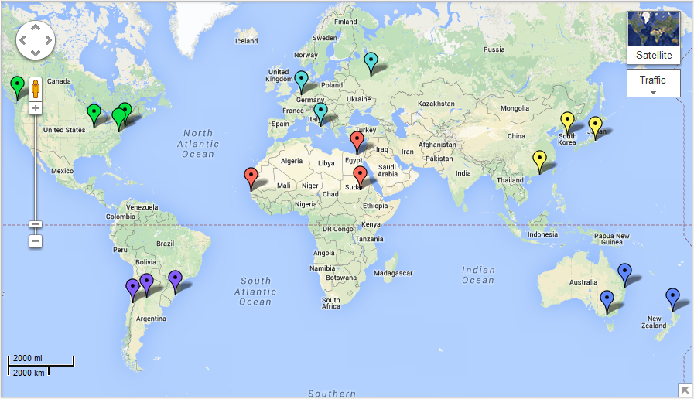
SYMPG Membership Map

Slide 6
Corresponding Members (CM)
Unlimited; open to anyone
Receive e-mails about the activities of the SYMPG and have the opportunity to provide input/feedback
Do not have voting privileges or participate in the day-to-day activities
CMs can be passive (i.e. read e-mails and keep informed) or active (i.e. provide input on our activities for SYMPG consideration)
End of SYMPG-1: 77 CM
Currently: 37 CM

Slide 7
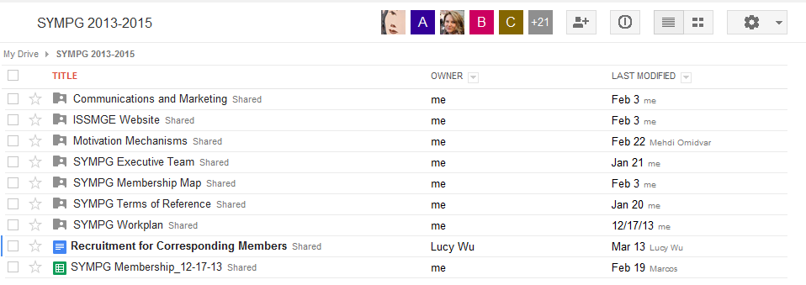
Membership Communication
E-mail
Skype
Google Drive

Slide 8
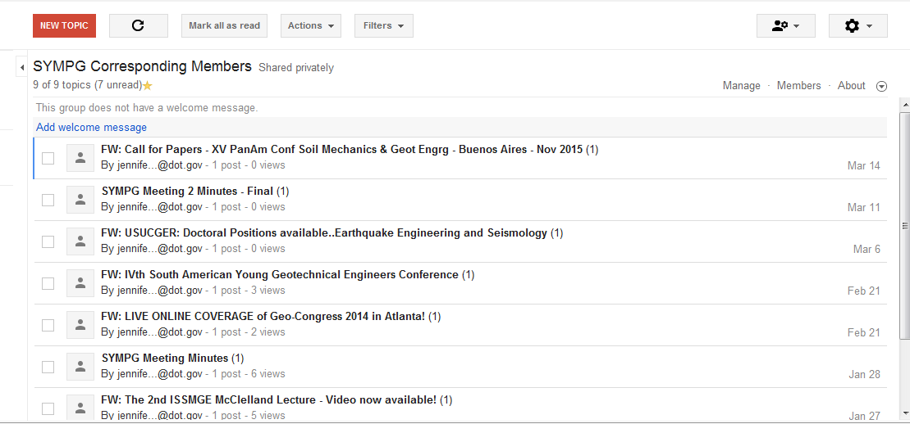
CM Communication
E-mail
CM Google Group

Slide 9
SYMPG Activities
Held elections for SYMPG Leadership Team
Reevaluated our mission statement
  2009-2013:
  To increase the attractiveness of the ISSMGE for the next generation of geotechnical engineers.
  2013-2015:
  To increase the attractiveness of the ISSMGE for younger generations of geotechnical engineers.

Slide 10
SYMPG Activities
Developed standard CM recruiting message
Established Task Forces
  Website
  Membership
  Motivation Mechanisms
  Communications & Marketing

Slide 11
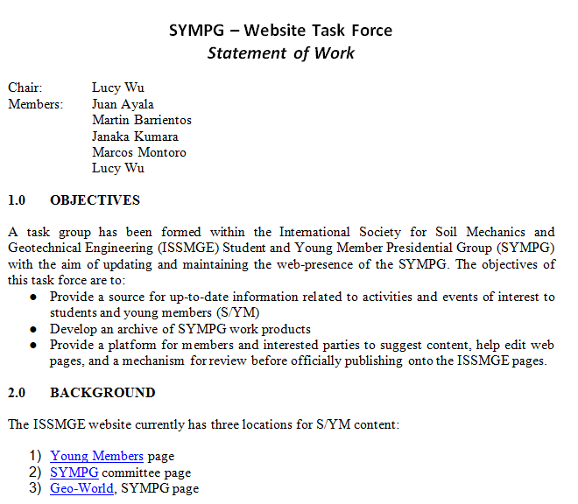
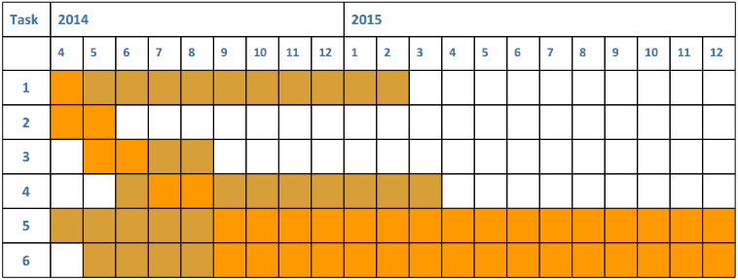
Task Forces
Subgroups to work on key issues identified by the SYMPG
Voluntary, led by a Chair
Develop SOW

Slide 12
Website Task Force
Objectives:
  Update and maintain various web pages of potential interest to S/YMs
  Develop an archive of SYMPG work products
Membership
Task 1: Website | Region
Lucy Wu | Asia
Janaka Kumara | Asia
Martin Barrientos | Australasia
Juan Ayala | South America
Marcos Montoro | South America
Mohamed Elbyhagi | Africa

Slide 13
Website Task Force
Progress:
  Started updating ISSMGE website
  Created a test website to test out new ideas and formats: https://sites.google.com/site/issmgesympg/
Goals for upcoming quarter:
  Add content to the Younger Members and SYMPG page
  Establish work meetings where interested parties can gather and update the website together
  Brainstorm content for the GeoWorld website
  Begin to collaborating with other SYMPG task forces to create content

Slide 14
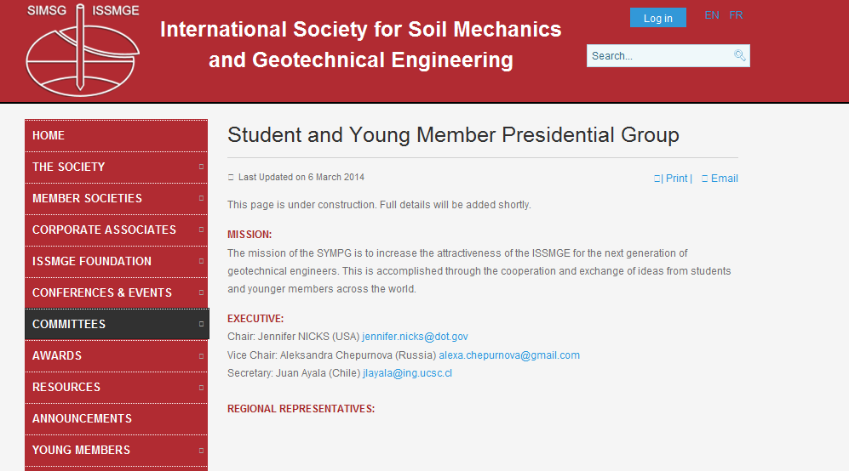
Initial Progress: SYMPG BLC Website

Slide 15
Initial Progress: YM Website

Slide 16
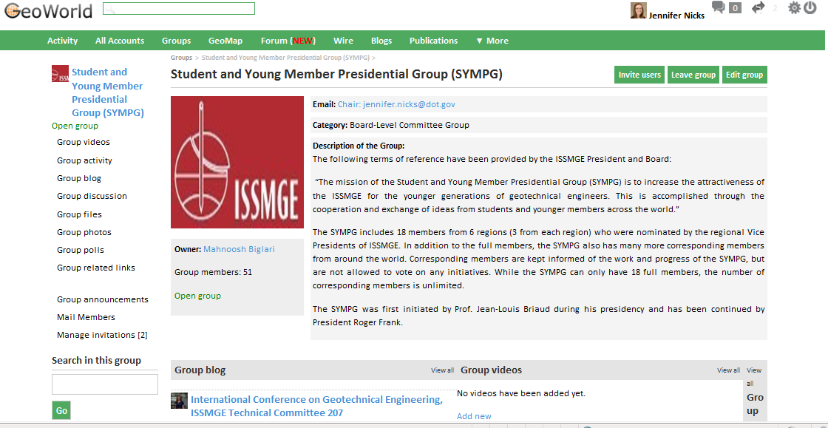
Initial Progress: SYMPG Geo-World Page

Slide 17
Membership Task Force
Objectives:
  Increase the number of CMs to increase participation in and the knowledge of S/YM activities in the broader geotechnical community
  Develop a membership map to highlight potential links and collaborations between academics, students, practitioners, and researchers, etc.
  Create a list of ISSMGE members willing to provide mentorship to S/YMs.
  Create a list of geotechnical topics and provide contacts within the SYMPG and CMs willing to act as a first contact for people with inquiries about the topic

Slide 18
Membership Task Force
Membership
Task 2: Membership | Region
Aleksandra Chepurnova | Europe
Sherif Akl | Africa
Julian McGreevy | North America
Felix Jacobs | Europe

Slide 19
Membership Task Force
Progress:
  Chair: Julian McGreevy
  Held first meeting via Skype
  Finalizing SOW
  Researching mapping programs
Goals for upcoming quarter:
  Get CM membership to at least 100
  Start a CM membership map

Slide 20
C&M Task Force
Objectives:
  Improve the publicity of ISSMGE and SYMPG among actual and future Young Members
  To be the link between ISSMGE – SYMPG and YMs
  Establish new communications ways between ISSMGE and the young members community
Membership:
Task 3: C&M | Region
Janaka Kumara | Asia
Sherif Akl | Africa
Martin Barrientos | Australasia
Juan Ayala | South America
Marcos Montoro | South America
Mehdi Omidvar | North America
Abdou Xaadir GAYE | Africa

Slide 21
C&M Task Force
Progress:
  Chair: Marcos Montoro
  Finalizing SOW
Goals for upcoming quarter:
  Prepare guidelines for YM publications in the ISSMGE Bulletin
  Prepare guidelines for YM webinars
  Start communication with member societies to improve their communication with their own YMs.
  Work together with the Public Relations Committee
  Brainstorm ideas to improve website(s) features

Slide 22
Motivation Mechanisms Task Force
Background: Previous SYMPG initiative
  Outstanding Young Geotechnical Engineer Award: To recognize S/YMs who had contributed to the field
  S/YM activities at ICSMGE
Objectives:
  Establish ISSMGE as the professional society of reference for younger geotechnical engineers
  Assist ICSMGE organizers with S/YM activities
  Develop motivation mechanisms to encourage S/YM involvement in ISSMGE

Slide 23
Motivation Mechanisms Task Force
Membership
Progress
  SOW developed
  Review of past SYMPG work
Task 4: Motivation Mechanisms | Region
Lucy Wu | Asia
Aleksandra Chepurnova | Europe
Janaka Kumara | Asia
Julian McGreevy | North America
Mehdi Omidvar | North America
Abdou Xaadir GAYE | Africa
Mohamed Elbyhagi | Africa
Cassie Rutherford | North America
Ilhan Chang | Asia

Slide 24
Motivation Mechanisms Task Force
Goals for next quarter:
  Work with the Awards Committee to better differentiate young member awards
  Contact 19ICSMGE organizers
  Develop proposal(s) for motivation mechanisms selected

Slide 25

Moving Forward
Continue progress on task forces
Hold next meeting (April 2014)
BLC Liaisons

Slide 26
Thank you
Questions, comments, or suggestions?
Want to be a CM or know someone who does?
  https://groups.google.com/forum/#!forum/sympg-corresponding-members

