Slide 1
ISSMGE
International Society for Soil Mechanics and Geotechnical Engineering www.issmge.org

Slide 2
ISSMGE
International Society for Soil Mechanics and Geotechnical Engineering www.issmge.org
1936 - First Int. Conf., USA (20 countries, 206 delegates)
Terzaghi is the first President
1957 - ISSMGE is more formally organized
2012 - 90 countries and 19,000 individual members

Slide 3
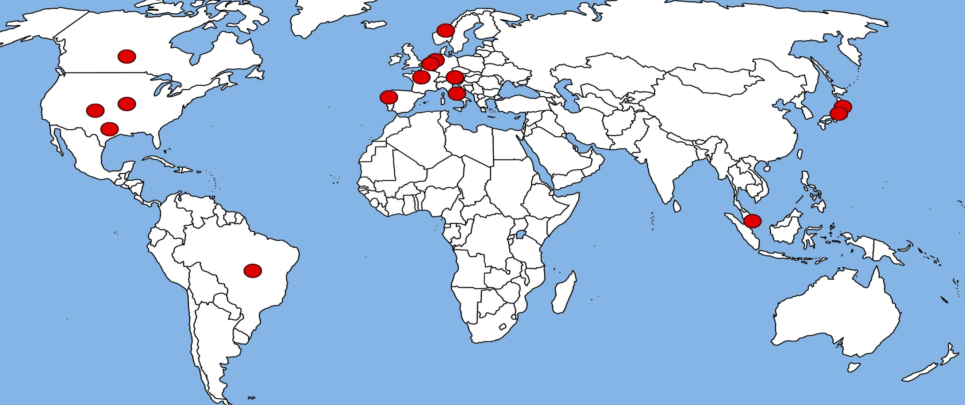
ISSMGE Presidents
1936–1957 | K. Terzaghi | Austria, USA
1957–1961 | A. W. Skempton | UK
1961–1965 | A. Casagrande | USA, Austria
1965–1969 | L. Bjerrum | Norway
1969–1973 | R. B. Peck | USA
1973–1977 | J. Kerisel | France
1977–1981 | M. Fukuoka | Japan
1981–1985 | V. F. B. de Mello | Brazil
1985–1989 | B. B. Broms | Singapore
1989–1994 | N. R. Morgenstern | Canada
1994–1997 | M. Jamiolkowski | Italy
1997–2001 | K. Ishihara | Japan
2001-2005 | W. Van Impe | Belgium
2005-2009 | P.S. Sêco e Pinto | Portugal
2009-2013 | J.-L. Briaud | USA

Slide 4
ISSMGE today
90 countries, ~19,000 members,
30 Technical Com., 38 Corporate Associates
My Professional Family

Slide 5
ISSMGE Members and Member Societies
FedIGS Board
ISSMGE Council
ISSMGE Secretariat
Students and Young Members Pres Group
ISSMGE Foundation
ISSMGE Board
Corporate Associates Presidential Group
Awards Committee
Technical
Oversight
Committee
Membership,
Practitioners, and
Academicians
Committee
Public
Relations
Committee
Innovations and
Development
Committee

Slide 6
ISSMGE Technical Committees
2 members per country unlimited number of corr. members
Chair rotating every 4 years renewable
Suggested to TOC 6 months before term
Executive group = leaders of TC tasks
Contribute to Case Histories Journal
Develop named lecture

Slide 7
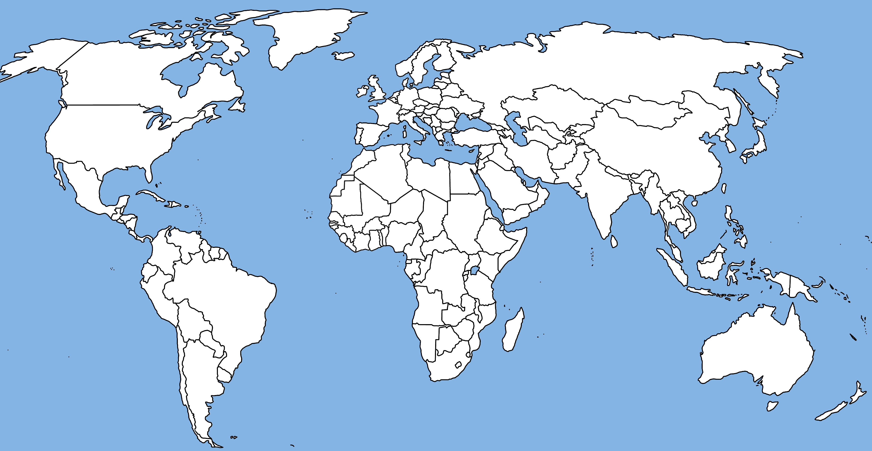
Technical Committee Locations
Fundamentals
TC 101- France
TC 102- USA
TC 103- Hong Kong
TC 104- Switzerland
TC 105- UK
TC 106- Spain
TC 107- Ghana
Applications
TC 201- Netherlands
TC 202- Portugal
TC 203- Greece
TC 204- France
TC 205- UK
TC 206- Canada
TC 207- Russia
TC 208- Canada
Impact on Society
TC 301- Italy
TC 302- India
TC 303- Japan
TC 304- Singapore
TC 305- Brazil
TC 306- Australia
TC 307- Southeast Asia
TC 209- USA
TC 210- China
TC 211- France
TC 212- Germany
TC 213- Germany
TC 214- Mexico
TC 215- Italy
TC 216- Germany

Slide 8
ISSMGE Named Lectures
ISHIHARA - Earthquake
MITCHELL – Site characterization
BISHOP – Laboratory testing
KERISEL – Monument preservation
SCHOFIELD – Physical modeling
McCLELLAND – Offshore geotechnics
FUJITA – Underground construction
MENARD – Soil Improvement
ROWE – Environmental geotechnics

Slide 9
ISSMGE International Journal of Geoengineering Case Histories
http://casehistories.geoengineer.org/
On line
Free
In color
Embedded data
Google Earth

Slide 10
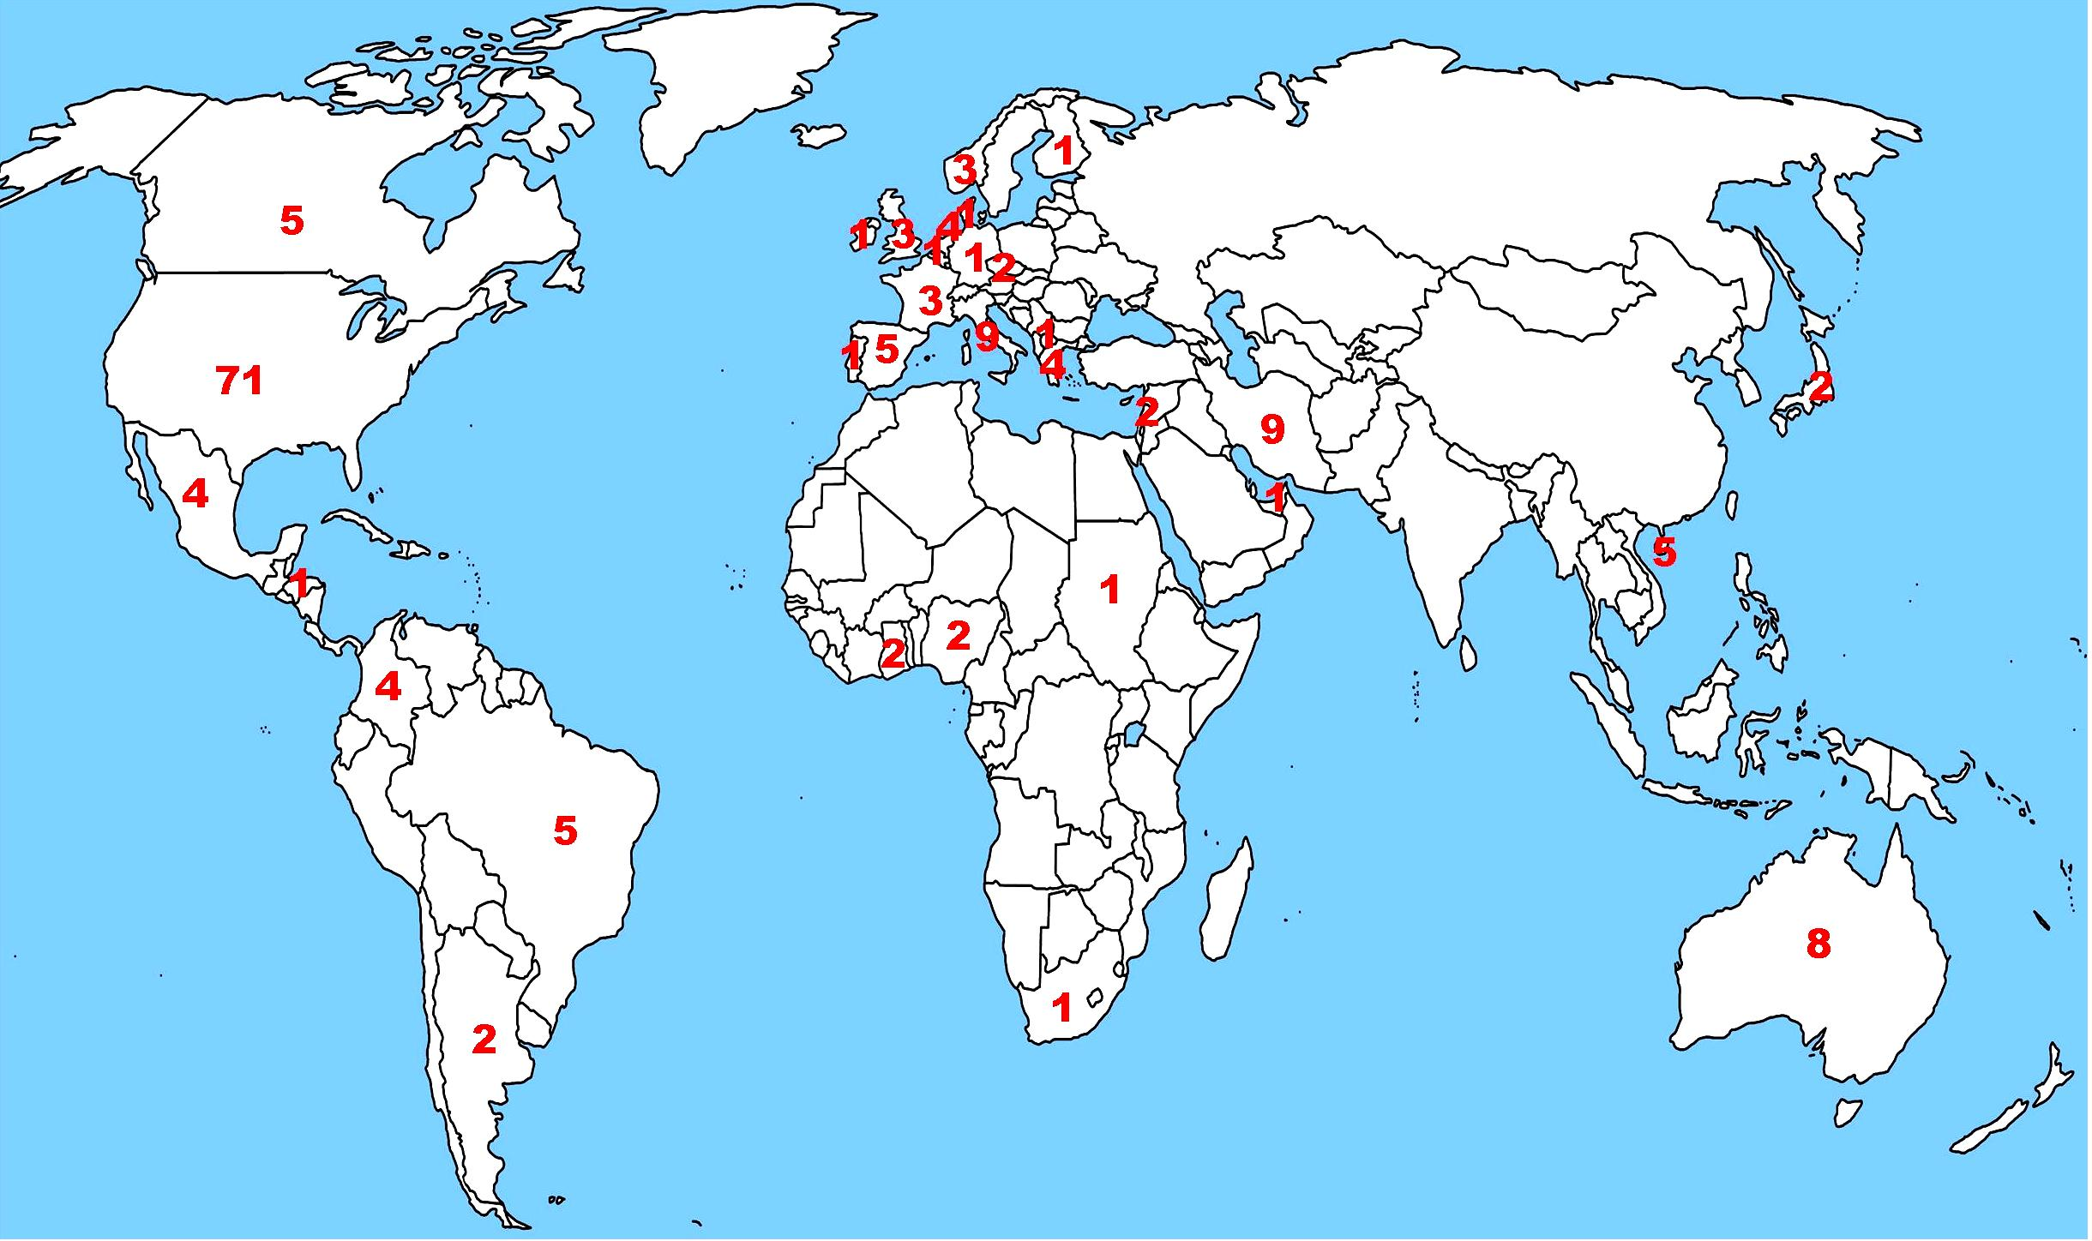
1. Scour and Erosion – Briaud-USA - 23Aug2011
2. Intelligent Compaction - Correia & Chang-Portugal - 25Oct2011
3. Eurocode – Bond-UK – 19Dec2011
4. Risk and Geotech Engrg – Medina & Uzielli-USA - 24Feb2012
5. Landfill liners – Rowe-Canada - April2012
6. Unsaturated soils – Alonso-Spain - July2012
7. Pile driving-Rausche-USA-September2012
8. Earthquake engineering-Towhata-Japan-November2012
9. Geosynthetics-Koerner-USA-January2013
10. Ground Improvement-Varaksin/Huybrechts-Belgium-March2013
11. Geophysics-Foti-Italy-May2013
Webinars: check http://www.issmge.org/
Location and number of computers connected during first webinar

Slide 11
GEOWORLD http://www.mygeoworld.info
A professional network for geotechnical engineers
GeoWorld is to geotechnical engineering what Facebook is to social networking

Slide 12
ISSMGE AWARDS
Terzaghi Oration
Kevin Nash Gold Medal
3 Young Geotechnical Engineer Awards
Outstanding Technical Committee
Outstanding Member Society
Outstanding Geotechnical Project
Outstanding Innovator
Outstanding Young Geotechnical Engineer
Outstanding Public Relations
Best paper in the Int. J. Geoeng. Case Hist.
9 Named Lectures

Slide 13
80 Places Visited by President Briaud in 3.5 years

Slide 14
The ISSMGE Foundation Donors

Slide 15





































ISSMGE 38 Corporate Associates

Slide 16
Map of ISSMGE Corporate Associate Locations

Slide 17
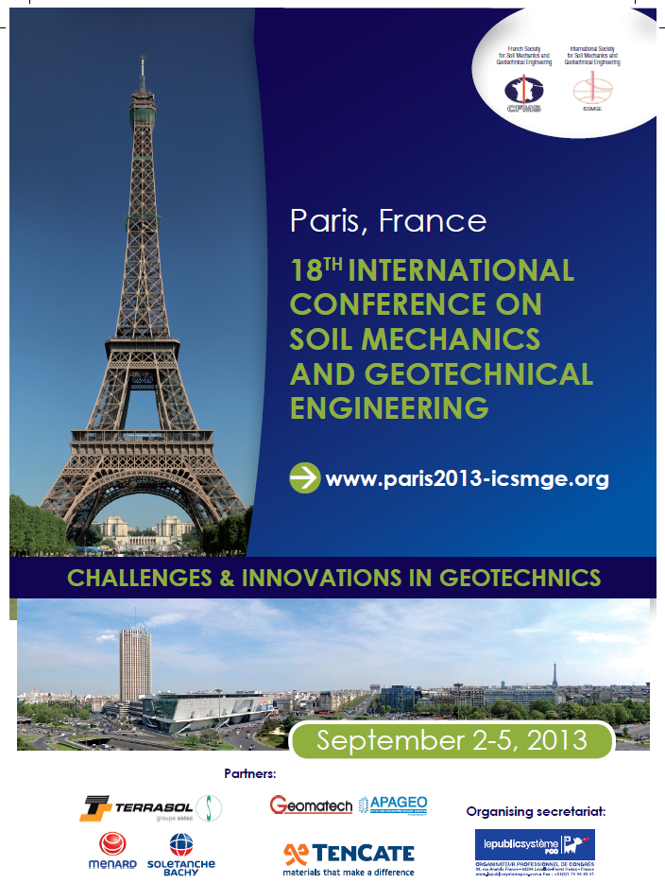
Fffff
gg
gg
gg
ggg
ggg

Slide 18
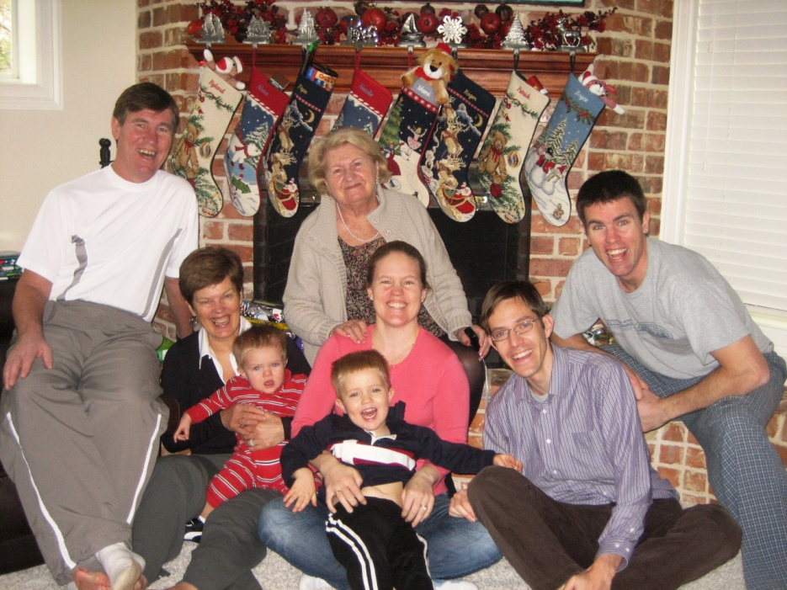
ISSMGE is our professional family.
Helping ISSMGE is at the level of a family obligation
My Professional Family
Don’t ask what ISSMGE can do for you,
ask what you can do for ISSMGE

