Slide 1
Southern Ventilation Building

Slide 2
Readings within Amber Trigger?
Y
Progress with Excavation
N
Readings within Red Trigger?
Y
Review and back-analysis of monitoring data to verify stability conditions
Progress with excavation if conditions are deemed safe
Y
N
Ground movement stabilised after exceedance
Y
Stop any further excavation
Install slab extents as required by traditional design sequence
Progress with excavation following traditional design sequence
N
Carry out emergency measures, including excavation backfilling

Slide 3
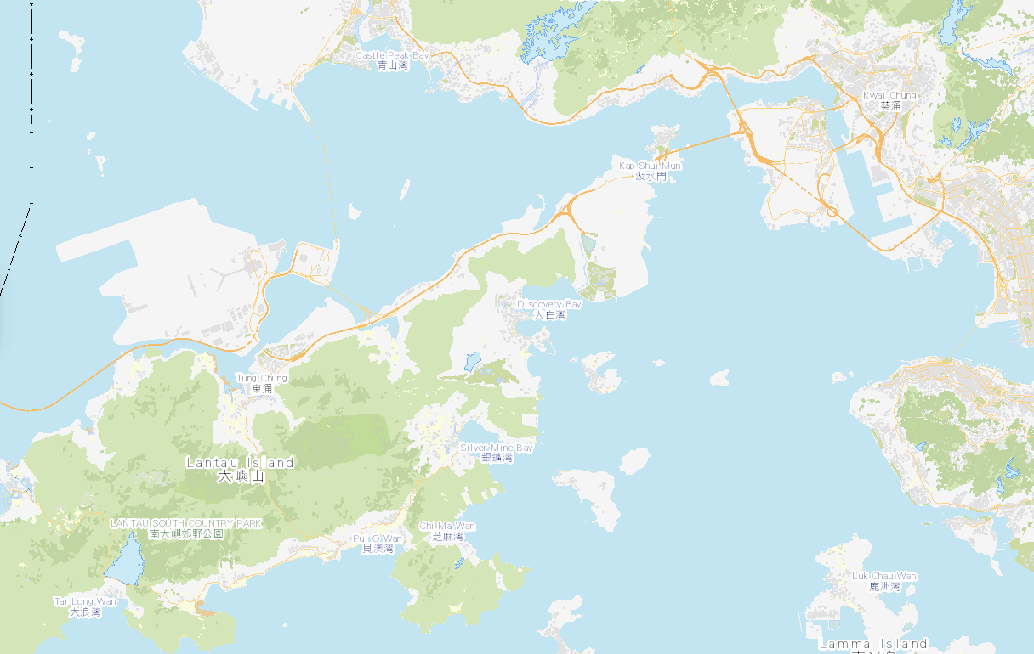


Hong Kong Boundary Crossing Facilities
Tuen Mun - Chek Lap Kok Link
Hong Kong International Airport
WSP OFFICE
HKBCF
Where I live
Hong Kong – Macau – Zhuhai Bridge
TO MACAU
LANTAU ISLAND
HK ISLAND

Slide 4
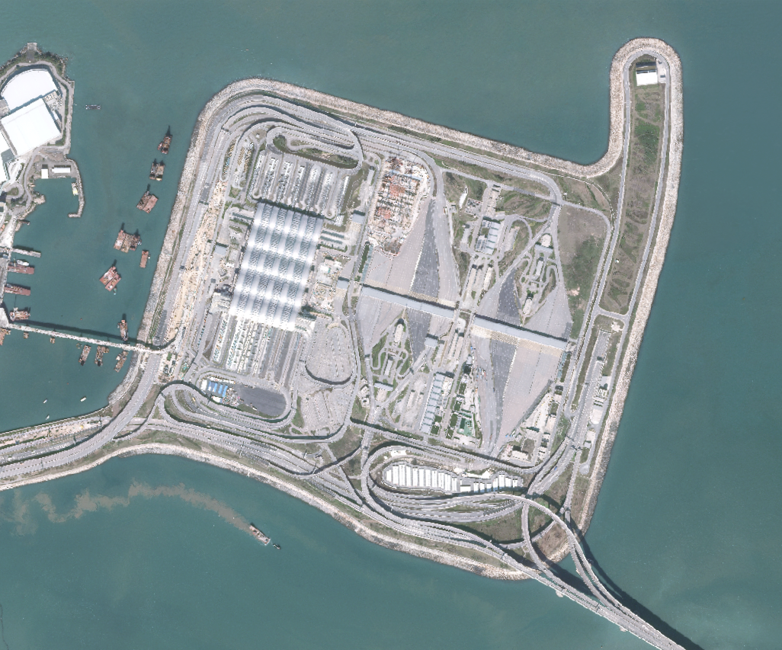
Hong Kong Boundary Crossing Facilities Golder WSP Involvement
Automated Car Park A
Paul Y CIMC JEC JV
Automated Car Park Detailed Design
TMCLKL Southern Landfall
Dragages Bouygues JV
Tunnel and Temporary Works detailed design
Passenger Clearance Building
Leighton-Chun Wo JV
Temporary Works detailed design
Aviation Academy
Hong Kong Airport Authority
Feasibility Study for raft foundations
Southern Infrastructure
China State
Geotechnical advice on ground conditions and pile design

Slide 5
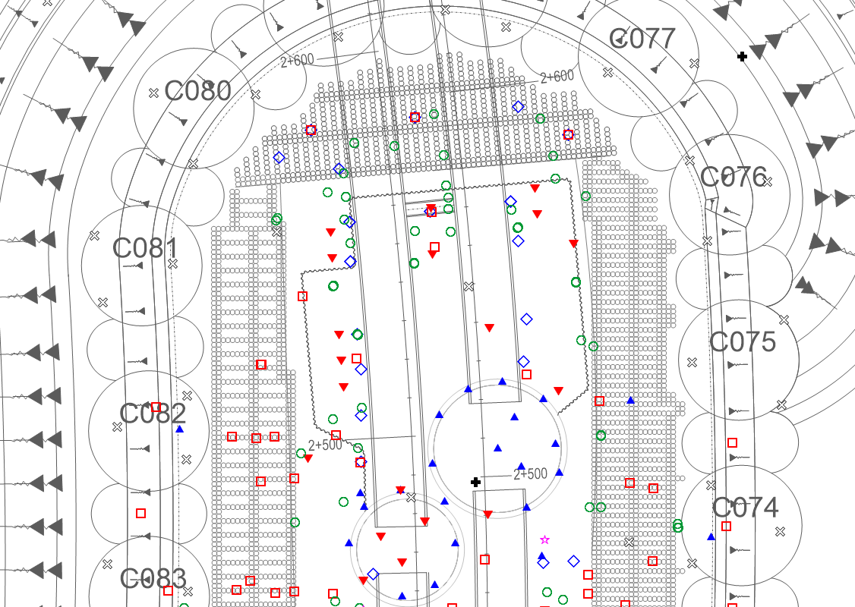
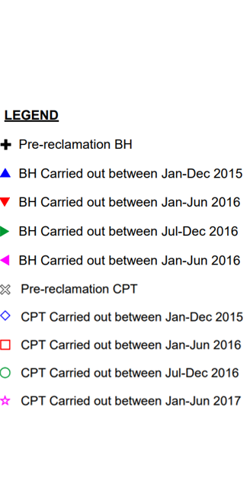
Layout Plan
SVB
Deep Cement Mixing Columns
Steel Cells
SVB
SVS
SVS

Slide 6
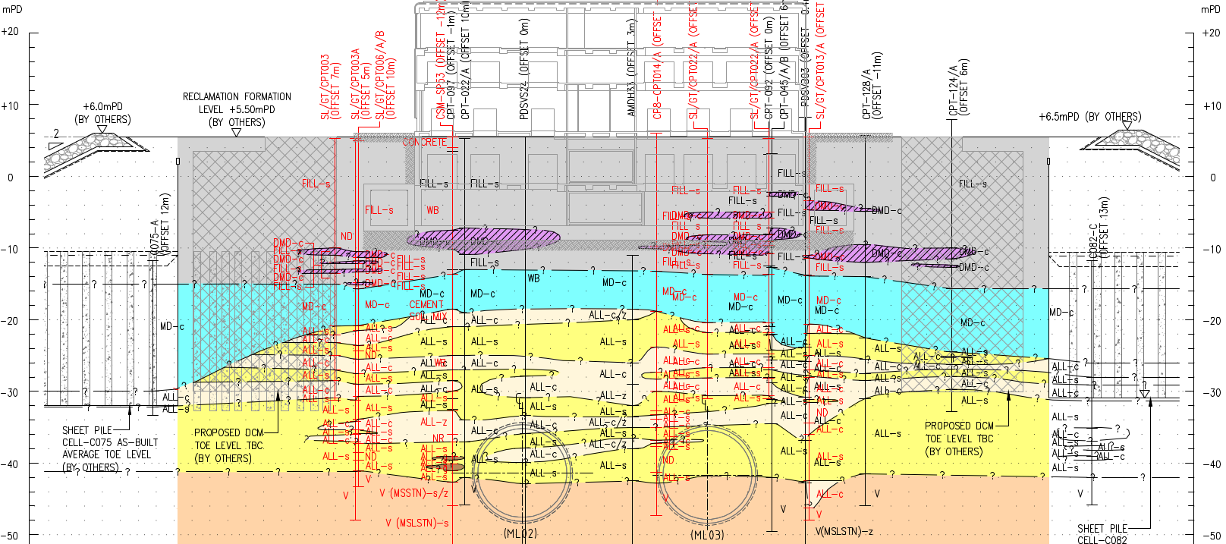
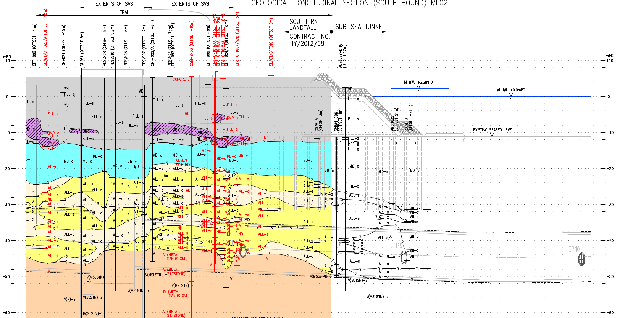
Geological Conditions
B
Section A-A’
SVB
A
A’
SVB
ML02 MLO3
SVS
SVS
B’
Section B-B’
SVS
SVB
ML02 & MLO3

Slide 7
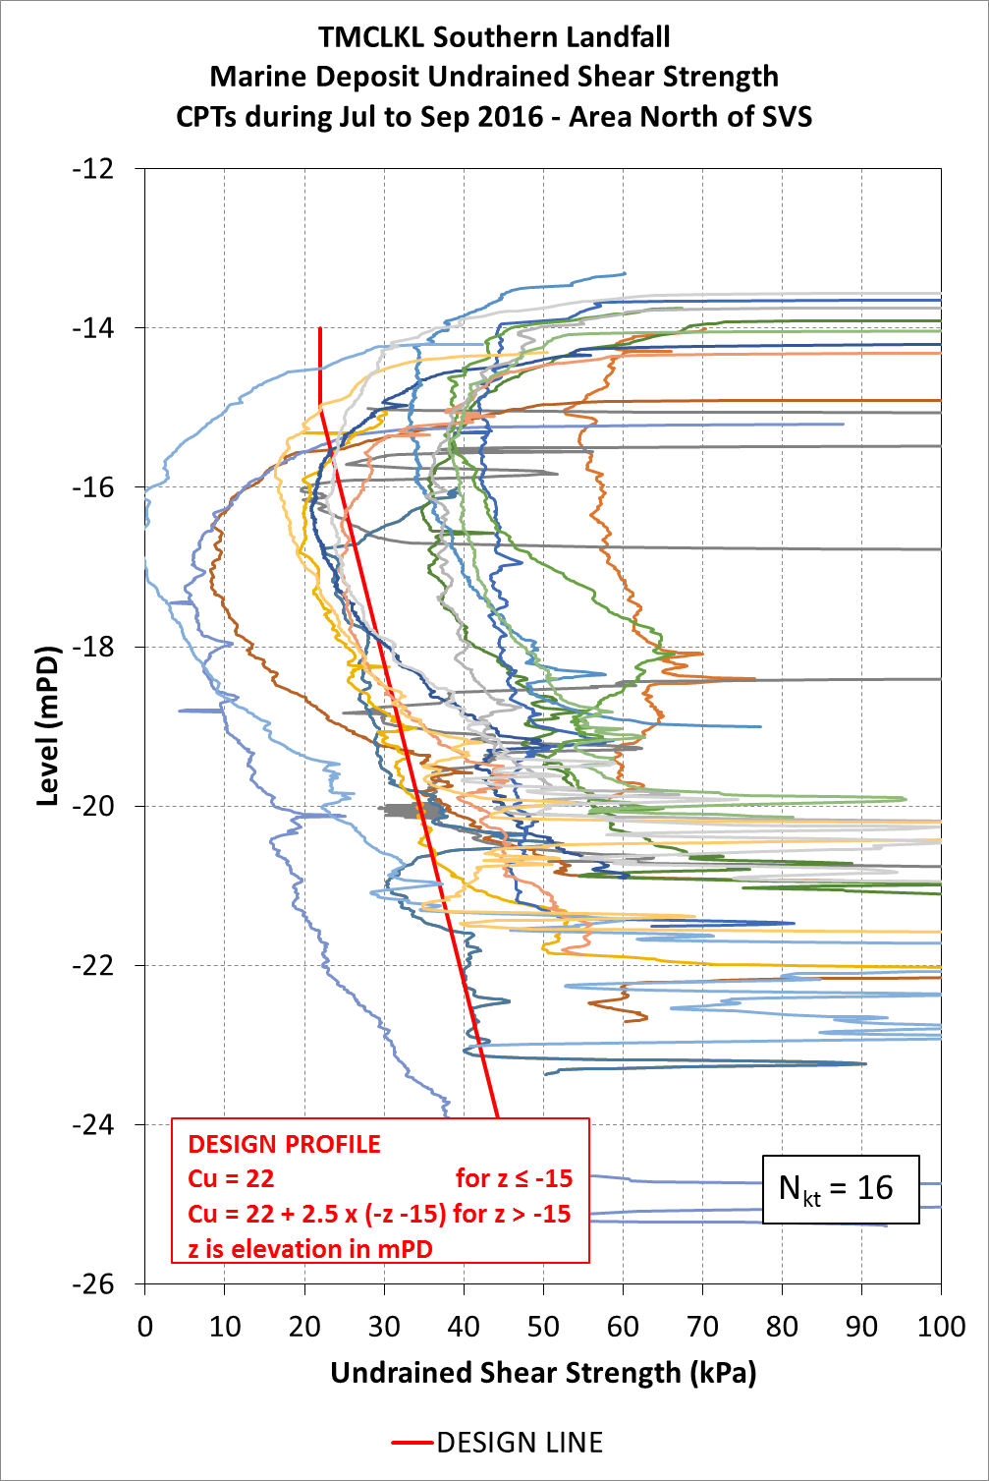
Marine Clay Strength after Surcharge Removal
Deep Cement Mixing Columns installed outside cofferdam

Slide 8
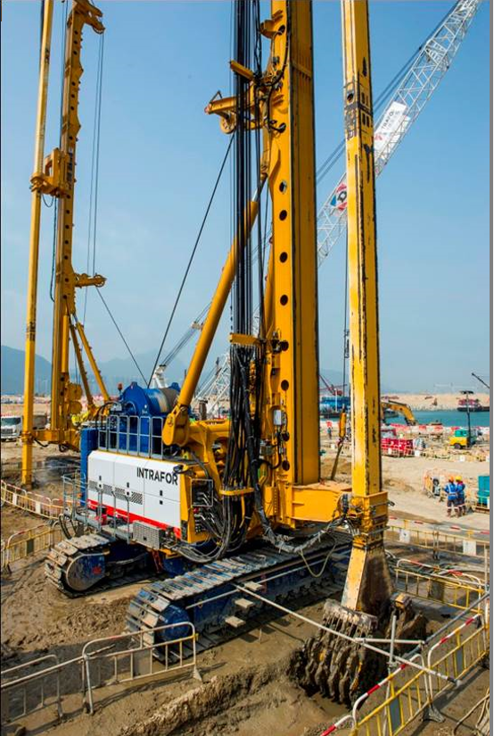
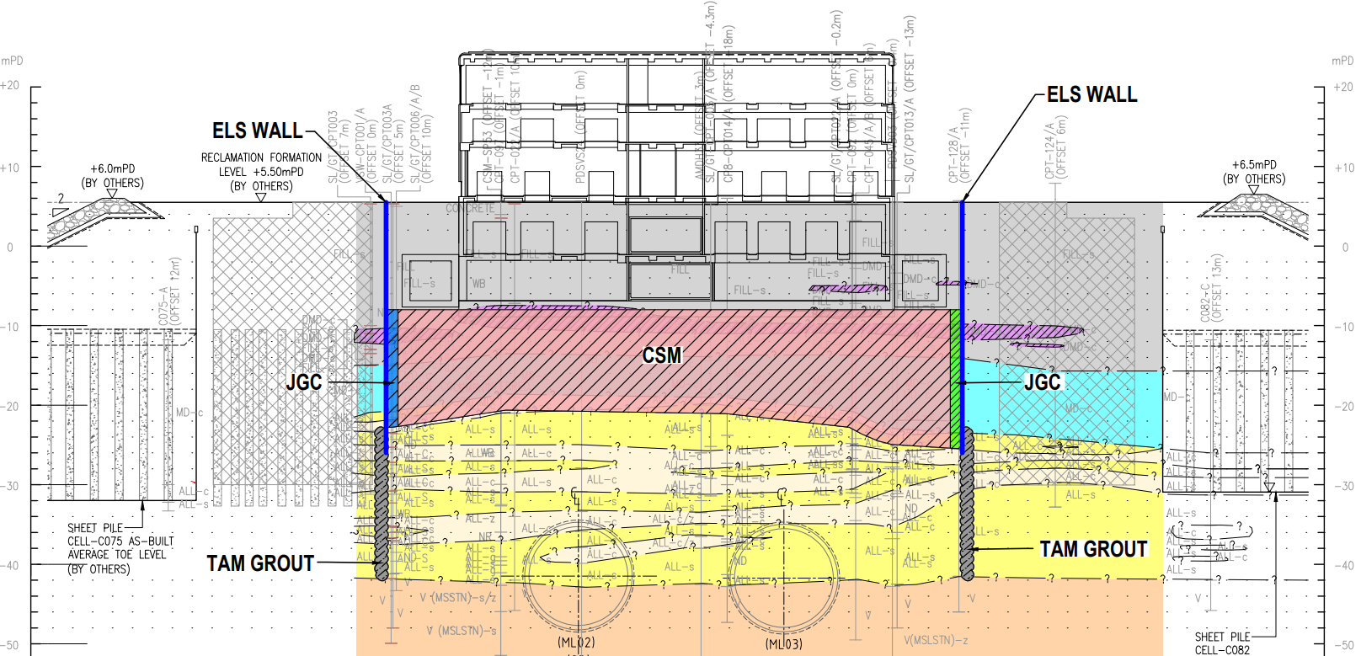
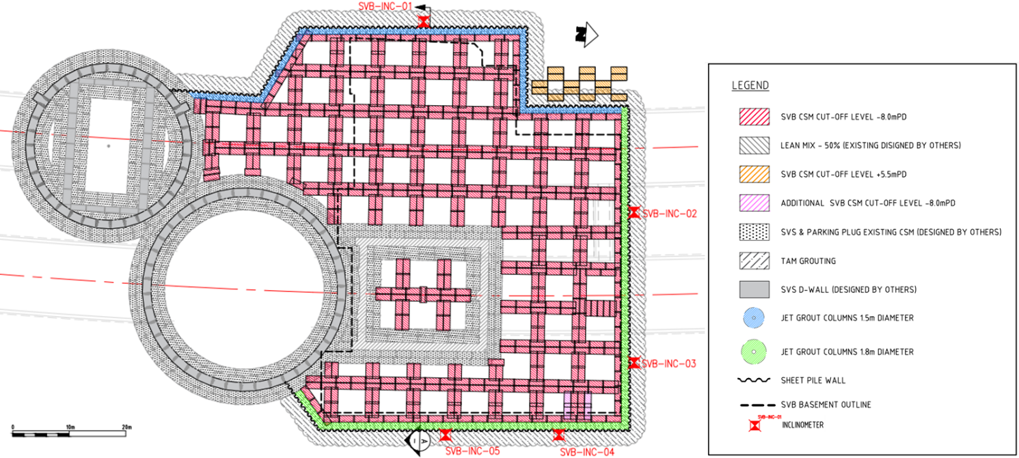
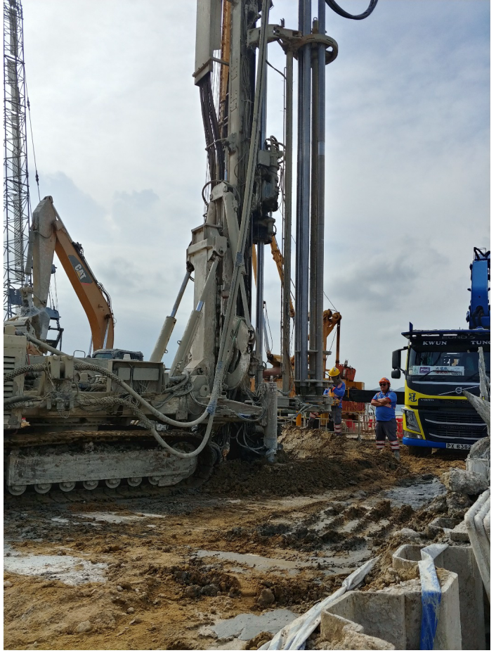
Ground Improvement Solution
CUTTER SOIL MIXING
SVB
JET GROUTING

Slide 9
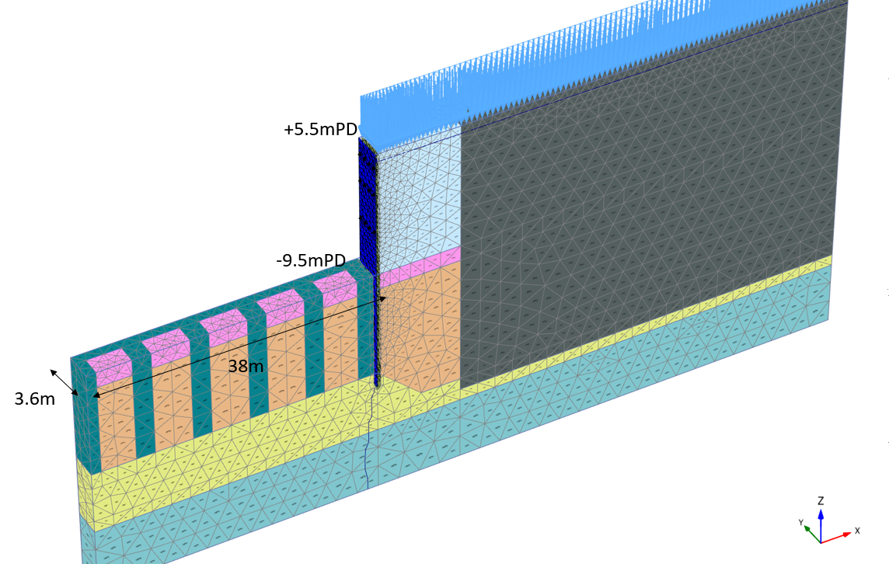
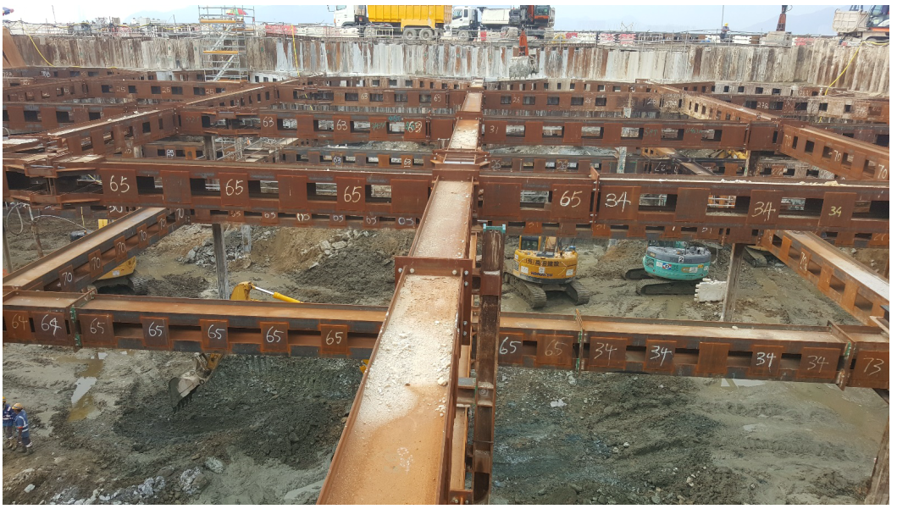
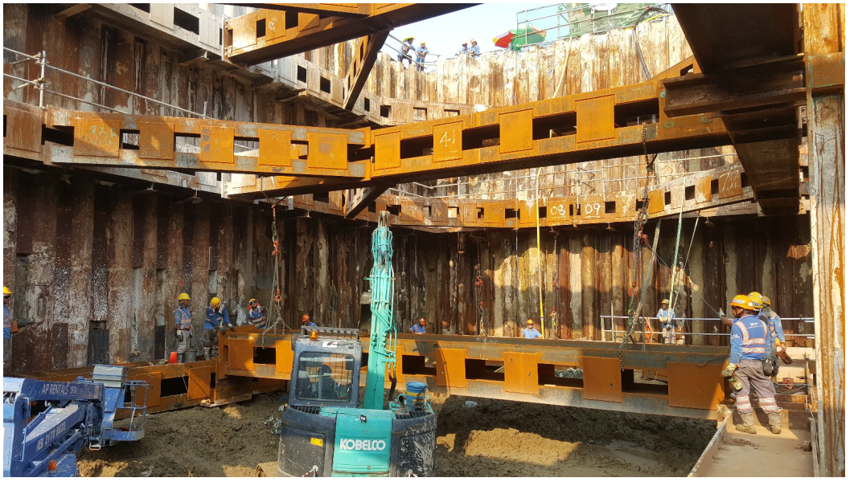
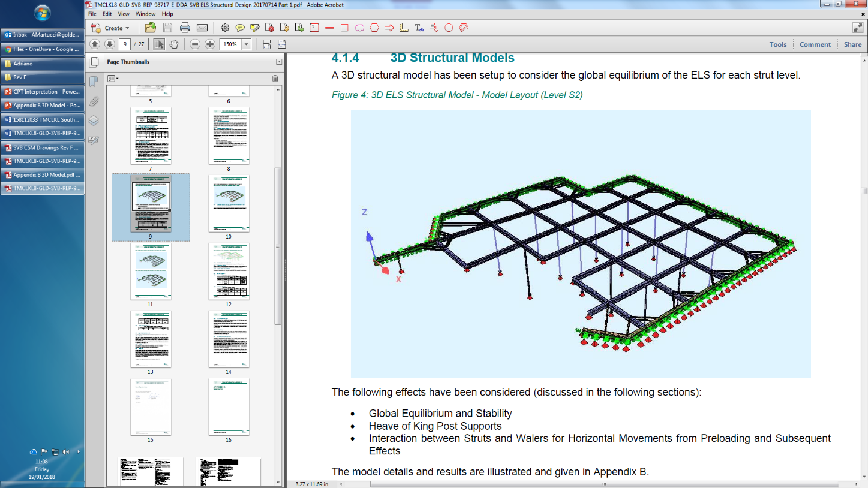
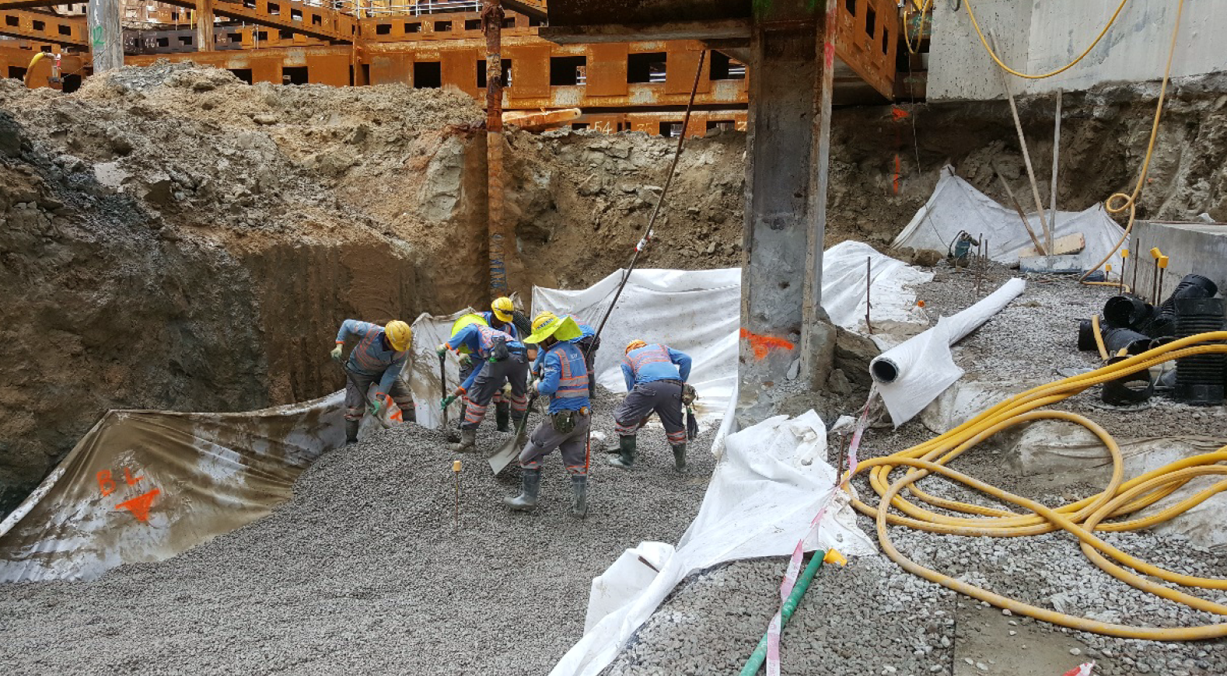
Temporary Works Design

Slide 10
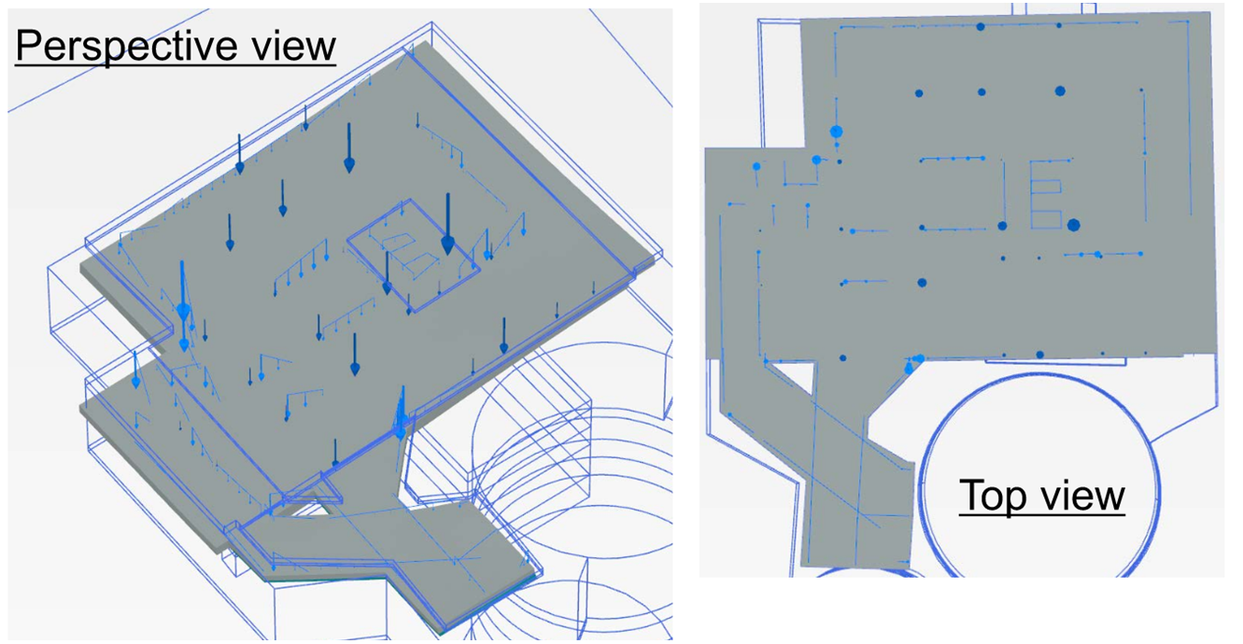
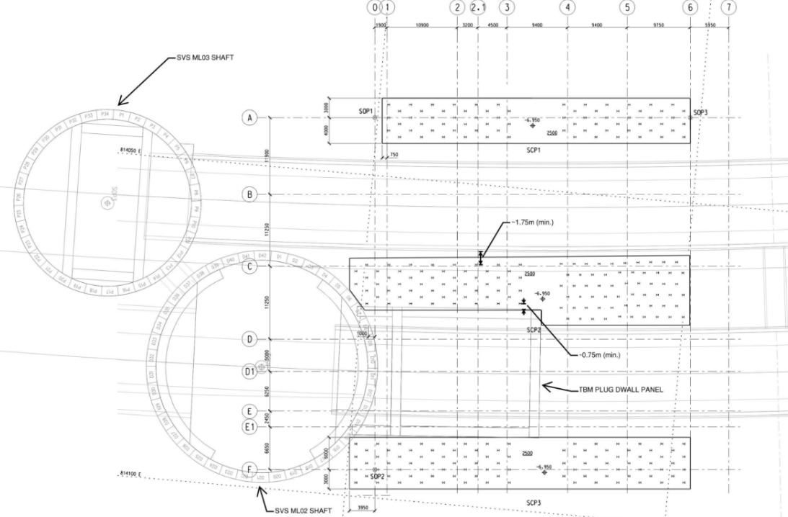
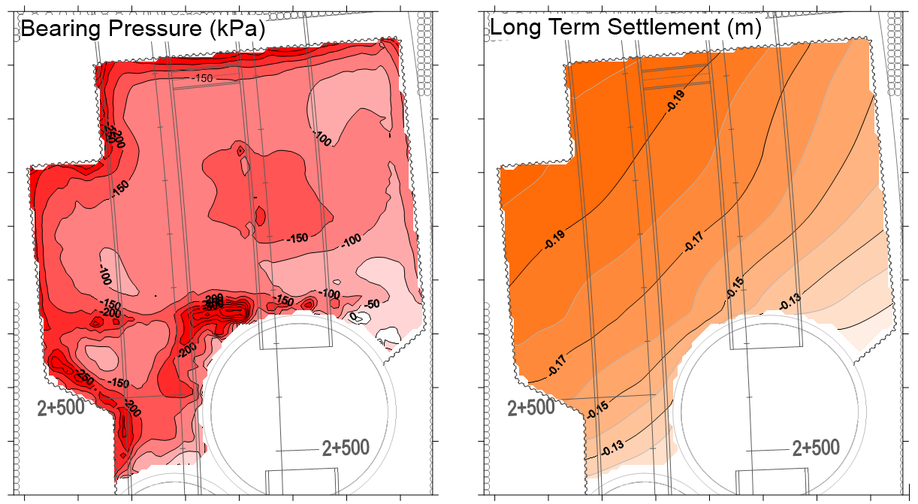
Foundations Design
Raft Foundations Design
TENDER DESIGN: 330 SHAFT GROUTED PILES 70m DEEP
ALTERNATIVE DETAILED DESIGN: RAFT FOUNDATION ON GROUND IMPROVEMENT

Slide 11
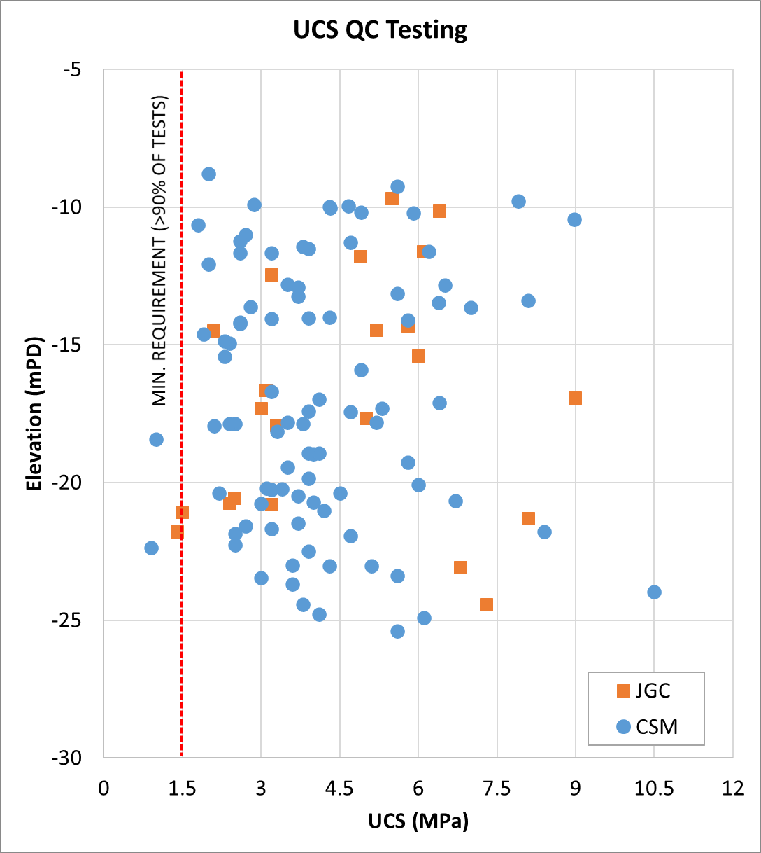
Ground Improvement Solution

Slide 12
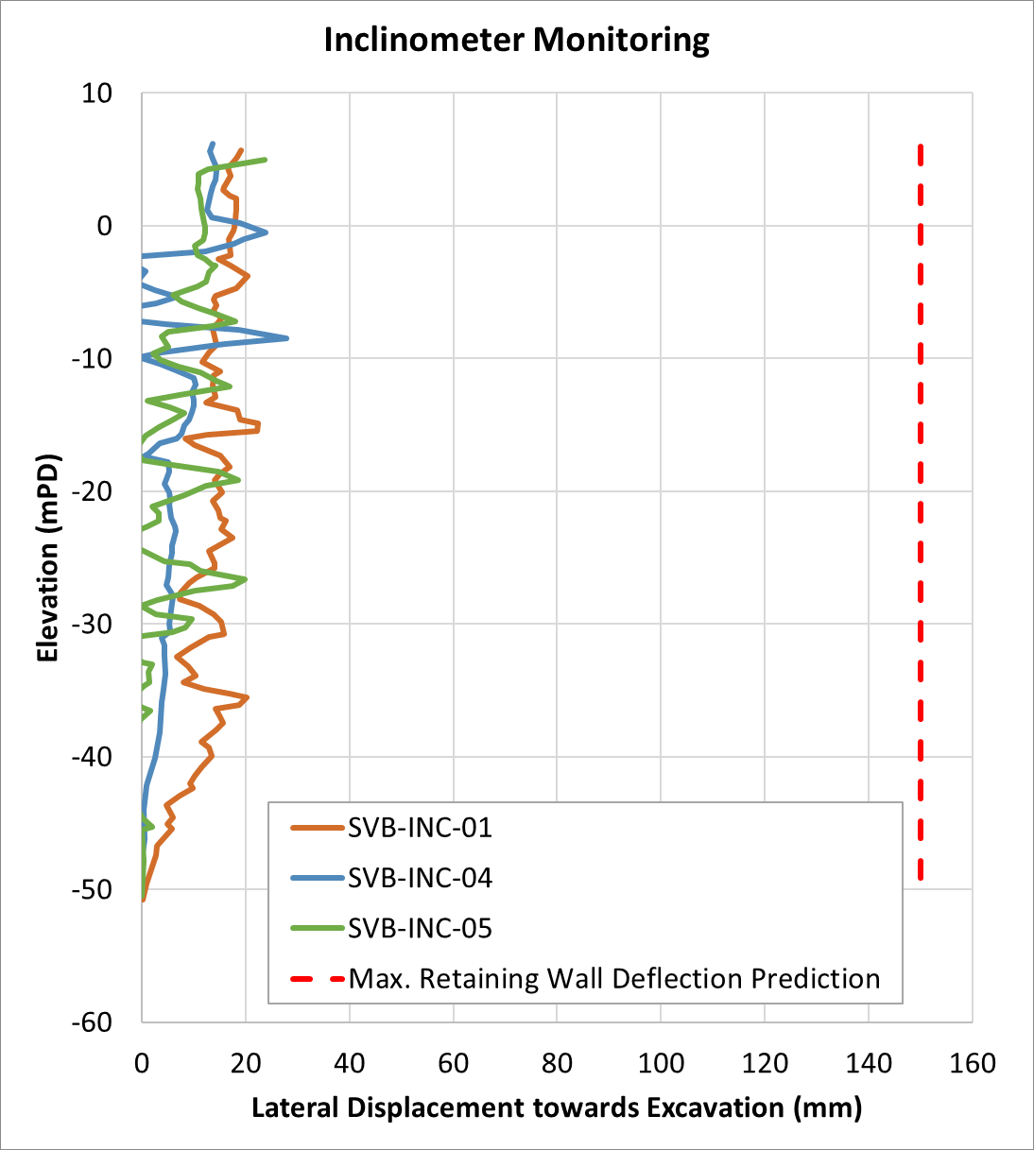
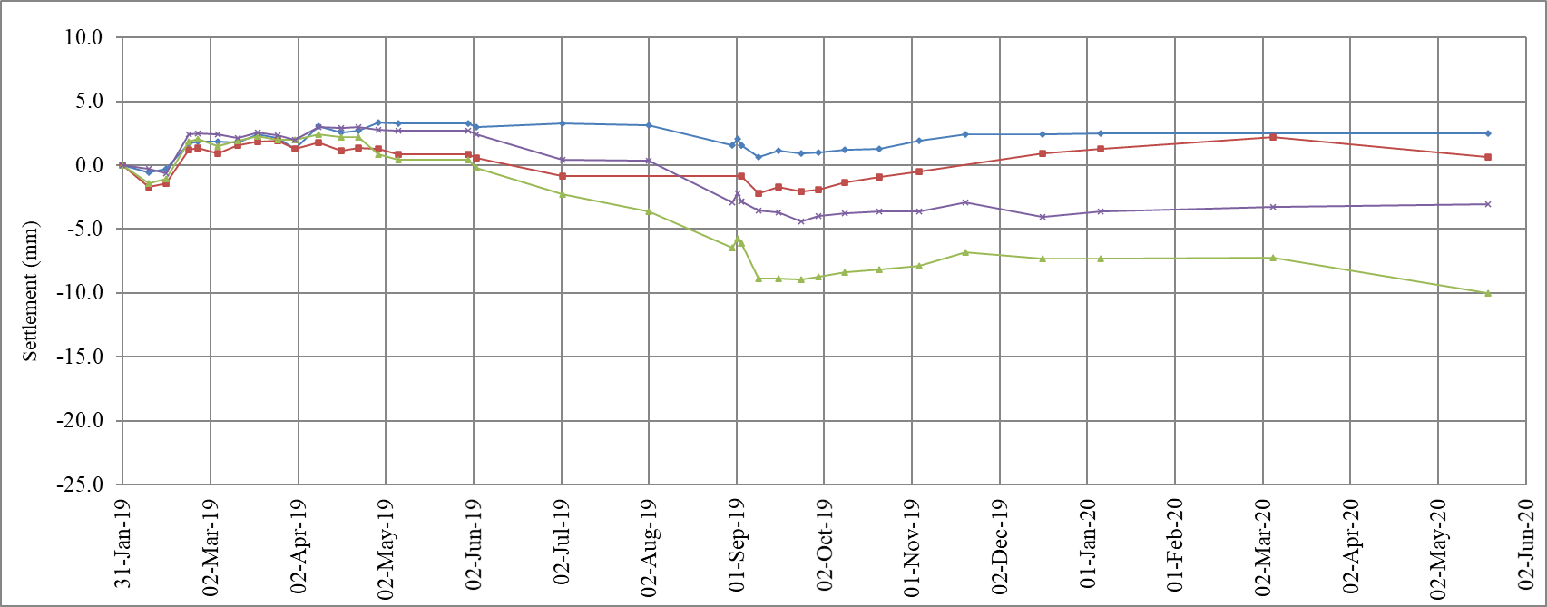
Monitoring Data
Monitoring Data
TEMPORARY WORKS DEFLECTIONS
FOUNDATIONS SETTLEMENT

Slide 13
Summary
I was the technical lead and project manager for the geotechnical design of SVB temporary works and raft foundations
The alternative ground improvement solution provided a optimized and robust solution to address key issues for both temporary works excavation and permanent conditions
The project was delivered successfully and I was responsible for weekly site inspections to verify the works were in accordance with design assumptions and that there were no signs of unexpected distress
Collaborative effort between Contractor-engineer-client-designer to find the best way out of difficult ground improvement conditions due to the reclamation issues prior to site handover

Slide 14
Thank you
Alessandro.Martucci@wsp.com

