Slide 1

ISSMGE - TC206
Technical Committee Meeting
26-02-2025 at 09:00hrs - UK time
Update on TC206 work
Duncan Nicholson - Chairperson TC206
Ying Chen – Vice Chair
Amit Srivastava - Secretary

Slide 2
Agenda
TC206 Management (5min)
  New Members
  Minutes of 28/11/24 – actions. Covered in agenda.
  Website update – Amit.
  Storage space - Contact ISSMGE.
  Membership development.
Honour Lecture (5 Min)
3.Conferences (5 min
  Vienna Update.
  12th Int. Symp. Field Monitoring
  Others - CIRIA R185 New Revision.
4.Working Group Updates.
  Monitoring - Duncan – 3 min
  RTBA - Franz – 5 min
  Tunnelling – Chris - 1 min
  Eurocodes - Johan – 3 min
  Contracts- Tony - 1 min
  Historical Assets – Mandy/ DPN 2 min
5. Presentation
  Dr Poh - Singapore BCA.
  Update on Implementation of OM in Singapore
7. AOB
8.Next TC Members' meeting
  Wed 28 May 2025 (09.30hrs UK time)
9.Next Management Meeting (09.00hrs UK time)
  28 March 2025 - 09.00hrs UK time
  29 April 2025 – 09. 00hrs UK time
  21 May 2025 – 09.00hrs UK time

Slide 3
2) TC206 Management
Welcome new TC206 Members.
Can members attending for the first time introduce themselves.
Members added to the ISSMGE list.
  Local Geotechnical society can identify
  Nominated (Voting) Members
  Corresponding Members

Slide 4
Minutes of meeting on 28-11-24
Circulated.
Issues to be updated during this meeting.

Slide 5
Admin. - Web site updates –
Dr Amit Srivastava (TC206 Secretary)
  Website Update – Amit.
  Storage space –
    Google storage space will cost >£100 /year
    Contacting ISSMGE for central storage.
  Membership development.

Slide 6
2) TC206 Honour Lecture - Actions from management meeting
Progress
We achieved 75% of Nominated (voting) Members –
  Supported lecture and Honour lecture titles. Done
    1)The Peck Observational Method Lecture (or The Peck OM Lecture) –
    The ASCE has established Ralph B Peck Lecture in the USA.
    2) The Peck – Terzaghi OM Lecture.
Confirmation Email sent to all Nominated Members + Helmet Schweiger – (coordinates Vienna). - Done.
Actions
Confirm Process with ISSMGE - TOC and Helmet. Done
Forward “Confirmation Email” to all TC206 members. - Done -Ying
Forward to Neil Taylor / Andrew McNamara to let ISSMGE know. Need to informally vet Honour Lecture Name.
Contact TOC chairman (Sanchez Castilla) Done - DPN
Agreed Honour Lecturer process with TC206 Management Group on 15/1/25:- Done - DPN/Chris/Ying

Slide 7
TC206 Honour Lecture -
Marcelo Sanchez feedback (29/1/25):-
“The main requirement is to demonstrate that there is a regular event series where the HLs will be delivered at consistent intervals, ideally, international events organized by the TC every 3 to 4 years. I believe it will be difficult to obtain Board approval without this requirement.”
Ying’s review - Existing Honour Lectures all linked to TC conferences.
Way Forward
  Update TC206 TC on Honour lecture status.
  Link with other TC’s and hold a regular joint conference. ProposeTC103 (Tunnelling).
  Discussing Joint Honour Lecture - alternate lecturers.
  Other suggestions??

Slide 8
5)Conferences
ISSMGE 21st ISSMGE Int. Conf. Vienna Conference
Vienna – Austria 2026
  Honour Lecture Proposals? –
    8 Proposals from other TC (TC206 is one)
  Workshops –
    TC206 - we have booked.
  Oral Session -
    Vienna has more than 2100 abstracts.
    TC206 has 26 Abstracts as first choice. OK for Oral session.

Slide 9
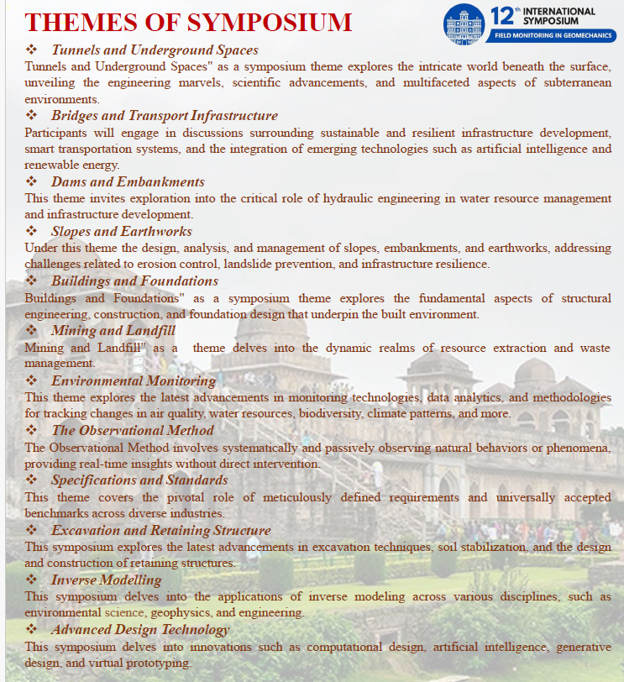
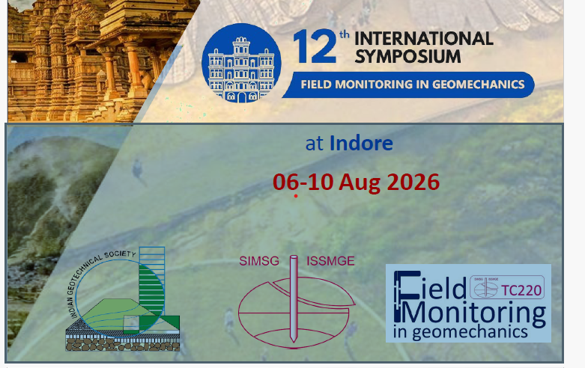
12th Int. Symp. Field Monitoring in Geomechanics https://isfmg2026.com/.
Abstract close on 31/5/25.
Contact – Prof Neelima Satyam neelima.satyam@gmail.com

Slide 10
Others
Kenichi Soga - Rankine Lecture on 19/3/25
Title:- From Geo-monitor to Geo-adapt: leveraging distributed sensing and data analytics for performance-based design, construction, and maintenance.
Much of Kenichi’s lecture links to Monitoring and OM. –
  Discussion OM Process with Kenichi.
Ciria Guide R185 - Revision – The Observational Method in Ground Engineering
    Start planned Sept 25
  CIRIA currently seeking stakeholder funding.
  CIRIA to talk to TC206 Management group about their involvement.
  Opportunity include new TC206 work.

Slide 11
6) Presentation by Dr Poh - Singapore BCA
  “Update on Implementation of OM in Singapore”
    OM contracts and TBM sensor monitoring.
20min presentation and 10min discussion

Slide 12
Any Other Business
Get involved by joining working groups.
Interesting OM presenters.

Slide 13
7)Next Meetings
ISSMGE - TC206 Tech Committee - Members meetings:-
  Wed 28 May 2025. 09.00hrs UK time
    OM Presenter. - Alessandro Martucci (Hong Kong)
TC206 Management Group Meetings
  28 March 2025 - 09.00hrs UK time
  29 April 2025 – 09.00hrs UK time
  21 May 2025 – 09.00hrs UK time
20/05/2024
Management Group Meeting

