Slide 1

ISSMGE - TC206 Technical Committee Meeting 28-05-2025 at 09:00hrs - UK time
Update on TC206 work
Duncan Nicholson - Chairperson TC206
Ying Chen – Vice Chair
??? - Secretary

Slide 2
Agenda
TC206 Management (5min)
New Members
Minutes of 28/11/24 – actions. Covered in agenda
Website update – Amit
Storage space - Contact ISSMGE
Membership development
Honour Lecture (5 Min)
3.Conferences (5 min)
Vienna Update
12th Int. Symp. Field Monitoring
Others - CIRIA R185 New Revision
4.Working Group Updates.
RTBA - Franz – 4 min
Monitoring - Hock – 4 min
Tunnelling – Chris - 1 min
Eurocodes - Johan – 1 min
Contracts - Tony - 1 min
Historical Assets – Mandy/ Ying Chen/DPN 1 min
5. Presentation
Alessandro Marucci - HK on 28/5/25.
“Observational Method Associated with 3D Analysis for HKBCF PCB Open Cut Excavation”
Suggestions for the next TC Meeting.
7. AOB
8.Next TC Members' meeting
10 September 2025 (09.30hrs UK time)
Presenter?
9.Next Management Meeting (09.00hrs UK time)
21 May 2025 – 09.00hrs UK time
17 Jun 2025 - 09.00hrs UK time
23 July 2023 - 09.00hre UK time

Slide 3
TC206 Management Group
The TC206 holds monthly Management meetings.
The Working Group leaders attend to plan activity.
Can members attending for the first time introduce themselves.
Members added to the ISSMGE list.
Local Geotechnical society can identify.
Nominated (Voting) Members.
Corresponding Members.

Slide 4
Minutes of meeting on 26-02-25
Circulated.
Issues to be updated during this meeting.

Slide 5
TC206 Administration – Dr Amit Srivastava (TC206 Secretary) Resigning TC206 needs a new Secretary.
Main Duties – Compile presentation material / minutes of meetings etc.
1) Update TC206 Website (Google Drive)
TC206 Members meeting minutes & presentations (2023 to 2024)
Knowledge information sharing.
Lisbon - Conf Workshop Presentations.
Google Space issues - £100/year for more space!
2) Update ISSMGE - TC206 webpages
What can we store? Including past events (2023 to 2024)
New Terms of Reference.
TC206 Membership Development
Ideally new Secretary from Far East (not Europe). To spread connections. Volunteers?

Slide 6
TC206 Honour Lecture - Management Meeting Actions
Early Progress
We achieved 75% of Nominated (voting) Members.
Supported lecture and Honour lecture titles. Done
1)The Peck Observational Method Lecture (or The Peck OM Lecture) –
The ASCE has established Ralph B Peck Lecture in the USA.
2) The Peck – Terzaghi OM Lecture.
Confirmation Email sent to all Nominated Members + Helmet Schweiger – (coordinates Vienna). - Done.
Actions
Confirm Process with ISSMGE - TOC and Helmet. Done
Forward “Confirmation Email” to all TC206 members. - Done -Ying
Forward to Neil Taylor / Andrew McNamara to let ISSMGE know. Need to informally vet Honour Lecture Name.
Contact TOC chairman (Sanchez Castilla) Done - DPN
Agreed Honour Lecturer process with TC206 Management Group on 15/1/25:- Done - DPN/Chris/Ying

Slide 7
TC206 Honour Lecture -
Marcelo Sanchez (Chairman of Tech Oversight Committee) - Feedback (29/1/25):-
“The main requirement is to demonstrate that there is a regular event series where the HLs will be delivered at consistent intervals, ideally, international events organized by the TC every 3 to 4 years. I believe it will be difficult to obtain Board approval without this requirement.”
Ying’s review - Existing Honour Lectures all linked to TC conferences.
Way Forward
Update TC206 TC members on Honour lecture status.
Link with other TC’s and hold a regular joint conference. ProposeTC203 (Tunnelling).
Discussing Joint Honour Lecture - alternate lecturers.
Web Conferences.
Extend TC206 workshops to be called Conferences.
Other suggestions??

Slide 8
International Journal of Geoengineering Case Histories (IJGCH). ISSMGE- Invitation to Select Editorial Board Member Representative from your Technical Committee.
TC206 Selection of an Editorial Board member -
Tony O’Brien volunteered. - Tony’s name forward to ISSMGE.
Other TC206 volunteers can contribute. – Contact Chairman.
IJGCH accepts long papers – e.g. Observational Method Case Histories.
Tony and Hock proposed paper from HS2 work – based on Hock’s talk.
This could also be a TC206 meeting presentation.

Slide 9
Conference Summary
ISSMGE 21st Int Conf - Vienna - 14-19 June 2026
RTBA Workshop – Imperial College – 17 March 2026 (Day before Rankine Lecture)
12th Int. Symp. Field Monitoring in Geomechanics 6-10 August 2026
6th Int. Conf. on Information Technology in Geo-Engineering (6th ICITG) in Graz, Austria, - 3 to 16 October 2026. - https://www.icitg2026.com
The conference will provide a platform to discuss current developments in digital transformation within geo-engineering. Topics include case studies on information technology in practice, integration of digital systems such as Scan2BIM and BIM2FEM, the use of open benchmark datasets, uncertainty quantification and mitigation, applications of machine learning including reinforcement learning and large language models, as well as Real-Time Back-Analysis (RTBA).

Slide 10
ICSMGE, Vienna Austria, 2026 Summary by Ying Chen
ICSMGE in Vienna, Austria – 2026
TC206 initially applied for key-note session for the proposed Observational Method Honour Lecture: withdraw due to deadline and approval by ISSMGE still in progress.
TC206 applied for conference session: 2 hours
Overview of the submitted Abstracts under TC206
OM Workshop Session
Open for Discussion: How Conference Session for TC206 shall be organized? Additional Session?

Slide 11
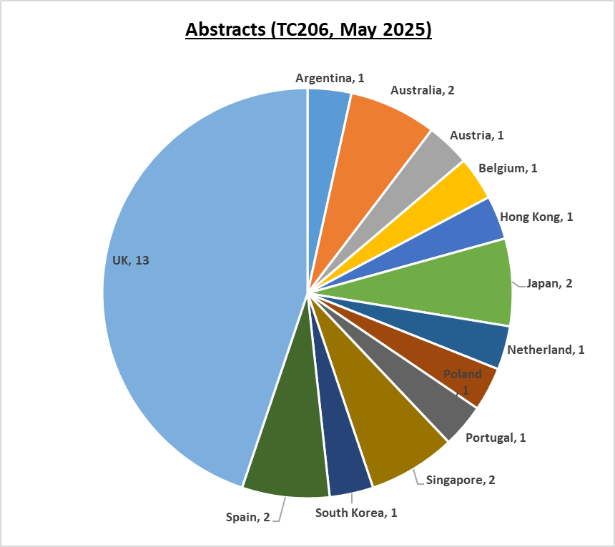
TC206 Abstracts at the ICSMGE, Vienna (1)
Successfully submitted Abstracts (OM was key word 1st choice): 29
Abstracts from 13 countries and regions: UK (13) & Europe (7) are dominated,
Also from Asia (6), Australia (2) and South America (1).

Slide 12
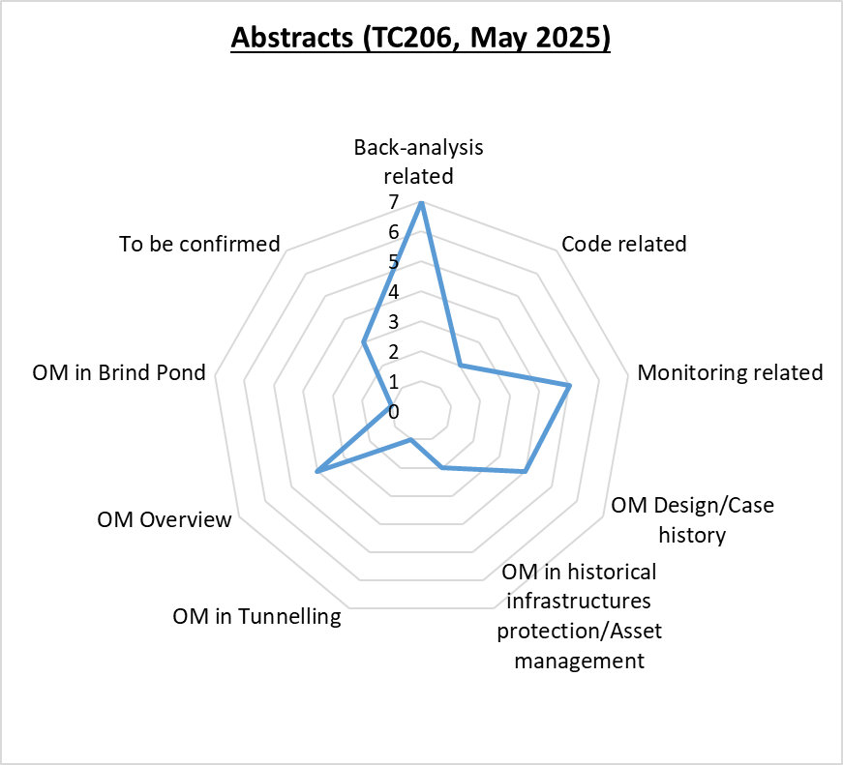
TC206 Abstracts at the ICSMGE, Vienna (2)
Topics of paper are associated with Observational Method in following subjective:
Back-analysis related (algorithms, cast study and overview etc.)
Monitoring related (new tech, data, data-driven design)
OM Design / Case history
OM Overview (contract, assurance, back analysis and monitoring)
OM in Tunnelling
OM in Brind Pond
To be confirmed (not identified from titled)

Slide 13
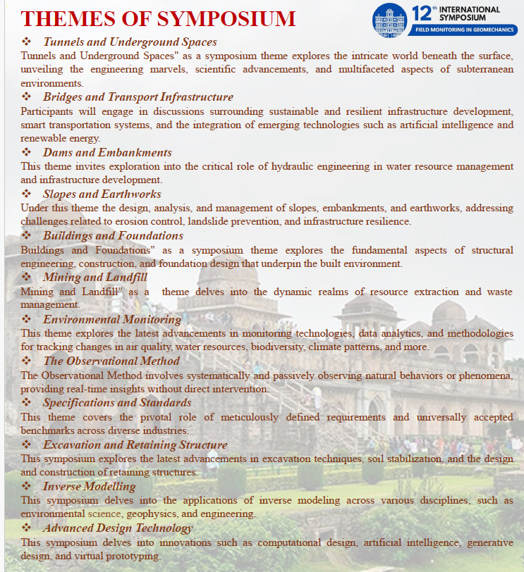
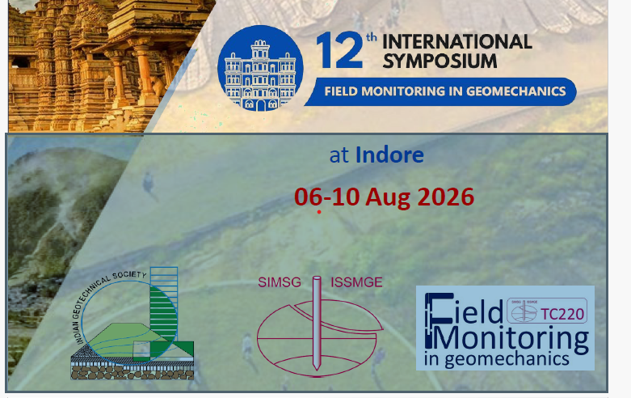
12th Int. Symp. Field Monitoring in Geomechanics https://isfmg2026.com/.
Abstract close on 31/5/25.
Contact – Prof Neelima Satyam neelima.satyam@gmail.com

Slide 14
Others
Ciria Guide R185 - Revision – The Observational Method in Ground Engineering
Start planned Sept 25
CIRIA currently seeking stakeholder funding.
Opportunity include new TC206 work.
CIRIA want one representative from TC206 – ideally outside UK.
So far Johan Spross

Slide 15
TC206 Working Groups
Real Time Back-Analysis - Franz Tschuchnigg
Monitoring - with TC220 - Daniele Fornelli, Hock Liong Liew, Dorota Symonidou.
Eurocodes – Johan Spross
Tunnelling – Chris Menkiti
Contracts – Tony O’Brien
Historical Assets – Mandy Korff / Ying Chen

Slide 16
TC 206 Tech COMMITTEE
Real Time Back-Analysis (RTBA) GROUP
Franz Tschuchnigg

Slide 17
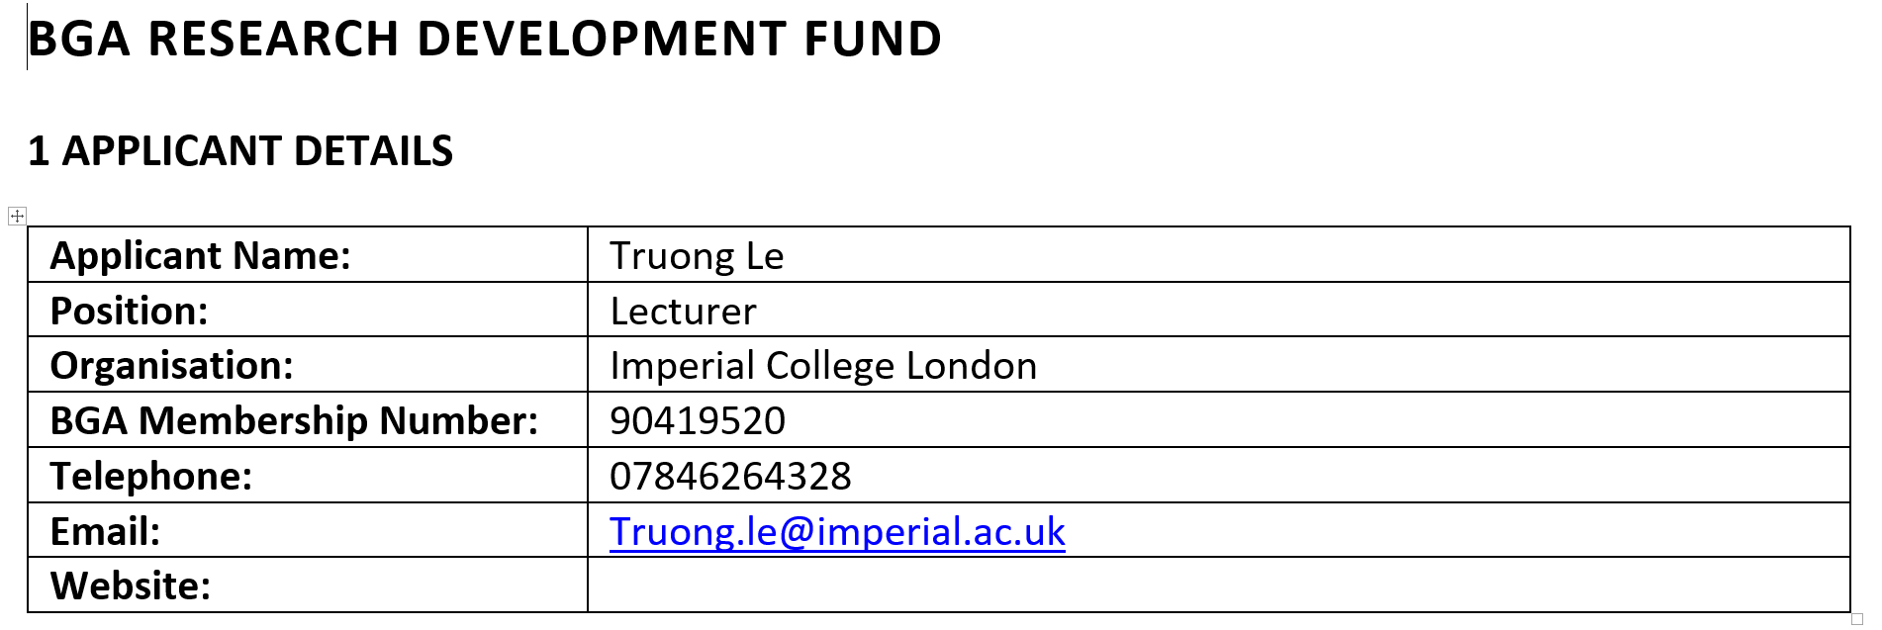
RTBA Group - Franz Tschuchnigg
RTBA Meetings – bi-monthly
Truong Le - organised the Workshop and Funding
@Imperial College – 17.03.2026 - One Day workshop
- Date, speaker, content…..coming soon

Slide 18
RTBA Group Meetings
How should we proceed?
Based on our previous conversations this is the list of actions:
A) Formulation of guidelines & definitions – How RTBA should/could be applied.
B) Specification of requirements – For example, monitoring needs for RTBA.
C) Collection and discussion of case studies – Where RTBA has been successful and where it hasn’t.
Definitions, Specifications, Requirements & Guidelines
(Guidelines could be formulated in form of examples (e.g. in the annex of the document)

Slide 19
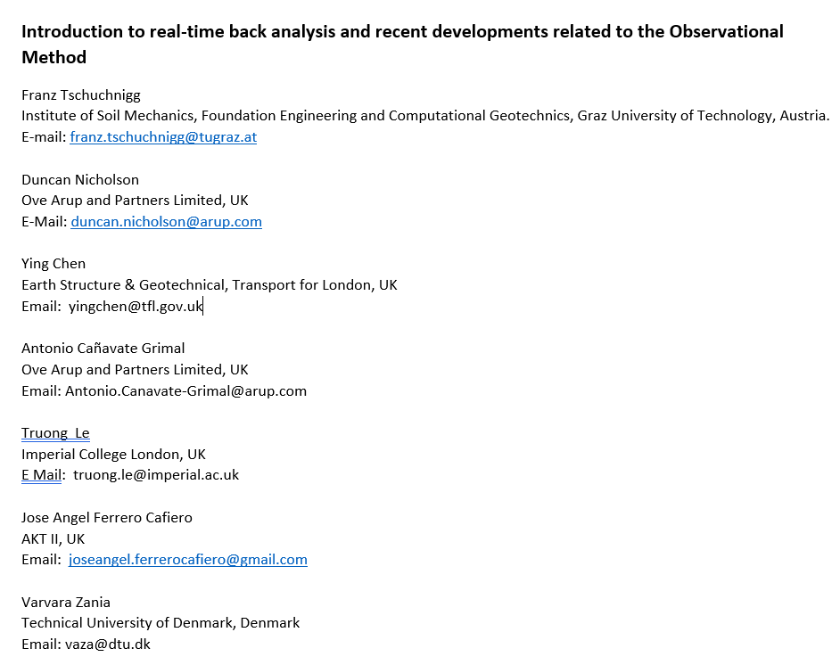
RTBA Meeting
Paper for ICSMGE 2026 (Vienna)
7No Paper on OM back-analysis.
(see later review.)
Introduction to RTBA and recent
Developments Related to OM.

Slide 20
RTBA Meeting
Introduction to RTBA and recent developments Related to OM.
Real-time back-analysis (RTBA) has emerged as a promising approach in geotechnical engineering, driven by advancements in cloud computing, instrumentation data availability, and interdisciplinary collaboration. RTBA enhances decision-making by integrating live or near-live observation data with prompt & reliable predictions from numerical models, aligning closely with the principles of the Observational Method (OM).
This paper provides a comprehensive definition of RTBA within the context of OM and explores its transformative potential in geotechnical practice. The study highlights the dual components of RTBA: observation and prediction, which combine real-time field measurements with computational models to replicate geotechnical challenges actively and accurately. These components enable engineers to alter designs dynamically, thereby reducing risks and improving project outcomes. Key benefits of RTBA include improved responsiveness to site conditions and the facilitation of proactive decision-making. However, its implementation faces notable challenges, including ensuring the near real-time availability, accuracy and reliability of instrumentation data, managing the complexity of model calibration, handling vast volumes of data efficiently, and navigating the coordination requirements between project parties, including contractors, designers, independent checkers, and clients. Addressing these issues is critical to fully realize the potential of RTBA.
The paper aims to underscores the importance of robust instrumentation practices as a foundation for successful RTBA implementation. Essential practices include establishing long-term baseline monitoring to account for environmental effects and instrument noise, as well as implementing redundancy through alternative measurement methods. These measures ensure the quality and reliability of input data, which are pivotal for successful back analysis

Slide 21
TC206 / TC220 Monitoring Group by Hock Liong Liew - with Daniele and Dorota
Enhance interaction between TC206 & TC220 – common interest/boundaries
Goals of this WG:
OM design + construction (design, triggers, back-analysis, site observations, contingency) + I&M (contract, spec, roles of I&M coordinator) + Database (AGS input)
Clear workflow (flow chart) – improve monitoring and reporting systems
Capturing good + bad performances – lessons learnt from different countries, project confidentiality to be respected
Prepare for new CIRIA R185 in OM – new I&M chapter, new Eurocode
Prepare for workshop – Imperial College March 2026 + Vienna Conference June 2026
Influence client/main contractor – contracts, construction data
and TC220

Slide 22
TC206 / TC220 Monitoring Group
Current 26 members:
Duncan Nicholson
Andrew Ridley
Ying Chen
Dorota Symonidou
Daniele Fornelli
Hock Liong Liew
Tony O’Brien
Chris Menkiti
Ignasi Aliguer
Angus Maxwell
Stuart Hardy
Paul Burton
De Vos Leen
Asha Panchal
Neelima Satyam
Colin Carter
Anil Joseph
Wei Cai
Daniella Petani
Berta Sola
Colin Eddie
Mandy Korff
James Sze
Philip Child
Teoh Yaw Poh
Stephen Walthall
Leadership team:
Duncan Nicholson – Chair of TC206
Andrew Ridley – Chair of TC220
Ying Chen – Vice Chair of TC206
Daniele Fornelli – Field Monitoring TC220
Dorota Symonidou – Database TC220
Hock Liong Liew – OM Designer TC206
and TC220

Slide 23
TC206 / TC220 Monitoring Group
Bi-monthly meetings – two meetings held to date (for this year)
First meeting on 26 March 2025
Set up goals for the working group; agreed on Terms of Reference – respect confidentiality
Lessons learnt – HS2 OM application by Hock Liong Liew
Focus should be on data quality NOT quantity - more data does not equal to better results!
A simple instrument can do the job if we know what the specific question to answer.
To ensure data quality, a real effort from everyone particularly the designer is required.
Second meeting on 14 May 2025
Presentation by Stephen Walthall – “Principles of data and information management for ground engineering projects”
Data and information management plan – incorporation into the contract – who, how and when? Other considerations – data quality, different types of contract, OM approaches
Next meeting -16 July 2025 – 09.00 – 10.00hrs UK time
and TC220

Slide 24
Tunnelling Working Group - update by C Menkiti
Leadership.
Chris Menkiti leads this group.
Chris has a GCG person
Restarting Tunnelling Working Group
For the Management meeting on 13/11/24 and TC206 meeting we need a presentation on:-
List people who previously attended the Tunnelling WG.
Terms of Reference. – topics
Links with TC204
Define tunnelling approach to OM and compare with Infrastructure approach. What can we learn?
Triggers and design. Abstract in Vienna
Examples.
HS2 – bored tunnels.
HS2 - SCL tunnels.
Silvertown tunnel.
Sensors and RTBA . – new sensors on cutting wheel.
Aim for a meeting before Christmas.
Strategic papers – Vienna conf
Hold working group meeting January ‘25.
Management Group Meeting

Slide 25
Eurocodes Group - Johan Spross
Abstracts - Vienna Conf - Stuart submitted paper on varying partial factors.
Need to progress paper on Eurocode.
Next meeting?

Slide 26
Contracts Group - update by Tony O’Brien
Need to complete table of OM projects with cost savings. - Now end May 2025
Chase other experts – Alan Marr - ?? Ferovila. Lisbon contact JST – Ko forces. Spanish rep Carbon calculations counting in Table 1 example. Canary Wharf – Arup carbon experience.
Paper for Vienna – summarise report. Individual case histories.
Link with ICE Client Initiatives.
Link to new OM Projects.
Cat 3 checker involvement.
TAA issues – AIP issues.
Paper on Culture –
Organisations need to reach consensus at start of OM.. This means skill base to extend and confidence. Effects all parties – Contractors and Consultants. Key Leaders.
Email from David J. Hatem DHatem@mgmlaw.com - US experience. Chase - presentation?
20/05/2024
Management Group Meeting

Slide 27
Historical Assets – Mandy Korff / Duncan Nicholson
This includes :-
Old canal walls, - Old dock walls, - Leen and Arup Canary Wharf Banana walls
Old railway walls – PVE walls
Old cut slopes - TFL / HA/ Network rail (GCG)
Embankment fill - London Underground
Reuse of building foundation, - Dinesh Patel
Bridges, - Structural Health Monitoring process. ??
Eurocode 0 Part 2 - UK rep? contact Andrew Bond? Stuart Hardy?
Goal set up working group.

Slide 28
6) Presentation by Alessandro Marucci
Observational Method Associated with 3D Analysis for HKBCF PCB Open Cut Excavation
20min presentation and 10min discussion.
Proposals for next TC206 meeting.

Slide 29
Any Other Business
Get involved by joining working groups.
Interesting OM presenters.

Slide 30
7)Next Meetings
Next TC Members' meeting
10 September 2025 (09.30hrs UK time)
Presentation Suggestions ??
Next Management Meetings (09.00hrs UK time)
21 May 2025 – 09.00hrs UK time
17 Jun 2025 - 09.00hrs UK time
23 July 2023 - 09.00hre UK time
20/05/2024
Management Group Meeting

