Slide 1

ISSMGE - TC206 Technical Committee Meeting 10-09-2025 at 09:30hrs - UK time
Update on TC206 work
Duncan Nicholson - Chairperson TC206
Ying Chen – Vice Chairperson TC206
Alessandro Martucci - Secretary

Slide 2
Agenda
TC206 Management (5min)
Minutes of 28/11/24 – actions. Covered in agenda.
New TC206 Secretary and Website update.
Membership development.
Honour Lecture Update (1 Min)
3.Conferences Uodate (5 min)
Vienna Update
12th Int. Symp. Field Monitoring
Others - CIRIA R185 New Revision.
4.Working Group Updates.
Contracts - Tony - 1 min.
Monitoring - Hock – 1 min
Tunnelling – Chris - 1 min
Eurocodes - Johan – 1 min
Historical Assets – Mandy/ Ying Chen/DPN 1 min
RTBA - Franz – 4 min.
Pre-Rankine Conference Truong (5 min).
5. Presentation
10 September 2025 -
Stephen Walthall (30 min)
“Principles of data and information management for ground engineering projects”
10 December 2025
Tara Wood
Bridging the knowledge gaps through observational methods: some Swedish examples.
March 26? - Suggestions
7. AOB
8.Next TC Members' meeting
10 December 2025 (09.30hrs UK time)
9.Next Management Meeting (09.00hrs UK time)
9 Oct 2025
6 Nov 2025
3 Dec 2025

Slide 3
Minutes of meeting on 26-02-25
Circulated.
Issues to be updated during this meeting.

Slide 4
TC206 Management Group
The TC206 holds monthly Management Group meetings.
The Working Group leaders attend to plan activity.
Minutes are stored on the TC206 web site.
New TC206 Members added to the ISSMGE list.
Local Geotechnical society can identify.
Nominated (Voting) Members.
Corresponding Members.

Slide 5
TC206 Administration – - Dr Amit Srivastava is the retiring Secretary. - Mr Alessandro Martucci is the new TC206 Secretary.
Main Duties – Compile presentation material / minutes of meetings etc.
1) Update TC206 Website (Google Drive)
TC206 Members meeting minutes & presentations (2023 to 2025)
Knowledge information sharing.
Lisbon - Conf Workshop Presentations.
2) Update ISSMGE - TC206 webpages
What can we store? Including past events (2023 to 2024)
New Terms of Reference.
3) TC206 Membership Tracking and Development.

Slide 6
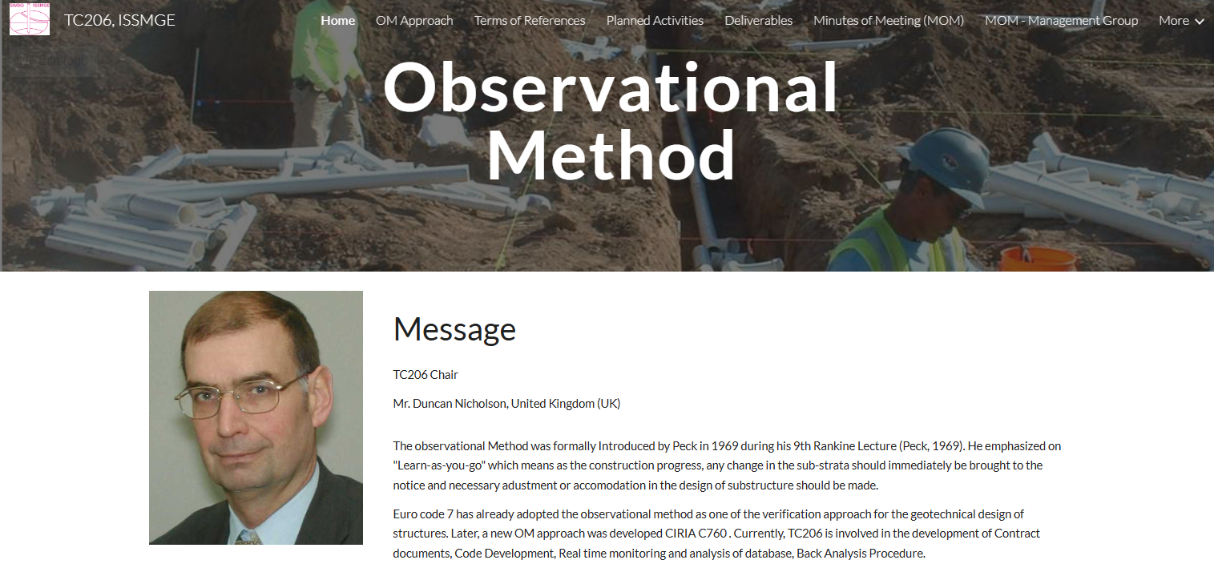
TC206 Google Site
Link to site:
MoMs and Presentation materials saved here
TC206, ISSMGE

Slide 7
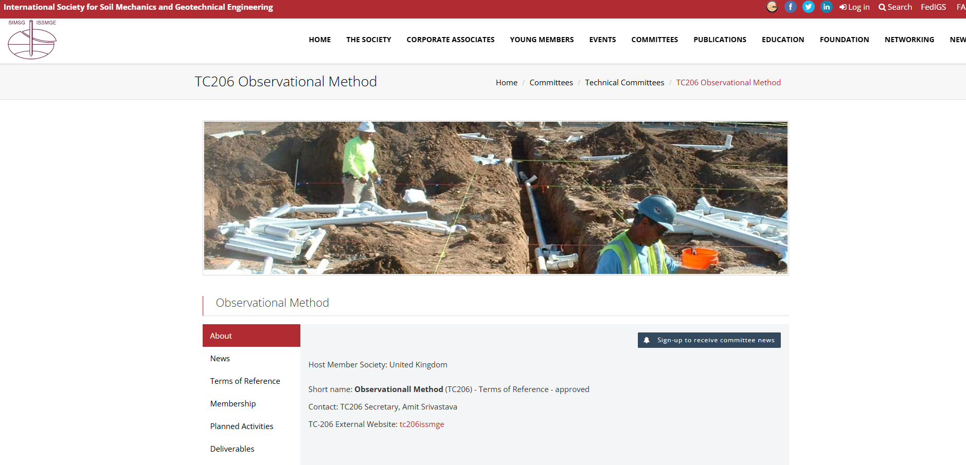
TC206 Page on ISSMGE Site
Link to site:
TC206 Observational Method | ISSMGE
This links to Google Site, however access is limited to TC206 Members only currently.
Further use of ISSMGE site to store more information under review

Slide 8
TC206 Honour Lecture Application
Marcelo Sanchez (Chairman of Tech Oversight Committee) - Feedback (29/1/25):-
“The main requirement is to demonstrate that there is a regular event series where the HLs will be delivered at consistent intervals, ideally, international events organized by the TC every 3 to 4 years. I believe it will be difficult to obtain Board approval without this requirement.”
Way Forward
Update TC206 TC members on Honour lecture status.
Link with other TC’s and hold a regular joint conference.
Discussing Joint Honour Lecture - alternate lecturers.
Web Conferences.
Extend TC206 workshops – Link to Pre-Rankine Lecture Conference.
Other suggestions??

Slide 9
International Journal of Geoengineering Case Histories (IJGCH). ISSMGE- Invitation to Select Editorial Board Member Representative from your Technical Committee.
TC206 Selection of an Editorial Board member -
Tony O’Brien volunteered. - and has been accepted.
IJGCH accepts long papers – e.g. Observational Method Case Histories.
Tony and Hock proposed paper from HS2 work – based on Hock’s talk.
This could also be a TC206 meeting presentation.

Slide 10
Conference Summary
RTBA Workshop – Imperial College – 17 March 2026 (Day before Rankine Lecture)
ISSMGE 21st Int Conf - Vienna - 14-19 June 2026
12th Int. Symp. Field Monitoring in Geomechanics 6-10 August 2026
6th Int. Conf. on Information Technology in Geo-Engineering (6th ICITG) in Graz, Austria, - 3 to 16 October 2026. - https://www.icitg2026.com
The conference will provide a platform to discuss current developments in digital transformation within geo-engineering. Topics include case studies on information technology in practice, integration of digital systems such as Scan2BIM and BIM2FEM, the use of open benchmark datasets, uncertainty quantification and mitigation, applications of machine learning including reinforcement learning and large language models, as well as Real-Time Back-Analysis (RTBA).

Slide 11

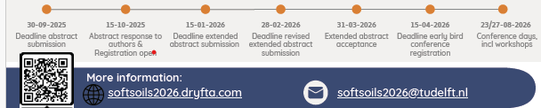
Soft Soil 2026
Initial Abstract 30/9/25
Based on extended abstracts.

Slide 12
ICSMGE, Vienna Austria, 2026
Tony O’Brien to give a key-note lecture on OM.
25 OM papers submitted. -
TC206 applied for conference paper presentation session:
OM Workshop Session. – Topics to be chosen.

Slide 13
Ciria Guide R185 - Revision – The Observational Method in Ground Engineering
Currently out to tender.
Start planned for October 25.
Opportunity to include new TC206 work.
CIRIA want one representative from TC206 – ideally outside UK.
So far Johan Spross

Slide 14
TC206 Working Groups
Contracts – Tony O’Brien
Monitoring - with TC220 -, Hock Liong Liew, Dorota Symonidou. Daniele Fornelli
Eurocodes – Johan Spross
Tunnelling – Chris Menkiti
Historical Assets – Mandy Korff / Ying Chen
Real Time Back-Analysis - Franz Tschuchnigg

Slide 15
Contracts Group - update by Tony O’Brien
Need to complete table of OM projects with cost savings. - Now end May 2025
Chase other experts – Alan Marr - ?? Ferovila. Lisbon contact JST – Ko forces. Spanish rep Carbon calculations counting in Table 1 example. Canary Wharf – Arup carbon experience.
Paper for Vienna – summarise report. Individual case histories.
Link with ICE Client Initiatives.
Link to new OM Projects.
Cat 3 checker involvement.
TAA issues – AIP issues.
Paper on Culture –
Organisations need to reach consensus at start of OM.. This means skill base to extend and confidence. Effects all parties – Contractors and Consultants. Key Leaders.
Email from David J. Hatem DHatem@mgmlaw.com - US experience. Chase - presentation?
20/05/2024

Slide 16
TC206 / TC220 Monitoring Group
Leadership team: Hock Liong Liew, De Vos Leen, Dorota Symonidou, Daniele Fornelli Duncan Nicholson, Andrew Ridley, Ying Chen,
Enhance interaction between TC206 & TC220 – common interest/boundaries
Goals of this WG:
OM design + construction (design, triggers, back analysis, site observations, contingency) + I&M (data quality, contract, spec, roles of I&M coordinator) + Database (AGS input, data/information management plan)
Capturing good + bad performances – lessons learnt from different countries, project confidentiality to be respected
Influence client/main contractor/asset owners, construction data
Target deliverables:
Clear workflow (flow chart) – improve monitoring and reporting systems
Input into new CIRIA R185 in OM – new I&M chapter, new Eurocode,
Workshops – Imperial College March 2026 + Vienna Conference June 2026
and TC220

Slide 17
TC206 / TC220 Monitoring Group
4 WG meetings and 5 WG Leadership meetings held to date
1st meeting on 26 March 2025: Hock Liong Liew – HS2 OM application. Key messages: Focus should be on data quality NOT quantity - more data does not equal to better results! A simple instrument can do the job if we know what the specific question to answer. To ensure data quality, a real effort from everyone particularly the designer is required.
2nd meeting on 14 May 2025: Stephen Walthall – Principles of data and information management for ground engineering projects. Key messages: Data and information management plan – incorporation into the contract – who, how and when? Other considerations – data quality, different types of contract, OM approaches
3rd meeting on 15 July 2025: Ying Chen and C. W. Kwang - Lessons Learned Reviewing Monitoring Data – Crossrail Excavation Case History Monitoring Data. Key messages: Reliable monitoring is essential for accurate back-analysis, requiring high-quality data from well-installed instruments and continuous collaboration among stakeholders.
4th meeting on 9 Sep 2025: Fiona Hughes and Colin Carter - Lessons Learned from Monitoring HS2 Northolt Tunnels. Key messages: Effective monitoring needs clear plans, collaboration, robust data management, early planning, and flexibility to address seasonal impacts, automation, and unforeseen risks.
Next meeting in Nov 2025: Date and agenda TBC at the next leadership meeting.
and TC220

Slide 18
Tunnelling Working Group - update by C Menkiti
Leadership.
Chris Menkiti leads this group.
Chris has a GCG person
Restarting Tunnelling Working Group
For the Management meeting on 13/11/24 and TC206 meeting we need a presentation on:-
List people who previously attended the Tunnelling WG.
Terms of Reference. – topics
Links with TC204
Define tunnelling approach to OM and compare with Infrastructure approach. What can we learn?
Triggers and design. Abstract in Vienna
Examples.
HS2 – bored tunnels.
HS2 - SCL tunnels.
Silvertown tunnel.
Sensors and RTBA . – new sensors on cutting wheel.
Aim for a meeting before Christmas.
Management Group Meeting

Slide 19
Eurocodes Group - Johan Spross
Abstracts - Vienna Conf - Stuart submitted paper on varying partial factors.
Need to progress paper on Eurocode.
Next meeting?

Slide 20
Historical Assets – Mandy Korff / Duncan Nicholson
This includes :-
Old canal walls, - Old dock walls, - Leen and Arup Canary Wharf Banana walls
Old railway walls – PVE walls
Old cut slopes - TFL / HA/ Network rail (GCG)
Embankment fill - London Underground
Reuse of building foundation, - Dinesh Patel
Bridges, - Structural Health Monitoring process. ??
Eurocode 0 Part 2 - UK rep? contact Andrew Bond? Stuart Hardy?
Goal set up working group.
Team Meeting 16/6/25 at 14.00hrs - UK time. (15.00hrs CET)

Slide 21
TC 206 Meeting
Real Time Back Analysis (RTBA)
Franz Tschuchnigg

Slide 22
Overview
Members: ~18
Meeting interval: 5 to 6 weeks
Since 11.01.2022: 28 online meeting (~90min)
Content: presentation & technical discussion & AOB (e.g. impact in industry)
Technical presentations: ~20 (members & guests)

Slide 23
Discussion
How should we proceed?
Based on discussions => list of actions:
A) Formulation of guidelines & definitions – How RTBA should/could be applied.
B) Specification of requirements – For example, monitoring needs for RTBA.
C) Collection and discussion of case studies – Where RTBA has been successful and where it hasn’t.
Definitions, Specifications, Requirements & Guidelines
(Guidelines could be formulated in form of examples (e.g. in the annex of the document)

Slide 24
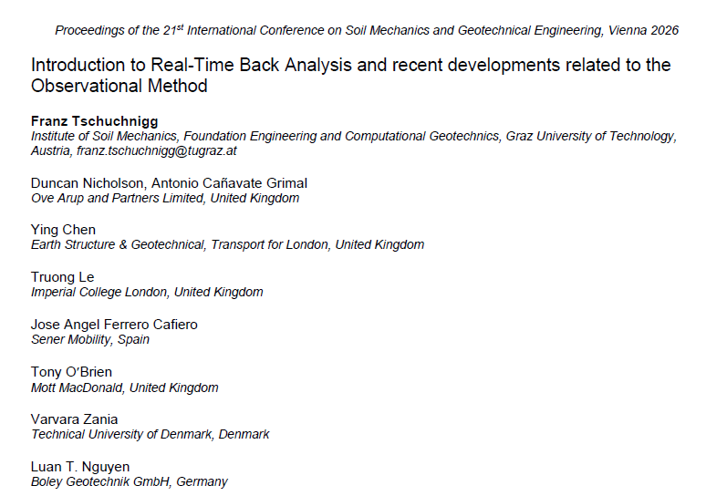

Paper SUBMITTED TO ICSMGE 2026

Slide 25
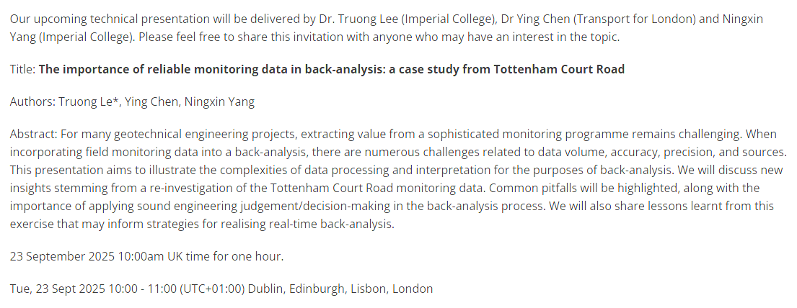
NEXT RTBA MEETing

Slide 26
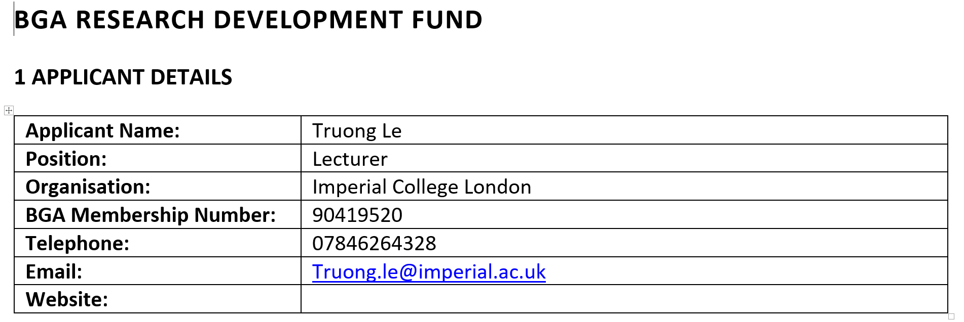
BGA & TC206 - PRE-RANKINE CONFERENCE
BGA RESEARCH DEVELOPMENT FUND - Budget Agreed - Truong

Slide 27
TC206 - PRE-RANKINE CONFERENCE ON OM DEVELOPMENTS
A state-of-the-art review on the observational method: Perspectives from academics, consultants, contractors, clients, and technical committees
@Imperial College
Workshop DATE: 17.03.2026
NEXT STEPS (Franz, Truong & Duncan): Discussion on the workshop's content and goals
AM session: Connection to other TCs & keynote presentations
PM session: Number of speakers from industry & academia
We try to integrate the first step towards a TC206 Honorary Lecture

Slide 28
RTBA group and/or upcoming Conferences
For further information, feel free to write
Franz Tschuchnigg - franz.tschuchnigg@TUGraz.at
Duncan Nicholson - Duncan.Nicholson@arup.com
PRE-RANKINE CONFERENCE: Le Truong - truong.le@imperial.ac.uk

Slide 29
PRE-RANKINE CONFERENCE ON OM DEVELOPMENTS – 17/3/2026 at Imperial College. Truong Le and Franz Tschuchnigg
Develop Agenda. – say 50 people?
Goals
Review Agenda – What can we improve on.
Set out presenter briefs.
Contact presenters. - Availability
Get titles.
Compile revised agenda. – Advertise.
Coordinate with IC.
Budget – BGA Support - £5000 – Registration fee - £100/person.
Present at TC206 Tech Committee on 10/9/25

Slide 30
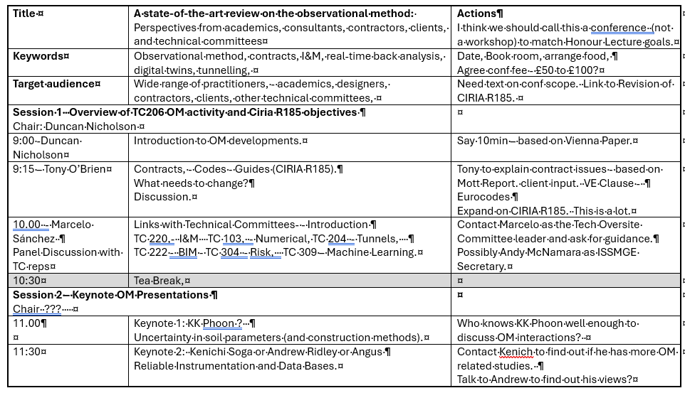

Slide 31
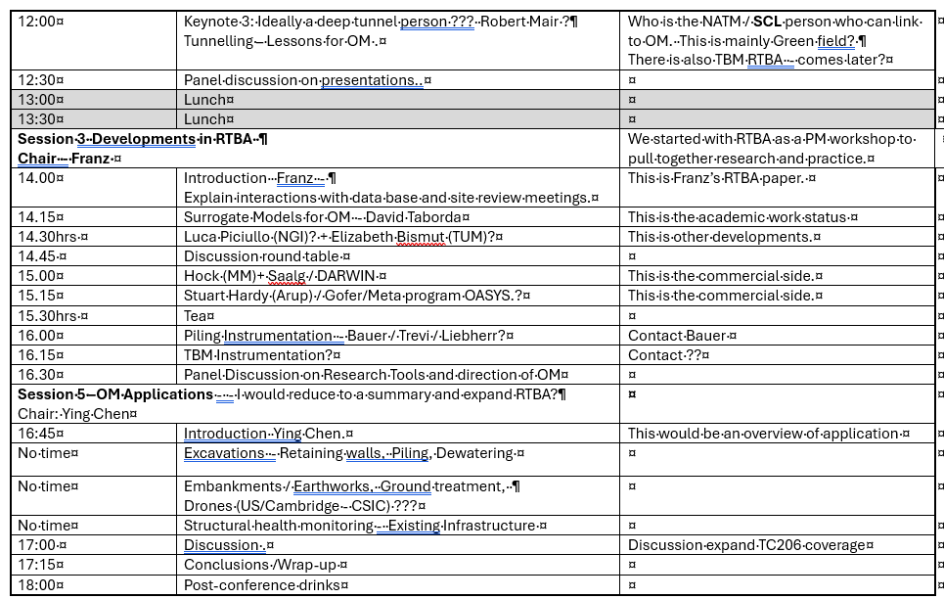

Slide 32
6) Presentation by Stephen Walthall
“Principles of data and information management for ground engineering projects”
Joint author of :-
AGS Guide to Planning a Programme of Geotechnical Instrumentation and Monitoring
Member of the AGS - Data Base Management Group.

Slide 33
Any Other Business
Get involved by joining working groups.
Suggestions for Interesting OM presenters.

Slide 34
7)Next Meetings
ISSMGE - TC206 Tech Committee - Members meetings:
10 September 2025 -
Stephen Walthall
“Principles of data and information management for ground engineering projects”
10 December 2025
Tara Wood – Bridging the knowledge gaps through observational methods: some Swedish examples.
March 26? -
Speaker ?
TC206 Management Group Meetings
9 Oct 2025
6 Nov 2025
3 Dec 2025
20/05/2024
Management Group Meeting

Slide 35
7)Next Meetings
Next TC Members' meeting
10 September 2025 (09.30hrs UK time)
Presentation Suggestions ??
Next Management Meetings (09.00hrs UK time)
21 May 2025 – 09.00hrs UK time
17 Jun 2025 - 09.00hrs UK time
23 July 2023 - 09.00hre UK time
20/05/2024
Management Group Meeting

