Slide 1

ISSMGE - TC206 Technical Committee Meeting 10-12-2025 at 09:30hrs - UK time
Update on TC206 work
Duncan Nicholson - Chairperson TC206
Ying Chen – Vice Chairperson TC206
Alessandro Martucci - Secretary

Slide 2
Agenda for 10-12-25
Minutes of 3/09/25 – review actions. Covered in agenda.
TC206 Admin Update
Website Update – Alessandro Martucci.
Conferences
OM Conference 17/3/26 at Imperial College
Truong presenting agenda.
Web site and banks accounts.
Vienna Conf. June 26 Update
Keynote / Papers/ Workshop.
4. CIRIA Guide R185 Revision
Arup/ Mott MacDonald have won tender.
Presentation on scope to follow.
5. Proposal for ICE Geot. Eng. Journal – Special Issue.
Ying Chen to Introduce.
6. Working Groups - Planned meetings.
RTBA - Franz – 5 min
Monitoring – Hock - 5 Min.
Tunnelling – Chris - 1 min.
Eurocodes - Johan - 1 min.
Contracts- Tony - 1 min.
Historical Assets – Mandy/ Ying - 1 min.
7. TC Presentation on 10/12/25
CIRIA Guide R185 Revision.
Hock Liong Liew to present scope of revision.
8. Next TC Members' meeting
25 or 26/3/2026 or 01 or 2/4/26 (09.30hrs UK time)
Tara Wood - Bridging the knowledge gaps through observational methods: some Swedish examples.
9.Next Management Meeting (09.00hrs UK time)
15 Jan 2025 - 09.00hrs UK time
12 Feb 2025 - 09.00hrs UK time
9 Mar 2025 - 09.00hrs UK time

Slide 3
1) Minutes of meeting on 3-09-25
Issues to be updated during this meeting.

Slide 4
TC206 Management Group (monthly)
The TC206 holds monthly Management Group meetings.
The Working Group leaders attend to plan activity.
Minutes are stored on the TC206 web site.
New TC206 Members added to the ISSMGE list.
Local Geotechnical society can identify.
Nominated (Voting) Members.
Corresponding Members.

Slide 5
TC206 Administration – - Mr Alessandro Martucci is the new TC206 Secretary.
Main Duties – Compile presentation material / minutes of meetings etc.
1) Update TC206 Website (Google Drive)
TC206 Members meeting minutes & presentations (2023 to 2025)
Knowledge information sharing.
Lisbon - Conf Workshop Presentations.
2) Update ISSMGE - TC206 webpages
What can we store? Including past events (2023 to 2024)
New Terms of Reference.
3) TC206 Membership Tracking and Development.

Slide 6
3) Conference Summary
TC206 OM Conference – Imperial College – 17 March 2026 (Day before Rankine Lecture)
ISSMGE 21st Int Conf - Vienna - 14-19 June 2026
TC220 -12th Int. Symp. Field Monitoring in Geomechanics 6-10 August 2026
6th Int. Conf. on Information Technology in Geo-Engineering (6th ICITG) in Graz, Austria, - 3 to 16 October 2026. - https://www.icitg2026.com
The conference will provide a platform to discuss current developments in digital transformation within geo-engineering. Topics include case studies on information technology in practice, integration of digital systems such as Scan2BIM and BIM2FEM, the use of open benchmark datasets, uncertainty quantification and mitigation, applications of machine learning including reinforcement learning and large language models, as well as Real-Time Back-Analysis (RTBA).

Slide 7
OM CONFERENCE ON OM DEVELOPMENTS -17/3/2026 at Imperial College. (Truong Le)
Conference Agenda – Presenters finalised.
Goals / Status
Agenda set.
Presenters Confirmed (still need bio)
IC meeting room (100 places) booked.
Coffee and Lunch booked.
Website live – set up by Truong.
TC206 Bank account in place.
Registration process live - fee = £50/person. - (3 people already registered)
Budget – BGA Support - £5000 – Received.
Fliers drafted by Truong. – put on BGA and ISSMGE TC206 sites.

Slide 8
OM Conference - Flier
Copy attached to the meeting invite.
Goal to circulate Flier
BGS website.
ICE meetings.
Advertise conference.

Slide 9
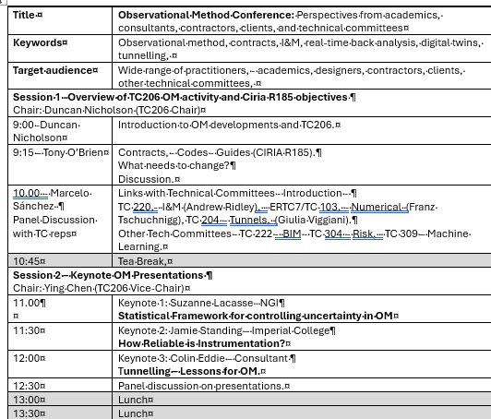
Agenda Morning
All Presenters agreed.

Slide 10
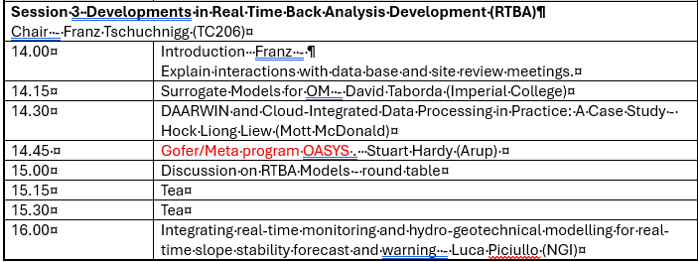
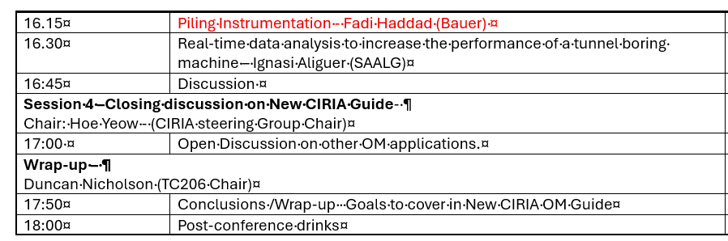
Agenda PM
Session 3 focuses on RTBA.
Session 4 discussion on Revisded CIRIA R185.

Slide 11
ISSMGE 21st Int. Conf. - Vienna - 14-19 June 2026 Ying Chen
Honour Lecture Proposal withdrawn.
Keynote speech on OM by Tony O’Brian Agreed.
25 OM Papers submitted.
Oral session booked (90 Minutes).
Papers will be passed to TC206 – Jan 2025 – TC206 to select papers for presentation.
“Workshop” Session booked (90 minutes?) – TC206 to organise.
This is 2 or 3 discussion topics???
Link to Oral Session Papers.
What do we want to discuss?
TC206 informal evening dinner during conference – Should we plan?

Slide 12
OM Oral Presentations Session: 90 minutes.
ICSMGE in Vienna, Austria – 14-19 June 2026.
TC206 to review submitted 25 OM papers.
TC206 to Organise Presentations.
Option 1 Select best 7 papers to present within 90 minutes’ session (12 minutes each presentation).
Option 2 Maximum numbers of papers to be present (7 minutes each, up to 12 papers to be presented)
Do we want a paper discussion?
We want these papers to inform the workshop discussions.

Slide 13
Other Conf / Publications:
6th Int. Conf. on Information Technology in Geo-Engineering (6th ICITG) in Graz, Austria, - 13 to 16 October 2026. - https://www.icitg2026.com
The conference will provide a platform to discuss current developments in digital transformation within geo-engineering. Topics include case studies on information technology in practice, integration of digital systems such as Scan2BIM and BIM2FEM, the use of open benchmark datasets, uncertainty quantification and mitigation, applications of machine learning including reinforcement learning and large language models, as well as Real-Time Back-Analysis (RTBA).

Slide 14
4)CIRIA Revised R185 on OM
Contract awarded to Arup / Mott MacDonald
Kick off Meeting with Collaborators on 10 November 2023.
CIRIA Steering Group Meeting on 3/12/25.
Using OM Conference 17/3/25 to gather industry feedback.
Johan Spross is TC206 rep on steering group.
Hock to give a presentations on Scope of Revisions

Slide 15
5) ICE Proceeding – Geotechnical Engineering
- Special Theme Issue (Ying Chen)
Initial meeting with ICE Proceeding – Geotechnical Engineering Chief Editor on 24th November 2025.
Summary of Discussion - Proposal of Special Theme Issue on ‘Observational Method’
Guest Chief Editor = Dr Su Jiang (TC206 representative = Dr Ying Chen)
Targeted Authors / Invitation to submit Journal standard Papers (Up to 20 papers)
Targeted Authors:
Keynote Speakers / Presenters at 1st OM Conference in March 2026.
Authors submitted OM papers (25 papers) to TC206 Sessions, in the 21st ICSSMGE Conference, June 2026.
The recent OM Case Histories – Nominated authors by TC206.

Slide 16
ICE Proceeding – Geotechnical Engineering
- Special Theme Issue
Preliminary Programme:
March 26
July 26
Sep 26
Dec 26
Send paper Invitation to targeted authors
Submit draft Journal paper
Final Journal paper (completed peer review & addressing comments)
Publish Special Theme OM Issue

Slide 17
6) Working Group Updates
RTBA – Franz Tschurchnigg -
Large effort put into Imperial College Workshop
Monitoring – Leaders Hock, Daniele, Dorota, Leen.
Contracts – Tony O’Brien.
Tunnels – Chris Menkiti.
Eurocodes – Johan Spross.
Historical Assets – Mandy Korff.

Slide 18
TC206 Working Groups
Real Time Back-Analysis - Franz Tschuchnigg
Monitoring - with TC220 - Hock Liong Liew, Dorota Symonidou. Daniele Fornelli
Eurocodes – Johan Spross
Tunnelling – Chris Menkiti
Historical Assets – Mandy Korff / Ying Chen
Contracts – Tony O’Brien

Slide 19
TC 206 Meeting
Real Time Back Analysis (RTBA)
Franz Tschuchnigg

Slide 20
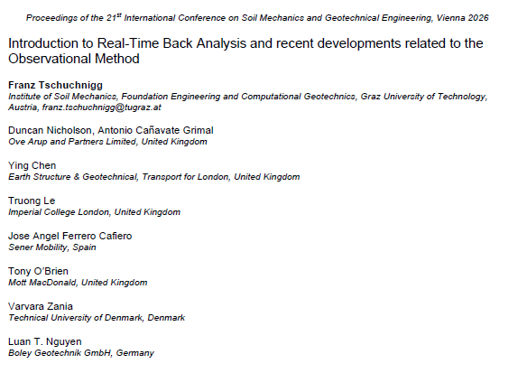

Paper for ICSMGE 2026
ACCEPTED / Revised version uploaded

Slide 21
RTBA MEETING – 12.11.2025 - 2.00pm (CET)
Fadi Hassad (Bauer Tech Director) presented on Piling Instrumentation.
Applying the Observational Method to Piling/ D’wall and Ground Treatment.
Dry run to select material for Fadi’s Pre-Rankine Conference Presentation.
Link:
https://teams.microsoft.com/l/meetup-join/19%3ameeting_Yzc5Njc3NjgtODlhMi00ZDkzLWI5ZjMtZDlhNjMxMjRiMWEy%40thread.v2/0?context=%7b%22Tid%22%3a%224ae48b41-0137-4599-8661-fc641fe77bea%22%2c%22Oid%22%3a%220f47b4f8-9962-4c38-a843-ac0b7070d53d%22%7d

Slide 22
TC206 / TC220 Monitoring Group
Leadership team: Hock Liong Liew, De Vos Leen, Dorota Symonidou, Daniele Fornelli Duncan Nicholson, Andrew Ridley, Ying Chen,
Enhance interaction between TC206 & TC220 – common interest/boundaries
Goals of this WG:
OM design + construction (design, triggers, back analysis, site observations, contingency) + I&M (data quality, contract, spec, roles of I&M coordinator) + Database (AGS input, data/information management plan)
Capturing good + bad performances – lessons learnt from different countries, project confidentiality to be respected
Influence client/main contractor/asset owners, construction data
Target deliverables:
Clear workflow (flow chart) – improve monitoring and reporting systems
Input into new CIRIA R185 in OM – new I&M chapter, new Eurocode,
Workshops – Imperial College March 2026 + Vienna Conference June 2026
and TC220

Slide 23
TC206 / TC220 Monitoring Group
4 WG meetings and 5 WG Leadership meetings held to date
1st meeting on 26 March 2025: Hock Liong Liew – HS2 OM application. Key messages: Focus should be on data quality NOT quantity - more data does not equal to better results! A simple instrument can do the job if we know what the specific question to answer. To ensure data quality, a real effort from everyone particularly the designer is required.
2nd meeting on 14 May 2025: Stephen Walthall – Principles of data and information management for ground engineering projects. Key messages: Data and information management plan – incorporation into the contract – who, how and when? Other considerations – data quality, different types of contract, OM approaches
3rd meeting on 15 July 2025: Ying Chen and C. W. Kwang - Lessons Learned Reviewing Monitoring Data – Crossrail Excavation Case History Monitoring Data. Key messages: Reliable monitoring is essential for accurate back-analysis, requiring high-quality data from well-installed instruments and continuous collaboration among stakeholders.
4th meeting on 9 Sep 2025: Fiona Hughes and Colin Carter - Lessons Learned from Monitoring HS2 Northolt Tunnels. Key messages: Effective monitoring needs clear plans, collaboration, robust data management, early planning, and flexibility to address seasonal impacts, automation, and unforeseen risks.
Next meeting in Nov 2025: Date and agenda TBC at the next leadership meeting.
and TC220

Slide 24
Tunnelling Working Group - update by C Menkiti
Leadership.
Chris Menkiti leads this group.
Chris has a GCG person
Restarting Tunnelling Working Group
For the Management meeting on 13/11/24 and TC206 meeting we need a presentation on:-
List people who previously attended the Tunnelling WG.
Terms of Reference. – topics
Links with TC204
Define tunnelling approach to OM and compare with Infrastructure approach. What can we learn?
Triggers and design. Abstract in Vienna
Examples.
HS2 – bored tunnels.
HS2 - SCL tunnels.
Silvertown tunnel.
Sensors and RTBA . – new sensors on cutting wheel.
Aim for a meeting before Christmas.
Management Group Meeting

Slide 25
Eurocodes Group - Johan Spross
Abstracts - Vienna Conf - Stuart submitted paper on varying partial factors.
Need to progress paper on Eurocode.
Next meeting?

Slide 26
Historical Assets – Mandy Korff / Duncan Nicholson
This includes :-
Old canal walls, - Old dock walls, - Leen and Arup Canary Wharf Banana walls
Old railway walls – PVE walls
Old cut slopes - TFL / HA/ Network rail (GCG)
Embankment fill - London Underground
Reuse of building foundation, - Dinesh Patel
Bridges, - Structural Health Monitoring process. ??
Eurocode 0 Part 2 - UK rep? contact Andrew Bond? Stuart Hardy?
Goal set up working group.
Team Meeting 16/6/25 at 14.00hrs - UK time. (15.00hrs CET)

Slide 27
Contracts Group - update by Tony O’Brien
Need to complete table of OM projects with cost savings. - Now end May 2025
Chase other experts – Alan Marr - ?? Ferovila. Lisbon contact JST – Ko forces. Spanish rep Carbon calculations counting in Table 1 example. Canary Wharf – Arup carbon experience.
Paper for Vienna – summarise report. Individual case histories.
Link with ICE Client Initiatives.
Link to new OM Projects.
Cat 3 checker involvement.
TAA issues – AIP issues.
Paper on Culture –
Organisations need to reach consensus at start of OM.. This means skill base to extend and confidence. Effects all parties – Contractors and Consultants. Key Leaders.
Email from David J. Hatem DHatem@mgmlaw.com - US experience. Chase - presentation?
20/05/2024

Slide 28
CIRIA Revised R185 on OM
Contract awarded to Arup / Mott MacDonald
Kick off Meeting with Collaborators on 10 November 2023.
CIRIA Steering Group Meeting on 3/12/25.
Using OM Conference 17/3/25 to gather industry feedback.
Johan Spross is TC206 rep on steering group.

Slide 29
7)Next Meetings
Next TC Members' meeting
10 December 2025
CIRIA OM GUIDE – AUTHORS - Contents proposal and feedback to Authors
Late March 2026? Run in UK and American Times?
Tara Woods (waiting for a date)
Bridging the knowledge gaps through observational methods: some Swedish examples.
Next Management Meetings (09.00hrs UK time)
15 Jan 2025 - 09.00hrs UK time
12 Feb 2025 - 09.00hrs UK time
9 Mar 2025 - 09.00hrs UK time
20/05/2024
Management Group Meeting

Slide 30
Any Other Business
Get involved by joining working groups.
Suggestions for Interesting OM presenters.

Slide 32
Revised CIRIA R185 on OM
Hock to share his presentation.

Slide 33


Proposed Chapter Headings
‘The O.M. Can Be Simple’
The Basic Issues – high level summaries
Core issues for Client, Contractor and Designer and Case Histories
Further Detail on Specific Topics
Chapters 2, 3 and 4
Key Requirements for the O.M.
Achieving Agreement to use the O.M.
Contract Conditions
Chapters 5, 6, 7 and 8
Client Considerations
Technical Considerations
Construction Considerations
Case Histories
6 Appendices
History
O.M. for Asset Management
Risk + Opportunity Management
Contractual Issues + Procurement
Observations (Instrumentation + Monitoring + Data Base Systems)
Real Time Back Analysis
Questions
Proposed Chapters – OK?
Anything Missing?
Suggestions?

Slide 34
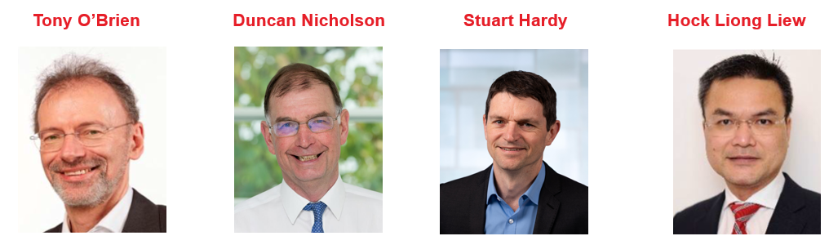
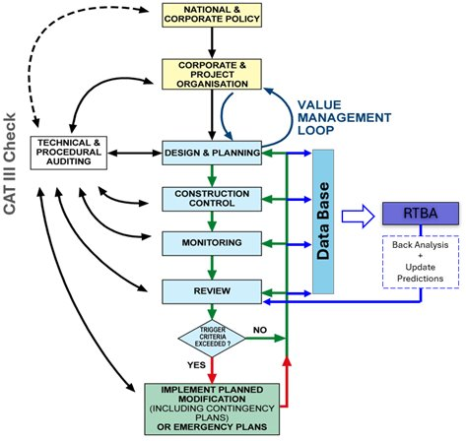
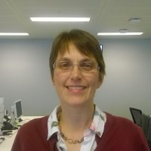
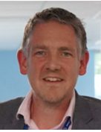
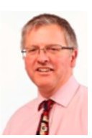
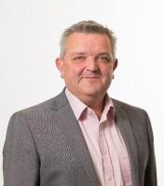
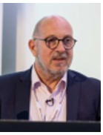
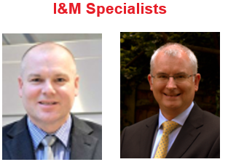
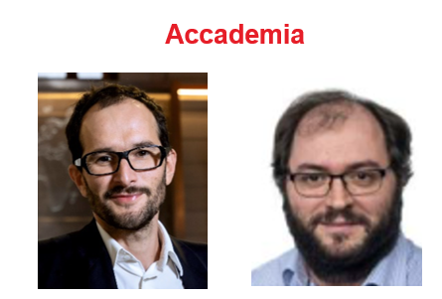
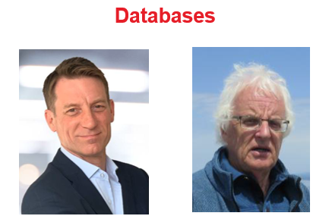

Our Team – Author’s Specialisms
Clients
Contracts
Designers
Sarah Trinder HS2
Alistair Hitchcock HS2
Richard Patterson Mott MacDonald
Contractors
Mark Pennington Balfour Beatty
Michael Southall Balfour Beatty
Peter Hewitt Laing O’Rourke
RTBA
Franz Tschuchnigg TU Graz
David Taborda Imperial College London
I&M
Databases
Andrew Ridley Geotechnical Observations
Angus Maxwell Maxwell GeoSystems
Tim Clegg Geosense
Steven Walthall Independent Consultant
Angus Maxwell Maxwell GeoSystems

Slide 35
Our Approach
Based on our previous CIRIA experience
PSG Steering Group meetings
2025
2026
2027
Oct | Nov | Dec | Jan | Feb | Mar | Apr | May | Jun | Jul | Aug | Sep | Oct | Nov | Dec | Jan | Feb | Mar | Apr
0
1
2
3
4
Industry View
TC206 OM Conference
ISSMGE Conf. Vienna
Peer Review

