Slide 1

ISSMGE - TC206 Technical Committee Meeting 24-03-2026 at 09:30hrs - UK time
Update on TC206 work
Duncan Nicholson - Chairperson TC206
Ying Chen – Vice Chairperson TC206
Alessandro Martucci - Secretary

Slide 2
Agenda for 24-03-26
Minutes of 10/12/25 – review actions. Covered in agenda.
TC206 Admin Update
Update – Alessandro Martucci.
Conferences
OM Conference 17/3/26 at Imperial College
Feedback from OM Conference
Vienna Conf. June 26 Update
Keynote / Papers/ Workshop.
4. CIRIA Guide R185 Revision
Arup/ Mott MacDonald have won tender.
Progress report
5. Proposal for ICE Geot. Eng. Journal – Special Issue.
Abstracts required – Ying Chen
6. Working Groups - Planned meetings.
Monitoring – Hock - 5 Min.
Existing Structures – Mandy/ Ying - 5 min
RTBA - Franz – 5 min
Tunnelling – Chris - 1 min.
Eurocodes - Johan - 1 min.
Contracts- Tony - 1 min..
7. TC Presentation on 24-03 26
Tara Wood - Bridging the knowledge gaps through observational methods: some Swedish examples.
8. Next TC Members' meeting
30 June or 1July 2026? –
Feed back on Vienna Conf.
9.Next Management Meetings (09.00hrs UK time)
15-04-2026 - 09:00am UK time
13-05-2026 - 09:00am UK time
03-06-2026 - 09:00am UK time

Slide 3
1) Technical Committee Minutes Meeting on 10-12-25
Issues to be updated during this meeting.

Slide 4
TC206 Management Group (monthly)
The TC206 holds monthly Management Group meetings.
The Working Group leaders attend to plan activity.
Minutes are stored on the TC206 web site.
New TC206 Members added to the ISSMGE list.
Local Geotechnical society can identify.
Nominated (Voting) Members.
Corresponding Members.

Slide 5
TC206 Administration – - Mr Alessandro Martucci is the new TC206 Secretary.
Main Duties – Compile presentation material / minutes of meetings etc.
1) Update TC206 Website (Google Drive)
TC206 Members meeting minutes & presentations (2023 to 2025)
Knowledge information sharing.
Lisbon - Conf Workshop Presentations.
2) Update ISSMGE - TC206 webpages
What can we store? Including past events (2023 to 2024)
New Terms of Reference.
3) TC206 Membership Tracking and Development.

Slide 6
3) Conference Summary
TC206 OM Conference – Imperial College – 17 March 2026 (Day before Rankine Lecture)
ISSMGE 21st Int Conf - Vienna - 14-19 June 2026
TC220 -12th Int. Symp. Field Monitoring in Geomechanics 6-10 August 2026
6th Int. Conf. on Information Technology in Geo-Engineering (6th ICITG) in Graz, Austria, - 3 to 16 October 2026. - https://www.icitg2026.com
The conference will provide a platform to discuss current developments in digital transformation within geo-engineering. Topics include case studies on information technology in practice, integration of digital systems such as Scan2BIM and BIM2FEM, the use of open benchmark datasets, uncertainty quantification and mitigation, applications of machine learning including reinforcement learning and large language models, as well as Real-Time Back-Analysis (RTBA).

Slide 7
1st OM Conference - Flier 17 March 2026
My thanks to Troung and Franz for their work to make the OM Conference happen

Slide 8
OM Conference Agenda
17 Presenters
48 Enrolments
Profit £5000.
Provides a base for TC206.

Slide 9
Session 1 TC206 OM activity and Ciria R185 objectives
09.00hrs - Duncan - Intro to TC206 and developments
09.15hrs - Tony – What OM needs ( Richard Patterson by video)
10.00hrs – Marcelo and TC reps – Links to TC.
10.45hrs – Tea.

Slide 10
Session 1 - Links with ISSMGE Technical Committees 10.00hrs to 10.45
Chair – Duncan Nicholson
ISSMGE TC overview – Marcelo Sánchez 10 Min
TC 220- Field Monitoring (Andrew Ridley), 10 Min
ERTC7/TC 103, - Numerical (Franz Tschuchnigg), 10 Min
TC 204 - Tunnels, (Andrea Franza). 10 Min
Panel Discussion 5 Min
Other Tech Committees –
TC207 -Walls (Prof Ong), TC208 - Slopes (Prof Cotecchia),
TC 222 - BIM, TC 304 - Risk, TC 309 – Machine Learning.

Slide 11
Session 2 Keynote Presentations
Chair – Ying Chen
1) Suzanne Lacasse – Risk (Teams).
2) Jamie Standing – I&M
3) Colin Eddie - Tunnels

Slide 12
Session 3 - RTBA
14.00 Franz – Chair
14.05 - David Taborda – Surrogate modelling.
14.35 – Hock Liong Liew - HS2 – OM retaining wall with RTBA.
14.55 - Stuart Hardy - RTBA – program development and testing
15.15 – Luca - Monitoring slopes and stability.
15.35 – Tea
16.00 – Fadi Haddad - Real time D’wall monitoring and tool steering
16.20 – Ignasi Aliguer - Real time TBM monitoring and control.
16.40 – Discussion

Slide 13
Session 4
17.00 – Hoe Intro and short presentation stimulating questions using the CIRIA Questionnaire.
17.50 – Duncan Wrap up and Photo
18.00 – Closing drinks
Meal on 17/3/26

Slide 14
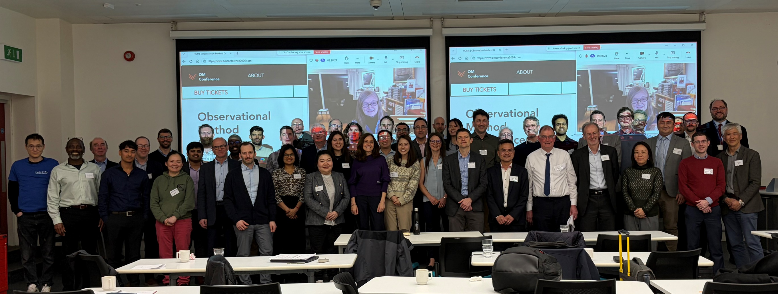
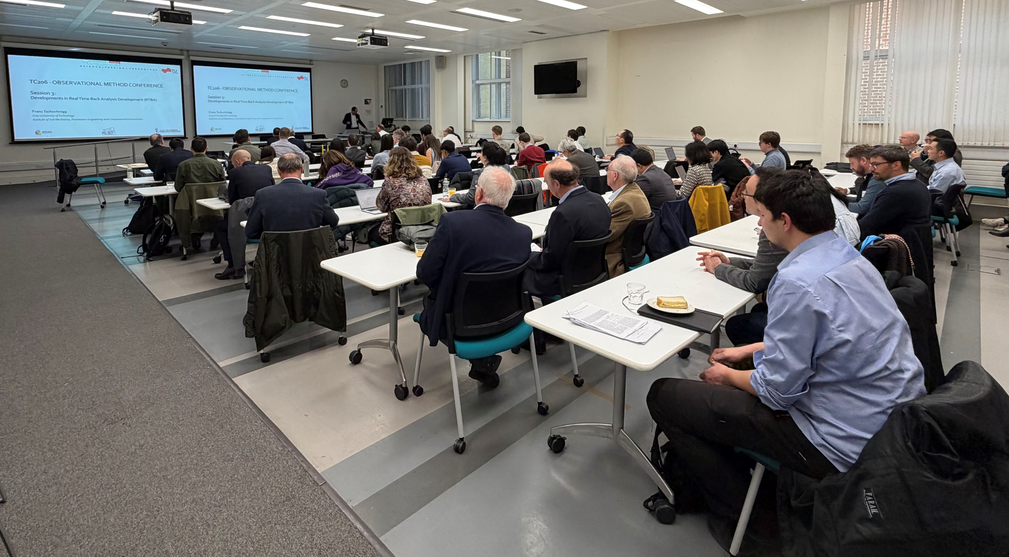
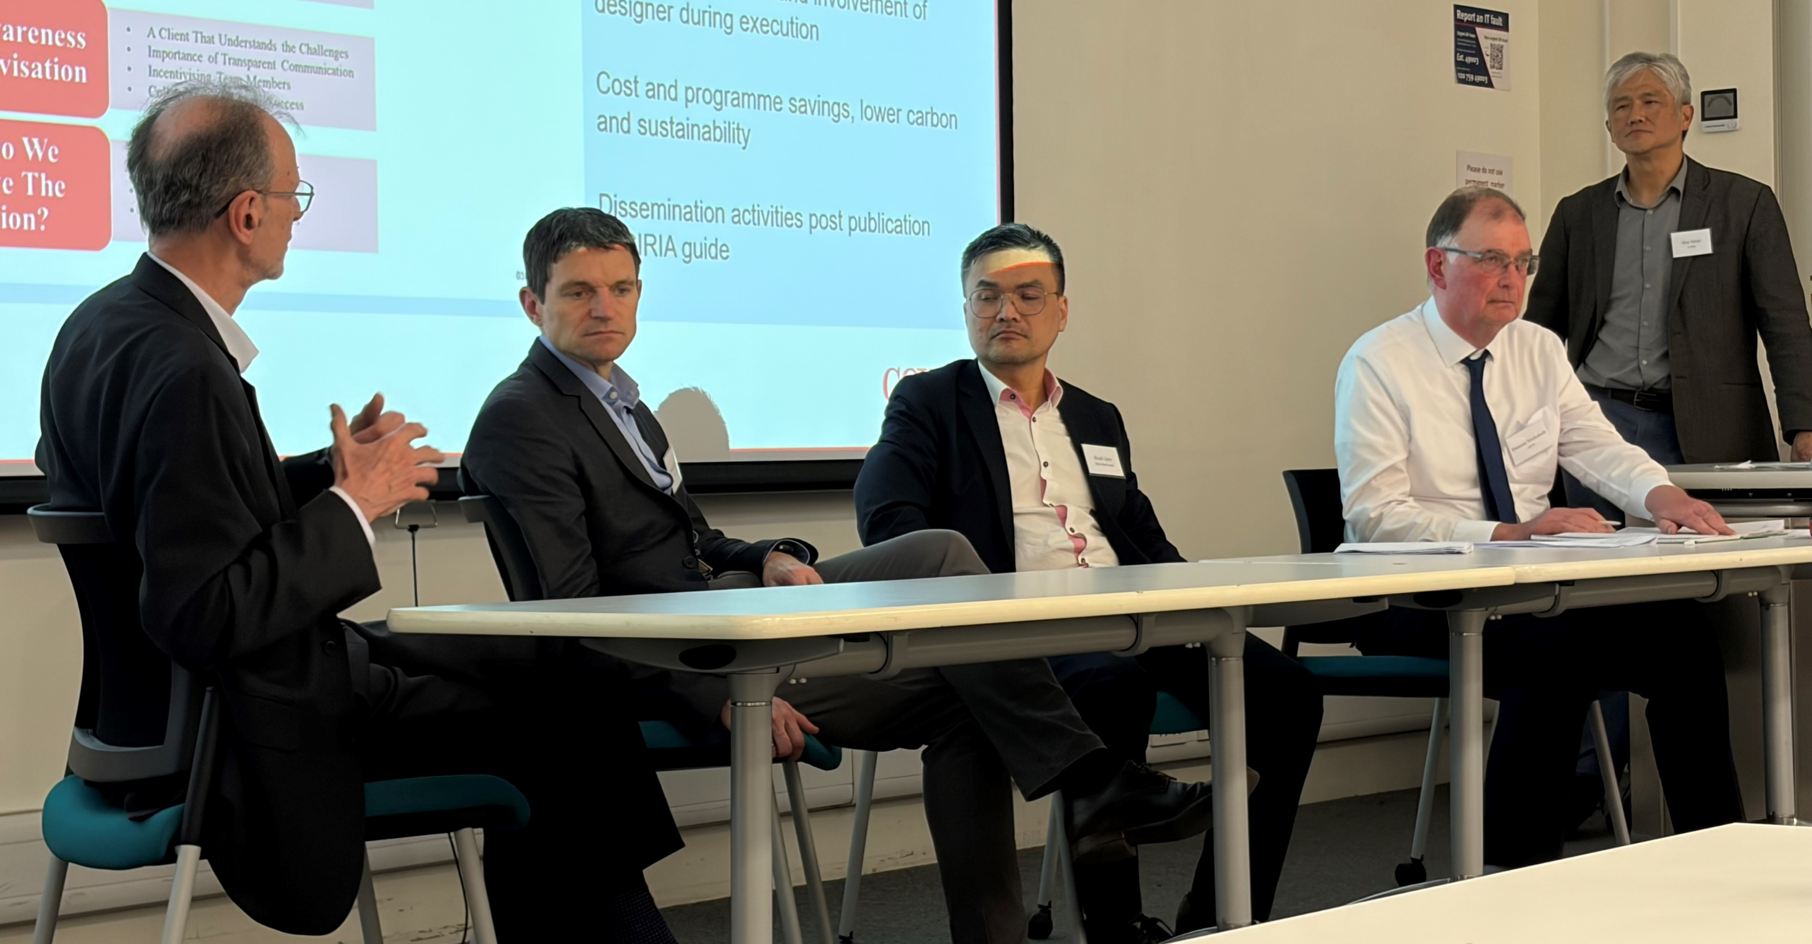
OM Conference 17/3/26 Imperial College
Conference Attendees
Lecture Room
Panel Session

Slide 15
ISSMGE 21st Int. Conf. - Vienna - 14-19 June 2026
Keynote speech on OM by Tony O’Brian Agreed – focus on collaboration and teams. - Link to 2 papers
25 OM Papers passed to TC206 (23/12/25).
Oral session booked (90 Minutes). – TC206 to define 6 paper for 10-12 min. presentations
Poster Session – TC206 to allocate 13 places.
TC206 Paper Selection Team – 5 people - Duncan, Ying, Alesandro, Hock, Mandy,
“Workshop” Session booked (90 minutes?) – TC206 to organise.
This is 2 discussion topics???
TC206 informal evening dinner during conference – Should we plan?

Slide 16
Vienna Conf – 14-19 June 2026.
Rules for OM Presentation Session:
Oral presentation: 10 to 12 minutes within a dedicated session. (6 No in 90 mins)
Poster and short presentation: a poster and one MS PowerPoint slide. (13 No)
sessions will start with short presentations of one slide and two minutes each.
After the short presentations, there will be 30 to 40 minutes for discussion.
Associated posters placed at back of lecture room.
Poster presentation: A conventional poster only presentation.

Slide 17
Oral and Poster Papers: Reviewed by Ying, Mandy, Alessandro, Hock, Duncan
6 papers for Oral selected – Vienna accepted.
13 papers for posters - 1 slide, 2 minutes) plus a poster.
The six papers for workshop removed from the short oral + poster session. Otherwise, authors would have to present their work twice in different formats.
Leave 7 papers for the short oral + poster session.
The 3 papers that you did not select will be posters only.
Authors Notification 10/2/26
Session | Paper No
Oral 6 No | 202
 | 231
 | 240
 | 872
 | 923
 | 1028
Posters 13 No | 168
 | 348
 | 458
 | 840
 | 917
 | 975
 | 1145
 | 1154
 | 1168
 | 1823
 | 2008
 | 2269
 | 2392
Not selected | 146
 | 440
 | 2293

Slide 18
TC206 Workshop Papers:
These 6 papers receive the status “Workshop presentation” in Conftool.
Contract Discussions - 30 Minutes
(Contract Group Organising)
RTBA - 60 minutes -
(RTBA group organising )
Workshop
Topic | Paper No
Contracts | 1145
 | 1154
RTBA | 975
 | 917
 | 348
 | 168

Slide 19
Other Conf / Publications:
6th Int. Conf. on Information Technology in Geo-Engineering (6th ICITG) in Graz, Austria, - 13 to 16 October 2026. - https://www.icitg2026.com
The conference will provide a platform to discuss current developments in digital transformation within geo-engineering. Topics include case studies on information technology in practice, integration of digital systems such as Scan2BIM and BIM2FEM, the use of open benchmark datasets, uncertainty quantification and mitigation, applications of machine learning including reinforcement learning and large language models, as well as Real-Time Back-Analysis (RTBA).

Slide 20
4)CIRIA Revised R185 on Observational Method
Contract awarded to Arup / Mott MacDonald
Kick off Meeting with Collaborators on 10 November 2023.
CIRIA Steering Group Meeting on 3/12/25.
Using OM Conference 17/3/25 to gather industry feedback.
Johan Spross is TC206 rep on steering group.

Slide 21


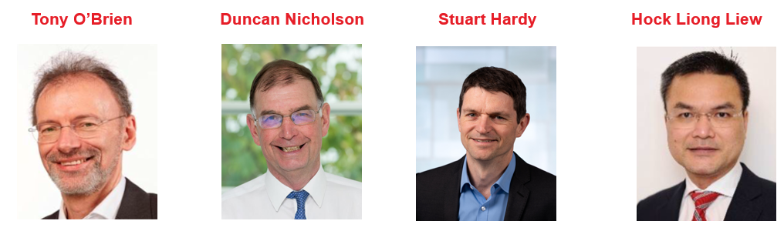
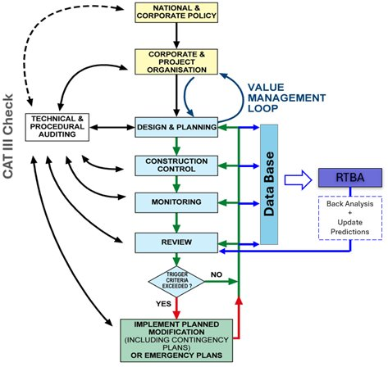
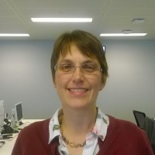
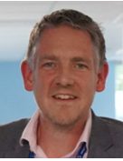
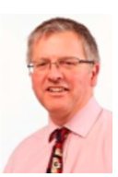
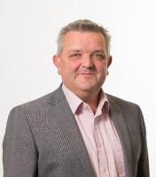
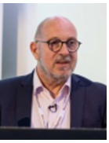
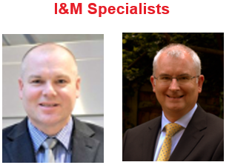
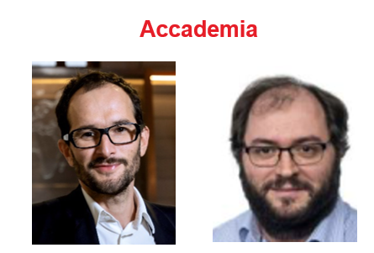
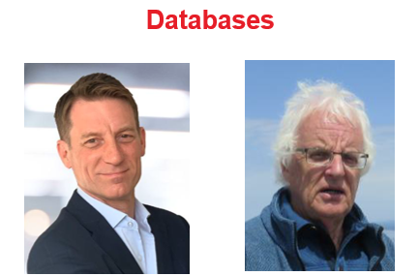
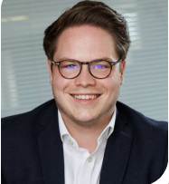
Our Team – Author’s Specialisms
Clients
Contracts
Designers
Sarah Trinder HS2
Alistair Hitchcock HS2
Richard Patterson Mott MacDonald
Contractors
Mark Pennington Balfour Beatty
Michael Southall Balfour Beatty
Peter Hewitt Laing O’Rourke
RTBA
Franz Tschuchnigg TU Graz
David Taborda Imperial College London
I&M
Databases
Andrew Ridley Geotechnical Observations
Angus Maxwell Maxwell GeoSystems
Tim Clegg Geosense
Steven Walthall Independent Consultant
Angus Maxwell Maxwell GeoSystems

Slide 22
Programme
Based on our previous CIRIA experience
2025
2026
2027
Oct | Nov | Dec | Jan | Feb | Mar | Apr | May | Jun | Jul | Aug | Sep | Oct | Nov | Dec | Jan | Feb | Mar | Apr
0
1
2
3
4
Industry View
TC206 OM Conference
ISSMGE Conf. Vienna
Peer Review
Peer Review
PSG meetings

Slide 23
5) ICE Proceeding – Geotechnical Engineering
- Special Theme Issue: Observational Method
Special Theme Issue: Observational Method – (New papers supporting Guide)
Call for Paper
Call for Papers: New Developments in Observational Method | Emerald Publishing
Topics:
Case Histories
Overview & Developments of OM in past two decades
Key Dates:
Abstract by 31st March
Full length paper by 30th June

Slide 24
ICE Proceeding – Geotechnical Engineering (Ying Chen)
- Special Theme Issue on OM
Preliminary Programme:
March 26
July 26
Sep 26
Dec 26
Send paper Invitation invite Abstracts
Submit draft Journal paper
Final Journal paper (completed peer review & addressing comments)
Publish Special Theme OM Issue

Slide 25
6) TC206 Working Groups
Real Time Back-Analysis - Franz Tschuchnigg
Monitoring - with TC220 - Hock Liong Liew, Dorota Symonidou. Daniele Fornelli
Old Structures – Mandy Korff.
Eurocodes – Johan Spross
Tunnelling – Chris Menkiti
Contracts – Tony O’Brien

Slide 26
TC 206 Meeting
Real Time Back Analysis (RTBA)
Franz Tschuchnigg

Slide 27
TC206 / TC220 Monitoring Group
Leadership team: Hock Liong Liew, De Vos Leen, Dorota Symonidou, Daniele Fornelli Duncan Nicholson, Andrew Ridley, Ying Chen,
Enhance interaction between TC206 & TC220 – common interest/boundaries
Goals of this WG:
OM design + construction (design, triggers, back analysis, site observations, contingency) + I&M (data quality, contract, spec, roles of I&M coordinator) + Database (AGS input, data/information management plan)
Capturing good + bad performances – lessons learnt from different countries, project confidentiality to be respected
Influence client/main contractor/asset owners, construction data
Target deliverables:
Clear workflow (flow chart) – improve monitoring and reporting systems
Input into new CIRIA R185 in OM – new I&M chapter, new Eurocode,
Workshops – Imperial College March 2026 + Vienna Conference June 2026
and TC220

Slide 28
Old Structures – Mandy Korff
This includes :-
Old canal walls, - Old dock walls, - Leen and Arup Canary Wharf Banana walls
Old railway walls – PVE walls
Old cut slopes - TFL / HA/ Network rail (GCG)
Embankment fill - London Underground
Reuse of building foundation, - Dinesh Patel
Bridges, - Structural Health Monitoring process. ??
Eurocode 0 Part 2 - UK rep? contact Andrew Bond? Stuart Hardy?
Goal set up working group.
Team Meeting 16/6/25 at 14.00hrs - UK time. (15.00hrs CET)

Slide 29
Tunnelling Working Group - update by C Menkiti
Leadership.
Chris Menkiti leads this group.
Chris has a GCG person
Restarting Tunnelling Working Group
For the Management meeting on 13/11/24 and TC206 meeting we need a presentation on:-
List people who previously attended the Tunnelling WG.
Terms of Reference. – topics
Links with TC204
Define tunnelling approach to OM and compare with Infrastructure approach. What can we learn?
Triggers and design. Abstract in Vienna
Examples.
HS2 – bored tunnels.
HS2 - SCL tunnels.
Silvertown tunnel.
Sensors and RTBA . – new sensors on cutting wheel.
Aim for a meeting before Christmas.
Management Group Meeting

Slide 30
Eurocodes Group - Johan Spross
Abstracts - Vienna Conf - Stuart submitted paper on varying partial factors.
Need to progress paper on Eurocode.
Next meeting?

Slide 31
Contracts Group - update by Tony O’Brien
Need to complete table of OM projects with cost savings. - Now end May 2025
Chase other experts – Alan Marr - ?? Ferovila. Lisbon contact JST – Ko forces. Spanish rep Carbon calculations counting in Table 1 example. Canary Wharf – Arup carbon experience.
Paper for Vienna – summarise report. Individual case histories.
Link with ICE Client Initiatives.
Link to new OM Projects.
Cat 3 checker involvement.
TAA issues – AIP issues.
Paper on Culture –
Organisations need to reach consensus at start of OM.. This means skill base to extend and confidence. Effects all parties – Contractors and Consultants. Key Leaders.
Email from David J. Hatem DHatem@mgmlaw.com - US experience. Chase - presentation?
20/05/2024

Slide 32
Tara Woods Presentation Bridging the knowledge gaps through observational methods: some Swedish examples.
Tara’s Bio
Born in UK and studied Civil & Environmental Engineering MENG at Imperial College.
Worked for Balfour Beatty on roads jobs.
Transferred to Stent – piling including West Keys.
2001- 2003 - Returned to Imperial for MSc in Soil Mechanics part time.
Moved to Sweden - 2003.
Worked on Citytunnel and part time PhD completed 2016. – Small strain stiffness.
2019 joined Ramboll – Head of Business Development.

Slide 33
7)Next Meetings
Next TC Members' meeting
24 /03 2026 Tara Woods
Bridging the knowledge gaps through observational methods: some Swedish examples.
Next TC Members meeting 30 June or 1 July 2026? – feedback on Vienna Conf.
Next Management Meetings (09.00hrs UK time)
15-04-2026 - 09:00am UK time
13-05-2026 - 09:00am UK time
03-06-2026 - 09:00am UK time
20/05/2024
Management Group Meeting

Slide 34
Any Other Business
Get involved by joining working groups.
Suggestions for Interesting OM presenters.

