Slide 1

ISSMGE - TC206
Management Meeting
6-11-2025 at 09:00 – 09.30hrs - UK time
Update on TC206 work
Duncan Nicholson - Chairperson TC206
Ying Chen – Vice Chair
Alessandro Martucci - Secretary
alessandro.martucci@tonygee.com

Slide 2
Management Group - Agenda
Minutes of 9/10/25 – review actions. Covered in agenda.
TC206 Admin Update
  New Secretary - Alessandro Martucci
  Website Update – Alessandro Martucci
  International Journal of Geoengineering Case Histories (IJGCH) – Tony O’Brien on board.
Conferences
  Pre-Rankine Conference
    Truong reviewing process
  Vienna Conf
    Keynote / Papers/ Workshop.
4. CIRIA Guid R185 Revision
    Arup/ Mott MacDonald won tender.
    Meetings planned with collaborators and steering group
5. Working Groups - Planned meetings.
  RTBA - Franz – 5 min
  Monitoring – Hock - 5 Min
  Tunnelling – Chris - 1 min
  Eurocodes - Johan - 1 min
  Contracts- Tony - 1 min
  Historical Assets – Mandy/ Ying - 1 min
6. Next TC Members' meeting
  10 December 2025 (09.30hrs UK time).
7. TC Presentation
  Tara Wood – on 10/12/25
    Bridging the knowledge gaps through observational methods: some Swedish examples.
8.Next Management Meeting (09.00hrs UK time)
  3 September 2025 – 09.00hrs.
  9 October 2025 - 09.00hrs
  6 November 2025 -09.00hrs
  3 December 2025 – 09.00hrs

Slide 3
2)TC206 Administration Websites Update –
Alessandro Martucci -
Alessandro’s main job:-
Transfer existing TC206 internal web site from Amit’s Google site to Google website registered as TC206.
Update data base minutes.
Use ISSMGE Hub as a TC206 internal site.
Update ISSMGE - TC206 public webpage - update.
  What can we store? Including past events (2023 to 2024)
  New Terms of Reference.
  We need to advertise the Pre-Rankine OM Conference on the TC206 web site. Action Truong and Alessandro.
TC206 Membership Development.
Progress report?
20/05/2024
Management Group Meeting

Slide 4
3) Conferences
Pre-Rankine Conference on OM (17/3/26)
Vienna Conference TC206 Involvement (14-19 June 2026)

Slide 5
PRE-RANKINE CONF. ON OM DEVELOPMENTS -17/3/2026 at Imperial College.
Truong Le and Franz Tschuchnigg
Review Agenda. – say 50 people?
Goals
  Agenda set.
  Presenters Confirmed
  IC meeting room (100 places) booked. We are budgeting on 50 people.
  Coffee and Lunch booked.
  Website drafted but not accessible by attendee sites. May transfer to IC?
  Need fliers to Email and pil
  Budget – BGA Support - £5000 – Registration fee - £100/person.
  TC206 Bank account – try to register via IC.
Need to go live and advertise.

Slide 6
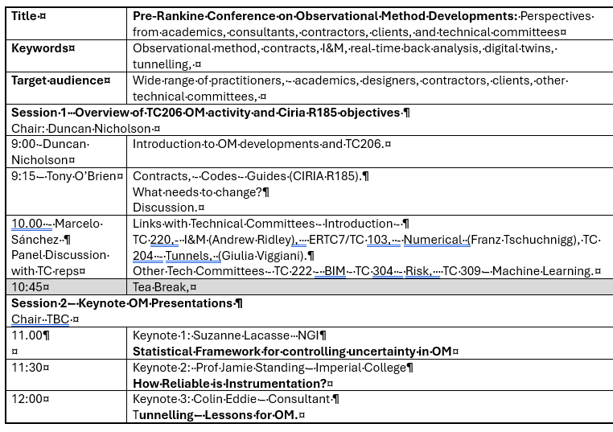

Slide 7
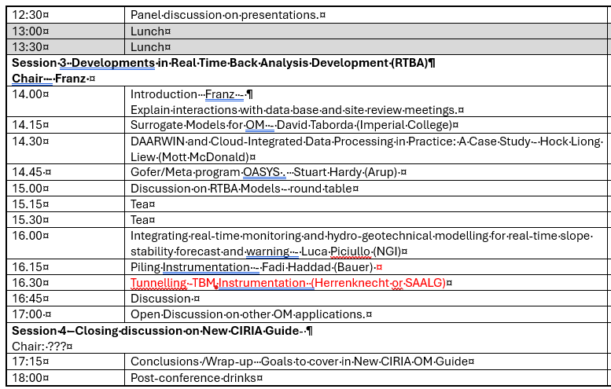

Slide 8
ISSMGE 21st Int. Conf. - Vienna - 14-19 June 2026
Ying Chen
  Honour Lecture Proposal withdrawn.
  Keynote speech on OM by Tony O’Brian Agreed.
  25 OM Papers submitted.
    Oral session booked (90 Minutes).
    Papers will be passed to TC206 – Dec 2025 – TC206 to select papers for presentation.
  “Workshop” Session booked (90 minutes?) – TC206 to organise.
    This is 2 or 3 discussion topics???
    Link to Oral Session Papers.
    What do we want to discuss?
  TC206 informal evening dinner during conference – Should we plan?

Slide 9
OM Oral Presentations Session: 90 minutes.
ICSMGE in Vienna, Austria – 14-19 June 2026.
TC206 to review submitted 25 OM papers.
TC206 to Organise Presentations.
  Option 1 Select best 7 papers to present within 90 minutes’ session (12 minutes each presentation).
  Option 2 Maximum numbers of papers to be present (7 minutes each, up to 12 papers to be presented)
  Do we want a paper discussion?
  We want these papers to inform the workshop discussions.

Slide 10
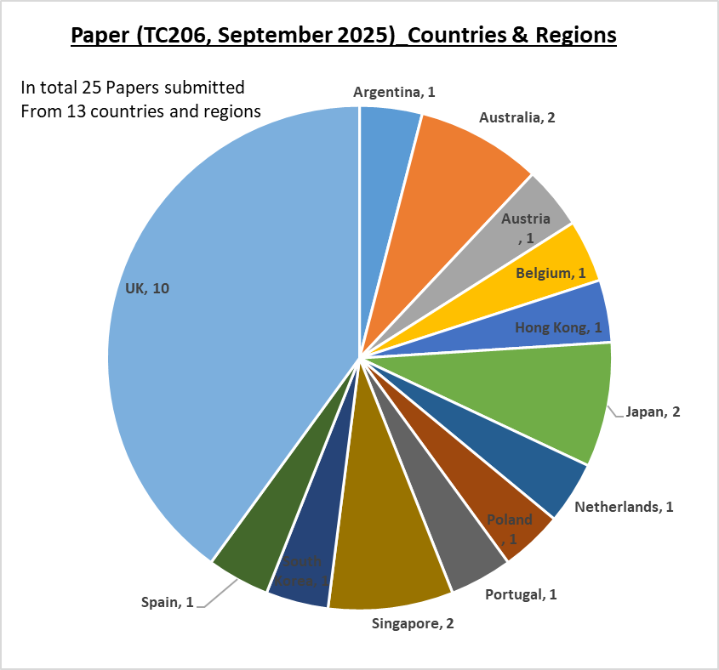
Regional sources of OM Papers
Successfully submitted full-length papers (First Key word OM): 25
Abstracts from 13 countries and regions:
  UK (10)
  Europe (6)
  Asia (6),
  Australia (2)
  South America (1).

Slide 11
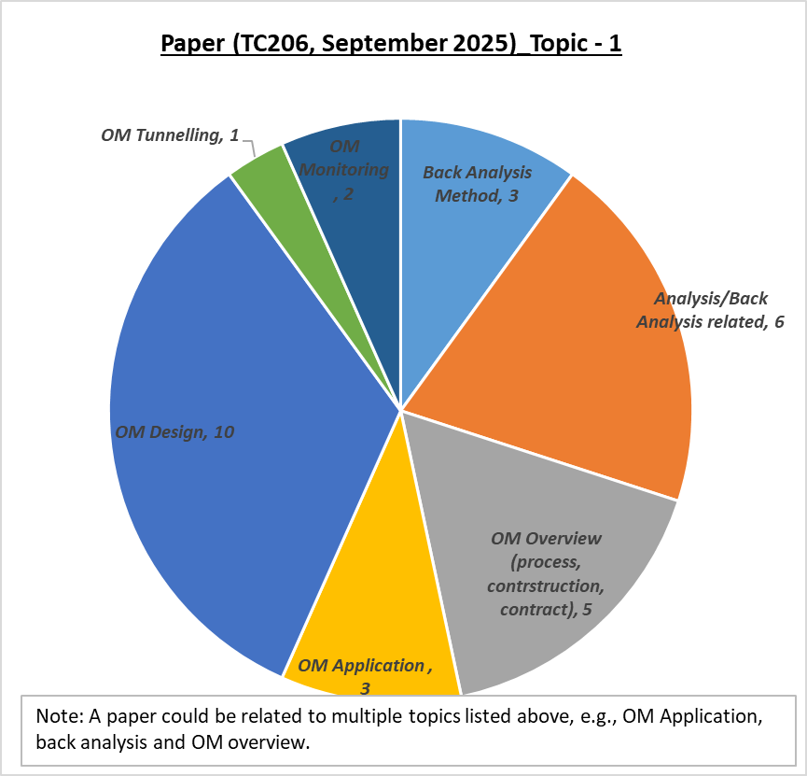
OM Subject in Papers
Subjects of OM papers:
Back-analysis methodology (3)
Analysis / Back-analysis related (6)
OM Overview (contract, assurance, process and construction) (5)
OM Application (Case histories) (3)
OM Design (10)
OM Tunnelling (1)
OM Monitoring (1)

Slide 12
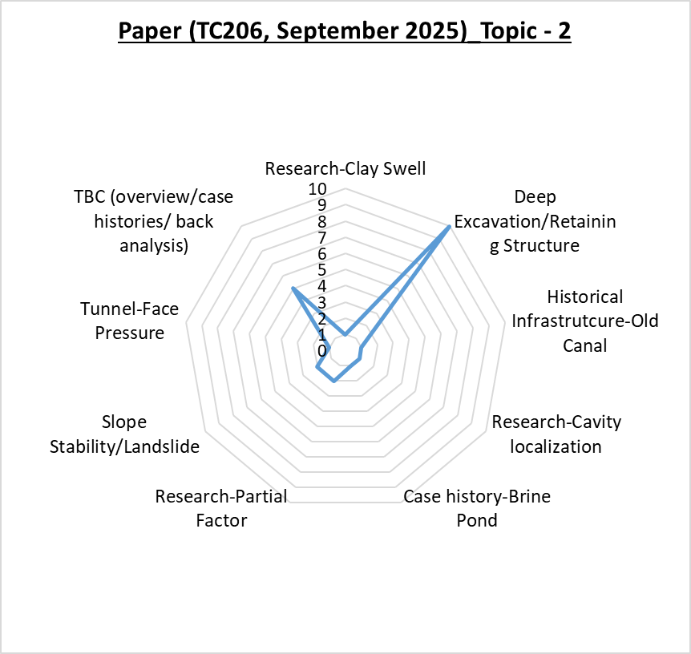
OM Applications in Papers
Review paper topics in terms of specific subjects, the following items are listed:
Deep-Excavation / Retaining Structures (10)
Research – Partial Factor (2)
Research – Clay Swell (1)
Research – Cavity Localization (1)
Case History – Brine Pond (1)
Case History – Old Canal (1)
Case History – Slope Stability / Landslide (2)
Tunnel - Face Pressure (1)
TBC (overview/ case history / back analysis) (5)

Slide 13
Other Conf / Publications:
6th Int. Conf. on Information Technology in Geo-Engineering (6th ICITG) in Graz, Austria, - 13 to 16 October 2026. - https://www.icitg2026.com
  The conference will provide a platform to discuss current developments in digital transformation within geo-engineering. Topics include case studies on information technology in practice, integration of digital systems such as Scan2BIM and BIM2FEM, the use of open benchmark datasets, uncertainty quantification and mitigation, applications of machine learning including reinforcement learning and large language models, as well as Real-Time Back-Analysis (RTBA).
CIRIA R185 on OM Guide revision.
  4 tenders submitted - Interviews in Progress -starts End October 2025.
  One place on the CIRIA Steering group for TC206 member. - Johan Spross Volunteered.
  TC206 Tech Committee meeting – Feb 26.
    Presentation by successful tenderer.
    Feedback from TC206 members on scope.
  Link to Pre-Rankine Conf. - Feedback to CIRIA Guide Authors.

Slide 14
CIRIA Revised TC285 on OM
Contract awarded to Arup / Mott MacDonald
Kick off Meeting with Collaborators on 10 November 2023.
Meeting with CIRIA Steering Group planned to agree framework.
Using Pre-Rankine Conference 17/3/25 to gather industry feedback.
Johan Spross is TC206 rep on steering group.

Slide 15
5)Working Group Updates
RTBA – Franz Tschurchnigg -
  Imperial College Workshop – BGS funding application (Truong )
Monitoring – Leaders Hock, Daniele, Dorota, Leen.
Contracts – Tony O’Brien.
Tunnels – Chris Menkiti.
Eurocodes – Johan Spross.
Historical Assets – Mandy Korff.

Slide 16
TC 206 Meeting
Real Time Back Analysis (RTBA)
Franz Tschuchnigg

Slide 17
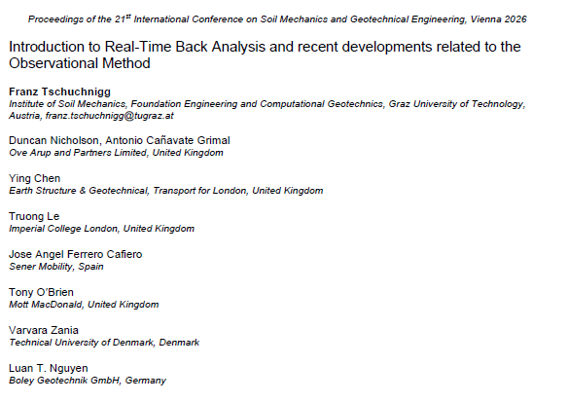

Paper for ICSMGE 2026
ACCEPTED / Revised version uploaded

Slide 18
NEXT RTBA MEETING – 12.11.2025 - 2.00pm (CET)
Fadi Hassad (Bauer Tech Director) presenting on Piling Instrumentation,
Applying the Observational Method to Piling/ D’wall and Ground Treatment.
Dry run to select material for Fadi’s Pre-Rankine Conference Presentation.
Link:
https://teams.microsoft.com/l/meetup-join/19%3ameeting_Yzc5Njc3NjgtODlhMi00ZDkzLWI5ZjMtZDlhNjMxMjRiMWEy%40thread.v2/0?context=%7b%22Tid%22%3a%224ae48b41-0137-4599-8661-fc641fe77bea%22%2c%22Oid%22%3a%220f47b4f8-9962-4c38-a843-ac0b7070d53d%22%7d

Slide 19
RTBA group and/or upcoming Conferences
For further information, feel free to write
Franz Tschuchnigg - franz.tschuchnigg@TUGraz.at
Duncan Nicholson - Duncan.Nicholson@arup.com
PRE-RANKINE CONFERENCE: Le Truong - truong.le@imperial.ac.uk

Slide 20
Monitoring Group
(Hock, Leen, Dorota, Daniele)
Last Meeting - 9 September 2025 - Fiona Hughes (Arup) and Colin Carter (SCS).
“Lessons Learned from Monitoring HS2 Northolt Tunnels”
Next Meeting -12 December 2025 - Dr Nader Saffari – Profession Head – Earthwork Structures & Geotechnical, Transport for London
“Monitoring of Earth Structures on LU Network”
Goal – Develop Flow Charts for Commissioning I&M.

Slide 21
Contracts - update by Tony O’Brien
Need to complete table of OM projects with cost savings. - Now end May 2025
Chase other experts – Alan Marr - ?? Ferovila. Lisbon contact JST – Ko forces. Spanish rep Carbon calculations counting in Table 1 example. Canary Wharf – Arup carbon experience.
Paper for Vienna – summarise report. Individual case histories
Link with ICE Client Initiatives.
Link to new OM Projects.
Need for Cat 3 checker to reassess temp work changes.
TAA issues – AIP issues.
Paper on Culture –
  Organisations need to reach consensus at start of OM.. This means skill base to extend and confidence. Effects all parties – Contractors and Consultants. Key Leaders.
Email from David J. Hatem DHatem@mgmlaw.com - US experience. Chase - presentation?
HS2 – WHRC –
  BBV, - omission of 112 temporary props. Carbon savings ?
  BBV have noted regardless of commercial saving they would continue with OM to avoid the construction constraints working around temporary props.
  OM Design – Motts
  CAT3 fee (£1M)
HS2 - VRCB - OM - best way-out example
  SCS - Cost of New wall
  OM assessment
  Time
HS2 - Old Oak Common
20/05/2024
Management Group Meeting

Slide 22
Eurocodes - Johan Spross
Papers - Vienna Conf - Stuart submitted paper on varying partial factors.
Next meeting?
Input into CIRIA Guide -

Slide 23
Historical Assets – Mandy Korff
Mandy held initial meeting on 16 June 25.
This includes :-
Old canal walls, - Old dock walls, - Leen and Arup Canary Wharf Banana walls
Old railway walls – PVE walls Euston.
Old cut slopes - TFL / HA/ Network rail (GCG) TFL presentation on 10/12/25 in Monitoring Group.
Embankment fill - London Underground
Reuse of building foundation, - Dinesh Patel
Bridges, - Structural Health Monitoring process. ??
Eurocode 0 Part 2 - UK rep? contact Andrew Bond? Stuart Hardy?
Mandy /Ying submitted Vienna Abstracts
Goal set up working group.

Slide 24
Tunnelling Working Group - update by C Menkiti
Leadership.
Chris Menkiti leads this group.
Chris has a GCG person.
Use Pre-Rankine Conferences as a starting Point.
Input into CIRIA GUIDE.
Restarting Tunnelling Working Group
For the Management meeting on 13/11/24 and TC206 meeting we need a presentation on:-
List people who previously attended the Tunnelling WG.
Terms of Reference. – topics
Links with TC204
Define tunnelling approach to OM and compare with Infrastructure approach. What can we learn?
Triggers and design.
Examples.
HS2 – bored tunnels. SAALG presenting
HS2 - SCL tunnels. Colin Eddie Presenting
Silvertown tunnel.
Sensors and RTBA . – new sensors on cutting wheel.
Aim for a meeting before Christmas.
Strategic papers – Vienna conf
Hold working group meeting January ‘25.
Management Group Meeting

Slide 25
7)Next Meetings
ISSMGE - TC206 Tech Committee - Members meetings:
  10 December 2025
    Tara Wood – Bridging the knowledge gaps through observational methods: some Swedish examples.
  March 2026? Run in UK and American Times?
    CIRIA OM GUIDE – AUTHORS - Contents proposal and feedback to Authors.
TC206 Management Group Meetings
  3 Sept 2025 - 09.00hrs UK time.
  9 Oct 2025 - 09.00hrs UK time.
  6 Nov 2025 - 09.00hrs UK time
  3 Dec 2025 - 09.00hrs UK time
20/05/2024
Management Group Meeting

Slide 26
Any Questions

Slide 27
Conferences
2nd Workshop on Polymer Support Fluids in Geotechnical Engineering - Cambridge Uni
Link to register: https://tinyurl.com/WorkshopPOPFS25
Deadline to register: Extended.
Registration fee (including networking dinner):
Members of British Geotechnical Association (BGA): £75
Young Members of BGA: £50
Other participants: £100

