Slide 1

ISSMGE - TC206 Management Meeting 3-12-2025 at 09:00 – 09.30hrs - UK time
Update on TC206 work
Duncan Nicholson - Chairperson TC206
Ying Chen – Vice Chair
Alessandro Martucci - Secretary
alessandro.martucci@tonygee.com

Slide 2
Management Group - Agenda
Minutes of 9/10/25 – review actions. Covered in agenda.
TC206 Admin Update
New Secretary - Alessandro Martucci
Website Update – Alessandro Martucci
Conferences
OM Conference 17/3/26 at Imperial College
Truong reviewing process
Agenda
Web site and banks Accounts
Vienna Conf. Update
Keynote / Papers/ Workshop.
4. CIRIA Guide R185 Revision
Arup/ Mott MacDonald won tender.
Presentation on scope of revision.
5. Proposal for ICE Geot. Eng. Journal – Special Issue.
Ying Chen to Introduce.
6. Working Groups - Planned meetings.
RTBA - Franz – 5 min
Monitoring – Hock - 5 Min
Tunnelling – Chris - 1 min
Eurocodes - Johan - 1 min
Contracts- Tony - 1 min
Historical Assets – Mandy/ Ying - 1 min.
7. Next TC Members' meeting
25or26/3/2026 or 1or2/4/26 (09.30hrs UK time).
? June 2026 (09.30hrs UK time)
8. TC Presentation
Tara Wood - Bridging the knowledge gaps through observational methods: some Swedish examples.
9.Next Management Meeting (09.00hrs UK time)
3 December 2025 – 09.00hrs
? Jan 2025 - 09.00hrs UK time
? Feb 2025 - 09.00hrs UK time
? Mar 2025 - 09.00hrs UK time

Slide 3
2)TC206 Administration Websites Update – Alessandro Martucci -
Alessandro’s main job:-
Transfer existing TC206 internal web site from Amit’s Google site to Google website registered as TC206.
Load minutes and presentations.
Use ISSMGE Hub as a TC206 internal site.
Update ISSMGE - TC206 public webpage - update.
What can we store? Including past events (2023 to 2024)
New Terms of Reference.
Load flier for OM Conference onto the TC206 web site. - Action Truong and Alessandro.
TC206 Membership Development.
Progress report?
20/05/2024
Management Group Meeting

Slide 4
3) Conferences
OM Conference at Imperial College (17/3/26)
Vienna Conference TC206 Involvement (14-19 June 2026)

Slide 5
OM CONFERENCE ON OM DEVELOPMENTS -17/3/2026 at Imperial College. Truong Le and Franz Tschuchnigg
Conference Agenda – Presenters finalised.
Goals / Status
Agenda set.
Presenters Confirmed (still need bio)
IC meeting room (100 places) booked.
Coffee and Lunch booked.
Website live – set up by Truong.
TC206 Bank account in place.
Registration process live - fee = £50/person. - (3 people already registered)
Budget – BGA Support - £5000 – Received.
Fliers drafted by Truong. – put on BGA and ISSMGE TC206 sites.

Slide 6
OM Conference - Flier
Need to get Flier on BGS website.
Conference Sponsors?
What other sponsor rolls?
Evening drink?
Lunch?
Are Arup and Mott’s happy to be Sponsors?

Slide 7
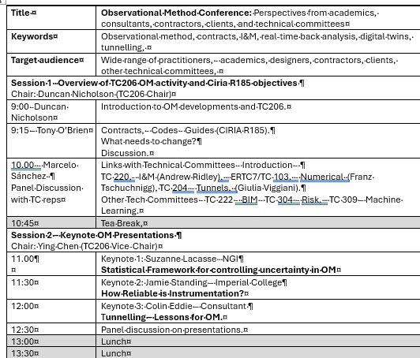
Agenda Morning
Presenters agreed.

Slide 8
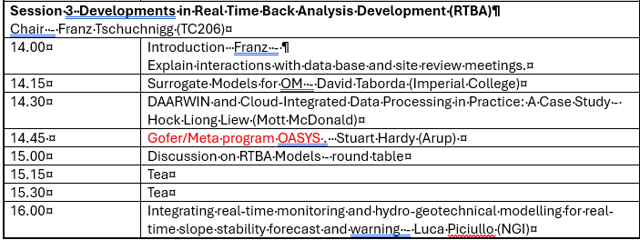
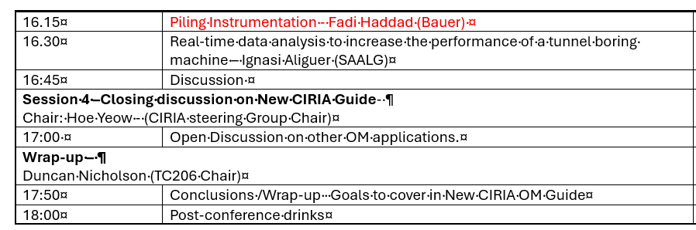
Agenda PM
Post Conf. Drinks?

Slide 9
ISSMGE 21st Int. Conf. - Vienna - 14-19 June 2026 Ying Chen
Honour Lecture Proposal withdrawn.
Keynote speech on OM by Tony O’Brian Agreed.
25 OM Papers submitted.
Oral session booked (90 Minutes).
Papers will be passed to TC206 – Dec 2025 – TC206 to select papers for presentation.
“Workshop” Session booked (90 minutes?) – TC206 to organise.
This is 2 or 3 discussion topics???
Link to Oral Session Papers.
What do we want to discuss?
TC206 informal evening dinner during conference – Should we plan?

Slide 10
OM Oral Presentations Session: 90 minutes.
ICSMGE in Vienna, Austria – 14-19 June 2026.
TC206 to review submitted 25 OM papers.
TC206 to Organise Presentations.
Option 1 Select best 7 papers to present within 90 minutes’ session (12 minutes each presentation).
Option 2 Maximum numbers of papers to be present (7 minutes each, up to 12 papers to be presented)
Do we want a paper discussion?
We want these papers to inform the workshop discussions.

Slide 11
Other Conf / Publications:
6th Int. Conf. on Information Technology in Geo-Engineering (6th ICITG) in Graz, Austria, - 13 to 16 October 2026. - https://www.icitg2026.com
The conference will provide a platform to discuss current developments in digital transformation within geo-engineering. Topics include case studies on information technology in practice, integration of digital systems such as Scan2BIM and BIM2FEM, the use of open benchmark datasets, uncertainty quantification and mitigation, applications of machine learning including reinforcement learning and large language models, as well as Real-Time Back-Analysis (RTBA).

Slide 12
CIRIA Revised R185 on OM (Hock /Tony)
Contract awarded to Arup / Mott MacDonald
Kick off Meeting with Collaborators on 10 November 2023.
CIRIA Steering Group Meeting on 3/12/25.
Using OM Conference 17/3/25 to gather industry feedback.
Johan Spross is TC206 rep on steering group.

Slide 13


Proposed Chapter Headings
‘The O.M. Can Be Simple’
The Basic Issues – high level summaries
Core issues for Client, Contractor and Designer and Case Histories
Further Detail on Specific Topics
Chapters 2, 3 and 4
Key Requirements for the O.M.
Achieving Agreement to use the O.M.
Contract Conditions
Chapters 5, 6, 7 and 8
Client Considerations
Technical Considerations
Construction Considerations
Case Histories
6 Appendices
History
O.M. for Asset Management
Risk + Opportunity Management
Contractual Issues + Procurement
Observations (Instrumentation + Monitoring + Data Base Systems)
Real Time Back Analysis
Questions
Proposed Chapters – OK?
Anything Missing?
Suggestions?

Slide 14
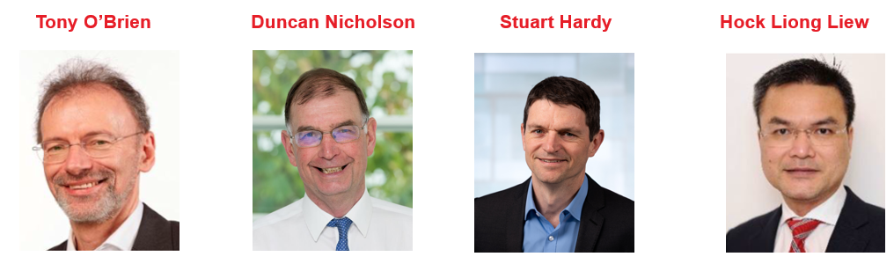
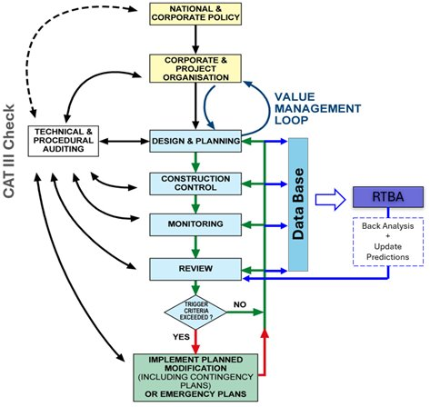
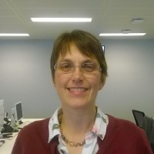
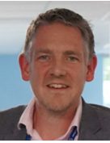
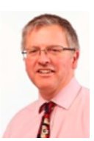
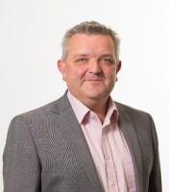
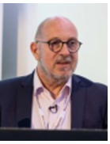
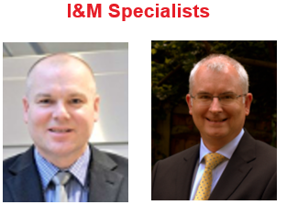
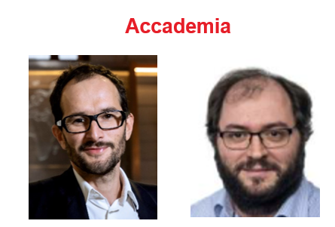
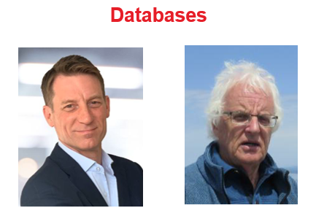
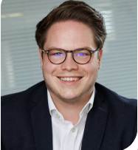
Our Team – Author’s Specialisms
Clients
Contracts
Designers
Sarah Trinder HS2
Alistair Hitchcock HS2
Richard Patterson Mott MacDonald
Contractors
Mark Pennington Balfour Beatty
Michael Southall Balfour Beatty
Peter Hewitt Laing O’Rourke
RTBA
Franz Tschuchnigg TU Graz
David Taborda Imperial College London
I&M
Databases
Andrew Ridley Geotechnical Observations
Angus Maxwell Maxwell GeoSystems
Tim Clegg Geosense
Steven Walthall Independent Consultant
Angus Maxwell Maxwell GeoSystems

Slide 15
Our Approach
Based on our previous CIRIA experience
PSG Steering Group meetings
2025
2026
2027
Oct | Nov | Dec | Jan | Feb | Mar | Apr | May | Jun | Jul | Aug | Sep | Oct | Nov | Dec | Jan | Feb | Mar | Apr
0
1
2
3
4
Industry View
TC206 OM Conference
ISSMGE Conf. Vienna
Peer Review

Slide 16
ICE Proceeding – Geotechnical Engineering
- Special Theme Issue (Ying Chen)
Initial meeting with ICE Proceeding – Geotechnical Engineering Chief Editor on 24th November 2025.
Summary of Discussion - Proposal of Special Theme Issue on ‘Observational Method’
Guest Chief Editor = Dr Su Jiang (TC206 representative = Dr Ying Chen)
Targeted Authors / Invitation to submit Journal standard Papers (Up to 20 papers)
Targeted Authors:
Keynote Speakers / Presenters at 1st OM Conference in March 2026.
Authors submitted OM papers (25 papers) to TC206 Sessions, in the 21st ICSSMGE Conference, June 2026.
The recent OM Case Histories – Nominated authors by TC206.

Slide 17
ICE Proceeding – Geotechnical Engineering
- Special Theme Issue
Preliminary Programme:
March 26
July 26
Sep 26
Dec 26
Send paper Invitation to targeted authors
Submit draft Journal paper
Final Journal paper (completed peer review & addressing comments)
Publish Special Theme OM Issue

Slide 18
5)Working Group Updates
RTBA – Franz Tschurchnigg -
Imperial College Workshop – BGS funding application (Truong )
Monitoring – Leaders Hock, Daniele, Dorota, Leen.
Contracts – Tony O’Brien.
Tunnels – Chris Menkiti.
Eurocodes – Johan Spross.
Historical Assets – Mandy Korff.

Slide 19
TC 206 Meeting
Real Time Back Analysis (RTBA)
Franz Tschuchnigg

Slide 20
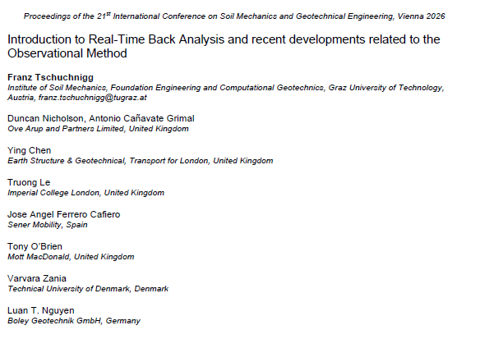

Paper for ICSMGE 2026
ACCEPTED / Revised version uploaded

Slide 21
RTBA MEETING – 12.11.2025 - 2.00pm (CET)
Fadi Hassad (Bauer Tech Director) presented on Piling Instrumentation.
Applying the Observational Method to Piling/ D’wall and Ground Treatment.
Dry run to select material for Fadi’s Pre-Rankine Conference Presentation.
Link:
https://teams.microsoft.com/l/meetup-join/19%3ameeting_Yzc5Njc3NjgtODlhMi00ZDkzLWI5ZjMtZDlhNjMxMjRiMWEy%40thread.v2/0?context=%7b%22Tid%22%3a%224ae48b41-0137-4599-8661-fc641fe77bea%22%2c%22Oid%22%3a%220f47b4f8-9962-4c38-a843-ac0b7070d53d%22%7d

Slide 22
RTBA group and/or upcoming Conferences
For further information, feel free to write
Franz Tschuchnigg - franz.tschuchnigg@TUGraz.at
Duncan Nicholson - Duncan.Nicholson@arup.com
OM CONFERENCE: Le Truong - truong.le@imperial.ac.uk

Slide 23
Monitoring Group (Hock, Leen, Dorota, Daniele)
Next Meeting -6 February 2026 ?-
Dr Nader Saffari – Profession Head – Earthwork Structures & Geotechnical, Transport for London
“Monitoring of Earth Structures on LU Network”
Goal – Develop Flow Charts for Commissioning I&M.

Slide 24
Contracts - update by Tony O’Brien
Need to complete table of OM projects with cost savings. - Now end May 2025
Chase other experts – Alan Marr - ?? Ferovila. Lisbon contact JST – Ko forces. Spanish rep Carbon calculations counting in Table 1 example. Canary Wharf – Arup carbon experience.
Paper for Vienna – summarise report. Individual case histories
Link with ICE Client Initiatives.
Link to new OM Projects.
Need for Cat 3 checker to reassess temp work changes.
TAA issues – AIP issues.
Paper on Culture –
Organisations need to reach consensus at start of OM.. This means skill base to extend and confidence. Effects all parties – Contractors and Consultants. Key Leaders.
Email from David J. Hatem DHatem@mgmlaw.com - US experience. Chase - presentation?
HS2 – WHRC –
BBV, - omission of 112 temporary props. Carbon savings ?
BBV have noted regardless of commercial saving they would continue with OM to avoid the construction constraints working around temporary props.
OM Design – Motts
CAT3 fee (£1M)
HS2 - VRCB - OM - best way-out example
SCS - Cost of New wall
OM assessment
Time
HS2 - Old Oak Common
20/05/2024
Management Group Meeting

Slide 25
Eurocodes - Johan Spross
Papers - Vienna Conf - Stuart submitted paper on varying partial factors.
Next meeting?
Input into CIRIA Guide -

Slide 26
Historical Assets – Mandy Korff
Mandy held initial meeting on 16 June 25.
This includes :-
Old canal walls, - Old dock walls, - Leen and Arup Canary Wharf Banana walls
Old railway walls – PVE walls Euston.
Old cut slopes - TFL / HA/ Network rail (GCG) TFL presentation on 10/12/25 in Monitoring Group.
Embankment fill - London Underground
Reuse of building foundation, - Dinesh Patel
Bridges, - Structural Health Monitoring process. ??
Eurocode 0 Part 2 - UK rep? contact Andrew Bond? Stuart Hardy?
Mandy /Ying submitted Vienna Abstracts
Goal set up working group.

Slide 27
Tunnelling Working Group - update by C Menkiti
Leadership.
Chris Menkiti leads this group.
Chris has a GCG person.
Use Pre-Rankine Conferences as a starting Point.
Input into CIRIA GUIDE.
Restarting Tunnelling Working Group
For the Management meeting on 13/11/24 and TC206 meeting we need a presentation on:-
List people who previously attended the Tunnelling WG.
Terms of Reference. – topics
Links with TC204
Define tunnelling approach to OM and compare with Infrastructure approach. What can we learn?
Triggers and design.
Examples.
HS2 – bored tunnels. SAALG presenting
HS2 - SCL tunnels. Colin Eddie Presenting
Silvertown tunnel.
Sensors and RTBA . – new sensors on cutting wheel.
Aim for a meeting before Christmas.
Strategic papers – Vienna conf
Hold working group meeting January ‘25.
Management Group Meeting

Slide 28
9)Next Meetings
ISSMGE - TC206 Tech Committee - Members meetings:
10 December 2025
CIRIA OM GUIDE – AUTHORS - Contents proposal and feedback to Authors
Late March 2026? Run in UK and American Times?
Tara Woods (waiting for a date)
Bridging the knowledge gaps through observational methods: some Swedish examples.
TC206 Management Group Meetings
3 Dec 2025 - 09.00hrs UK time
15 Jan 2025 - 09.00hrs UK time
12 Feb 2025 - 09.00hrs UK time
9 Mar 2025 - 09.00hrs UK time
20/05/2024
Management Group Meeting

Slide 29
Any Questions

