Slide 1

ISSMGE - TC206 Technical Committee Meeting 11-02-2026 at 09:00 – 09.30hrs - UK time
Update on TC206 work
Duncan Nicholson - Chairperson TC206
Ying Chen – Vice Chair
Alessandro Martucci - Secretary
alessandro.martucci@tonygee.com

Slide 2
Management Group - Agenda
Minutes of 13/12/25 – review actions. Covered in agenda.
TC206 Admin Update
New Secretary - Alessandro Martucci
Website Update – Alessandro Martucci
Conferences
OM Conference 17/3/26 at Imperial College (Truong)
Agenda – Minor modifications.
Contacting Presenters for titles / abstracts
Vienna Conf. Update (Alessandro)
Keynote / Papers/ Workshop.
4. CIRIA Guide R185 Revision
Arup/ Mott MacDonald - Progress. (Johan /Hock)
5. Proposal for ICE Geot. Eng. Journal – Special Issue.
Ying Chen to Introduce.
6. Working Groups - Planned meetings.
RTBA - Franz/ – 5 min
Monitoring – Hock - 5 Min
Historical Assets – Mandy / Ying - 1 min.
Tunnelling – Chris - 1 min
Eurocodes - Johan - 1 min
Contracts- Tony - 1 min
7. Next TC Members' meeting
24/3/2026 (09.30hrs UK time).
? June 2026 (09.30hrs UK time) Presenter needed.
8. TC Presentations
Tara Wood - Bridging the knowledge gaps through observational methods: some Swedish examples.
9.Next Management Meeting (09.00hrs UK time)
12 Feb 2026 - 09.00hrs UK time
9 Mar 2026- 09.00hrs UK time

Slide 3
2)TC206 Administration Websites Update – Alessandro Martucci -
Alessandro – now registered as TC206 secretary with access to files.
Alessandro’s main job:-
Transfer existing TC206 internal web site from Amit’s Google site to Google website registered as TC206.
Load minutes and presentations.
Use ISSMGE Hub as a TC206 internal site.
Update ISSMGE - TC206 public webpage - update.
What can we store? Including past events (2023 to 2024)
New Terms of Reference.
Load flier for OM Conference onto the TC206 web site. - Action Truong and Alessandro.
TC206 Membership Development.
Progress report?
20/05/2024
Management Group Meeting

Slide 4
3) Conferences
OM Conference at Imperial College (17/3/26)
Vienna Conference TC206 Involvement (14-19 June 2026)

Slide 5
OM CONFERENCE at Imperial College -17/3/2026 Truong Le and Franz Tschuchnigg
Goals / Status
Agenda revised (still need bio) - Chase presentation status!
IC meeting room Royal School of Mines - Room RSM G41) (100 places).
Coffee and Lunch – booked.
Website and bank account set up.
Budget – BGA Support received - £5,779 in account.
Registration process live - fee = £50/person. (Half Price - Students and TC206 members)
(Approx 20 people registered + 17 Presenters )
Fliers drafted by Truong. – Need to advertise.
Put on BGA and ISSMGE TC206 sites.
Contact Individuals for invites – eg all Ciria Guide reviewers etc.

Slide 6
OM Conference - Flier
Need to get Flier on BGS website.
Conference Sponsors?
What other sponsor rolls?
Evening drink?
Lunch?
Are Arup and Mott’s happy to be Sponsors?

Slide 7
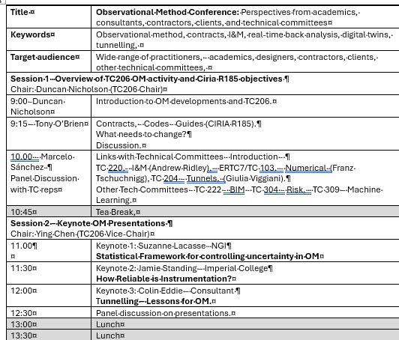
Agenda Morning
Presenters agreed.

Slide 8
Agenda PM
Session 3 Developments in Real Time Back Analysis Development (RTBA) Chair - Franz Tschuchnigg (TC206)
14.00 – 14.05 | Introduction Franz - Explain interactions with data base and site review meetings.
14.05 – 14.35 | Surrogate Models for OM - David Taborda (Imperial College)
14.35 -14.55 | DAARWIN and Cloud-Integrated Data Processing in Practice: A Case Study - Hock Liong Liew (Mott McDonald)
14.55 -15-15 | Gofer/Meta program OASYS . Stuart Hardy (Arup)
15.15 – 15.35 | Integrating real-time monitoring and hydro-geotechnical modelling for real-time slope stability forecast and warning - Luca Piciullo (NGI)
15.35-16.00 | Tea
16.00 – 16.20 | Observational Method in Foundation Engineering - Fadi Haddad (Bauer)
16.20 – 16.40 | Real-time data analysis to increase the performance of a tunnel boring machine – Ignasi Aliguer (SAALG)
16:40 – 17.00 | Open discussion with question for the audience – Where can we use RTBA? What is missing? What are limitations?
Session 4 –Closing discussion on New CIRIA Guide- Chair: Hoe Yeow
17:00 | Open Discussion on other OM applications.
Wrap-up – Duncan Nicholson (TC206 Chair)
17:50 | Conclusions /Wrap-up Goals to cover in New CIRIA OM Guide
18:00 | Post-conference drinks

Slide 9
ISSMGE 21st Int. Conf. - Vienna - 14-19 June 2026
Keynote speech on OM by Tony O’Brian Agreed – focus on collaboration and teams. - Link to 2 papers
22 OM Papers passed to TC206 (23/12/25).
Oral session booked (90 Minutes). – TC206 to define 6 paper for 10-12 min. presentations
Poster Session – TC206 to allocate 13 places.
TC206 Paper Selection Team – 5 people - Duncan, Ying, Alesandro, Hock, Mandy,
“Workshop” Session booked (90 minutes?) – TC206 to organise.
This is 2 or 3 discussion topics???
Link to Oral Session Papers.
What do we want to discuss?
TC206 informal evening dinner during conference – Should we plan?

Slide 10
Vienna Conf – 14-19 June 2026.
Rules for OM Oral Presentations Session:
Oral presentation: 10 to 12 minutes within a dedicated session. (6 No in 90 mins)
Poster and short presentation: a poster and one MS PowerPoint slide. (13 No)
sessions will start with short presentations of one slide and two minutes each.
After the short presentations, there will be 30 to 40 minutes for discussion.
Associated posters placed at back of lecture room.
Poster presentation: A conventional poster only presentation.

Slide 11
Oral and Poster Papers: Reviewed by Ying, Mandy, Alessandro, Hock, Duncan
6 papers for Oral selected – Vienna accepted.
3 papers that you selected for posters 1 slide, 2 minutes) plus a poster.
The six papers for workshop removed from the short oral + poster session. Otherwise, authors would have to present their work twice in different formats.
Leave 7 papers for the short oral + poster session.
The 3 papers that you did not select will be posters only.
Author Notification 10/2/26
Session | Paper No
Oral 6 No | 202
 | 231
 | 240
 | 872
 | 923
 | 1028
Posters 13 No | 168
 | 348
 | 458
 | 840
 | 917
 | 975
 | 1145
 | 1154
 | 1168
 | 1823
 | 2008
 | 2269
 | 2392
Not selected | 146
 | 440
 | 2293

Slide 12
TC206 Workshop Papers:
These 6 papers receive the status “Workshop presentation” in Conftool.
In mid-February, the authors of the submissions you selected for your workshop will receive a notification from me informing them that their paper has been selected for a dedicated workshop session.
I will also inform them that they will receive workshop details from the TC. Please provide them with information about the schedule and presentation requirements in a timely manner.
Workshop
Topic | Paper No
Contracts | 1145
 | 1154
RTBA | 975
 | 917
 | 348
 | 168

Slide 13
Other Conf / Publications:
6th Int. Conf. on Information Technology in Geo-Engineering (6th ICITG) in Graz, Austria, - 13 to 16 October 2026. - https://www.icitg2026.com
The conference will provide a platform to discuss current developments in digital transformation within geo-engineering. Topics include case studies on information technology in practice, integration of digital systems such as Scan2BIM and BIM2FEM, the use of open benchmark datasets, uncertainty quantification and mitigation, applications of machine learning including reinforcement learning and large language models, as well as Real-Time Back-Analysis (RTBA).

Slide 14
CIRIA Revised R185 on OM
Contract awarded to Arup / Mott MacDonald
Kick off Meeting with Collaborators on 10/12/2023.
CIRIA Steering Group Meetings on 3/12/25 and 10/2/26
Using OM Conference 17/3/25 to gather industry feedback.
Johan Spross is TC206 rep on steering group.
Hock to give a presentations on Scope of Revisions.

Slide 15


Proposed Chapter Headings
‘The O.M. Can Be Simple’
The Basic Issues – high level summaries
Core issues for Client, Contractor and Designer and Case Histories
Further Detail on Specific Topics
Chapters 2, 3 and 4
Key Requirements for the O.M.
Achieving Agreement to use the O.M.
Contract Conditions
Chapters 5, 6, 7 and 8
Client Considerations
Technical Considerations
Construction Considerations
Case Histories
6 Appendices
History
O.M. for Asset Management
Risk + Opportunity Management
Contractual Issues + Procurement
Observations (Instrumentation + Monitoring + Data Base Systems)
Real Time Back Analysis
Questions
Proposed Chapters – OK?
Anything Missing?
Suggestions?

Slide 16
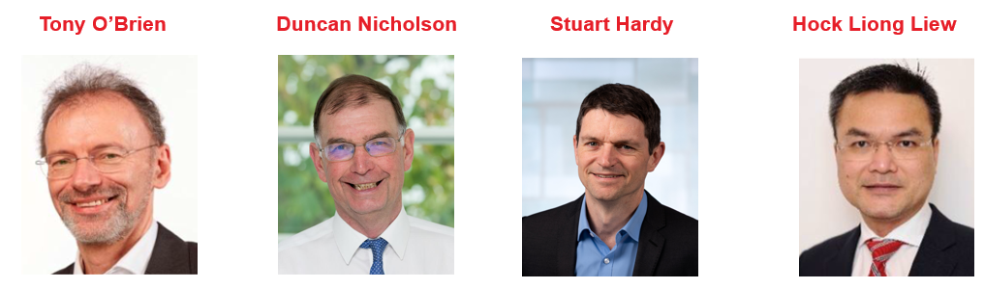
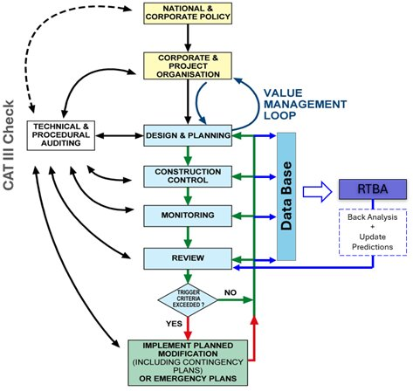
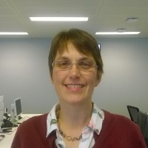
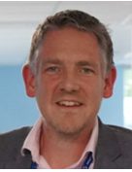
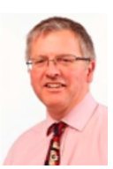
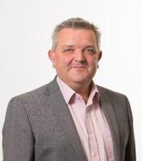
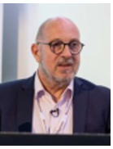
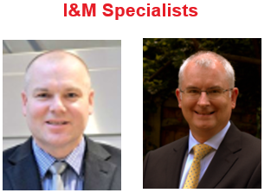
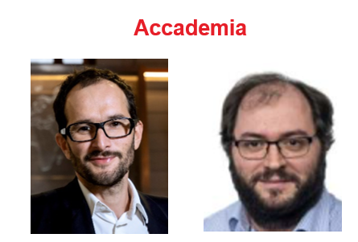
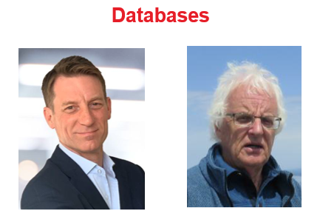
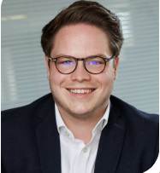
Our Team – Author’s Specialisms
Clients
Contracts
Designers
Sarah Trinder HS2
Alistair Hitchcock HS2
Richard Patterson Mott MacDonald
Contractors
Mark Pennington Balfour Beatty
Michael Southall Balfour Beatty
Peter Hewitt Laing O’Rourke
RTBA
Franz Tschuchnigg TU Graz
David Taborda Imperial College London
I&M
Databases
Andrew Ridley Geotechnical Observations
Angus Maxwell Maxwell GeoSystems
Tim Clegg Geosense
Steven Walthall Independent Consultant
Angus Maxwell Maxwell GeoSystems

Slide 17
Our Approach
Based on our previous CIRIA experience
PSG Steering Group meetings
2025
2026
2027
Oct | Nov | Dec | Jan | Feb | Mar | Apr | May | Jun | Jul | Aug | Sep | Oct | Nov | Dec | Jan | Feb | Mar | Apr
0
1
2
3
4
Industry View
TC206 OM Conference
ISSMGE Conf. Vienna
Peer Review

Slide 18
ICE Proceeding – Geotechnical Engineering
- Special Theme Issue, (Ying Chen)
Initial meeting with ICE Proceeding – Geotechnical Engineering Chief Editor on 24th November 2025.
Summary of Discussion - Proposal of Special Theme Issue on ‘Observational Method’
ICE Proceeding Call for Paper
Call for Papers: New Developments in Observational Method | Emerald Publishing
Topics:
Case Histories
Developments of OM in past two decades
Key Dates:
Abstract by 8th March
Full length paper by 30th June

Slide 19
ICE Proceeding – Geotechnical Engineering
- Special Theme Issue
Preliminary Programme:
March 26
June 26
Sep 26
Dec 26
Abstract to be submitted
Full length paper draft to be submitted
Final Journal paper (completed peer review & addressing comments)
Publish Special Theme OM Issue

Slide 20
5)TC206 Working Group Updates
RTBA – Franz Tschurchnigg -
OM Conference - Imperial College
Monitoring – Leaders Hock, Daniele, Dorota, Leen.
Historical Assets – Mandy Korff.
Contracts – Tony O’Brien.
Tunnels – Chris Menkiti.
Eurocodes – Johan Spross.

Slide 21
TC 206 Meeting
Real Time Back Analysis (RTBA)
Franz Tschuchnigg

Slide 22
RTBA NEXT MEETING – 9/3/26 - 2.00pm (CET)
Discussing OM Conference 17/3/26
Plan for afternoon Session 3 on RTBA.
2) Planning the Vienna Conference Workshop. June 26
4No RTBA papers presented - Consider running order.

Slide 23
RTBA group and/or upcoming Conferences
For further information, feel free to write
Franz Tschuchnigg - franz.tschuchnigg@TUGraz.at
Duncan Nicholson - Duncan.Nicholson@arup.com
OM CONFERENCE: Le Truong - truong.le@imperial.ac.uk

Slide 24
Monitoring Group (Hock, Leen, Dorota, Duncan, Daniele)
Meeting held - 6 February 2026
Dr Nader Saffari – Profession Head – Earthwork Structures & Geotechnical, Transport for London
“Monitoring of Earth Structures on LU Network”
Possible Next Meeting - Joe Milton - Network Rail
Goal – Develop Flow Charts for
OM on historical Assets
I&M contractual and supervision arrangement .

Slide 25
Historical Assets – Mandy Korff
This includes :-
Old canal walls, - Old dock walls, - Leen and Arup Canary Wharf Banana walls
Old railway walls – PVE walls Euston.
Old cut slopes - TFL / HA/ Network rail (GCG)
Embankment fill - London Underground
Reuse of building foundation, - Dinesh Patel
Bridges, - Structural Health Monitoring process. ??
Eurocode 0 Part 2 - UK rep? contact Andrew Bond? Stuart Hardy?
Mandy submitted Vienna Abstracts.
Next meeting 6 March 2026. 09/03/2026 UK time -

Slide 26
Next Meeting - 06 March 2026. 09.00 UK time.
The draft agenda for the meeting is:-
Discuss group name, “Historical assets / Existing structures/?” and focus 2026
Identify key challenges & how these vary globally (materials, type of structures, predictive maintenance and renewing strategies, monitoring etc) (input all)
Case Study: Gothenburg canal walls upgrade (Tara Wood, Ramboll)
Update on Eurocode Working Group existing structures
Actions, way forward and next meeting
AOB

Slide 27
Contracts - update by Tony O’Brien
Need to complete table of OM projects with cost savings. - Now end May 2025
Chase other experts – Alan Marr - ?? Ferovila. Lisbon contact JST – Ko forces. Spanish rep Carbon calculations counting in Table 1 example. Canary Wharf – Arup carbon experience.
Paper for Vienna – summarise report. Individual case histories
Link with ICE Client Initiatives.
Link to new OM Projects.
Need for Cat 3 checker to reassess temp work changes.
TAA issues – AIP issues.
Paper on Culture –
Organisations need to reach consensus at start of OM.. This means skill base to extend and confidence. Effects all parties – Contractors and Consultants. Key Leaders.
Email from David J. Hatem DHatem@mgmlaw.com - US experience. Chase - presentation?
HS2 – WHRC –
BBV, - omission of 112 temporary props. Carbon savings ?
BBV have noted regardless of commercial saving they would continue with OM to avoid the construction constraints working around temporary props.
OM Design – Motts
CAT3 fee (£1M)
HS2 - VRCB - OM - best way-out example
SCS - Cost of New wall
OM assessment
Time
HS2 - Old Oak Common
20/05/2024
Management Group Meeting

Slide 28
Activity
OM Conference – Session 1- Tony O’Brien
Contract Communication Collaboration.
Vienna Workshop – Contracts? - Speakers
Vienna – Keynote Presentation – Tony O’Brien

Slide 29
Eurocodes - Johan Spross
Papers - Vienna Conf - Stuart submitted paper on varying partial factors.
Next meeting?
Input into CIRIA Guide -

Slide 30
Tunnelling Working Group - update by C Menkiti
Leadership.
Chris Menkiti leads this group.
Chris has a GCG person.
Use Pre-Rankine Conferences as a starting Point.
Input into CIRIA GUIDE.
Restarting Tunnelling Working Group
For the Management meeting on 13/11/24 and TC206 meeting we need a presentation on:-
List people who previously attended the Tunnelling WG.
Terms of Reference. – topics
Links with TC204
Define tunnelling approach to OM and compare with Infrastructure approach. What can we learn?
Triggers and design.
Examples.
HS2 – bored tunnels. SAALG presenting
HS2 - SCL tunnels. Colin Eddie Presenting
Silvertown tunnel.
Sensors and RTBA . – new sensors on cutting wheel.
Aim for a meeting before Christmas.
Strategic papers – Vienna conf
Hold working group meeting January ‘25.
Management Group Meeting

Slide 31
9)Next Meetings
ISSMGE - TC206 Tech Committee - Members meetings:
24 March 2026 Run in UK and American Times?
Tara Woods - Bridging the knowledge gaps through observational methods: some Swedish examples.
June 2026 – New Presentation?
TC206 Management Group Meetings
12 Feb 2025 - 09.00hrs UK time
9 Mar 2025 - 09.00hrs UK time
20/05/2024
Management Group Meeting

Slide 32
Any Questions

